Slide 1
SetStats
Mark Byrne Richard Collins Liam Denning Florian Scheunert

Slide 2
Contribution
Liam Denning:
Designed Website
Connected website to database
Connected website to pubnub
Created Login/ Register system
Created Graphs
Richard Collins:
Wrote code to collect data from sensors and send to pubnub.
Soldered sensors and connected to pi.
Figured out how and wrote code to count reps/sets.
Put website on instance.
Got the setstats.tk domain.
Secured website with SSL encryption using cloudflare.
Mark Byrne:
Created the database.
Connected Database to instance.
Filled database with sample data.
Made sql queries for grabbing and inserting data.
Helped with how to count reps.
Florian Scheunert:
Setup a testing suite and tested methods
Did an evaluation in the gym
Performed a user-test
Helped to develop the website (Graph,History and Security)

Slide 3

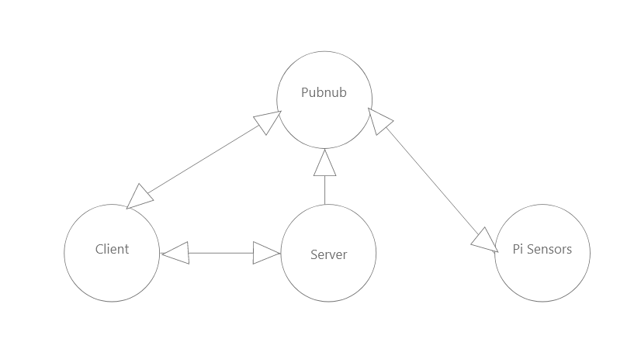
System Architecture
Client-> Website
Pubnub-> real time communication platform
Server-> AWS Flask app & database
Pi-Sensors-> raspberry pi with sensors

Slide 4
Security
https using Cloudflare.
We use Hashing and salting to protect passwords of users accounts
Auth key for putty to instance so only people with this private key can ssh into the AWS instance.
Mysql root password so only people with this password, can log into and use Mysql on the instance.

Slide 5
Known Issues
Graph does not display the way we want it to (pubnub graph)
Website needs apache2 restart every few hours or it breaks and you cant login.
Height can only be measured if sensor is faced directly at the ground

Slide 6
The Future
Comment ability for trainers on each of their trainees session.
Add different lifts e.g. squat, bench press.
Friend system (see how your friends are progressing).
Full trainer implementation.
Better installation of device on bar, so height can be measured perfectly everytime.

Slide 7
DEMO OF WEBSITE

