Slide 1
SetStats
Mark Byrne Liam Denning Richard Collins Florian Scheunert

Slide 2
Introduction
SetStats is an application that wants to help YOU improve YOUR form in the gym. Whether you are a new user or a 20-year veteran, SetStats will try it's best to help you.
Not only do we aim for you to have a better time in the gym, SetStats will also help the trainers, with our history system YOUR trainer will be able to keep an eye on you while you train alone, measuring your progress and seeing results.

Slide 3

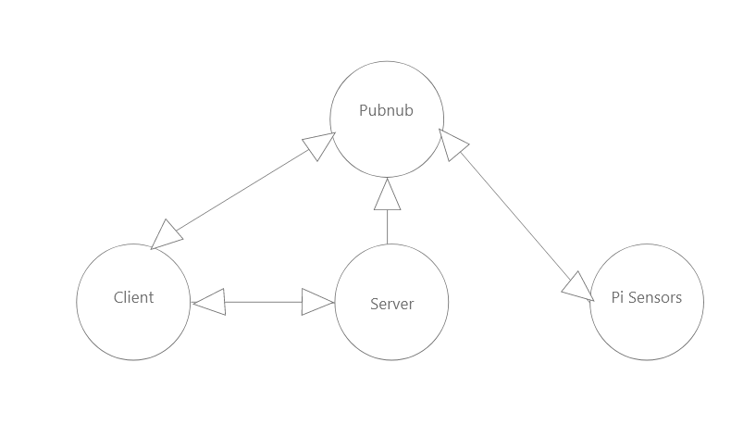
SYSTEM ARCHITECTURE
Client:
The Website that you interact with.
Server:
The database, AWS, secret key, FlaskApp
Pubnub:
Communicator?
Pi Sensors:
The raspberry pi & sensors that are connected to the bar.

Slide 4
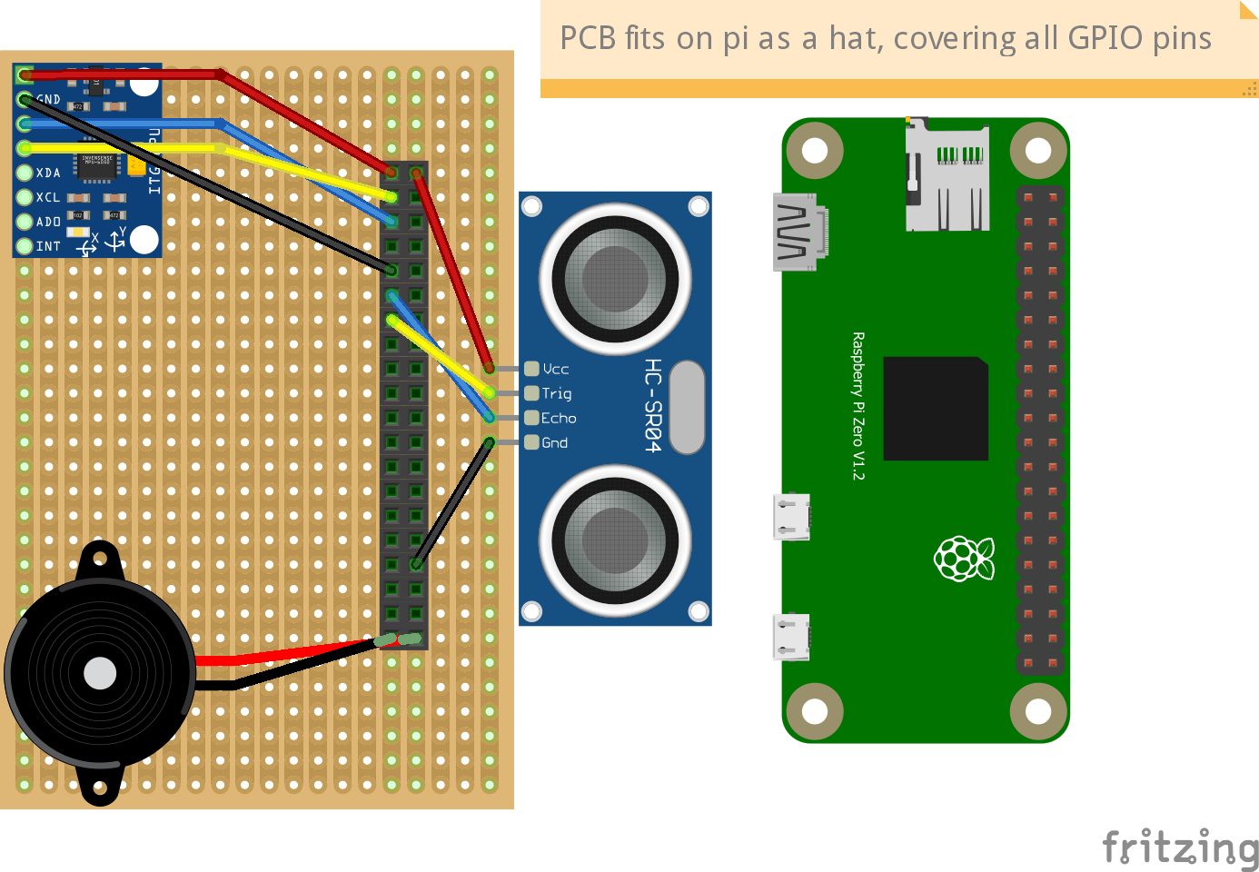
HARDWARE
Sensors collect height and sway(in depth on mahara)
Collect data every .15 sec
Uses height to calculate reps/sets
Audio feedback for lift status
Use cellular in future but for demo using hotspot

Slide 5
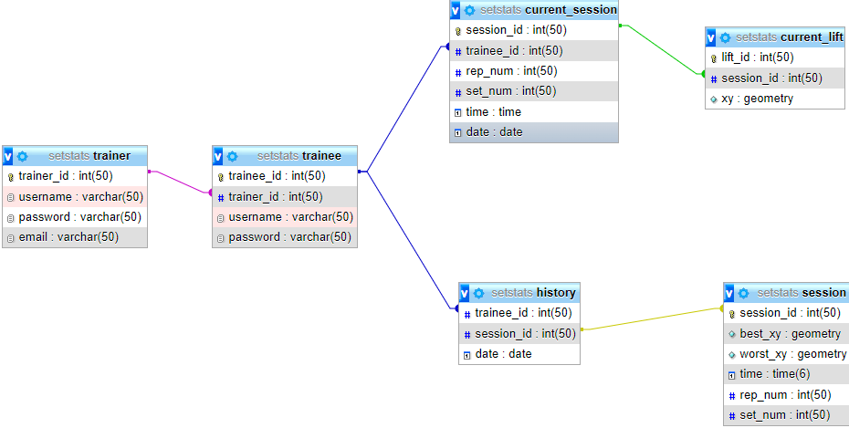
Database

Slide 6
SECURITY
Os.getENV to grab variables for stuff.
https using cloudflare.
We use Hashing and salting to protect passwords of users accounts
Auth key for putty to instance so only people with this private key can ssh into the AWS instance.
Mysql root password so only people with this password, can log into and use Mysql on the instance.
ETC ETC ETC ETC

Slide 7

EXAMPLE USER
Likes to train after work, usually 2 – 3 times a week
Trains to stay healthy and get the head free from the daily stress
Likes a quiet environment and wants to train on his own
Has good knowledge about Smartphones/Apps and the usage of them
Expects the app to help him improve his form and give feedback
Kind of new to deadlifting and therefor needs more advice
Name: John Savage
Age: 28
Occupation: Electrician
Skill Level(1-10): 4
Maraital Status: Married

Slide 8
LIVE DEMO

Slide 9
Thank You ☺

