Slide 1
SetStats
Mark Byrne Richard Collins Liam Denning Florian Scheunert

Slide 2
Contribution
Liam Denning:
Richard Collins:
Wrote code to collect data from sensors and send to pubnub.
Soldered sensors and connected to pi.
Figured out how and wrote code to count reps/sets.
Put website on instance.
Got the setstats.tk domain.
Secured website with SSL encryption using cloudflare.
Mark Byrne:
Created the database.
Connected Database to instance.
Filled database with sample data.
Made sql queries for grabbing and inserting data.
Helped with how to count reps.
Florian Scheunert:
Setup a testing suite and tested methods
Did an evaluation in the gym
Performed a user-test
Helped to develop the website (Graph,History and Security)

Slide 3

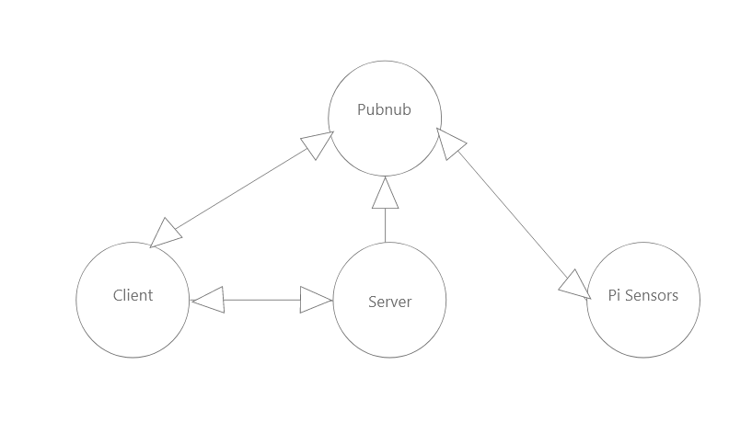
System Architecture
Client-> Website
Pubnub-> real time communication platform
Server-> AWS Flask app & database
Pi-Sensors-> raspberry pi with sensors

Slide 4
Known Issues
Graph does not display the way we want it to (pubnub graph)
Website needs apache2 restart every few hours or it breaks and you cant login.

Slide 5
The Future
Comment ability for trainers on each of their trainees session.
Add different lifts e.g. squat, bench press.
Friend system (see how your friends are progressing).
Full trainer implementation.
Better installation of device on bar, so height can be measured perfectly everytime.

Slide 6
DEMO OF WEBSITE

