Slide 1
User:
Password:
Sign up
Sign in

Slide 2
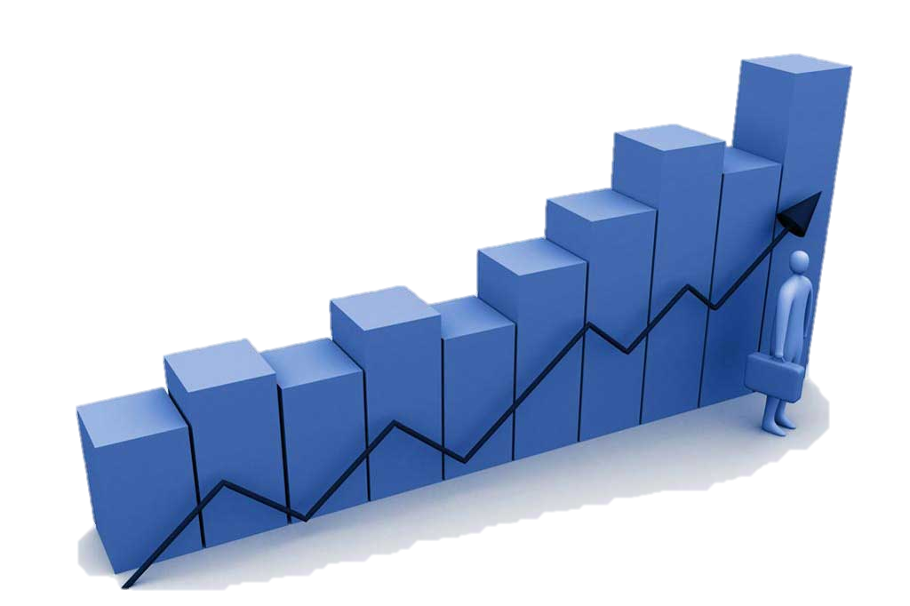
User: Password:
Sign up
Sign in

Slide 3
Output1
Output2
NEWS:
NewsOutput
Welcome Hansen!
My investment: $10000
My stock: 25
My stock
All stocks
Trade
News
Mode select
Log out

Slide 4
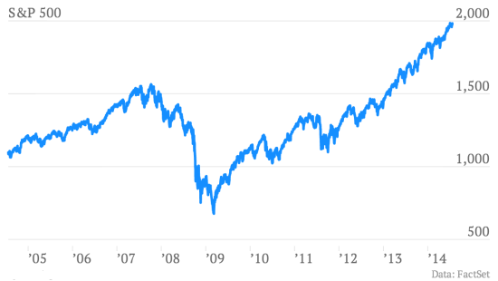
Banana 111 up 0.01
NEWS:
CEO of banana company has been arrested because he was found …
Welcome Hansen!
My investment: $10000
My stock: 25
My stock
All stocks
Trade
News
Mode select
Log out

Slide 5
Banana 111 up 0.01
NEWS:
CEO of banana company has been arrested because he was found …
Welcome Hansen!
My investment: $10000
My stock: 25
My stock
All stocks
Trade
News
Mode select
Log out

Slide 6
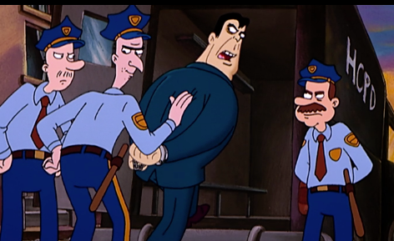
What happened?
NEWS:
CEO of banana company has been arrested because he was found …
Welcome Hansen!
My investment: $10000
My stock: 25
My stock
All stocks
Trade
News
Mode select
Log out

Slide 7
Mode 1: Mode 2:
….. ….
NEWS:
CEO of banana company has been arrested because he was found …
Welcome Hansen!
My investment: $10000
My stock: 25
My stock
All stocks
Trade
News
Mode select
Log out

Slide 8
Store Withdraw
….. ….
NEWS:
CEO of banana company has been arrested because he was found …
Welcome Hansen!
My investment: $10000
My stock: 25
My stock
All stocks
Trade
News
Mode select
Log out

Slide 9
Search:
Input money:
Confirm
Secure Password:
Num :
10
1450
Buy
Sell

Slide 10
Welcome Hansen!
Total investment: $10000
Money available: $7000
Stock worth: $3000
Stock own: 20
Banana 111 up 0.01
Quantity :
10
calculate
Secure Password:
Buy
Sell
Confirm
Note: If you want to put more money into investment, go to setting

Slide 11



Slide 13
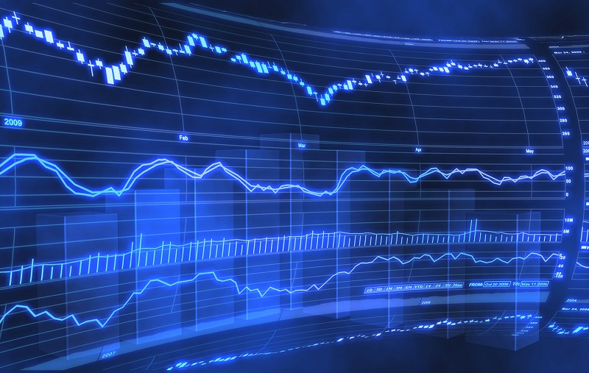
STOCK
SIMULATION

