Slide 1
ECOMO CAE Velocity Model
by
M. Cary
23/05/2023

Slide 2
DoE Notes
The core design is a 28-point Sobol sequence.
The 4-corner points are added manually to ensure the design covers the entire space.
Axial velocity distributions are available for each operating point.
The variable OP_rpm_Nm contains the list of (N,Tq) operating points
The variable OP_maf_temp contains the corresponding list of (m_egr, Tin) points.
M_egr is in [kg/h]
Tin is in [ºC]

Slide 3
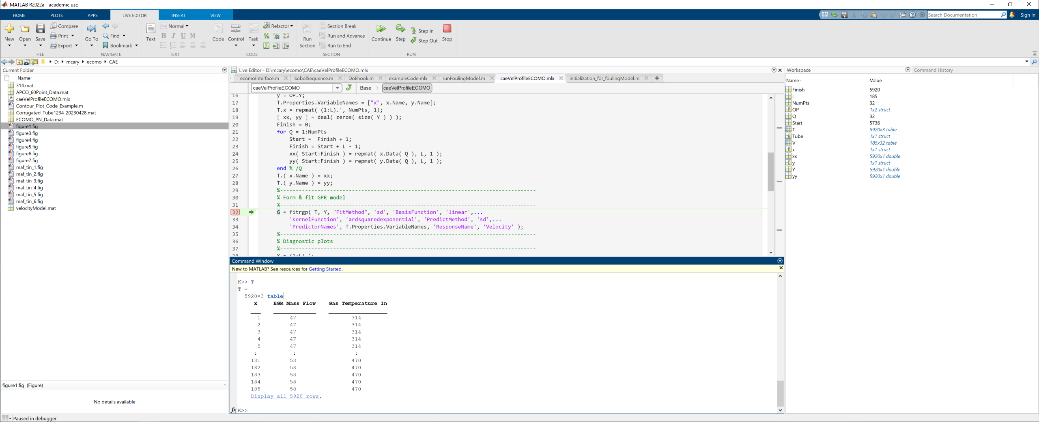
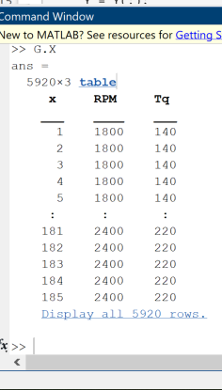
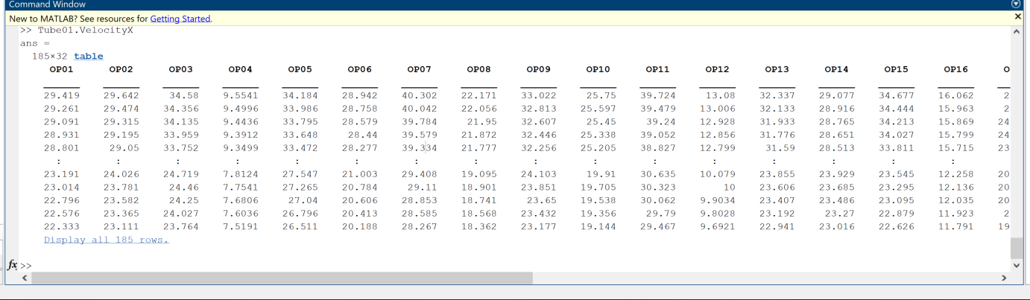
Data Format Conversion
Original Format
Required Format
The GPR tool accepts tables for input data.
The required format lists all possible combinations of axial distance (x), engine speed/ EGR mass flow and brake torque/input gas temperature.
The data format conversion is handled automatically by the analysis code.
Data is a table with operating points as columns.
The rows represent axial distance along the tube.
The model may be constructed as a function of (m_egr, Tin) or (rpm, Torque).

Slide 4
User Instructions
Load the CAE data
load('Corrugated_Tube1234_20230428.mat’)
Run analysis function to construct model object
G = caeVelProfileECOMO( Tube#, OP, L );
Tube# is the CAE data tube structure.
OP is a structure of operating point data (either OP_maf_temp or OP_rpm_Nm).
L is the tube length in [mm].
G is a RegressionGP object.
The analysis file utilies the fitrgp tool from the Machine Learning and Statistics toolbox.
The ‘sd’ fit option is used for building the model to limit the computational burden. This implies a subset of the data is used to fit the model.
The kernel function is ‘ARDSquaredExponential’ which provides a length scale per dimension.
To predict the gas velocity at some previously tried configuration, use:
Vel = G.predict( [ x, X, Y ] )
Where x is the axial distance vector, X the corresponding engine speed of egr mass flow data vector and Y is the associated brake torque or gas input temperature vector.
Note all vectors must be of the same length.

Slide 5
Diagnostic Plots
The analysis tool generates, and automatically saves, confirmation plots demonstrating the model capability against the training data.

Slide 6
GitHub File Repository
https://github.com/MarkCaryLboro/Velocity_Analysis_CAE_ECOMO_Corrugated_Tube

