Slide 1
Scalability
Multi-Machine
Distributed Tree
Multi-Process
LockFree Tree
Fine-grain
Multi-Thread
Coarse-grain
Sequential
Speedup
1
5
10

Slide 2












Ins $k_{7}$
Get $k_{3}$
Get $k_{2}$
Ins $k_{6}$
Thread 1
Thread 2
Thread 3
Thread 1 holds the mutex lock and have full access to the entire tree.
Thread 2 wait for mutex.
(De-scheduled by OS)
Thread 3 wait for mutex.
(De-scheduled by OS)
Shared Memory Space
$$k_{1}$$
$$k_{2}$$
$$k_{3}$$
$$−$$
$$k_{4}$$
$$k_{5}$$

Slide 3






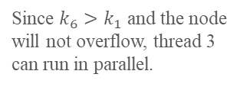


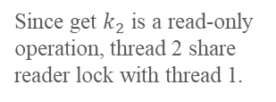
Ins $k_{7}$
Get $k_{3}$
Get $k_{2}$
Ins $k_{6}$
Thread 1
Thread 2
Thread 3
Thread 1 holds the reader lock at leaf and can only read.
Since get $k_{2}$ is a read-only operation, thread 2 share reader lock with thread 1.
Since $k_{6}>k_{1}$ and the node will not overflow, thread 3 can run in parallel.
Shared Memory Space
$$k_{1}$$
$$−$$
$$−$$
2
R
$$k_{2}$$
$$k_{3}$$
$$−$$
2
$$k_{3}$$
$$k_{4}$$
R
W

Slide 4
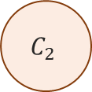
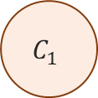
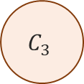
Search
Distribute
Leaf Execute
Worker Threads
Background Thread
$$C_{1}$$
Lock-free
Request
Queue
Client Thread(s)
$$C_{2}$$
Root Execute
Re-Distribute
Internal Execute
Collect
$$C_{3}$$

