Slide 1
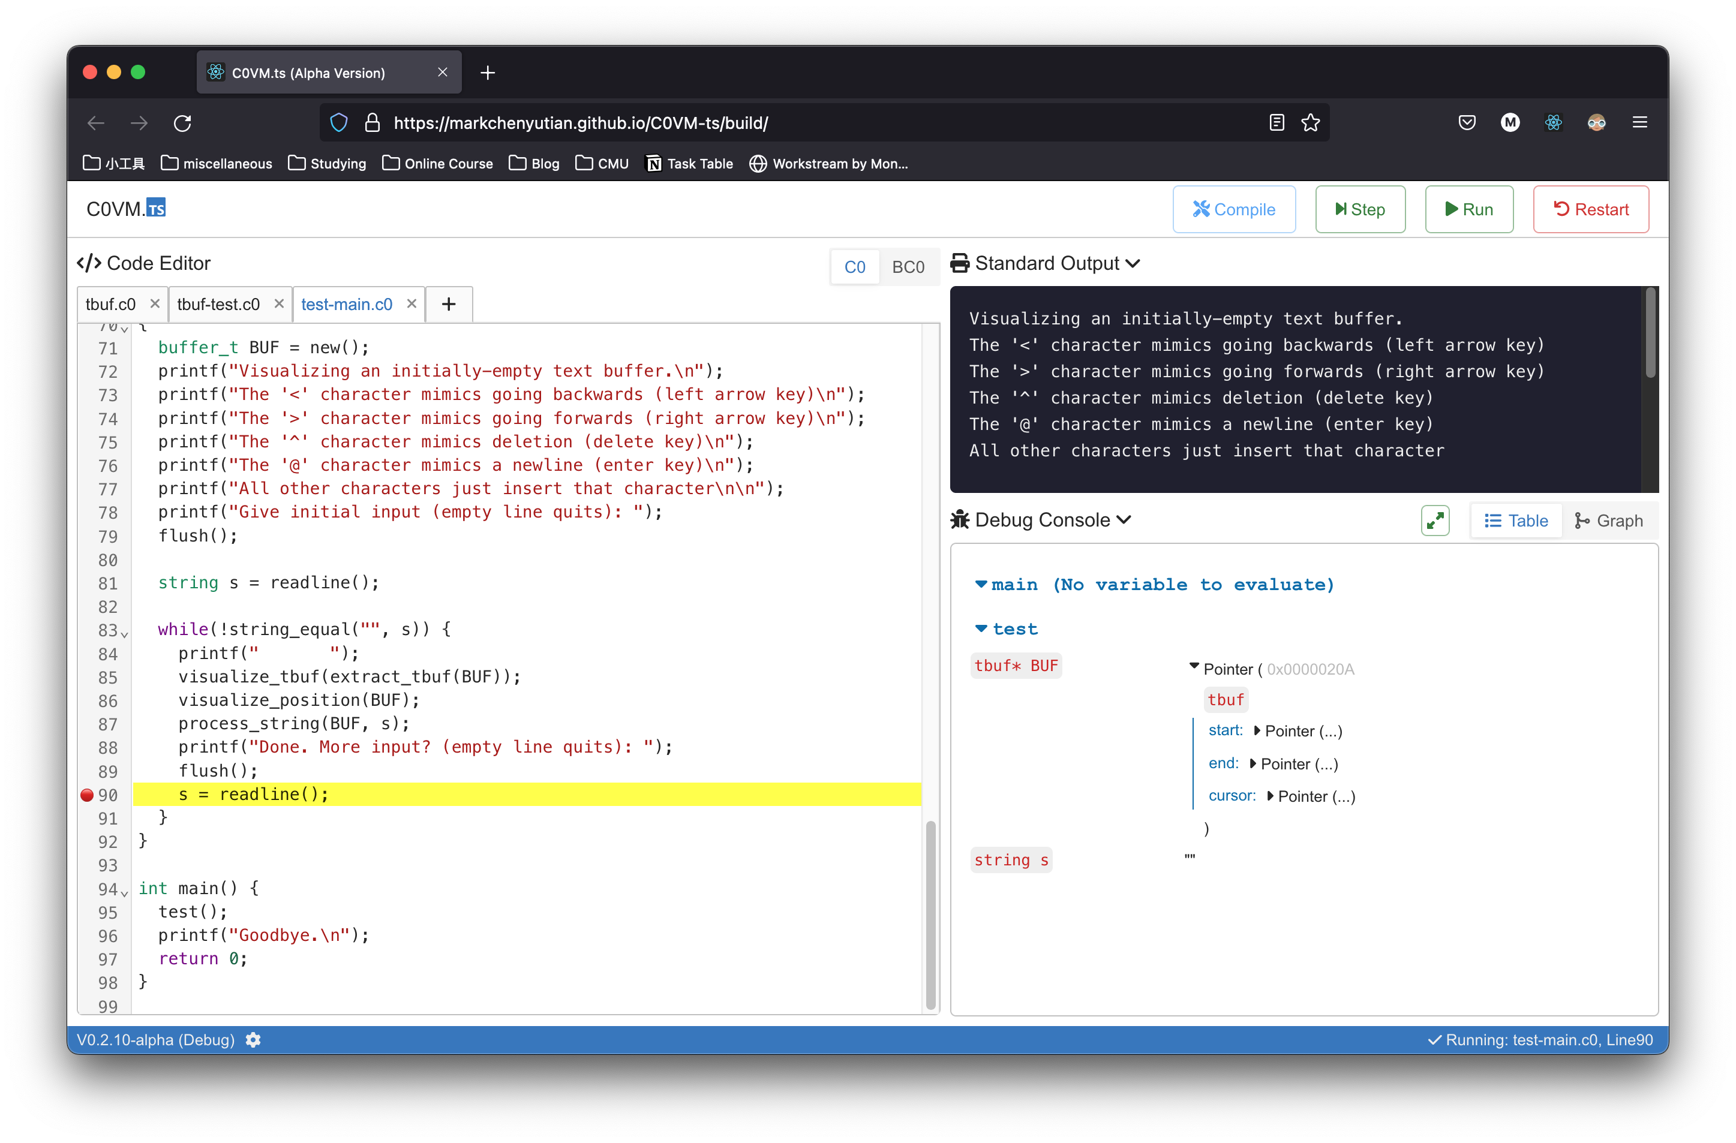
Output / Debug Area
Main Control Bar
Editor Area
Tabs
Last Line Executed (Highlighted)
Breakpoints
Release Version
Settings
VM Status Indicator

