Slide 1


Slide 2
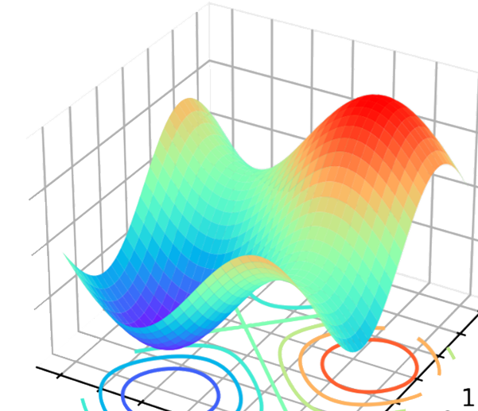

Slide 3


Slide 4


Uniswap

Slide 5


Slide 6


Slide 7





How Serverless File Sharing Page Works?
Client
AWS SDK
Amazon Cognito
AWS Identity and Access Management (IAM)
Amazon Simple Storage Service (Amazon S3)
Client

