Slide 1
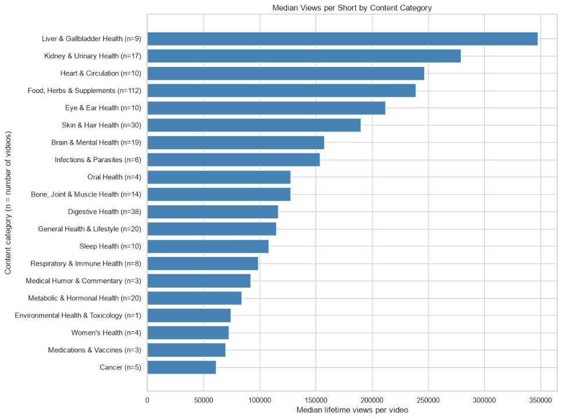
Category Performance Across the Export
Category analysis by Marco Cruz · Executive summary 1 of 5
Among 343 categorized Shorts, Liver & Gallbladder Health leads with a median of 347,597 lifetime views across nine videos. Kidney & Urinary Health follows at 279,013 across 17 videos, then Heart & Circulation at 246,630 across ten.
Category sizes vary substantially. Food, Herbs & Supplements contains 112 videos and has a median of 238,852 views. Total views alone would mix publishing volume with typical video performance. Publication age also differs across categories.
Use median views together with the video count. Categories combine 289 title-based proposals and 54 assignments from supplied summaries. Three unresolved videos remain in the master dataset but are excluded here. These labels describe content topics, not verified medical claims.
Use the leading categories to select comparable topics for content tests. Review classifications before major editorial decisions, and evaluate new videos after the same number of days. Category membership alone does not establish a cause of higher reach.
Notes:
Source: user-provided category analysis tables and notebook screenshot image(20261017-053943).png, October 17, 2026. Median lifetime views per video, grouped by content category. Counts appear in chart labels. Chart is the original notebook image and is not an editable PowerPoint chart. Narrative text is editable. Values in narrative are rounded to whole views. Scope: 343 categorized videos from 346 exported Shorts. Three unresolved videos are excluded only from category comparisons. 289 labels remain proposals and 54 come from supplied summaries, without independent video verification. Yearly charts share an axis range. Lifetime exposure differs by publication date. Recommendations are proposed tests, not causal findings or approved commitments.

Slide 2
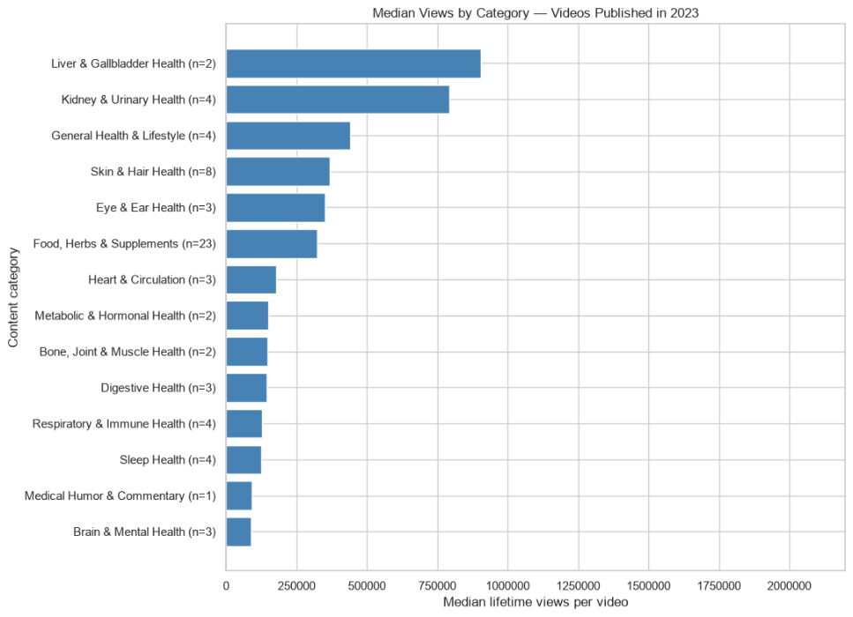
2023 Category Performance
Category analysis by Marco Cruz · Executive summary 2 of 5
For videos published in 2023, Liver & Gallbladder Health ranks first at 903,324 median lifetime views with two videos. Kidney & Urinary Health follows at 791,322 with four. General Health & Lifestyle reaches 439,345 with four.
The leading groups are small. With two videos, the median is the average of the two observations and offers little protection against an exceptional result. These are accumulated views for the 2023 publication cohort, not views earned during 2023.
Skin & Hair Health provides eight observations with a median of 368,732. Food, Herbs & Supplements provides 23 at 323,542. Their larger groups offer more examples for content review, but neither proves that a category will repeat its historical performance.
Review the liver and kidney videos individually and compare their topics and openings with the larger food and skin groups. Treat any recurring content features as hypotheses for new tests rather than established explanations of reach.
Notes:
Source: user-provided category analysis tables and notebook screenshot image(20261017-055724).png, October 17, 2026. Median lifetime views per video, grouped by content category and publication year. Counts appear in chart labels. Chart is the original notebook image and is not an editable PowerPoint chart. Narrative text is editable. Values in narrative are rounded to whole views. Scope: 343 categorized videos from 346 exported Shorts. Three unresolved videos are excluded only from category comparisons. 289 labels remain proposals and 54 come from supplied summaries, without independent video verification. Yearly charts share an axis range. Lifetime exposure differs by publication date. Recommendations are proposed tests, not causal findings or approved commitments.

Slide 3
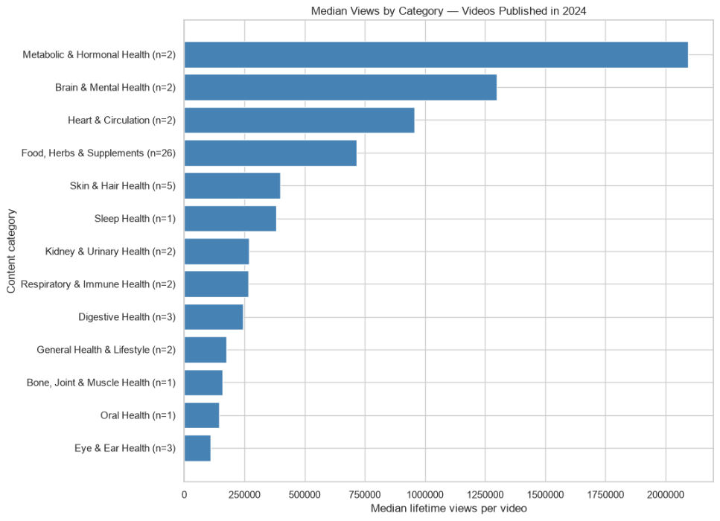
2024 Category Performance
Category analysis by Marco Cruz · Executive summary 3 of 5
Metabolic & Hormonal Health leads the 2024 publication cohort with a median of 2,093,848 lifetime views. Brain & Mental Health follows at 1,300,181 and Heart & Circulation at 957,325. Each of these categories contains only two videos.
The largest bars summarize six videos in total. Their rankings are sensitive to individual results, and a two-video median equals the mean. Expanding production solely on these ranks would assume repeatability that this export cannot demonstrate.
Food, Herbs & Supplements records a median of 716,599 views across 26 videos, half of the 52 categorized videos published in 2024. Skin & Hair Health records 398,761 across five. Food offers a larger set of examples for investigating the strong historical performance.
Study the food category in more detail and review the six videos in the top three categories separately. Test promising topics on a limited scale before allocating more production. Use equal observation windows to judge whether results repeat.
Notes:
Source: user-provided category analysis tables and notebook screenshot image(20261017-055737).png, October 17, 2026. Median lifetime views per video, grouped by content category and publication year. Counts appear in chart labels. Chart is the original notebook image and is not an editable PowerPoint chart. Narrative text is editable. Values in narrative are rounded to whole views. Scope: 343 categorized videos from 346 exported Shorts. Three unresolved videos are excluded only from category comparisons. 289 labels remain proposals and 54 come from supplied summaries, without independent video verification. Yearly charts share an axis range. Lifetime exposure differs by publication date. Recommendations are proposed tests, not causal findings or approved commitments.

Slide 4
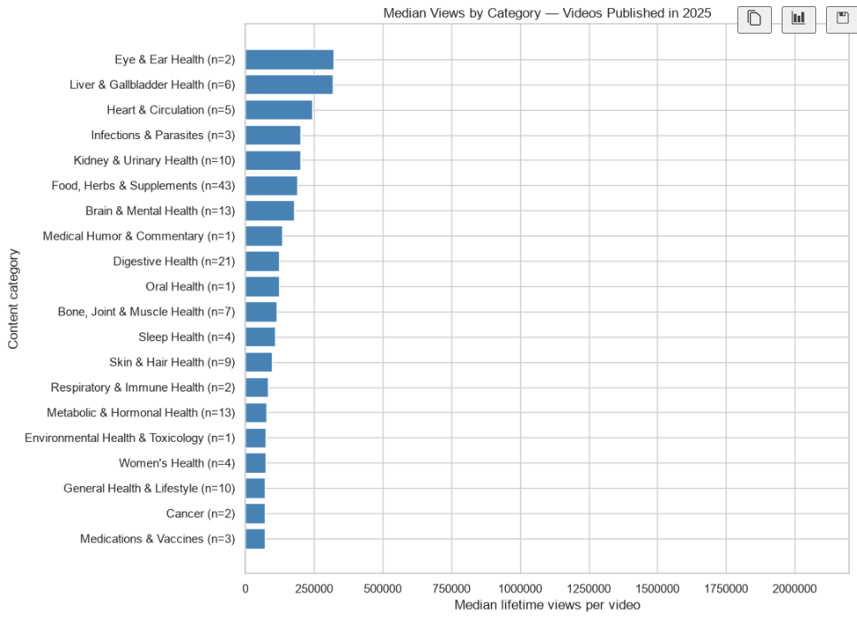
2025 Category Performance
Category analysis by Marco Cruz · Executive summary 4 of 5
Eye & Ear Health leads the 2025 cohort at 319,896 median lifetime views across two videos. Liver & Gallbladder Health is close at 317,213 across six, followed by Heart & Circulation at 243,497 across five.
The 2,684-view gap between the first two medians is too limited, with these small groups, to establish a dependable advantage. Several larger categories have lower medians, but publishing volume alone does not explain the difference.
Kidney & Urinary Health reaches 200,545 median views across ten videos. Food, Herbs & Supplements reaches 189,720 across 43, Brain & Mental Health 176,902 across 13, and Digestive Health 122,212 across 21. These groups provide useful comparison cases.
Compare higher- and lower-viewed videos within these categories before choosing test ideas. Keep video counts visible in Tableau. Differences from earlier publication cohorts may reflect unequal exposure or content mix and do not prove declining audience interest.
Notes:
Source: user-provided category analysis tables and notebook screenshot image(20261017-055754).png, October 17, 2026. Median lifetime views per video, grouped by content category and publication year. Counts appear in chart labels. Chart is the original notebook image and is not an editable PowerPoint chart. Narrative text is editable. Values in narrative are rounded to whole views. Scope: 343 categorized videos from 346 exported Shorts. Three unresolved videos are excluded only from category comparisons. 289 labels remain proposals and 54 come from supplied summaries, without independent video verification. Yearly charts share an axis range. Lifetime exposure differs by publication date. Recommendations are proposed tests, not causal findings or approved commitments.

Slide 5
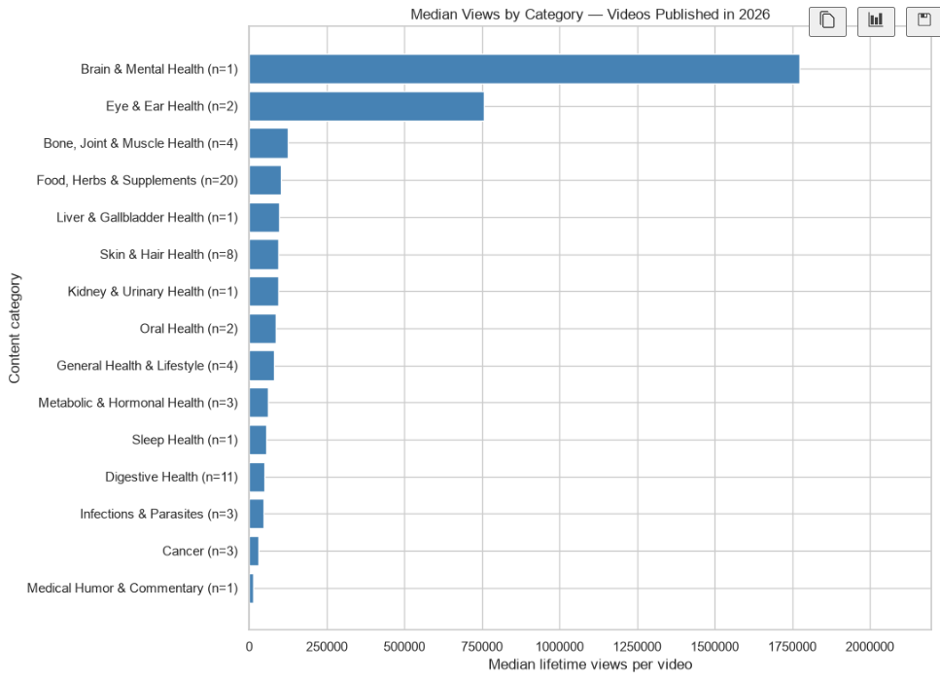
2026 Category Performance
Category analysis by Marco Cruz · Executive summary 5 of 5
Brain & Mental Health leads the available 2026 cohort at 1,772,775 lifetime views, but this is one video. Eye & Ear Health follows at a median of 756,895 across two videos. Neither result establishes typical performance for a broad category.
The export includes 2026 publications only through May 8. This is a partial publication year, and observation time varies across videos. A single-video median equals that video’s views. Cross-year comparisons therefore cannot establish annual growth or decline.
Food, Herbs & Supplements has 20 videos with a median of 101,465 views. Skin & Hair Health has eight at 95,132, while Digestive Health has 11 at 50,207. These larger groups show why the two leading bars should be treated as individual cases for review.
Review the three videos in the leading categories and test related topics with consistent evaluation windows. Continue collecting 2026 data before setting category targets. The four yearly charts use the same horizontal scale for visual comparison.
Notes:
Source: user-provided category analysis tables and notebook screenshot image(20261017-055815).png, October 17, 2026. Median lifetime views per video, grouped by content category and publication year. Counts appear in chart labels. Chart is the original notebook image and is not an editable PowerPoint chart. Narrative text is editable. Values in narrative are rounded to whole views. Scope: 343 categorized videos from 346 exported Shorts. Three unresolved videos are excluded only from category comparisons. 289 labels remain proposals and 54 come from supplied summaries, without independent video verification. Yearly charts share an axis range. Lifetime exposure differs by publication date. Recommendations are proposed tests, not causal findings or approved commitments.

