Slide 1
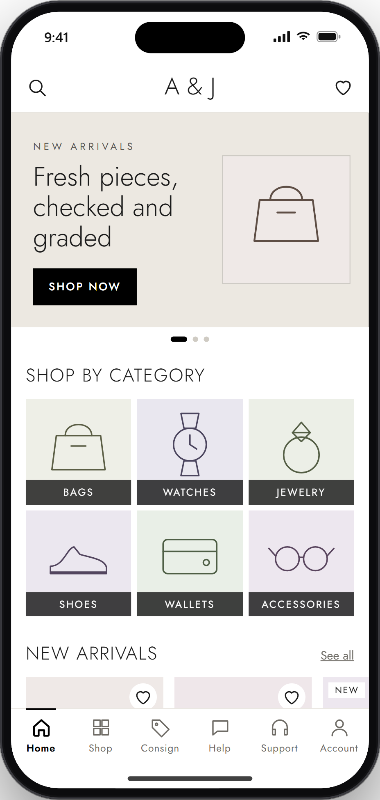
App Walkthrough
A&J Luxury mobile app, step by step: buying, selling and consigning, getting help, and the admin side.

Slide 2
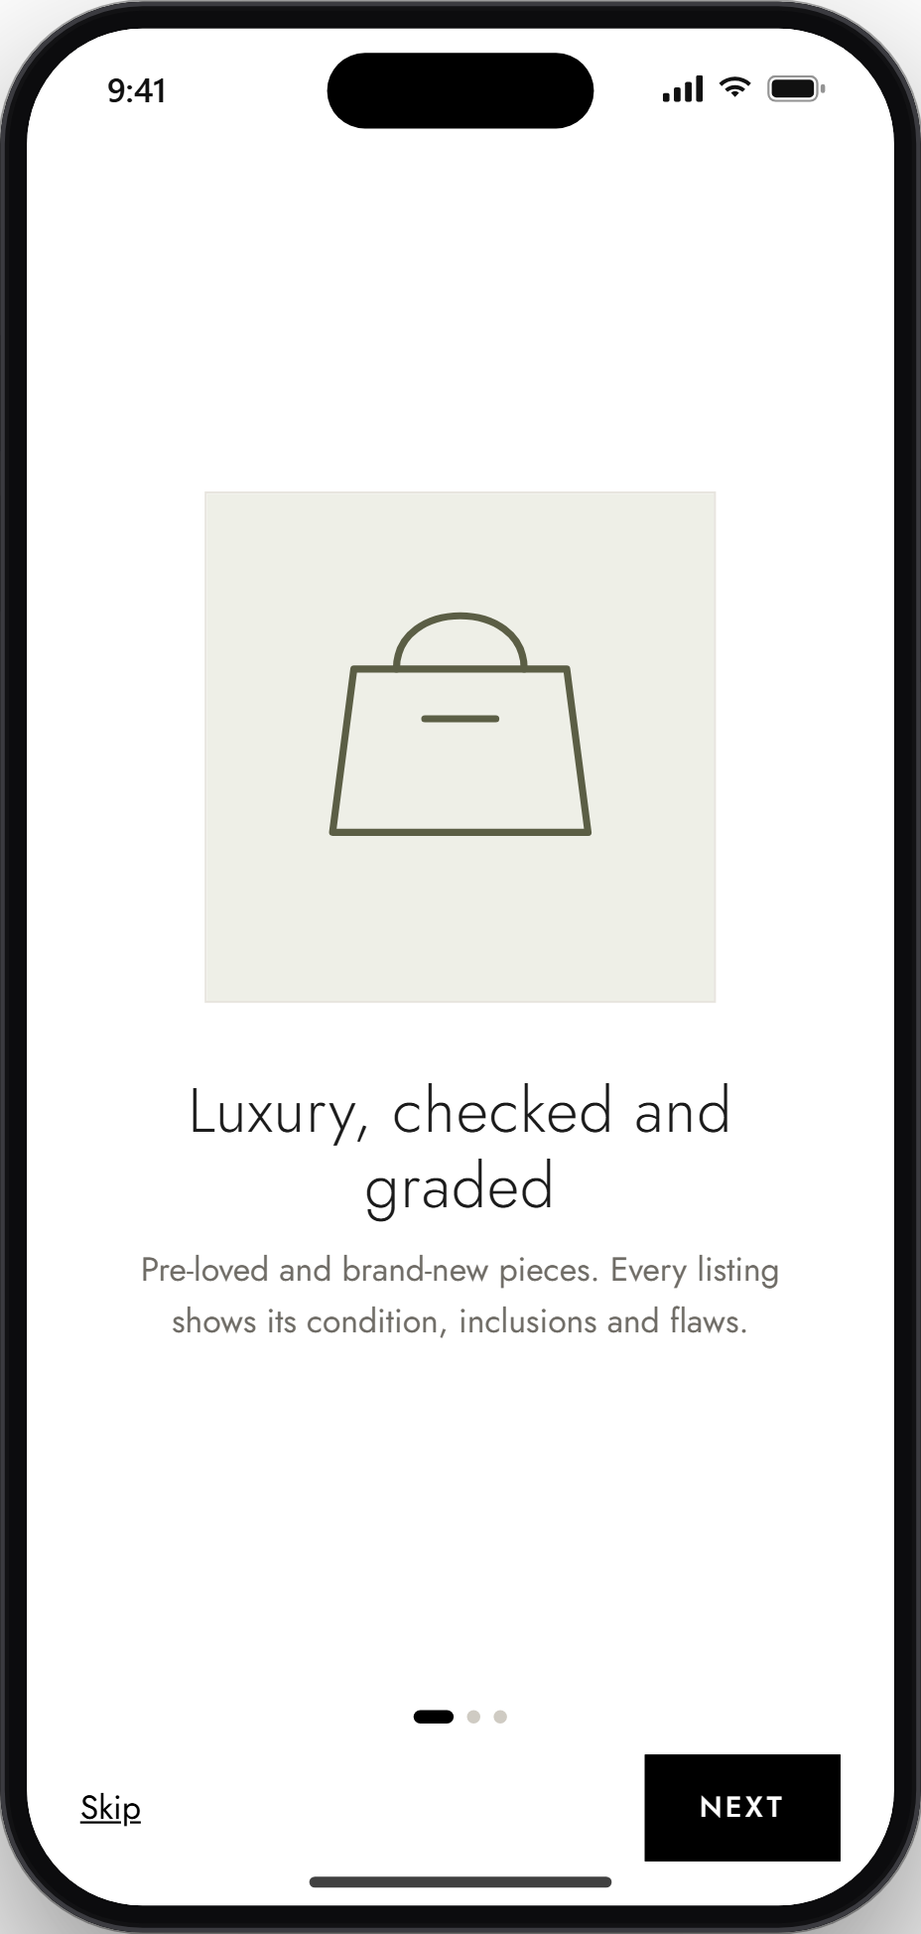
App Walkthrough
STEP 1: Open the App
A few short intro screens explain buying, consigning and condition grading. Tap Next to continue, or Skip to go straight to login.
Notes:
Step 1: Open the App. A few short intro screens explain buying, consigning and condition grading. Tap Next to continue, or Skip to go straight to login.

Slide 3
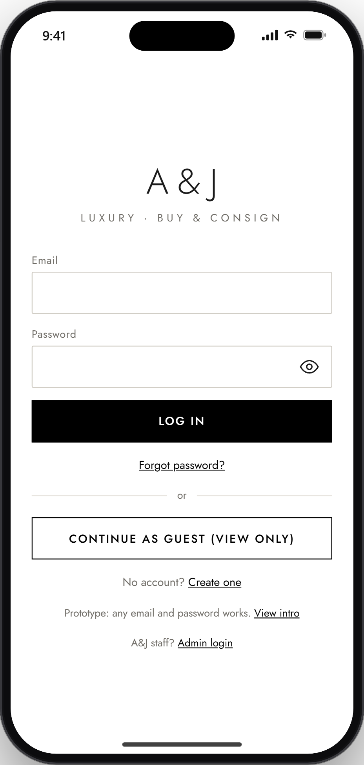
App Walkthrough
STEP 2: Login Page
Log in with your email and password. You can also create an account, reset your password, or browse as a guest. A&J staff use the separate Admin login.
Notes:
Step 2: Login Page. Log in with your email and password. You can also create an account, reset your password, or browse as a guest. A&J staff use the separate Admin login.

Slide 4
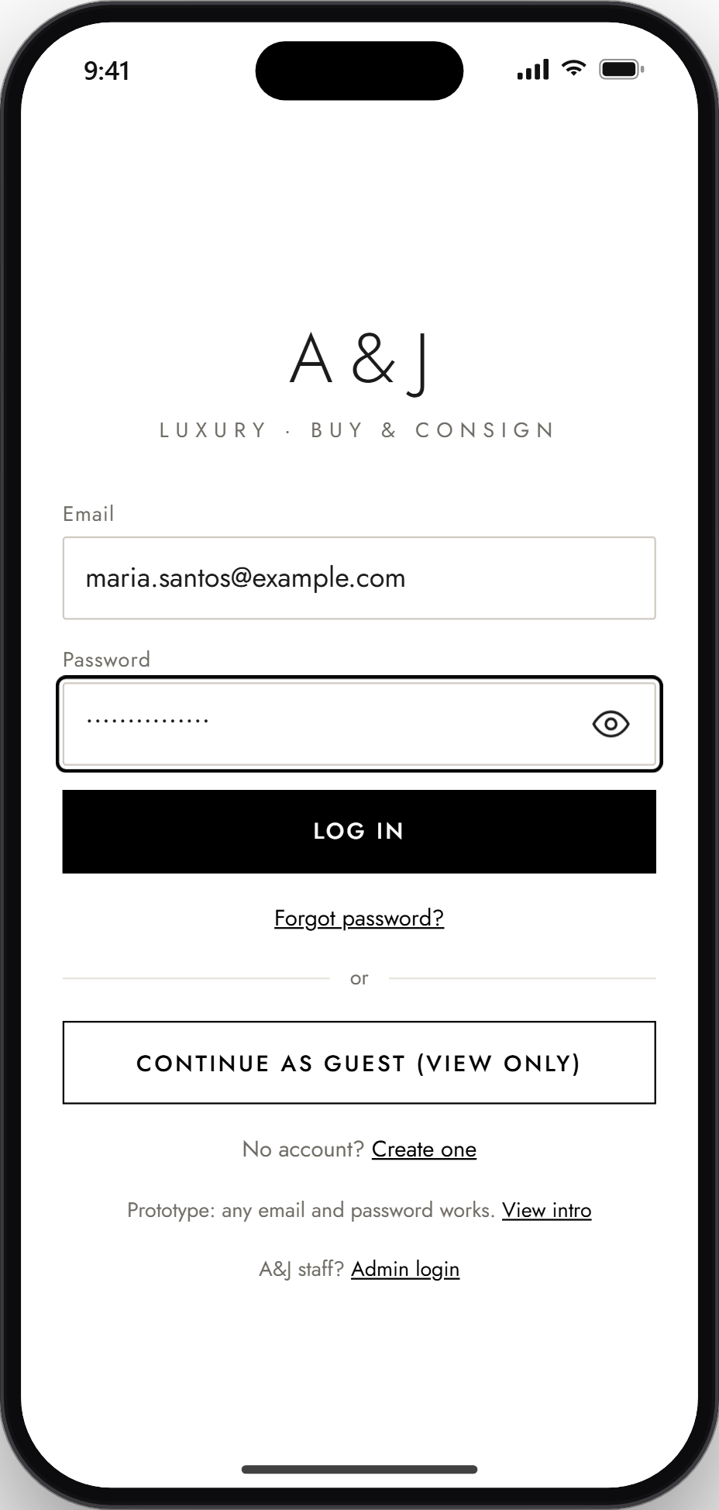
App Walkthrough
STEP 3: Log in or Continue as Guest
Log in to use everything, or continue as a guest to browse, search and ask the chatbot. Saving items, inquiring, consigning and support tickets need an account.
Notes:
Step 3: Log in or Continue as Guest. Log in to use everything, or continue as a guest to browse, search and ask the chatbot. Saving items, inquiring, consigning and support tickets need an account.

Slide 5
App Walkthrough
STEP 4: Home Screen
See the newest arrivals and shop by category. The menu at the bottom takes you to Shop, Consign, Help, Support and your Account.
Notes:
Step 4: Home Screen. See the newest arrivals and shop by category. The menu at the bottom takes you to Shop, Consign, Help, Support and your Account.

Slide 6
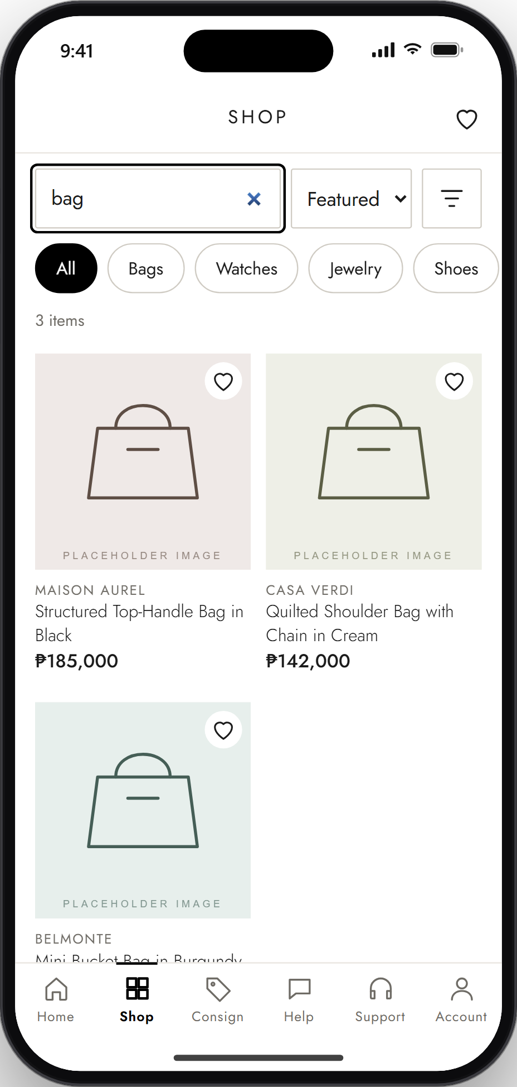
App Walkthrough
STEP 5: Browse or Search Items
Search for an item, pick a category, or filter by brand, condition and price. Each item shows its brand, name and price.
Notes:
Step 5: Browse or Search Items. Search for an item, pick a category, or filter by brand, condition and price. Each item shows its brand, name and price.

Slide 7
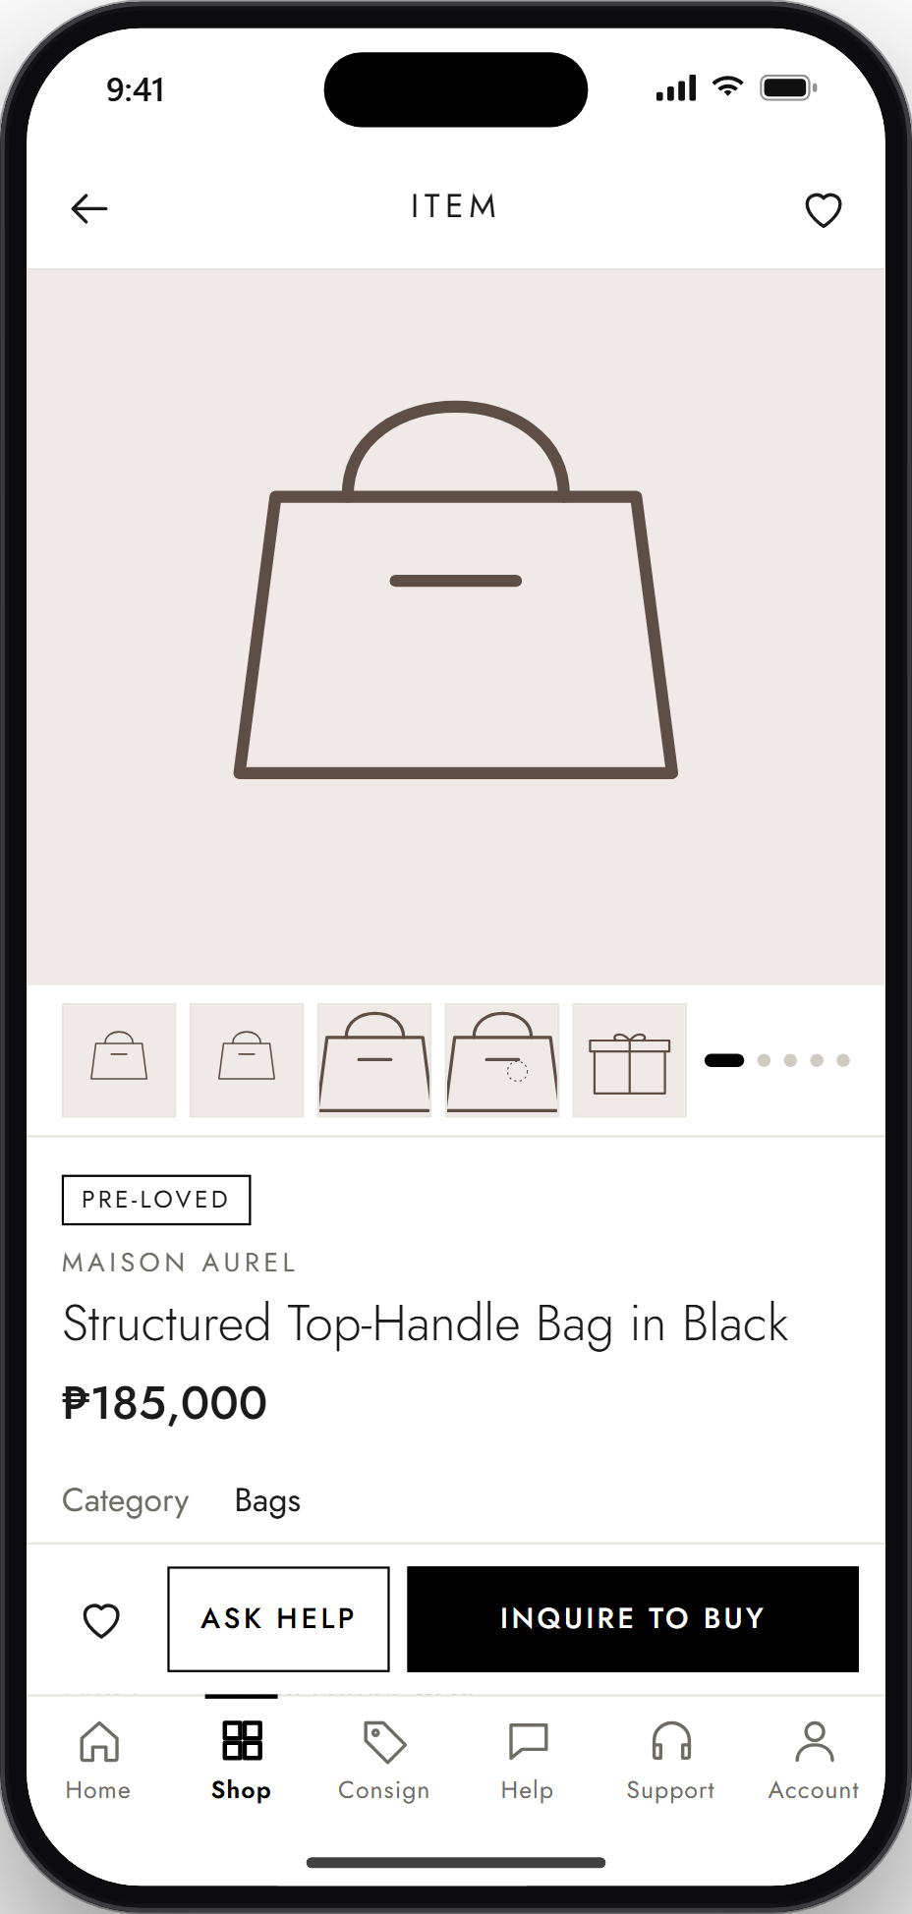
App Walkthrough
STEP 6: Item Detail Page
Swipe through the photos and check the condition, brand and price. Tap the heart to save it, Ask Help for questions, or Inquire to buy.
Notes:
Step 6: Item Detail Page. Swipe through the photos and check the condition, brand and price. Tap the heart to save it, Ask Help for questions, or Inquire to buy.

Slide 8
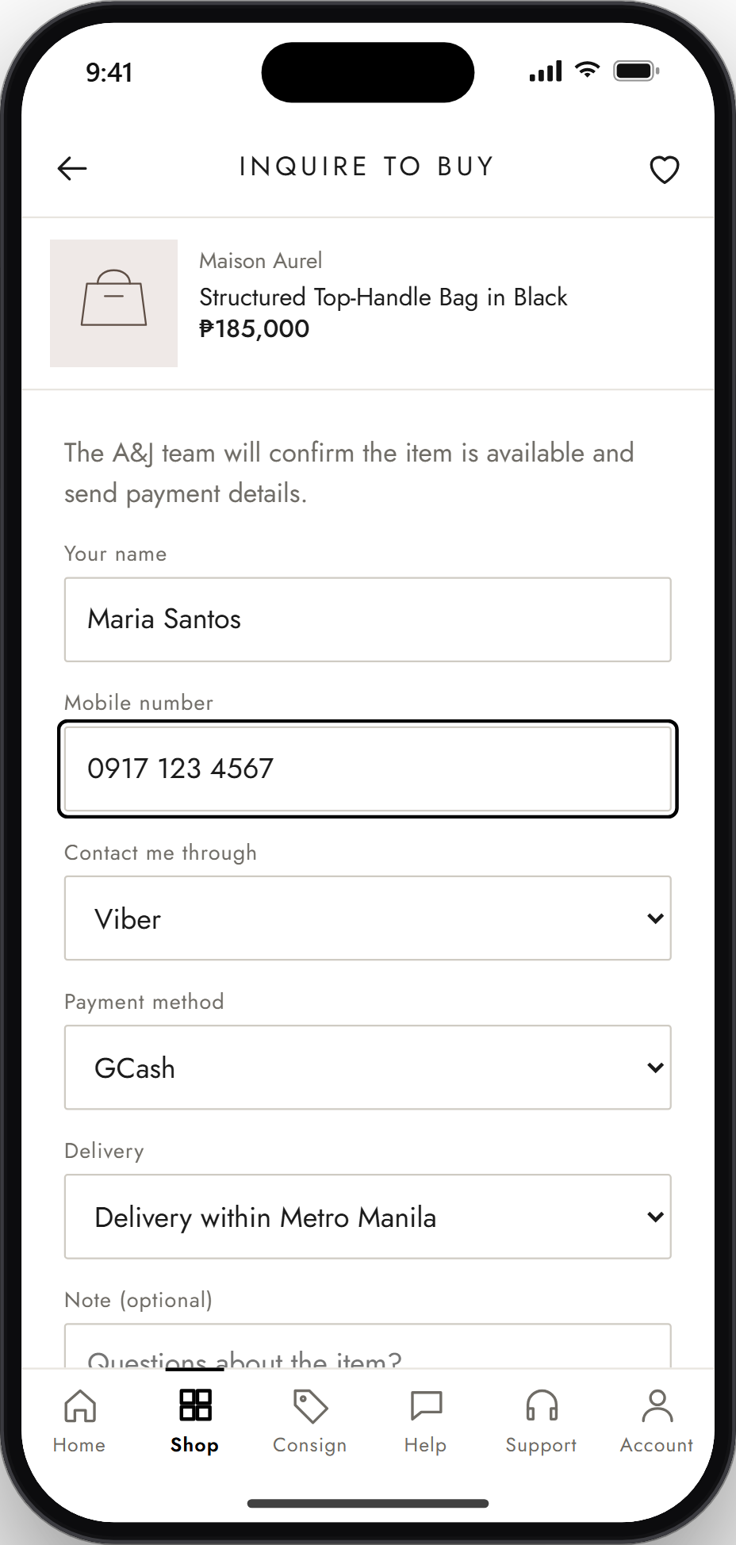
App Walkthrough
STEP 7: Inquire to Buy
Fill in your name, mobile number, how A&J should contact you, how you'll pay (like GCash) and delivery or pick-up. Then tap Send inquiry.
Notes:
Step 7: Inquire to Buy. Fill in your name, mobile number, how A&J should contact you, how you'll pay (like GCash) and delivery or pick-up. Then tap Send inquiry.

Slide 9
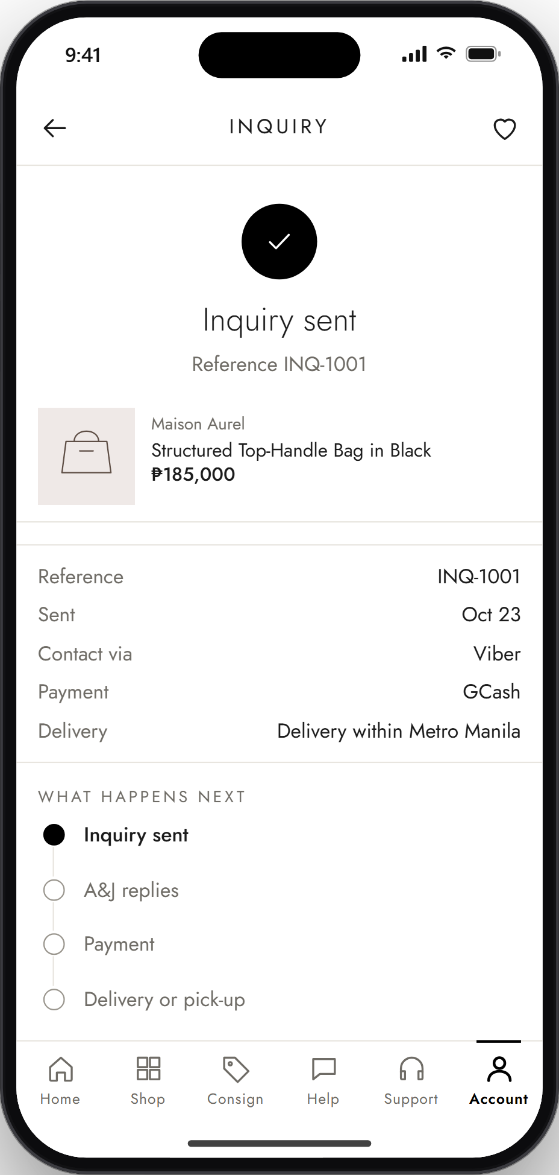
App Walkthrough
STEP 8: Inquiry Sent
You get a reference number and a summary of your inquiry. Next, A&J replies, confirms payment, and arranges delivery or pick-up.
Notes:
Step 8: Inquiry Sent. You get a reference number and a summary of your inquiry. Next, A&J replies, confirms payment, and arranges delivery or pick-up.

Slide 10
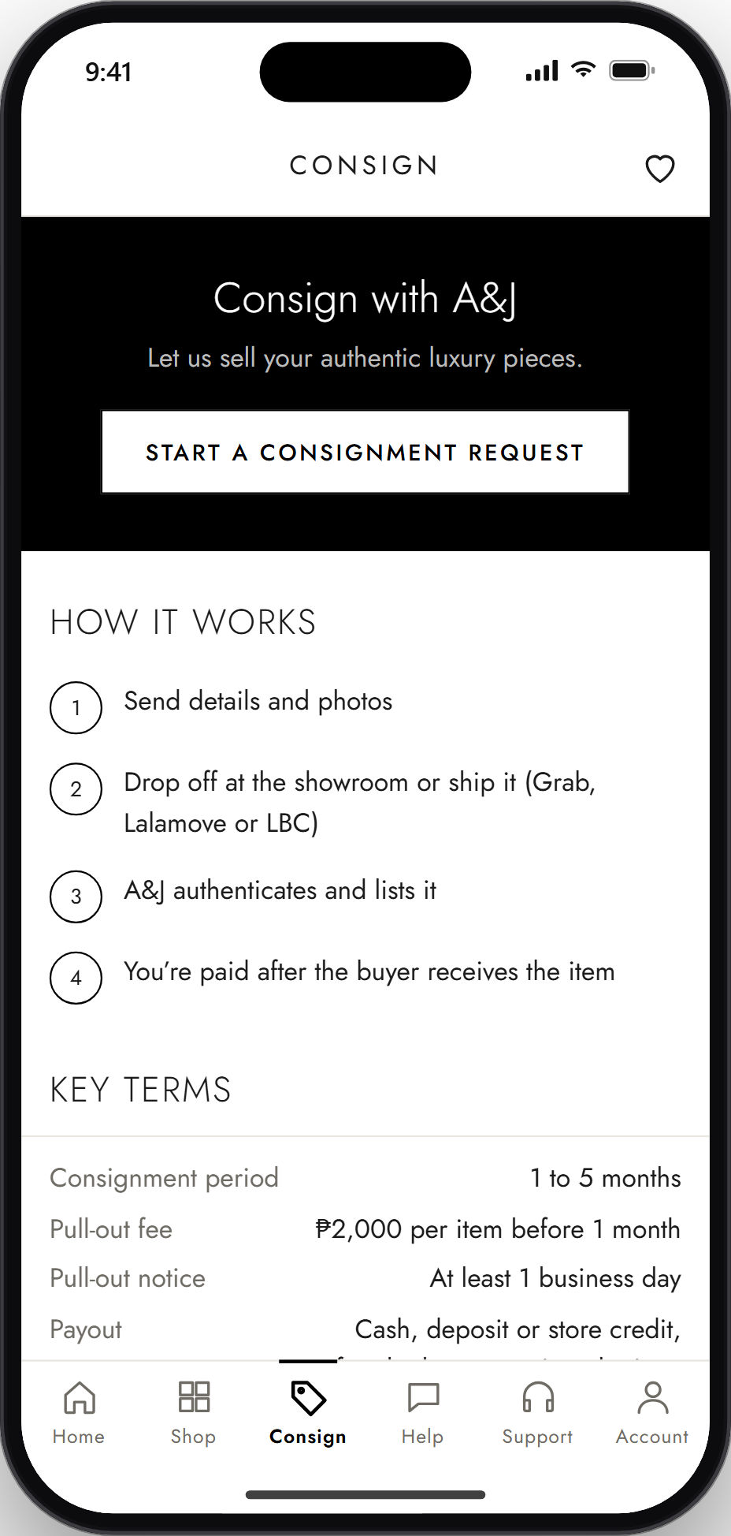
App Walkthrough
STEP 9: Open the Consignment Section
The Consign tab explains how consigning works and the key terms. Tap Start a consignment request to begin.
Notes:
Step 9: Open the Consignment Section. The Consign tab explains how consigning works and the key terms. Tap Start a consignment request to begin.

Slide 11
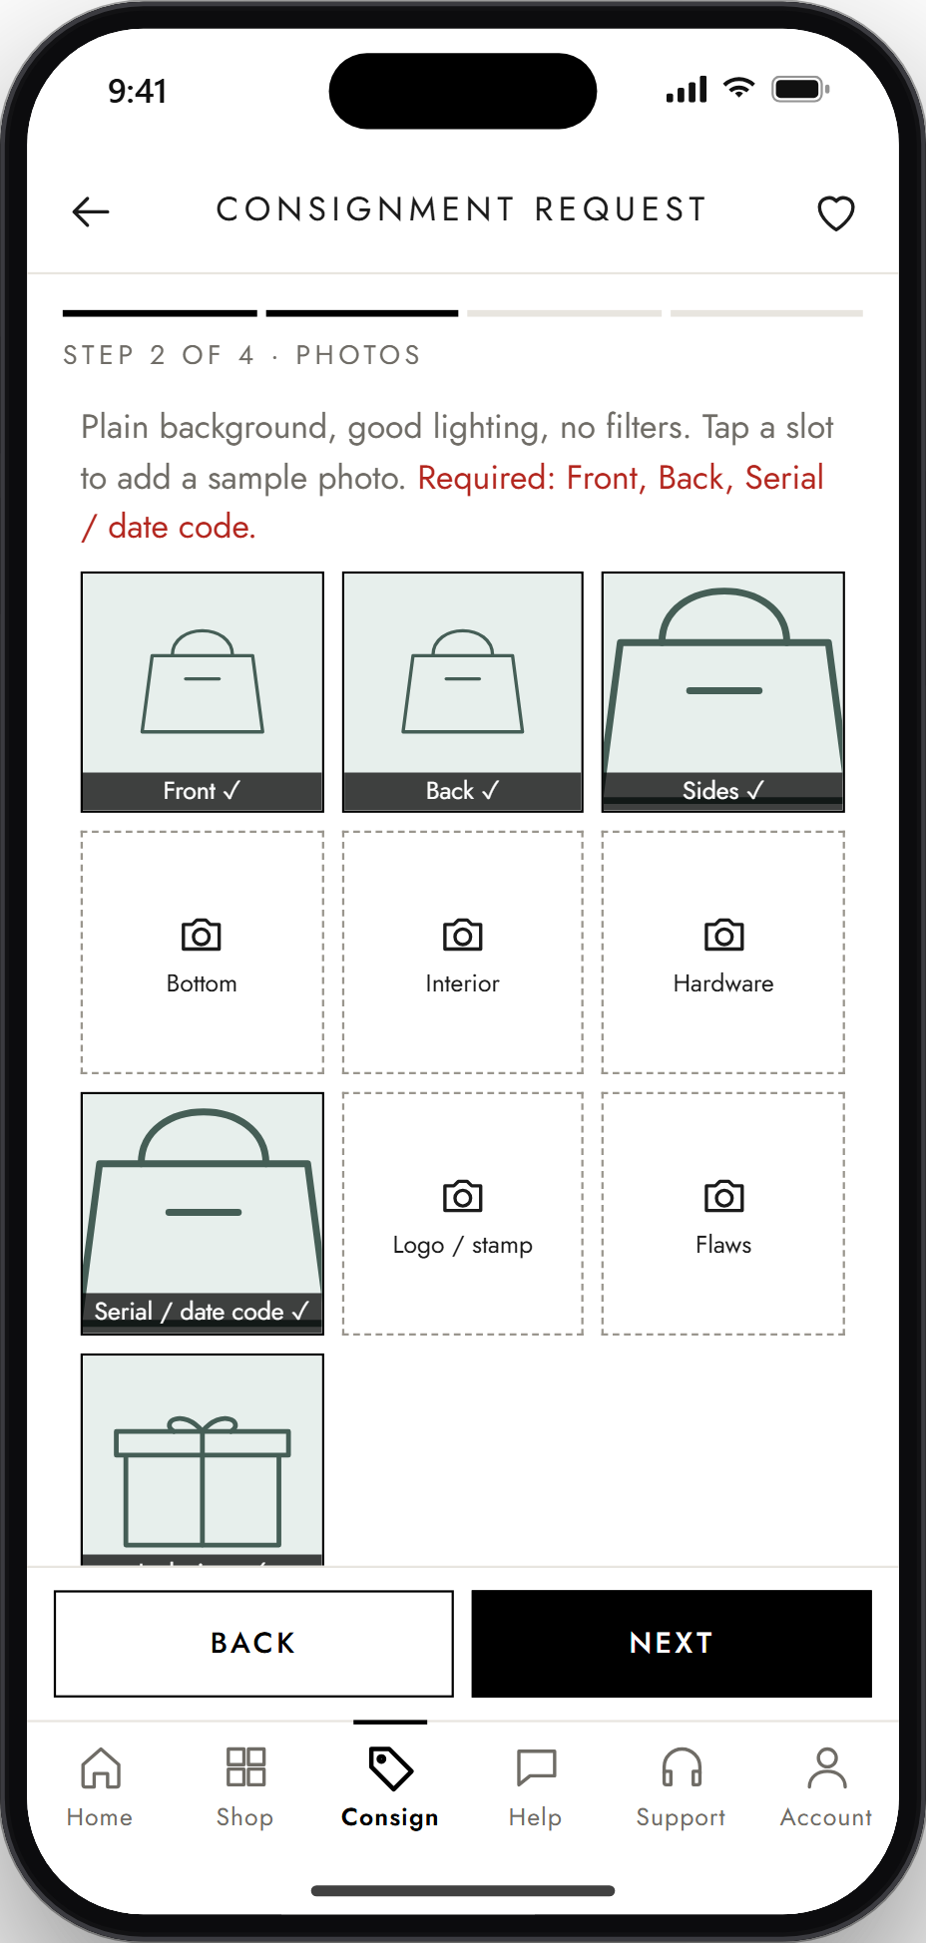
App Walkthrough
STEP 10: Submit Item Details and Photos
Choose to sell or consign, then enter the brand, item name and condition. Add photos of the front, back and serial or date code.
Notes:
Step 10: Submit Item Details and Photos. Choose to sell or consign, then enter the brand, item name and condition. Add photos of the front, back and serial or date code.

Slide 12
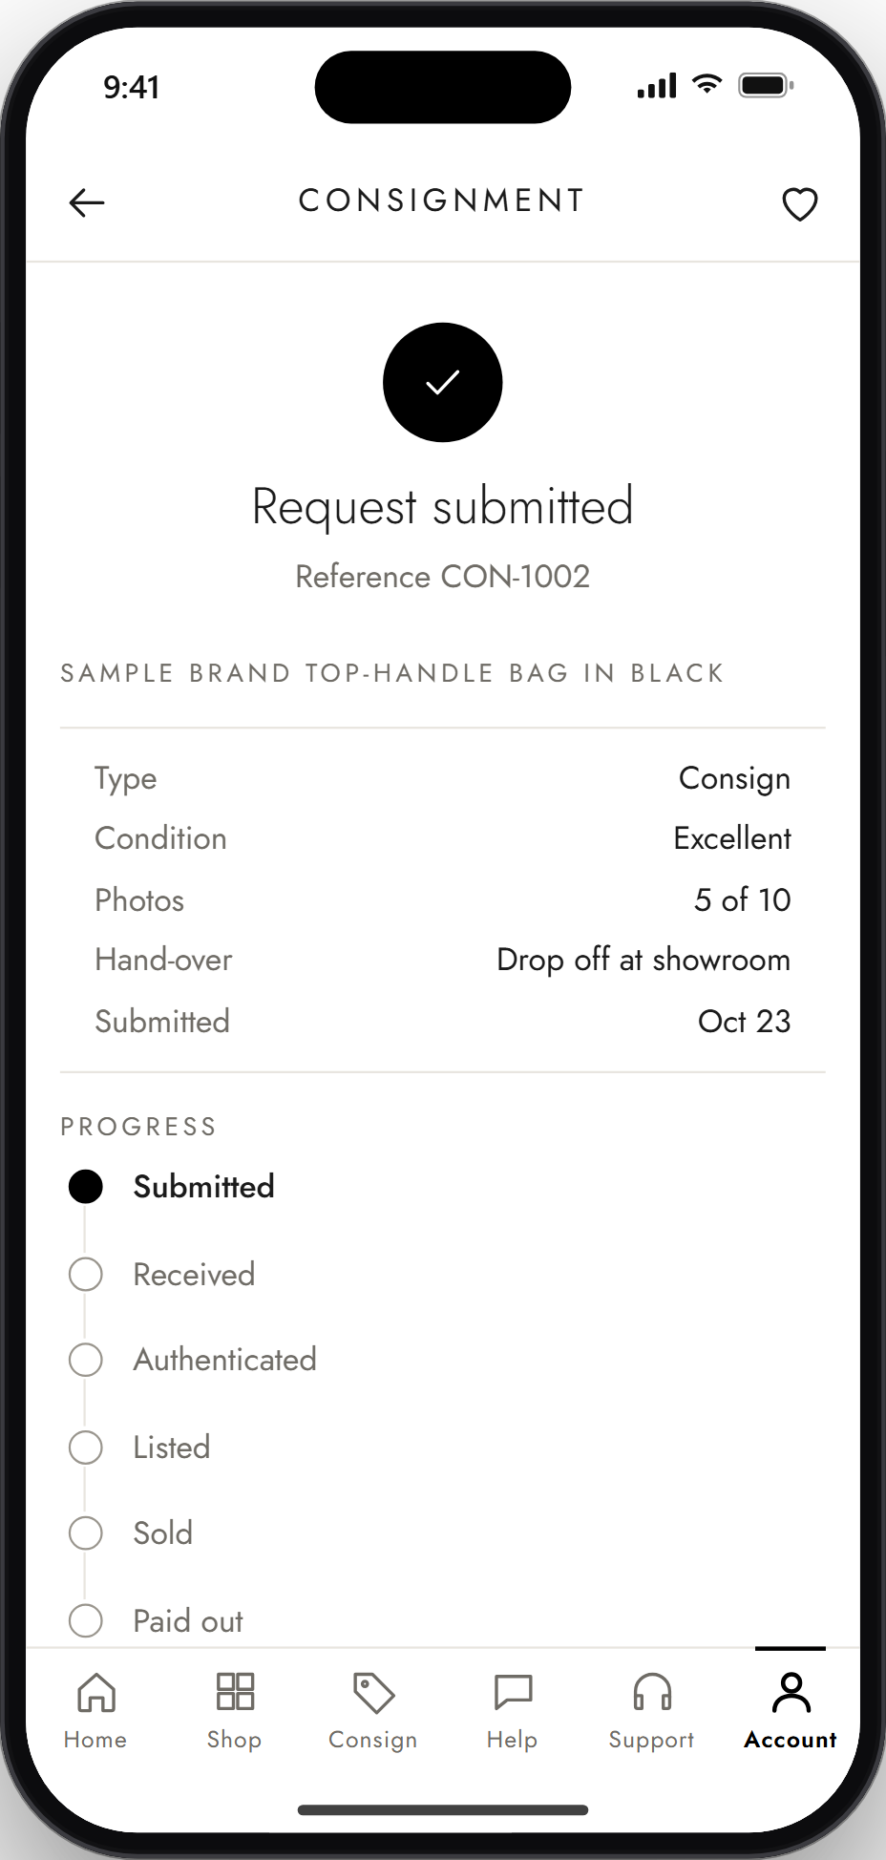
App Walkthrough
STEP 11: Review and Submit
Check the summary of your request, then tap Submit request. You get a reference number right away.
Notes:
Step 11: Review and Submit. Check the summary of your request, then tap Submit request. You get a reference number right away.

Slide 13
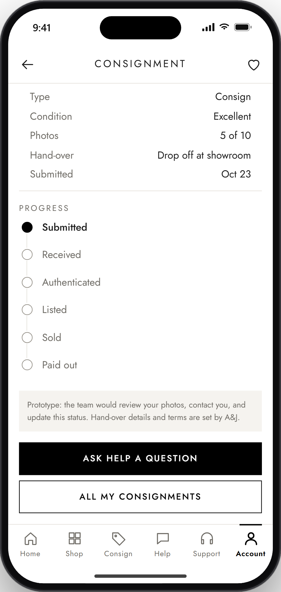
App Walkthrough
STEP 12: Track Consignment Status
Go to Account, then My consignments, to see where your item is: Submitted, Received, Authenticated, Listed, Sold, then Paid out.
Notes:
Step 12: Track Consignment Status. Go to Account, then My consignments, to see where your item is: Submitted, Received, Authenticated, Listed, Sold, then Paid out.

Slide 14
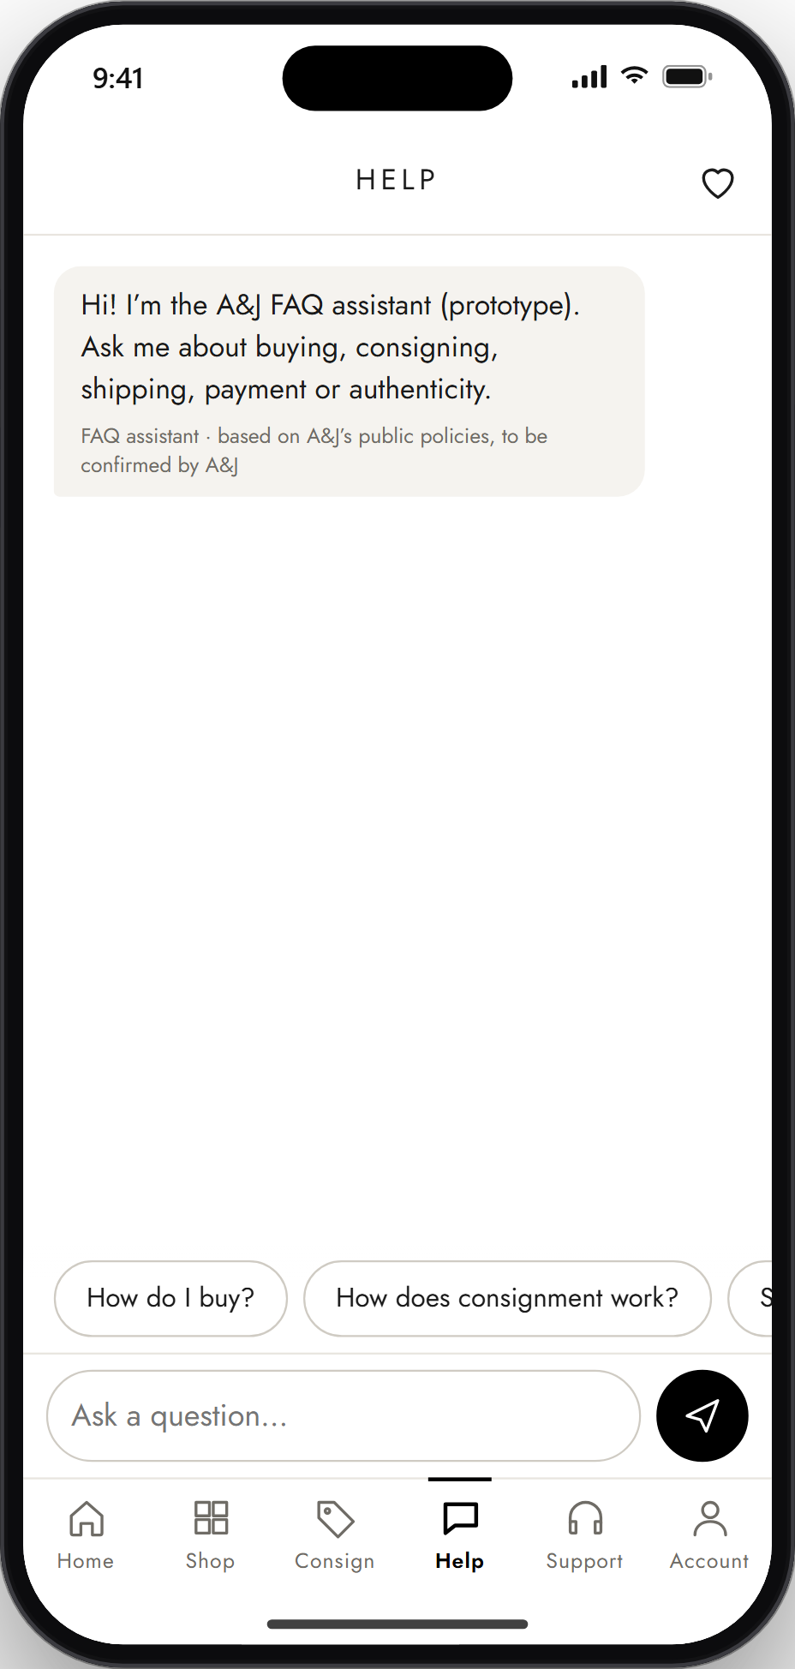
App Walkthrough
STEP 13: Open the Chatbot
The Help tab opens the FAQ assistant. Suggested questions appear as buttons so you can tap instead of type.
Notes:
Step 13: Open the Chatbot. The Help tab opens the FAQ assistant. Suggested questions appear as buttons so you can tap instead of type.

Slide 15

App Walkthrough
STEP 14: Ask or Choose a Question
Type your own question, like how layaway works, or tap one of the suggested questions.
Notes:
Step 14: Ask or Choose a Question. Type your own question, like how layaway works, or tap one of the suggested questions.

Slide 16
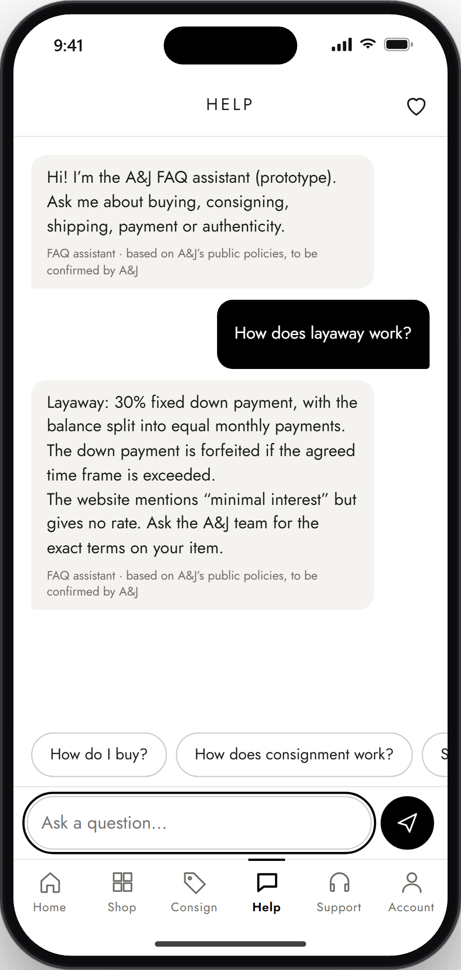
App Walkthrough
STEP 15: Receive an Answer
The assistant answers using A&J's approved FAQs. If it can't help, tap Talk to a support agent to open a ticket with your chat attached.
Notes:
Step 15: Receive an Answer. The assistant answers using A&J's approved FAQs. If it can't help, tap Talk to a support agent to open a ticket with your chat attached.

Slide 17
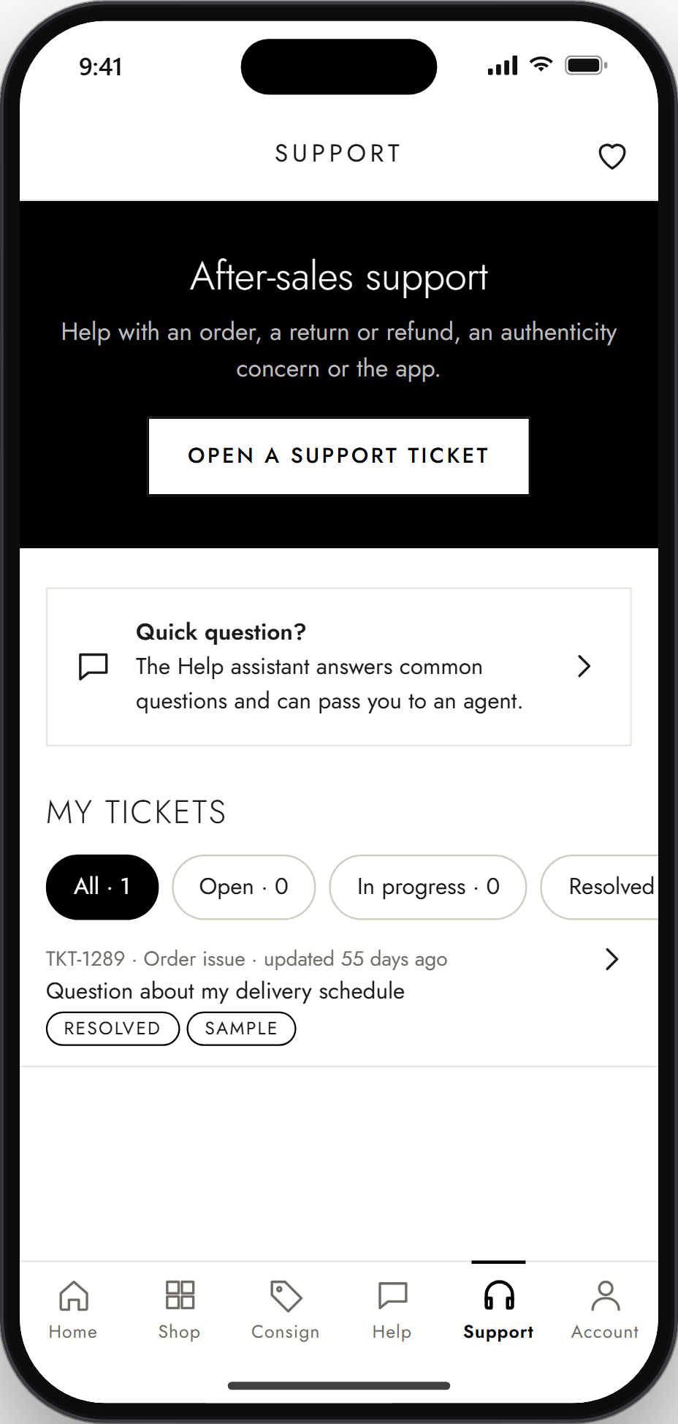
App Walkthrough
STEP 16: Open the Support Section
The Support tab lets you open a new ticket, ask the Help assistant a quick question, or check your existing tickets.
Notes:
Step 16: Open the Support Section. The Support tab lets you open a new ticket, ask the Help assistant a quick question, or check your existing tickets.

Slide 18
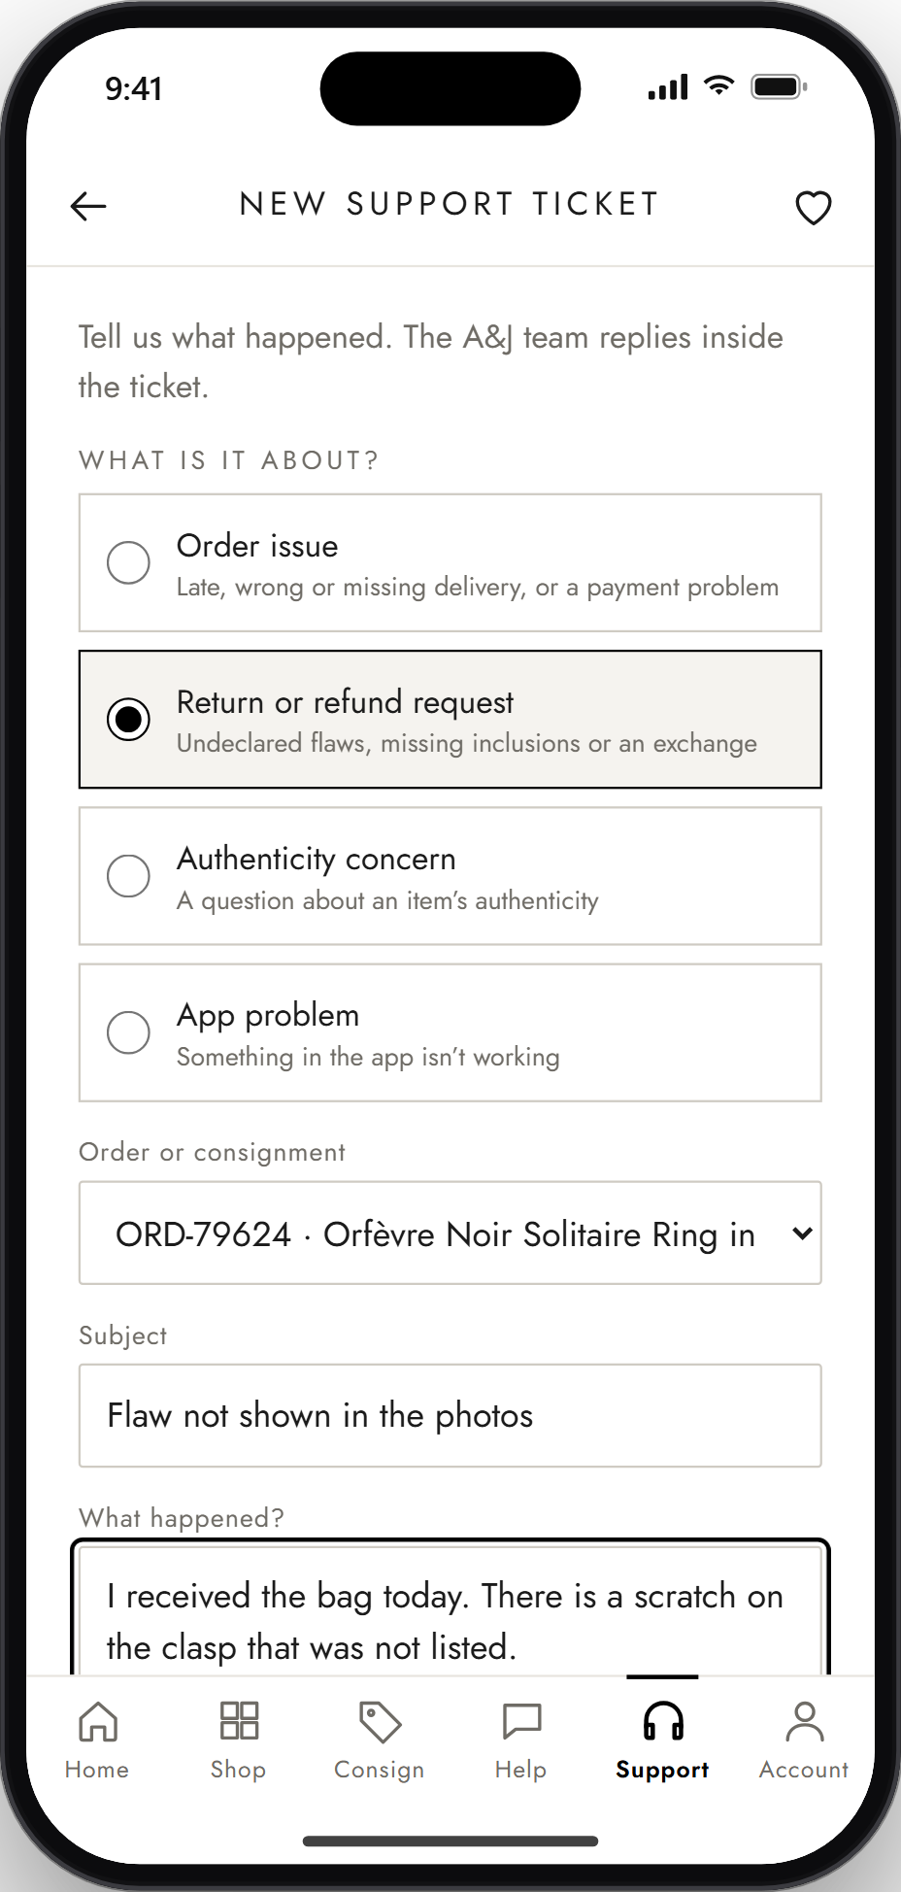
App Walkthrough
STEP 17: Submit a Support Ticket
Choose what the problem is about, like a return or refund, pick the related order, describe the issue, and tap Submit ticket.
Notes:
Step 17: Submit a Support Ticket. Choose what the problem is about, like a return or refund, pick the related order, describe the issue, and tap Submit ticket.

Slide 19
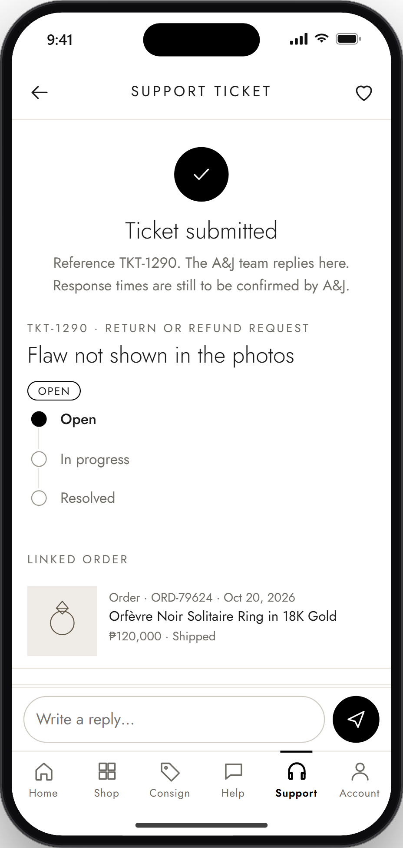
App Walkthrough
STEP 18: Track Ticket Status
See your ticket's reference number and status: Open, In progress or Resolved. Come back here to read staff replies and send your own.
Notes:
Step 18: Track Ticket Status. See your ticket's reference number and status: Open, In progress or Resolved. Come back here to read staff replies and send your own.

Slide 20
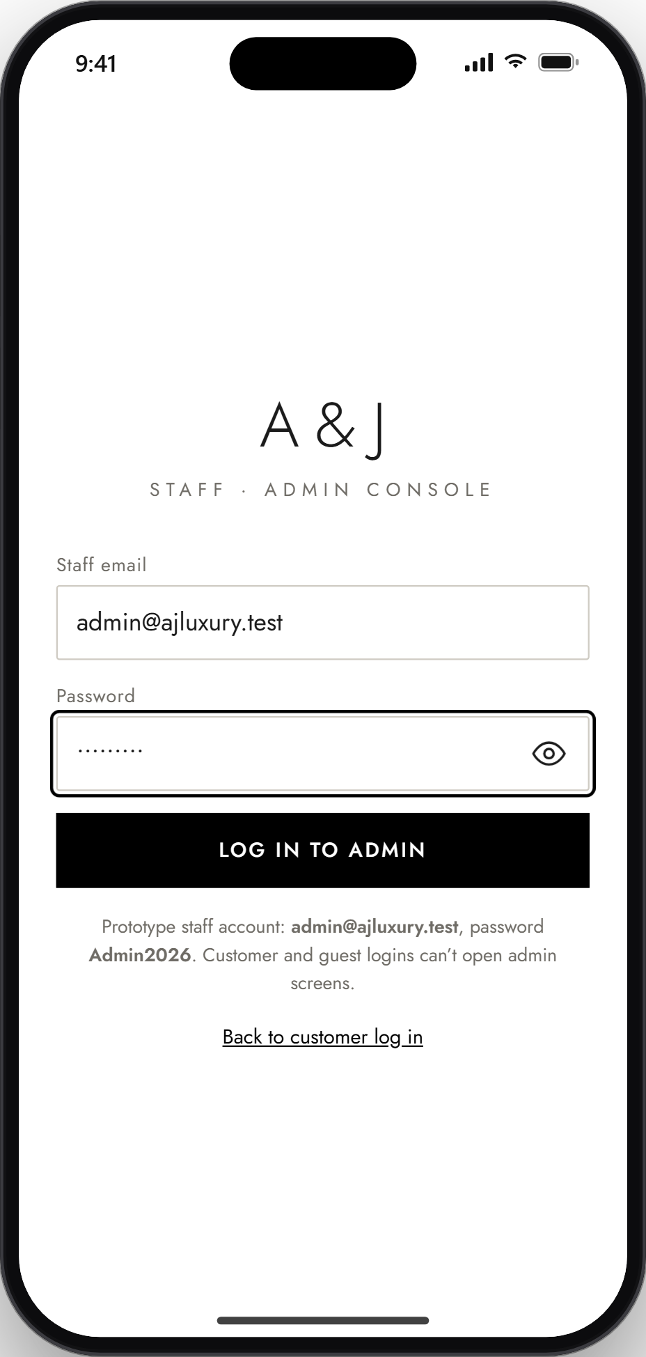
App Walkthrough
STEP 19: Admin Login
A&J staff sign in through a separate Admin login. Customer and guest accounts can't open the admin screens.
Notes:
Step 19: Admin Login. A&J staff sign in through a separate Admin login. Customer and guest accounts can't open the admin screens.

Slide 21
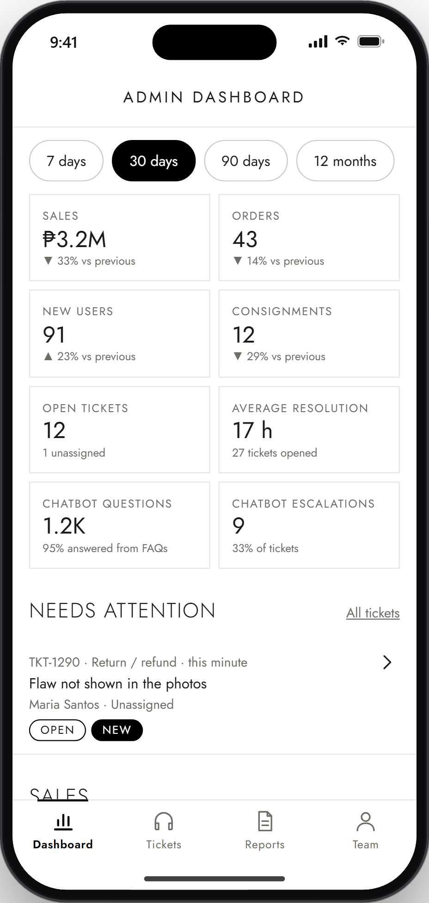
App Walkthrough
STEP 20: Dashboard
See sales, orders, new users, consignments, open tickets, reply speed and chatbot activity for any period. New or unassigned tickets show up under Needs attention.
Notes:
Step 20: Dashboard. See sales, orders, new users, consignments, open tickets, reply speed and chatbot activity for any period. New or unassigned tickets show up under Needs attention.

Slide 22
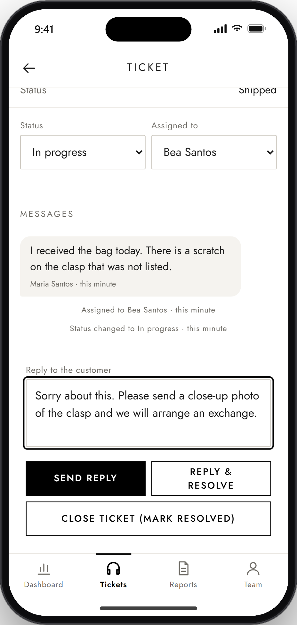
App Walkthrough
STEP 21: Handle Support Tickets
Open a ticket, assign it to yourself, update its status and reply. The customer sees every update in their ticket right away.
Notes:
Step 21: Handle Support Tickets. Open a ticket, assign it to yourself, update its status and reply. The customer sees every update in their ticket right away.

Slide 23
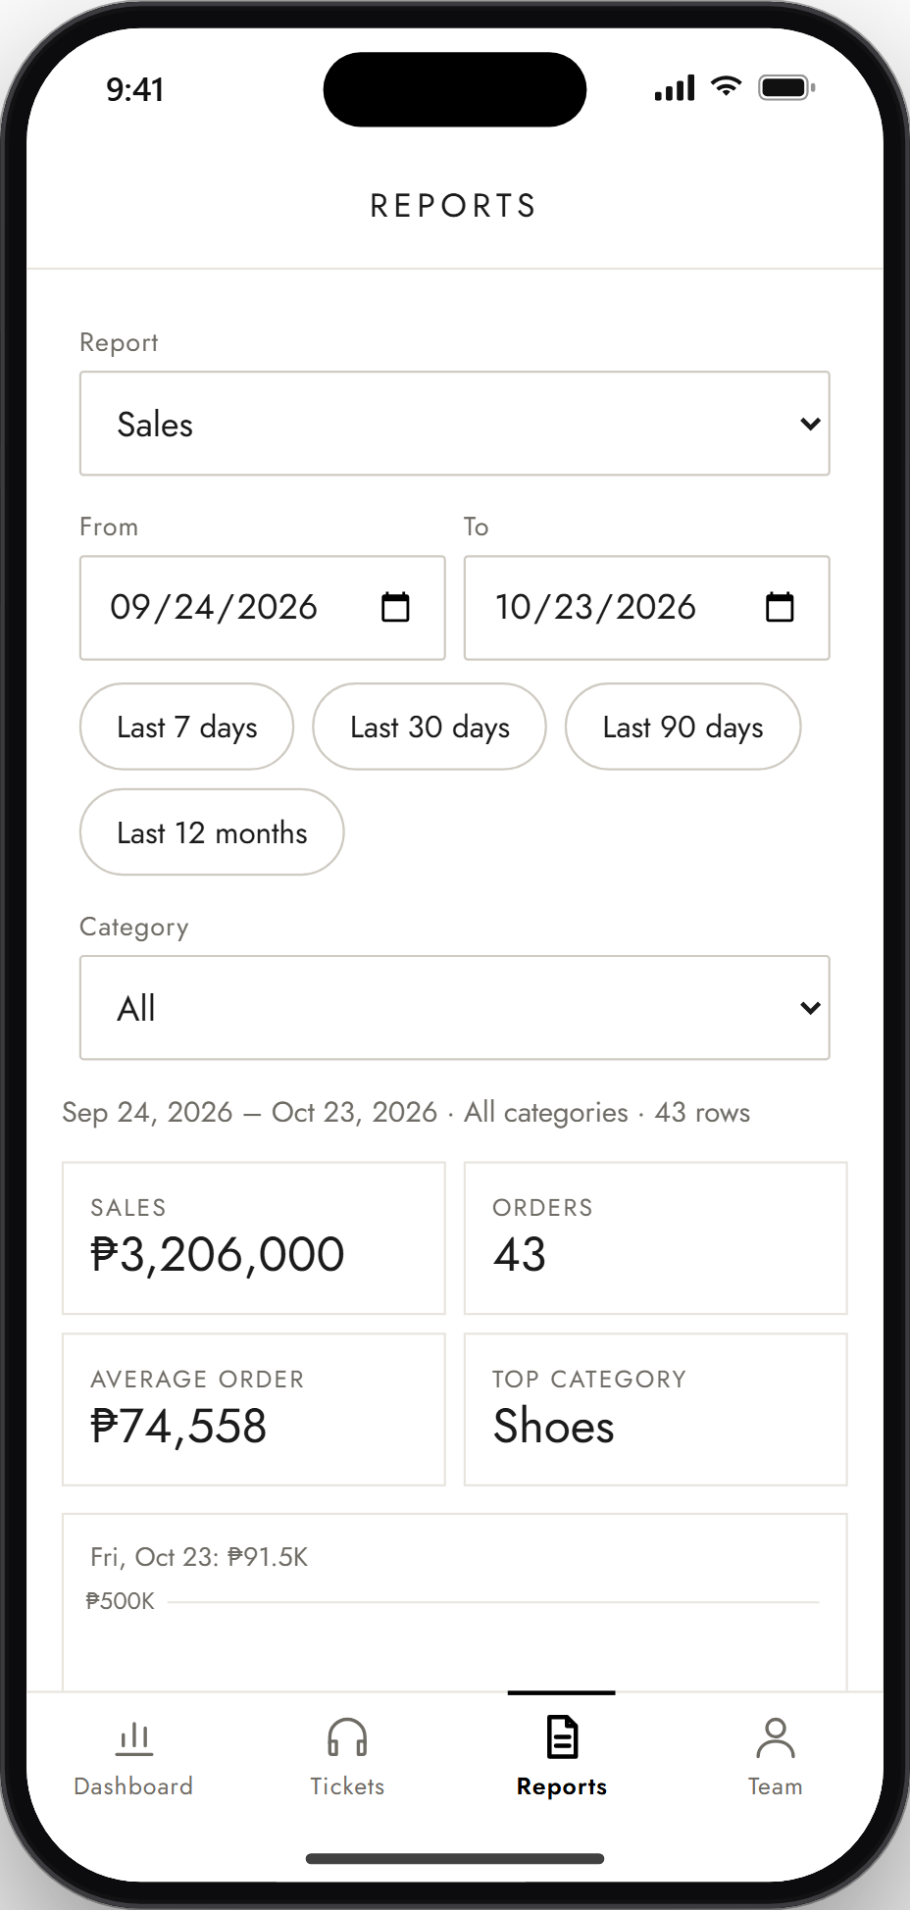
App Walkthrough
STEP 22: Reports and Analytics
Pick a report type, date range and category. View the totals and chart, then download the results as CSV or PDF.
Notes:
Step 22: Reports and Analytics. Pick a report type, date range and category. View the totals and chart, then download the results as CSV or PDF.

