Slide 1
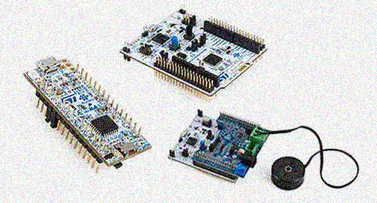
ARM Cortex-M4 within the STM32G431VBx3
Mark Dannemiller

Slide 2
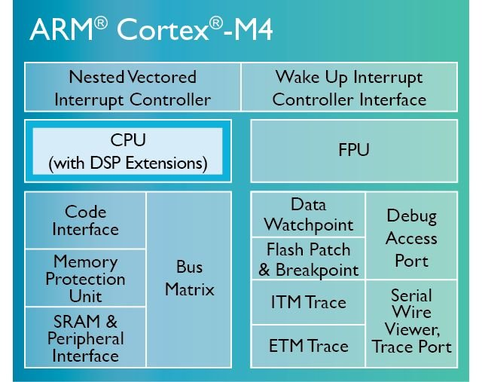
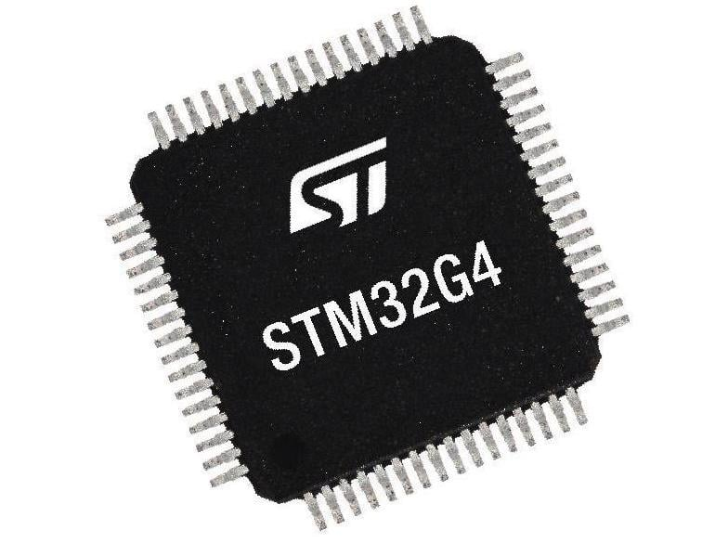
Agenda
STM32G431Vbx3
Part Number breakdown
Features
Application
Peripherals & Block Diagram
Pin Assignments
Programming and Debugging
ARM Cortex-M4
Registers
Reset
Pipeline Stages
Program and Data Memory
Memory Access
ALU
Stack
Instruction Set and Formats
Branching and Interrupts
Multiply and Math Acceleration

Slide 3
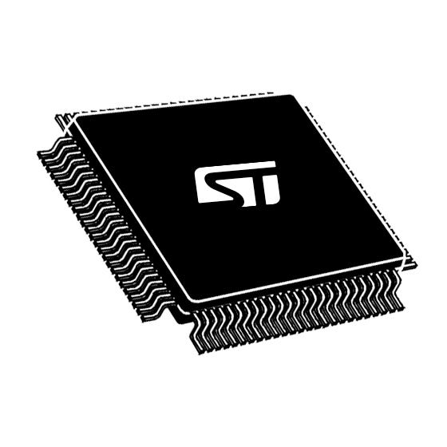
STM32G431Vbx3
$3.70 | 10ku $6.32 | 1u
STM32 = 32‑bit Arm® MCU family
G4 = Motor‑/DSP‑centric “G4” series
31 = Sub‑line with math accelerators (CORDIC, FMAC)
V = 100‑pin LQFP package (14 × 14 mm)
B = 128 KB Flash / 32 KB + 10 KB SRAM
T = LQFP (0.5 mm pitch)
3 = –40 °C → +125 °C industrial temp
Great for Motor Controllers and Power Management

Slide 4
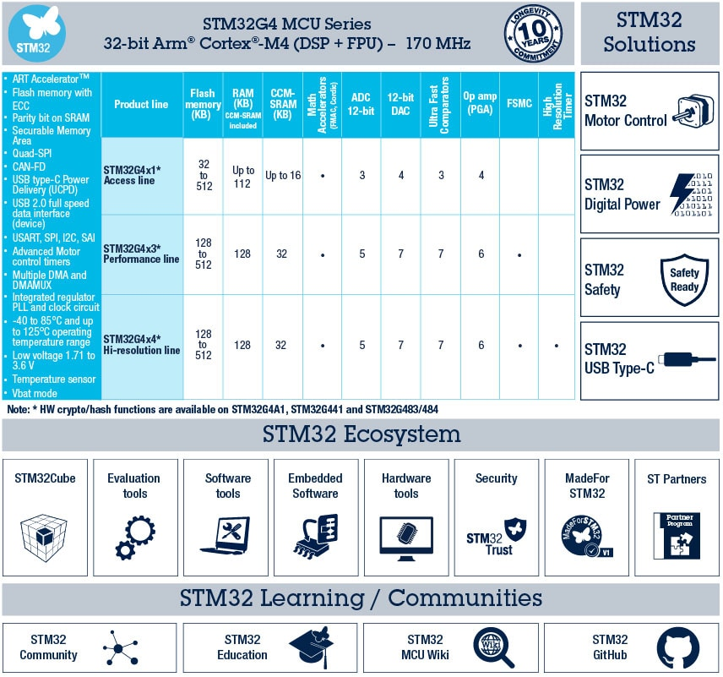
STM32G4 Microcontroller Feature Overview
Arm Cortex‑M4F @ 32kHz-170 MHz + FPU
128 KB Flash | 32 KB SRAM1 + 10 KB CCM
4 Msps dual‑ADC + 4 × 12‑bit DAC
3 × Op‑Amp, 4 × Comparator, Vref buffer
2 × Advanced PWM (TIM1/8) + HR PWM (184 ps)
CORDIC & FMAC accelerators for trig/filter math
USB‑C/PD UCPD, FDCAN, 3 × I²C (FM+), 3 × SPI, 4 × USART/LPUART
‑40 °C … +125 °C, 1.8 – 3.6 V core supply
[1]

Slide 5
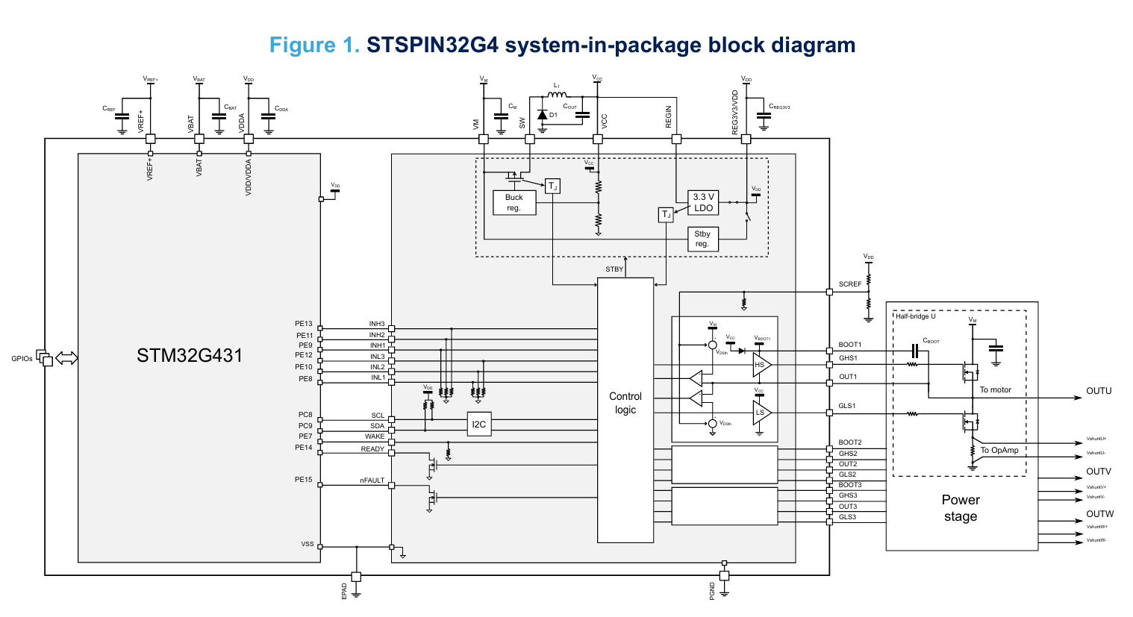
Application
STSPIN32G4
STM32 included with peripherals suitable for brushless DC motor control
Built-in Gate Driver, LDO Converter (For MCU and LDO),
5-75 V input voltage
OPAMP & Comparator
$3.76
[4]
STSPIN32G4 - High performance 3-phase motor controller with embedded STM32G4 MCU - STMicroelectronics

Slide 6
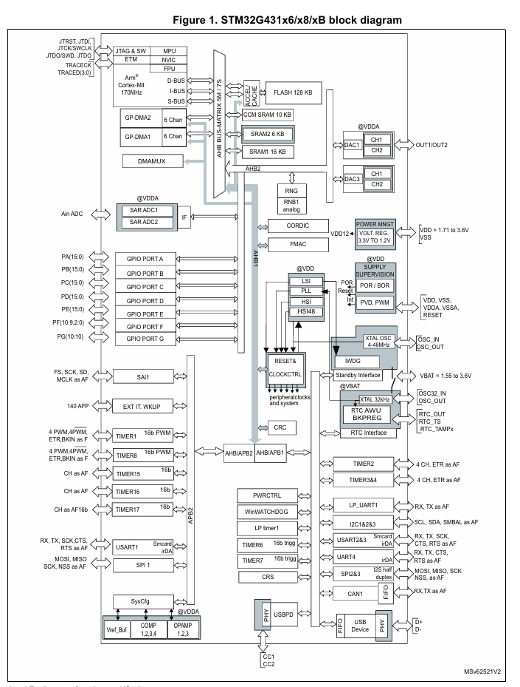
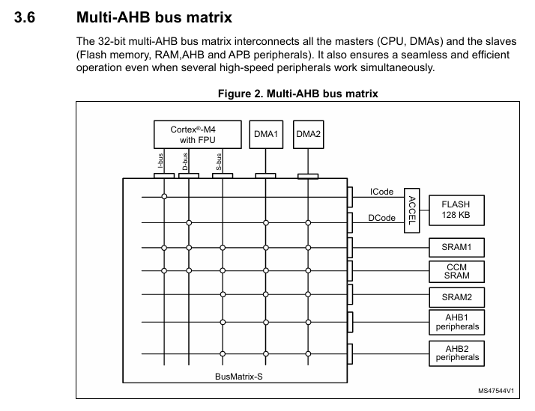
MCU Peripherals
Cortex‑M4 core + NVIC, MPU, FPU + DMA + AHB Bus
[1]

Slide 7
MCU Peripherals
Cortex‑M4 core + NVIC, MPU, FPU + DMA + AHB Bus
Analog domain (ADC1/2, DAC, OPAMP, COMP)
[1]

Slide 8
MCU Peripherals
Cortex‑M4 core + NVIC, MPU, FPU + DMA + AHB Bus
Analog domain (ADC1/2, DAC, OPAMP, COMP)
Clock/PWR, ART flash interface, CRC
[1]

Slide 9
MCU Peripherals
Cortex‑M4 core + NVIC, MPU, FPU + DMA + AHB Bus
Analog domain (ADC1/2, DAC, OPAMP, COMP)
Clock/PWR, ART flash interface, CRC
Timer domain (TIM1/8, TIM2/3/4, LPTIM, Watchdog)
[1]

Slide 10
MCU Peripherals
Cortex‑M4 core + NVIC, MPU, FPU + DMA + AHB Bus
Analog domain (ADC1/2, DAC, OPAMP, COMP)
Clock/PWR, ART flash interface, CRC
Timer domain (TIM1/8, TIM2/3/4, LPTIM, Watchdog)
Comms: FDCAN, USBC-PD, SPI/I²C/UART
[1]

Slide 11
MCU Peripherals
Cortex‑M4 core + NVIC, MPU, FPU + DMA + AHB Bus
Analog domain (ADC1/2, DAC, OPAMP, COMP)
Clock/PWR, ART flash interface, CRC
Timer domain (TIM1/8, TIM2/3/4, LPTIM, Watchdog)
Comms: FDCAN, UCPD, SPI/I²C/UART
GPIO (Ports A-G)
[1]

Slide 12
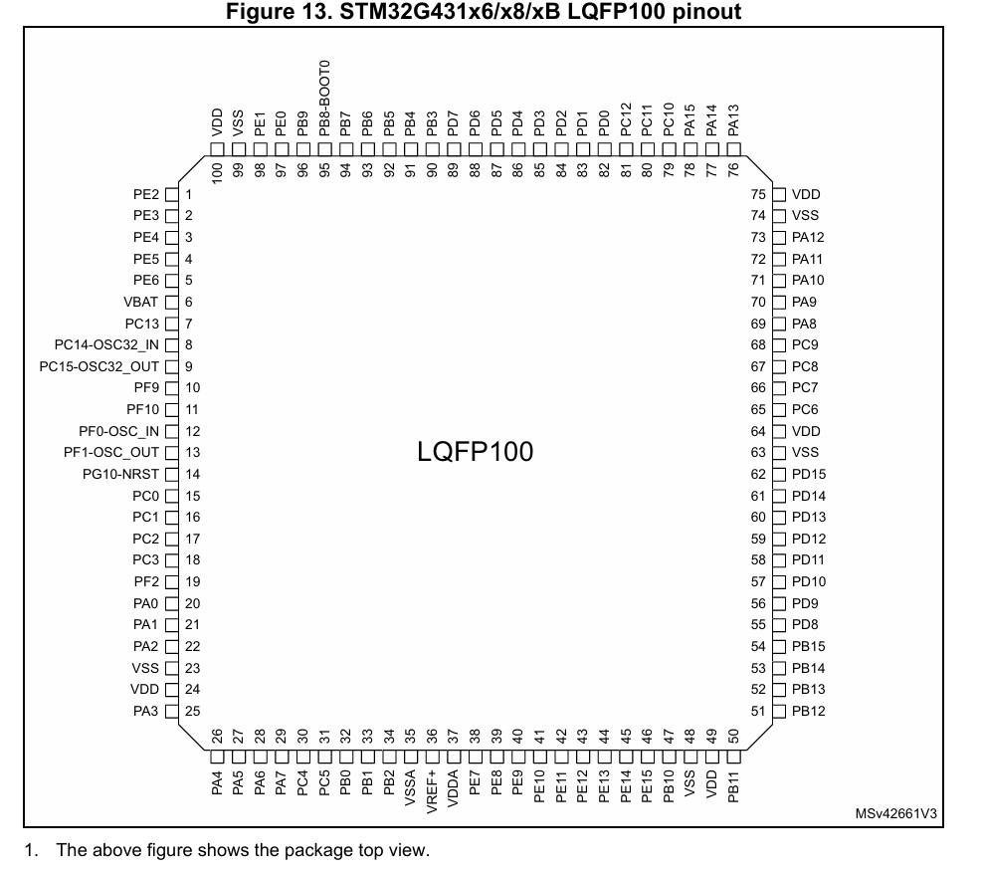
MCU Pinout
100 pins
86 fast GPIOs (5 V‑tolerant, 20 mA each)
8mA recommended output
Max sink/source 100mA
Multiple alternate functions per pin (Digital, Analog)
Dedicated: NRST, BOOT0, VREF+, VDDA, VBAT
SWD/JTAG on PA13 / PA14 / PB3 / PB4 (Debugging)
Dual analog supply domains isolate noise
I/O supply 1.7 V – 5.5 V (FM+) on I²C pins
[1]

Slide 13
Programming & Debugging
Single‑Wire Debug (SWD) + full JTAG on PA13 (SWDIO) / PA14 (SWCLK)
On‑board Flash & option‑bytes programmer: ST‑LinkUtility / STM32 CubeProgrammer (GUI + CLI) for erase, mass‑write, & secure RDP levels
System bootloader in ROM boots from USART1, I²C1, SPI1, FDCAN or USB‑C (DFU) when BOOT0 = 1 - zero‑hardware field firmware update

Slide 14
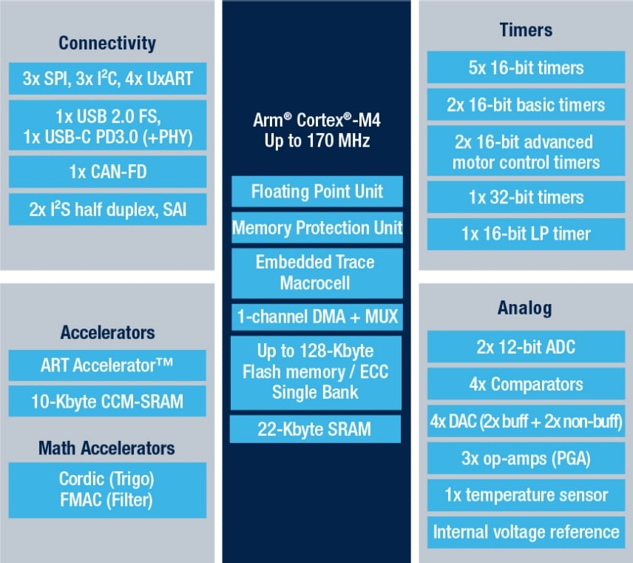
Arm Cortex-M4
32-bit RISC
Low-cost platform ($2.74)
Reduced Pin count (32-100)
Low power consumption (150 µA/MHz @ 170 MHz) 120 nA @ 3 V (Standby)
Internal 16 MHz RC with PLL option
Single-precision Floating Point Unit (FPU)
[1]

Slide 15
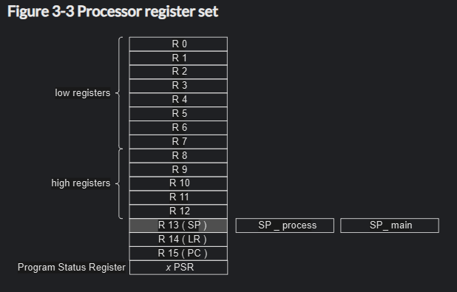
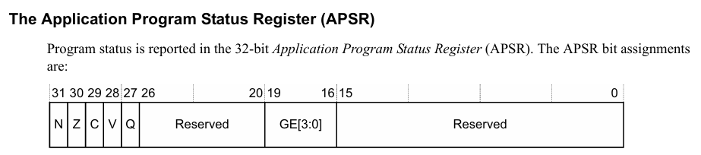
Registers
[3]
16 × 32‑bit GPRs: R0‑R12, SP(R13), LR(R14), PC(R15)
8-12 only accessible by 32-bit instructions
Thumb-1 only access low
APSR / xPSR
N Z C V Q flags, IPSR + EPSR
MSP & PSP dual stack pointers
PRIMASK | BASEPRI | FAULTMASK for interrupt control
CONTROL registers
Table 4-1 System control registers (0xE000E008 -> 0xE000EF00)

Slide 16
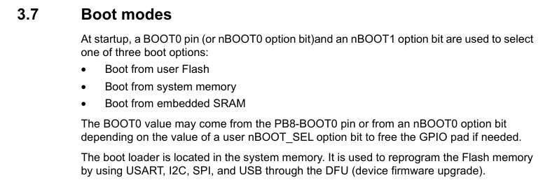
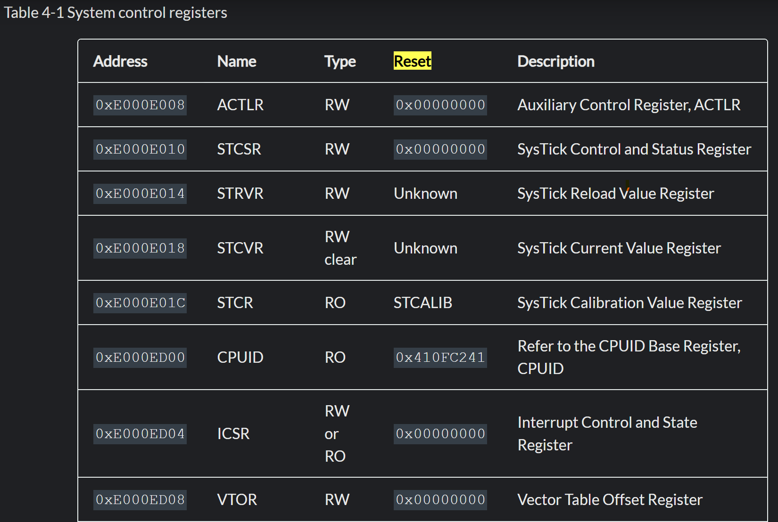
Reset & Boot
[2]
MCU LP Modes - CPU stops on sleep
Hardware reset → HSI16 clock, MSP loaded from 0x0000 0000
PC loaded from Reset_Handler in FlashVT
BOOT0 + option bytes select Flash / System ROM / SRAM
User startup sets PLL→16-170 MHz, enables ART & peripherals

Slide 17
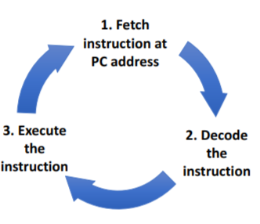
3-Stage Pipeline
Fetch – ART accelerator feeds 128‑bit line
Decode – Thumb‑2 16/32‑bit instruction decode
Execute – ALU, Barrel‑shifter, MAC, Memory access
Branch prediction & zero‑overhead loop support
Pipeline is flushed when branch encountered
Pipeline stalled on multi-cycle instructions
IF
DECODE
EX
IF
DECODE
EX
IF
DECODE
EX
[2]
Notes:
MAC – Multiply Accumulate

Slide 18
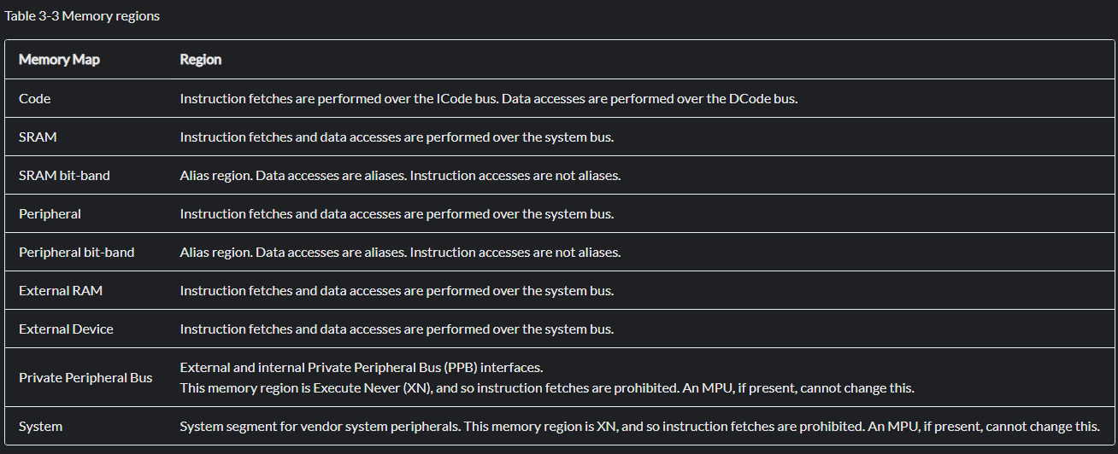
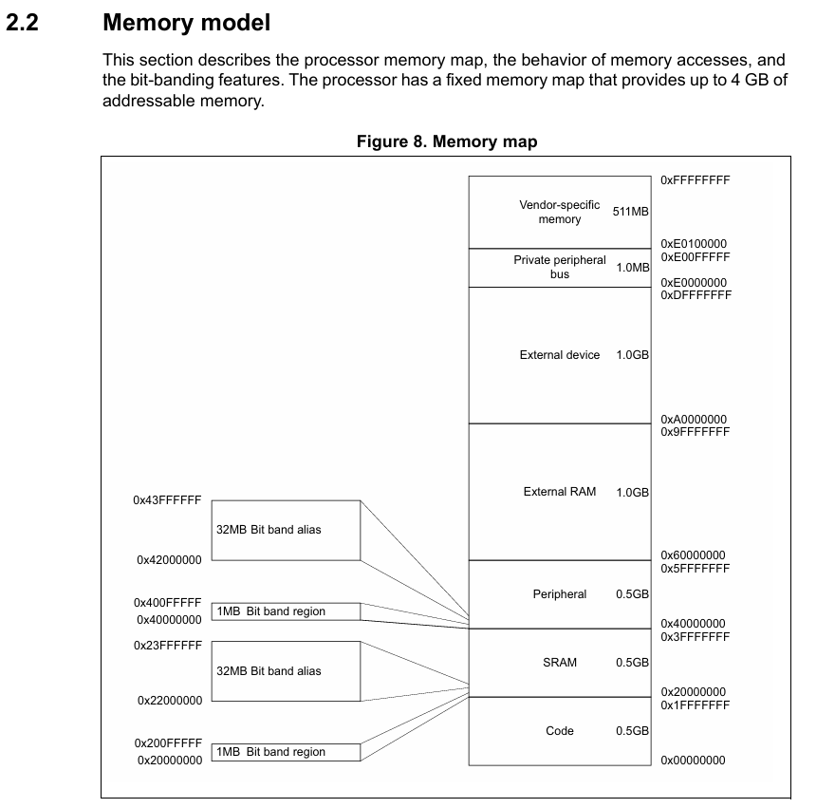
Program & Data Memory
Unified 4 GB address map, Modified Harvard bus
128KB Flash
22 KB SRAM1
10 KB CCM SRAM
[3]

Slide 19
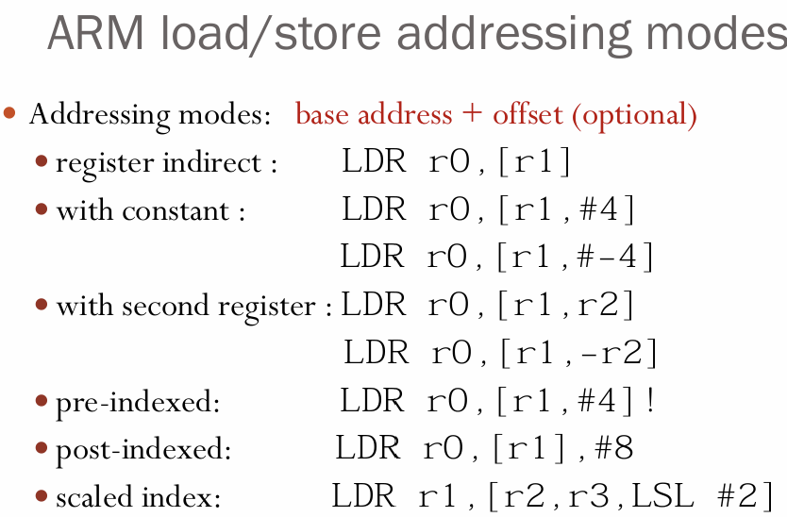
Mem Addressing & Stack
Load/Store only – register, immed + offset, pre/post‑index
PC‑relative literals, stack push/pop (STMDB/LDMIA)
Pointer arithmetic via ADD/SUB on base registers
8‑, 16‑, 32‑bit transfers (multiple instructions), unaligned supported
Full‑descending stack, 8‑byte aligned
MSP for ISR/privileged, PSP for tasks
On interrupt: HW push R0‑R3,R12,LR,PC,xPSR (+ FP regs if active)
Stack origin: value placed in vector table = top of SRAM (0x2000 8000). Size left completely to linker / user.
Notes:
STMDB – Full descending stack

Slide 20
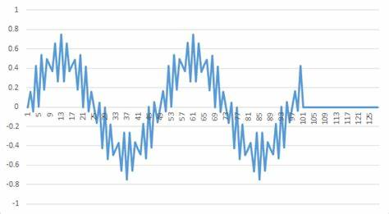
ALU, FPU & CORDIC
32‑bit ALU, single‑cycle ADD/SUB/logic/shift (Integer)
1‑cycle 32×32→32 multiply
flags N, Z, C, V updated on every ALU op; Q (saturation) set on DSP sat instructions.
Single‑precision FPU (1‑cycle MUL, 14‑cycle DIV) (Float)
MULS/MUL 1‑cycle, Long multiply (64-bit result) 2 clock
SMLAL, SMLSD dual MAC DSP ops
CORDIC HW engine (trig): sin/cos, atan, sqrt in < 25 cycles
FMAC 16‑tap FIR at 7 MSample/s
Ideal for FOC, PID, and sensor‑filtering in motor drives

Slide 21
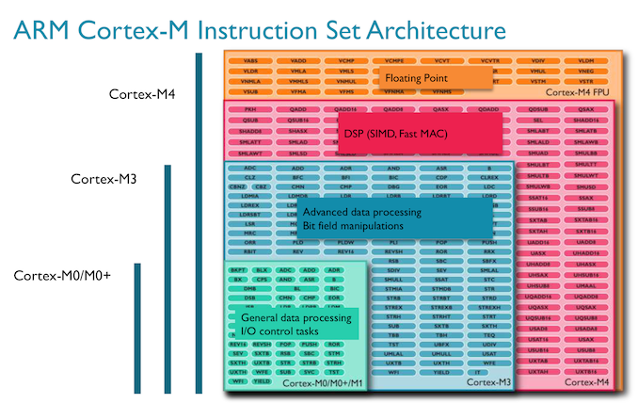
Instructions
Thumb‑2: 16‑bit & 32‑bit mixed encodings
~150 + DSP + FPU mnemonics (>200 encodings)
15 × 16‑bit format groups + 10 × 32‑bit format groups
NOP = 0xBF00; Blocks for 4‑deep exec
[2]

Slide 22
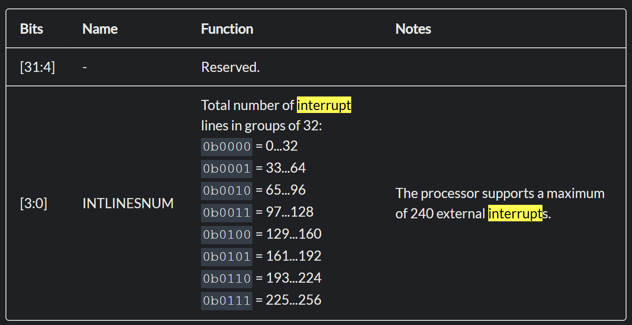
Branching & Interrupts
Unconditional B / BL / BLX (±16 MB)
Conditional B<cond> uses N Z C V flags (EQ, NE, GT…)
NVIC: 240 IRQs, 4‑bit priority fields
Event → NVIC pending bit
Arbitration win = exception entry
LR loaded with EXC_RETURN
ISR executes in Handler mode
BX LR triggers exception return
Tail-chaining / late-arrival
Notes:
Event → NVIC pending bit. Peripheral or GPIO edge sets its bit; NVIC checks priority against PRIMASK (all-off) and BASEPRI (threshold).
Arbitration win = exception entry. If not masked and higher urgency, core finishes current instruction, then auto-stacks 8 registers (R0-R3, R12, LR, PC, xPSR) to the active stack (12 cycles).
LR loaded with EXC_RETURN. Magic value tells hardware how to unwind (Thread/Handler, MSP/PSP). PC is fetched from vector table → ISR starts.
ISR executes in Handler mode. Equal-or-lower interrupts are blocked; code may raise PRIMASK or BASEPRI for inner critical sections.

Slide 23
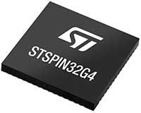
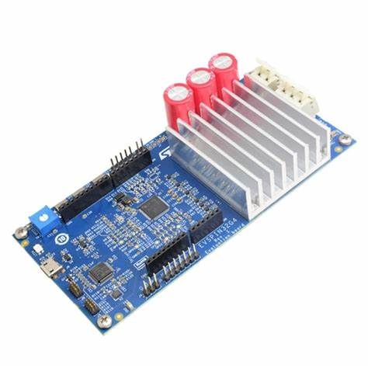
Summary
Arm Cortex-M4 is a powerful 32-bit CPU
Features FPU and FMAC
Simple 3-Stage RISC
STM32G431Vbx3 adds OPAMP, Comparator, and Peripherals
All of this is packaged in one chip, the STSPIN32G4, a great chip solution for Brushless DC motor control, driving mosfets, and processing sensor data
[4]

Slide 24
Sources
[1] https://www.st.com/resource/en/datasheet/stm32g431c6.pdf#:~:text=M%20%3D%2080%20pins%20V,UFBGA%20T%20%3D%20LQFP
[2]
Arm Cortex-M4 Processor Technical Reference Manual Revision r0p1
[3]
ARMv7-M Architecture Reference Manual
[4]
STSPIN32G4 - High performance 3-phase motor controller with embedded STM32G4 MCU - STMicroelectronics

