Slide 1
GROUP 1
Presented By:
Leader : Baliwag, John Dave A.
Angeles, Augustine M.
De Guzman, Nathaniel DL.
Ronquillo, Airish D.
Velez, Robin G.

Slide 2
Project Name
Redgieniel Business Consultancy Record Management System
Date of Project Approval: September 12, 2023

Slide 3
Nature of Bussiness
OFFERED SERVICES:
Barangay/Municipal permit
DTI permit
BIR documents
Pag – Ibig
SSS
PhilHealth
Also renewal of old business and helping clients for new business.

Slide 4
Reasons:
Document Filing
File Loss
Resource and Time Waste

Slide 5
Business Options:
Maintain Current Status
Embrace Proposed System

Slide 6
Expected Benefits:
Reduce File Redundancy
Enhance File Retrieval
Cut Supply Costs
Increase Client Capacity

Slide 7
Expected Downside:
Unpaid Additional Tasks
Decreased Employee Morale

Slide 8
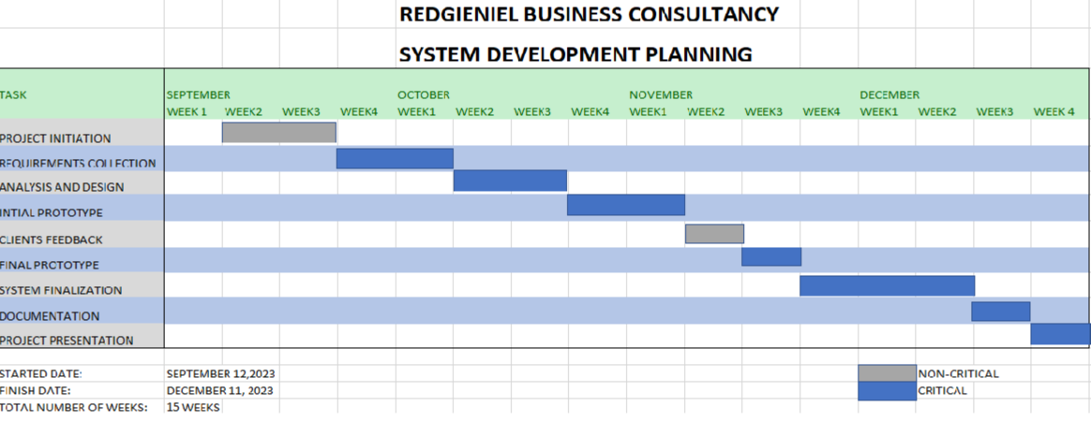
Time Scale:

Slide 9
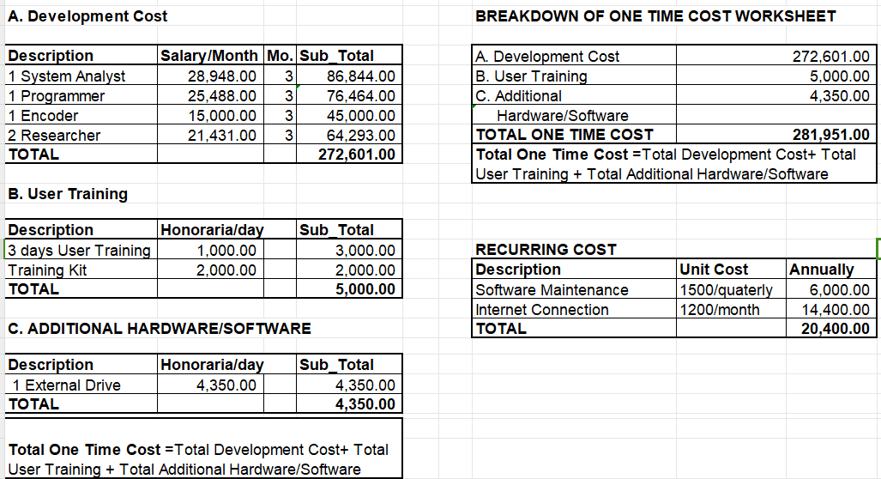
•Cost

Slide 10
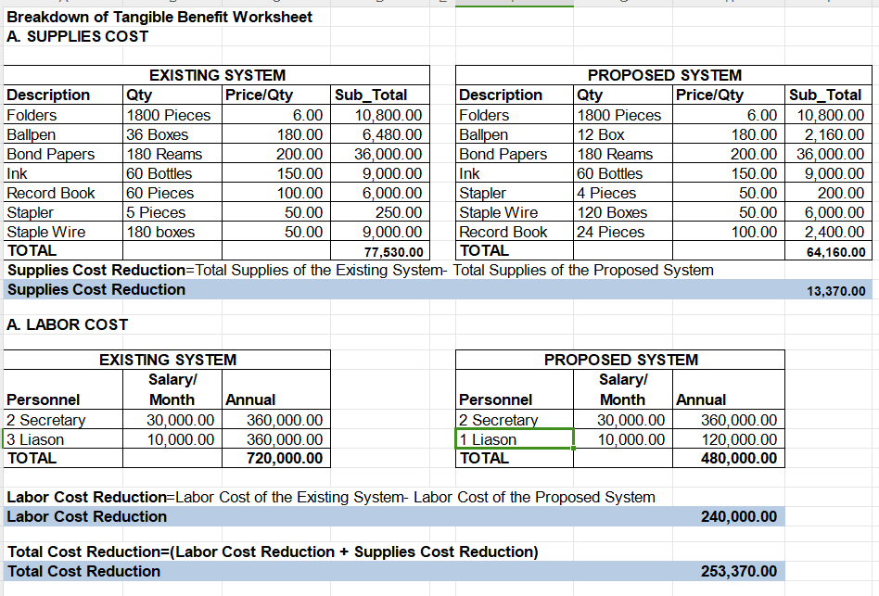
•Benefit

Slide 11
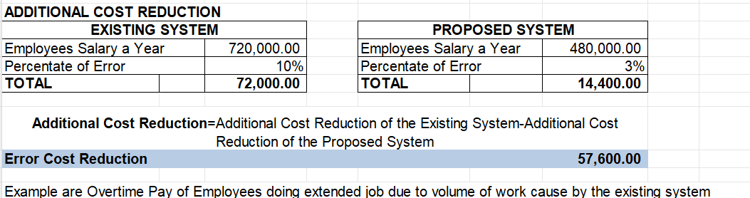

Slide 12
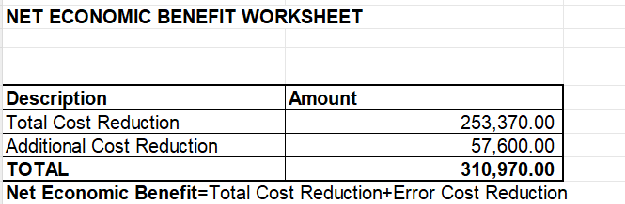

Slide 13
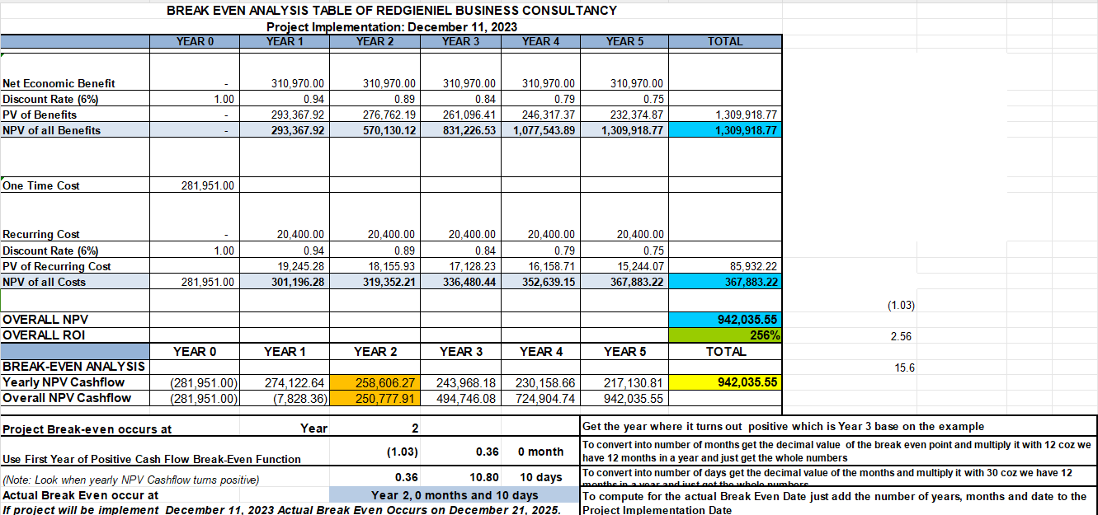
Break-Even Analysis Table and Chart

Slide 14
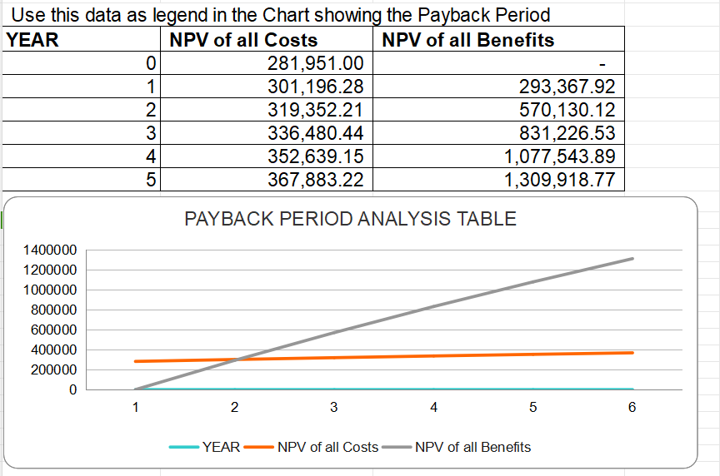

Slide 15
Major Risk
The inexperienced project team conducting the initial data gathering may struggle to specify system requirements, potentially resulting in incorrect system software deliverables and hindering the anticipated project benefits.

Slide 16
Recommendations:
With a return on investment (ROI) of 256% for an initial capital of PHP 281,951.00 and a payback period of 2 years and 10 days, upon thorough examination and contemplation of the suggested information system, We affirm that implementing this project at Redgieniel Business Consultancy is deemed feasible.

