Slide 1
Lesson 1: Interoperability
2019
Notes:
Lesson 1: Interoperability

Slide 2
Lesson agenda
What is Interoperability?
Specification & Command Classes
Certification
Notes:
In this lesson we will be covering:
What is Interoperability?
We will go through our
Specification & Command Classes
And finaly we will be looking into the
Z-Wave Certification Process.

Slide 3

Z-Wave Guarantees All Products Work Together
Notes:
But first, I want to show you a video that in 1½ minute explains how Z-Wave defines interoperability.

Slide 4
What is Interoperability?
Notes:
Let’s look into; What is Interoperability.

Slide 5
Interoperability – What is it?
”Interoperability is the successful interworking of multiple products from multiple manufacturers, for multiple applications, that may be based on multiple versions of ZWave.”
The Z-Wave Certification Overview
Notes:
So interoperability is not just having devices on the same network. They all need to speak the exact same language to be able to speak to each other.
Read the quote on the slide.
That is what we call Interoperability.
We want devices that can lock the doors, set the temperature, switch on and off the lights and control the curtains.
These devices are likely from different vendors and in addition very likely to have been build on different protocol versions.
At the same time, we want to control all these devices from a single app on our smartphone.
This is why we need interoperability. Z-Wave ensures product-to-product interoperability regardless of manufacture and protocol version.

Slide 6

Interoperability is Beneficial
Enables end-user to combine products from different vendors
Enables manufacturers with different competence areas to bring together a complete solution
Provides future-proof investments
Creates a platform for joint promotional activities
Notes:
The benefits of interoperability exist for both partners and end-customers.
For consumers, they can mix products from different vendors, as it is very likely that not one vendor has all the different products in their catalog.
Z-Wave has a 15 year legacy of backwards compatibility, the first ever sold Z-Wave devices will still work in a network of brand new devices.
For partners, they can leverage on other vendors:
Eg: You can develop your best-in-class sensor, without the need of heavily investing in also developing a Gateway
In addition, partners can leverage on the Z-Wave brand and together bring value into the brand by adding more and more products into the Z-Wave eco-system.

Slide 7
More Importantly, Interoperability is Required
Interoperability is required of all Z-Wave devices.
For the device to achieve Z-Wave interoperability the product must pass the Z-Wave Certification program
Only certified Z-Wave devices may carry the Z-Wave or Z-Wave Plus logo.
There are no proprietary implementation or closed ecosystems / walled-gardens with Z-Wave. All devices must coexist and allow usage of the device or devices regardless of make, model, or manufacturer.
Notes:
More importantly; Interoperability is not only beneficial, it is Required!
Every Z-Wave product must be certified,
And only then can it be sold with the Z-Wave logo.
It is worth noting that Z-Wave does not allow any proprietary implementations or closed ecosystems. All devices must coexist and allow usage of the device regardless of make, model or manufacturer.

Slide 8
Specification & Command Classes
Notes:
In this section, we will be looking into the specification: The foundation of interoperability.

Slide 9

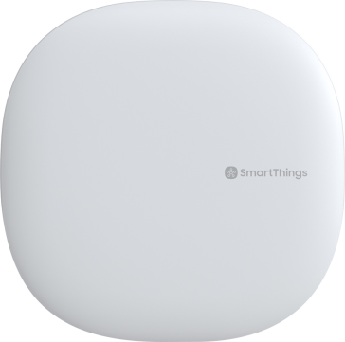
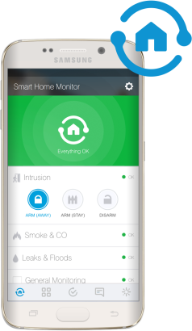
Specification & Command Classes
How does Z-Wave ensure Interoperability?
The device is well described:
Role Device Class: Defines the role in the network.
Device Classes: Describes the type and functionality of a device.
The commands between devices are well defined:
Command classes: The grammar for the Z-Wave language.
Welcome to the network.
I’m a Controller.
I’m an Always-On-Slave
Notes:
So how does Z-Wave ensure interoperability?
By having a clear specification that defines a set of Command Classes.
Let’s start with an example.
The Role Device Class defines the role in the network.
In this example a Controller and a Slave.

Slide 10
Specification & Command Classes
How does Z-Wave ensure Interoperability?
The device is well described:
Role Device Class: Defines the role in the network.
Device Classes: Describes the type and functionality of a device.
The commands between devices are well defined:
Command classes: The grammar for the Z-Wave language.
What type of device are you?
I am a dimmable light switch
Notes:
When the role is known, we need to know which kind of slave device.
This is defined in the Device Class specification.
In this example a dimmable light switch.
Because of the specification, the controller knows how to talk to such a device.

Slide 11

Specification & Command Classes
How does Z-Wave ensure Interoperability?
The device is well described:
Role Device Class: Defines the role in the network.
Device Classes: Describes the type and functionality of a device.
The commands between devices are well defined:
Command classes: The grammar for the Z-Wave language.
Light Switch—Please dim to 90%
Okay
Notes:
The “Z-Wave Language” is defined as Command Classes.
So the controller can send a command asking to turn on the light at 90% intensity.

Slide 12
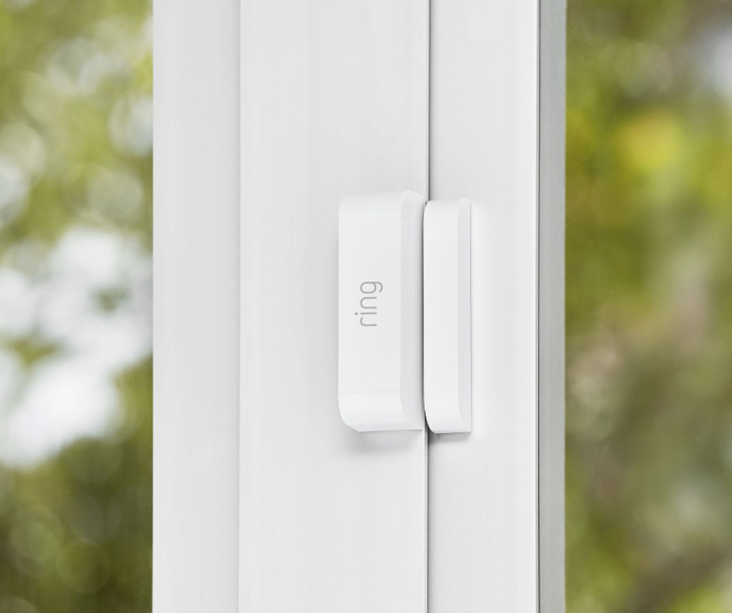
Role Types Specification
Role types
Always On
Can receive and send commands at all times
Is a repeater in the network
Sleeping devices
Battery Powered
Can not be reached by all nodes
Will wake up on timer or on events
Frequently Listening slaves (FLiRS)
Battery Powered
Can be reached by all nodes with latency <= 1s
Will wake up on timer or on events
Notes:
Let’s have a quick look at the specification.
The Role Types Specification provides a high level definition of how Z-Wave nodes must act and react from a networking perspective.
Generally speaking, we divide our devices into 3 categories.
Always On
Sleeping Devices
FLiR
These will be covered in a greater detail in the Z-Wave Fundamentals lesson, so very briefly explained, the
Always On device, is mains powered device, that also acts as a repeater in the network.
Sleeping Devices are battery powered, and will only wake on specific events.
And FLiRS devices are also battery powered, but can still be reached by other nodes with a latency less than 1s. A great example of a FLiRS device is a DoorLock, where we still need minimal power consumption, but we need to be able to lock and unlock the door from our app.

Slide 13
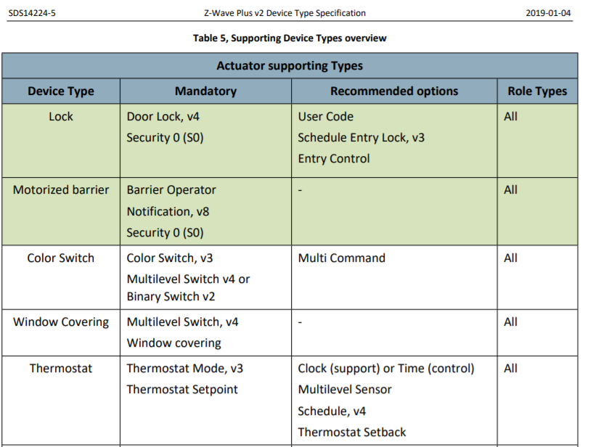
Device Types Specification
Z-Wave Plus v2 Device Type
The functionality of any Z-Wave device is defined by:
Z-Wave Plus v2 Device Type Specification (SDS14224)
The Device Type
Identify the functionality of the device, on the application level
Define expected behavior of the device, on a networking level
Establish a foundation for interoperability
Notes:
The Device Type Specification defines the core functionalities of every Z-Wave device.
Depending on device type, we can identify the functionality of the device on
- an application level described by the mandatory command classes
- And on a networking level described by the role type. As you can see for most device types, it is optional which role type you will be using.
For some device types, we also list a set of recommended options to implement.
These are not required to pass the Z-Wave Certification, but are known to improve the user experience with the product.
As an example, it makes sense to use a Thermostat to also read out the temperature, but it is actually not a requirement.
So this is also where you as a manufacturer can distinguish yourself from your competitors, by implementing optional features that makes your product stand out.

Slide 14
Command Class
A Command Class is a collection of commands used for controlling, querying, and reporting information corresponding to a specific function supported by a device.
Each Command Class is designed for a specific function. It can go from routing and network management all the way up to application functionality.
Foundation for application layer interoperability between devices
All commands sent between devices must be consistent with the commands defined in the Command Class Specifications:
Application Command Classes (SDS13781)
Management Command Classes (SDS13782)
Encapsulation Command Classes (SDS13783)
Network Command Classes (SDS13784)
Notes:
And finally; At the core of the Z-Wave language we have the Z-Wave Command Classes.
Command Classes are a collection of commands used for controlling and reporting information between devices.
Each Command Class is designed for a specific function, ranging all the way from low level networking routing principles and up to application functionality like in what format to send a temperature reading in.
And very important: They serves as the foundation for application layer interoperability between devices because we have a clear definition of how the devices talk to each other.
All commands sent between devices must be consistent with the commands defined in the Command Class Specification (SDS11060-XX) and can be found on Silicon Labs website.

Slide 15
Fundamental Commands
The fundamental commands utilized by most command classes are:
SET: | Used to command a device to perform a specific task(s) or change a setting.
GET: | Used to request information from a device (current status or setting)
REPORT: | Used to send current information or status about the device. Such commands can be sent in response to receiving a GET command or may be sent unsolicited.
Notes:
As a general example, most commands classes consist of a
Set
Get
and a Report.
Set is used to command a device to perform a specific task
An example could be Set Temperature Setpoint to 20 degrees Celsius
Get is used to request information from a device.
So an example could be to request what the Temperature Setpoint is currently set to
Report is used to send information about the device. This is sent in response to receiving a GET command but may be sent unsolicited depending on the type of device, for example when a motion sensor detects movement.

Slide 16
Example Commands
7 | 6 | 5 | 4 | 3 | 2 | 1 | 0
Command Class = COMMAND_CLASS_SWITCH_BINARY
Command = SWITCH_BINARY_SET
Value
7 | 6 | 5 | 4 | 3 | 2 | 1 | 0
Command Class = COMMAND_CLASS_SENSOR_MULTILEVEL
Command = SENSOR_MULTILEVEL_REPORT
Sensor Type
Precision |  |  | Scale |  | Size
Sensor Value 1
…
Sensor Value n
Notes:
Let’s have a look at two examples of Z-Wave Commands as defined by the specification.
The first example is the Switch Binary SET Command, used to switch a device ON/OFF. As shown, the Switch Binary SET Command is part of the Switch Binary Command Class , and includes a 1 byte value for defining ON/OFF.
This is the most simple form a command can be in.
The second example is the Sensor Multilevel Report Command used to report a sensor value, for example a temperature.
The Sensor Multilevel Report Command is part of the Sensor Multilevel Command Class and is send in a response to a Sensor Multilevel Get command.
It includes the following parameters.
1 Byte, Sensor Type to identify the type of sensor reporting, for example temperature.
3 bit’s for Size to indicate the number of bytes used for the value.
2 bit’s for Scale to indicate the unit of the value for example Celsius or Fahrenheit
3 bit’s for Precision to indicate the number of decimal places in the value.
1, 2 or 4 bytes, used for the actual Sensor value

Slide 17









Z-Wave Plus v2 requirements
Basic Command Class:
All actuators must now support Basic
Any controller can control any actuator
Basic Command Class

Slide 18
Extension and Development
The extension and development of the specifications that define application interoperability are driven by the needs of the ecosystem.
The Z-Wave Alliance + Z-Wave Developers + Silicon Labs Z-Wave Specification team
Notes:
I also want to mention, that
the specification and command classes are defined and developed in a collaboration between the Z-Wave Alliance and the Z-Wave developers.
With input from Z-Wave developers, the Silabs Specification team updates existing command classes and writes new command classes as new needs arise for new products.

Slide 19
Certification
Notes:
And finally, I will go through the Z-Wave Certification Process.

Slide 20

Certification Objectives
Z-Wave certification program goal:
Achieve 100% interoperability and backwards compatibility between all vendors
Products are easy to use
High security level on all products
Z-Wave certification program provides:
Clear specifications for products and services
High quality test tools
Notes:
The goal of our Certification program is to ensure interoperability and thus guarantee compatibility between all vendors and ensure backwards capabilities are kept.
While the Command Classes serves the purpose of a defined specification, they can be intérpreted differently resulting in a poor user experience for both manufacturers (and any involved service provider) and the end-users because they expected a different behavior.

Slide 21
Certification Focus
General Z-Wave Compliance - Protocol Version - Device Identification - - Openness and Interoperability with devices from various manufacturers -
Product Documentation - Terminology - Z-Wave Device Usage - Interoperability -
Hardware & RF Performance - Radio RF / Range Performance - Frequency - Design Qualification for Chips -
Z-Wave Network Role Type Functionality - Inclusion - Exclusion - Battery Implementation - Advanced Control Features -
Z-Wave Device Type Functionality - Implementation of Required and Optional Command Classes
Controller Functionality & Minimum Requirements
Z-Wave Brand and Logo Usage
Notes:
Certification focuses on more than just the implementation of the command classes.
This table highlights the different areas.
The
- General Z-Wave Compliance includes protocol version. You must certify a new product on the newest SDK.
- You must have a certain level of documentation for your product.
- You must have a minimum RF performance. But bear in mind the certification tests does not ensure optimal RF performance, you should do your own testing! And this is also one of the areas where you can distinguish yourself from competitors, by having a really good RF performance.
- The device must work as intended by the role type, for example the AOS must also work as a repeater, and a FLiRS device must respond within 1 second
- And the device must have implemented the required command classes which will be tested, including any optional command classes. So if you choose to implement optional command classes, these will also be tested and must also comply with the specification.
- For controllers, controller functionality will be tested, like including different devices.
- And finally, that the Z-Wave logo and QR codes are used correctly.

Slide 22
Certification Reality Check
Certification can be painful…..
If you don’t pay attention to the mandatory requirements
If you don’t use the proper tools
If you don’t pay attention to the process
If you wait until the last minute to do your Market Certification
Notes:
Certification can be painful…..
At least it is, if certification is the last thing you do in your development cycle.
So when designing a new product, remember to think about the specification during your design phase.
Use the device type specification to realize which command classes are required.
Use our compliance test tool during development, to self-test if a command is correctly implemented.
Start on the certification form, early on in your development cycle, to make sure you fully understand the certification requirements in order to plan accordingly.
And remember to join the Z-Wave Alliance, as they are responsible for Market Certification, such as loge usage etc

Slide 23

Certification Overview
Certification requirements are defined by Z-Wave Specifications and input from the Z-Wave Alliance.
https://www.silabs.com/products/wireless/mesh-networking/z-wave/specification
Compliance test tool (CTT)
Allows developers to self-test for device certification
https://www.silabs.com/products/wireless/mesh-networking/z-wave/certification
All devices are submitted using an interactive form on the web-based Z-Wave Plus Certification Portal
https://z-wavecertification.silabs.com/
Test Specifications are included in the online certification portal’s Wiki
https://z-wavecertification.silabs.com/wiki
Notes:
This is a short summary of where to find things.
The full specification requirements along with the self-test tool are available through the Silabs website.
In addition, when using the Online Certification Form to submit your product for certification, a Wiki-page is available for guiding you in how to fill the form.

Slide 24
Thank you!
silabs.com
End of Lesson 1: Interoperability
Notes:
This concludes the lesson on Z-Wave Interoperability.

