Slide 1
Lesson 4: Embedded SDK
2019
Notes:
In this lesson we will be looking into the Z-Wave Embedded SDK offering.

Slide 2
Embedded Development Kit
Z-Wave Libraries Supporting Slave and Controller devices
Sample Applications based on the App Framework
Modular library of robust code
Helps eliminate errors and minimizes the need for custom coding
Streamlined Development time
Notes:
The Z-Wave Development Kit contains mainly 2 parts: The Embedded SDK and the Controller SDK.
The Controller SDK enables you to develop gateways connecting the end-devices to the cloud. We will cover the Controller SDK in the next lesson.
The Embedded SDK is intended to help developers creating Z-Wave compliant products.
The Embedded Kit is designed especially for embedded Z-Wave software and hardware development. The kit includes sample embedded applications for quick prototyping, the Z-Wave protocol is already implemented, and the developer kit includes Z-Wave hardware modules for building prototypes.
In addition, it contains the Zniffer tool for analyzing the RF traffic, which we already saw in the Security lesson.

Slide 3

The Application Framework on Z-Wave 700
Z-Wave 700 running on Silabs Gecko Chip platform !!
Simplicity Studio IDE based on Eclipse
Real Time Operating System (FreeRTOS)
Z-Wave Protocol task
Application task
No polling: All interaction with the protocol is based on events
Low power handled in protocol
Always use lowest possible power mode
Hardware abstraction in applications
Introduced a board header file with the possibility of having implementations for each hardware platform
Notes:
With the Z-Wave 700 release, Z-Wave is now running on the Silabs Gecko Chip platform.
This means you will get all the benefits of the Silabs ecosystem, like the Eclipse based IDE Simplicity Studio, with integrated debugger and energy profiler.
The Z-Wave software now uses a Real Time Operating System to divide the Z-Wave protocol and the application into two independent tasks and using an event driving architecture to ensure no direct function calls between protocol and application.
The protocol handles power management to automatic power down to lowest possible power mode.
While everything has been redesigned, existing customers will find the Z-Wave Framework has been kept, thereby ensuring easy development for both existing and new customers.
[BONUS]
Event driven
Event Queues no callback functions like 500 series
Z-Wave task
Handles communication and protocol events
Application task
Handles application code events
Low Power
Shut down of the processor is handled by the protocol
When the application returns from a function the protocol takes over and performs the shut down based on internal rules for which sleep level is allowed

Slide 4
Protocol
End-device
Product specific code
Certified Application
Application Framework
Security S2
SmartStart
Power management
FLiRS multicast
Z-Wave Protocol
• Security S2
• SmartStart
Z-Wave Module
Notes:
Let’s have a look at the building blocks in an End-Device.
Communicating directly with the Z-Wave hardware module, we have the Z-Wave Protocol running in a separate task.
The protocol module handles everything related to Z-Wave like the Security 2, SmartStart, Routing in the mesh network, Power management of the chip and so on.

Slide 5
Application Framework
End-device
Product specific code
Certified Application
Mandatory Command Classes Implemented
OTA handling
Multichannel
Supervision
Etc…
Utilities for rapid development
Event handling
Sample Apps
Etc.
Application Framework
Z-Wave Protocol
• Security S2
• SmartStart
Z-Wave Module
Notes:
On top of the protocol, we have the Application Framework, also running in a separate thread.
The framework is the foundation of which you will build your application on.
The framework handles all the generic mandatory command classes like OTA, Association, Supervision and Version.
You will then have to implement the required command classes for your device type.
So for a Wall Plug you would have to implement the Binary Switch Command class.

Slide 6
Sample Applications using the Application Framework
End-device
Product specific code
Pre certified code
Switch ON/OFF
Door lock
Power strip
Wall Controller
PIR sensor
Initialisation
Handles incoming events from protocol and drivers
Certified Application
Application Framework
Z-Wave Protocol
• Security S2
• SmartStart
Z-Wave Module
Notes:
The Embedded SDK also ships with a number of Pre-Certified Sample Applications.
The certified applications are build on top of the framework, and implements the needed command classes for the specific device types.
Since the applications are already certified, you basically only need to modify the interface to match your hardware and optionally you can add more functionality in the form of optional command classes.
However, even though the sample applications are already certified you still need to pass certification for your product!

Slide 7
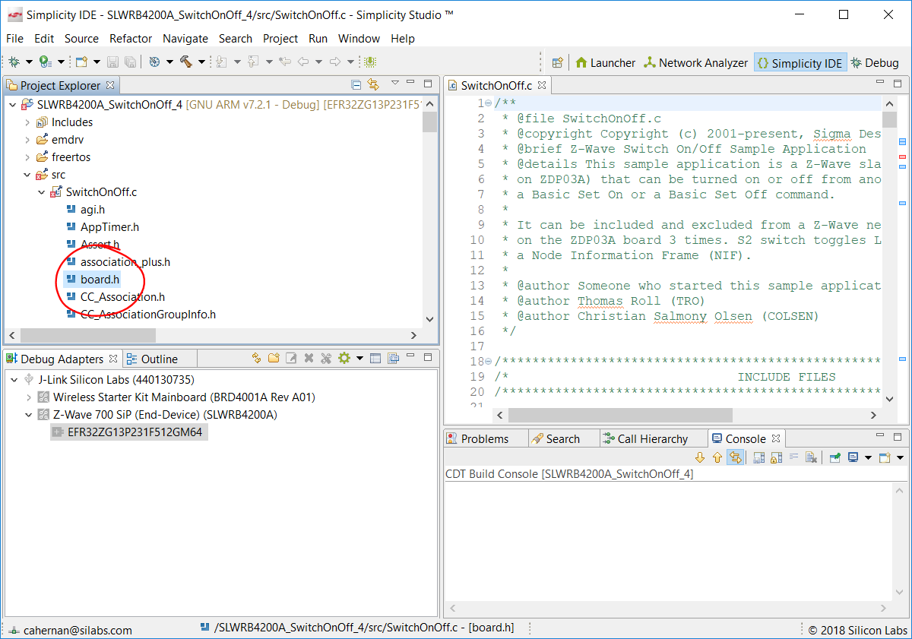
Hardware abstraction in application
Board header file with implementations for each hardware platform so that the rest of the project remains unchanged
Notes:
- Instead of having a file specific to the different platforms like we had in the past where the ZDP03A board would have a file and the ZDB50101 and the ZDB5202 would have a different file
- Now you have one common header file with a set of functions that call upon a C file with our specific dev platform and will call a client’s specific hardware c file

Slide 8
Basic Framework Configuration
Notes:
In this section we will cover how to configure the Z-Wave framework to fit your needs based on the device type you are developing.

Slide 9
Basic Framework Configuration
Configuration needed in 3 files
config_app.h
config_rf.h
Main source file
Notes:
To setup the framework to fit your device, you need to configure 3 files:
config_app.h, config_rf.h and the Main source file of the application.
In the following slides, we will go through these files.

Slide 10
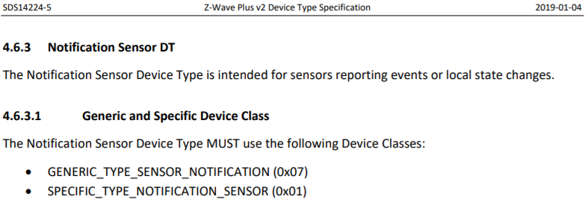
Basic Framework Configuration: config_app.h
config_app.h
Using Spec SDS14224
Configure Role Type: Always On, Sleeping devices, Frequently Listening slaves (FLiRS)
Configure Generic Type and Specific Type.
Notes:
The first step is to configure Role Type and Device Type. This is done in the config_app.h file.
For Role Type you must decide if your device should be Always On, Sleeping or Frequently Listening. For most device types this is up to the developer to decide, but always refer to the Specification to be sure.
For Device Type you must refer to the “Device Type Specification”, which we see an example of here.
For a Notification Sensor Device Type, this could be a movement detection, the generic type is defined as a “Sensor Notification”.

Slide 11

Basic Framework Configuration: config_app.h
config_app.h - example
Configure Role Type: Always On, Sleeping devices, Frequently Listening slaves (FLiRS)
Configure Generic Type and Specific Type.
Notes:
This information is then used in the Application Framework using the “Config_App.h” file.
In this case, our role type is “NOT_LISTENING”. This means we are a battery powered sleeping device.
And the type is configured as defined in the specification as “SENSOR_NOTIFICATION”
These defines already exist in the framework, you just need to fill in the information.

Slide 12
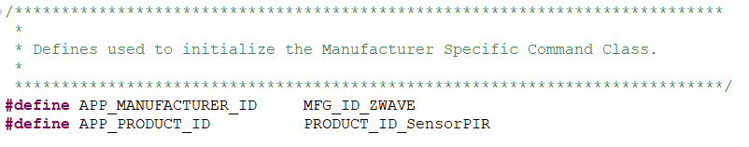
Basic Framework Configuration: config_app.h
config_app.h (continued)
Manufacturer Specific CC
APP_MANUFACTURER_ID
APP_PRODUCT_ID
Example:
Notes:
The manufacturer and product ID’s are used to identify a Z-Wave product from a manufacturer point of view.
Other applications can also use this information to show a company logo, type of product, user guide, etc. on the user interface.
This information is exchanged via the Manufacturer Specific CC and is also defined in the “Config_App.h” file, and the IDs are issued by the Z-Wave Alliance.

Slide 13
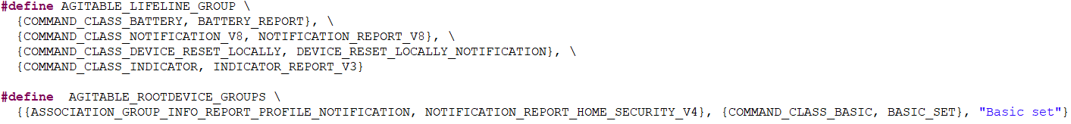
Basic Framework Configuration: config_app.h
config_app.h (continued)
Association Group Information (AGI)
Lifeline
Other groups?
Example:
Notes:
For Association Group Information you must define the Lifeline group and optionally any other groups.
We saw an example of this in the Fundamentals Lesson, where a Motion sensor sends notifications to both the lifeline, which is the gateway, and to other devices like a Siren and a Lamp.
This is how we would implement that in the framework;
The sensor reading is mapped to the Lifeline group, together with a battery level and other relevant information.
Then we have another group which handles local application functionality such as turning on a lamp based on movement by sending a Basic Set.

Slide 14

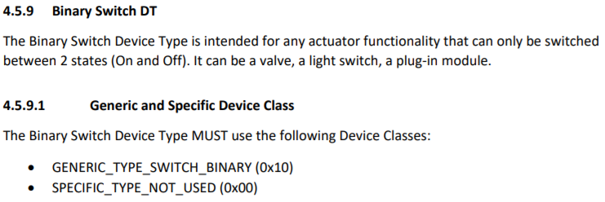
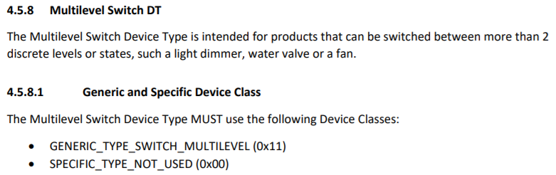
Basic Framework Configuration: config_app.h
config_app.h (continued)
Endpoint: Example of PowerStrip
Endpoint 1 Device Type: Binary Switch
Endpoint 2 Device Type: Multilevel Switch
Notes:
Text needs update…
Each endpoint specifies a set of device and command classes supported and can be controlled individually.

Slide 15
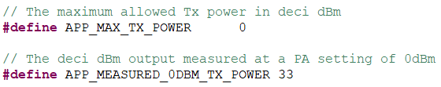
Basic Framework Configuration: config_rf.h
config_rf.h
Two parameters for configuring TX power
APP_MEASURED_0DBM_TX_POWER is for tuning of TX power to 0 dBm in a conducted environment. During the turning process, 'APP_MAX_TX_POWER' should be 0 (0dBm).
APP_MAX_TX_POWER is a value from -100 to +100 deci dBm (-10dBm to +10dBm) and is for adjusting TX power by the application framework after completion of TX power tuning.
Notes:
In the config_rf.h file you configure the output power of the device.
This is defined by using 2 variables called APP_MEASURED_0DBM_TX_POWER and APP_MAX_TX_POWER.
This needs to be done on the finished product, with the actual hardware and antenna design.
The first step is to calibrate the output power to 0 dBm. This is done by setting APP_MAX_TX_POWER to 0, and
then use APP_MEASURED_0DBM_TX_POWER to tune the TX power in a conducted environment.
After this, the APP_MAX_TX_POWER parameter can be used to set the desired output power in dBm.

Slide 16
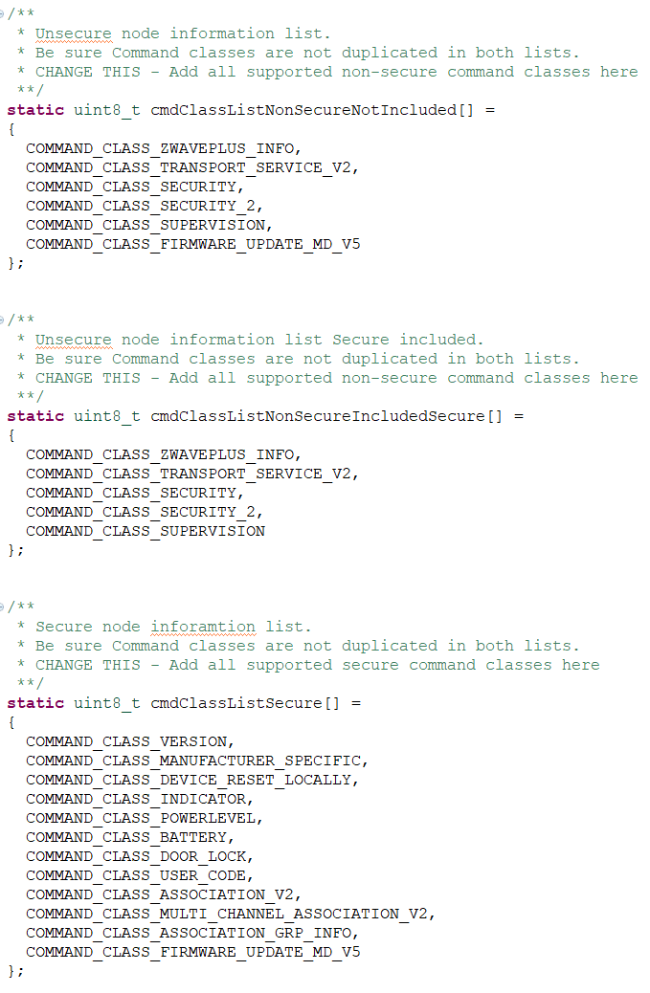
Basic Framework Configuration: main source file
Main source file
Supported Command Classes by device
cmdClassListNonSecureNotIncluded[]
cmdClassListNonSecureIncludedSecure[]
cmdClassListSecure[]
Example
Door Lock Command Class is only added to cmdClassListSecure !!
Notes:
And finally we must include the needed command classes in the main file.
The command classes are added to the cmdClassLists, which are divided based on security.
These are already defined in the framework, and implemented with all the general command classes. You only need to add your specific command classes based on the device type.
As an example, the Door Lock Command Class should only be added to the cmdClassListSecure, because
we only want the controller to be able to talk with the Door Lock securely.
[BONUS INFO]
cmdClassListNonSecureNotIncluded (NIF, before inclusion)
when the node is not included or non-securely included.
cmdClassListNonSecureIncludedSecure (NIF, after secure inclusion (support when unsecure))
represents the Command Classes that are supported non-securely even though the device has been securely included.
cmdClassListSecure (Secure Cmds Supported Report)
when node is securely included. It contains the Command Classes that are supported securely only.

Slide 17
Basic Framework Configuration: Done!
Main source file
All basics configurations are now done!
Role Type
Generic Type + Specific Type
Manufacture ID + Product ID
AGI: Lifeline + other groups
TX power tuning
Support for application command classes
Next Step: Implement your application logic!
Notes:
This completes the configuration needed for developing a new application using the framework.
We have now setup the
Role Type, this could be a Sleeping devices.
Generic Type + Specific Type, this could be a Notification Sensor
Manufacture ID + Product ID, so other devices know which logo to display in the user interface
Association Group Information, including the Lifeline + other groups, so our gateway gets the notifications from our sensor
We know how to tune the output power.
And we have added support for application command classes.
Now we just need to implement the actual application logic. Yah!

Slide 18
Framework Flow
Notes:
In order to implement our application logic, let’s dig into the flow of the framework.

Slide 19
Framework Flow
Overview of framework flow
Functions in the main file you need to know
ApplicationInit Initialize the application.
ApplicationTask Setup of events and IO.
Transport_ApplicationCommandHandlerEx Incoming RF frames
AppStateManager Core state machine of framework
CommandClass functions, e.g. CC_Basic_Set_handler Application logic for various command classes
Notes:
This is the flow you will encounter the functions in in the main source file:
ApplicationInit is used by the framework to initialize the application.
ApplicationTask
Setup events and this is where you configure your IO.
Transport_ApplicationCommandHandlerEx
This is where you will received the incoming RF frames
AppStateManager
The core state machine of this sample application, and typically where you need to add your own functionality
CommandClass functions, e.g. CC_Basic_Set_handler
This is where you will implement the application logic for the various command classes.
[BONUS]
ApplicationTask is a RTOS task. RTOS task wait & process of events.

Slide 20
Framework Flow
AppStateManager: States
Depending on functionality, the most common states are
STATE_APP_STARTUP Init state
STATE_APP_IDLE The ‘looping’ state, if no other states
STATE_APP_LEARN_MODE Inclusion, SmartStart, etc.
STATE_APP_RESET “DeviceResetLocally”
STATE_APP_TRANSMIT_DATA Usually used for sending data (e.g. notifications)
STATE_APP_POWERDOWN Waiting for power down….
Notes:
Depending on the functionality, and mainly depending on the role type, these are the most common states in the AppStateManager.
Most of the states are used by the framework, for example the Startup and Learn_Mode state.
The states you most likely need to know are Idle and Transmit_Data.
The “Idle state” is our looping state, meaning this is the state we will be in, while waiting for incoming events.
When a event is received, we typically switch to another state.
That could be the “Transmit Data” state, where we usually send out data, for example a notification.

Slide 21
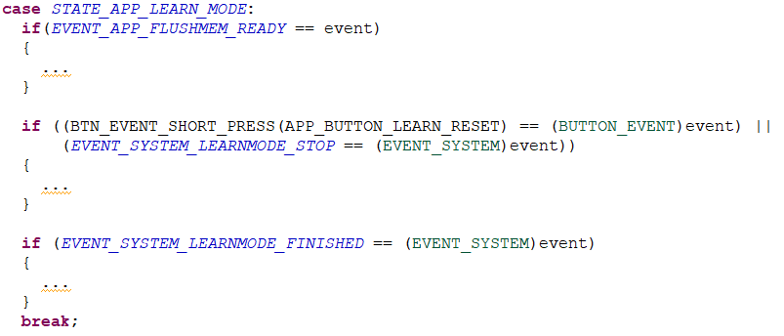
Framework Flow
AppStateManager: Events
Each state has the option of executing multiple events.
Example: State Learn Mode
Notes:
Each state then has the option of executing multiple events.
In this example we have instructed our state machine to go to state State App Learn Mode,
Which is a state that is already implemented by the general framework.
While we are in this state we can execute several events depending on what we receive, e.g.
events from button presses or events that can be thrown from other parts of the code.

Slide 22
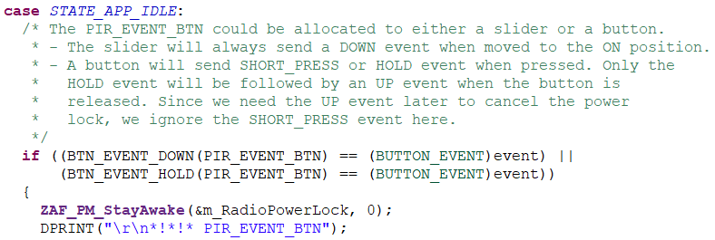
Framework Flow
AppStateManager: Events
Each state has the option of executing events.
Example: State App Idle
Notes:
The same goes for this example from State App Idle.
If we received an external interrupt from the Pir_Event_Btn we execute the code for that event.

Slide 23
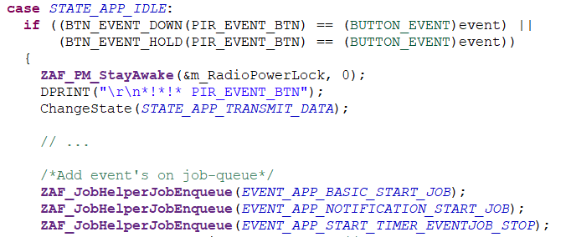
Framework Flow
AppStateManager: Events
Add events to the job queue
Notes:
Usually, when an event is received in the Idle state, we want the state machine to go to another state.
So in the example from before, where we received an external interrupt from the Pir_Event_Btn,
we then instructs the state machine to go to state “Transmit Data” and add 3 job-events to the queue.
The state machine will go to the state “Transmit Data” and process the events in the queue.
When the queue is empty, it will return to the Idle state, waiting for new interrupts.
Now, we could then find the Transmit Data State in the code and explore what these events do, but I will
leave that as an exercise for you to explore further on your own.

Slide 24
Power Management

Slide 25
Energy Modes
Available energy modes
EM0 Active | Radio available for RX or TX, flash memory access
EM1 Sleep | MCU sleeping. Radio available for RX or TX, flash memory access
EM2 Deep Sleep | Memory and registers retain their values, HF clocks inactive
EM3 Stop | Memory and registers retain their values, LF clocks inactive
EM4 Shutoff | MCU completely shut down. No RAM retention. Only wakeup by reset and external interrupts.
Notes:
The Z-Wave chip provides several low energy modes (EM). Each energy mode manages whether the CPU and the various peripherals are available.
These modes are identical to other Silabs Gecko chips, where
EM0 Active mode provides the highest number of features, enabling the CPU, Radio, and peripherals with the highest clock frequency.
and down to
EM4 Shutoff Mode which provides the lowest power state, only allowing the chip to return to EM0 Active on a specific wake-up condition.

Slide 26
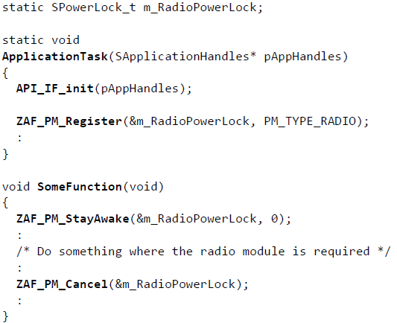
The Z-Wave Power Manager
Power Manager
Z-Wave Protocol controls the energy mode
Will always go to sleep mode if possible
Power Locks
lock the chip from entering sleep mode.
Power Lock Type
PM_TYPE_RADIO don’t enter EM2/EM3/EM4
PM_TYPE_PERIPHERAL don’t enter EM3/EM4
Notes:
The Z-Wave Power Manager is owned by the Z-Wave protocol thread and controls what energy mode the
RTOS should go to when idle.
The protocol will always try to go to sleep mode, if not instructed otherwise.
This means you do not have to put the Z-Wave module to sleep – you need to make sure it is awake for your functionality to be executed.
It uses the concept of Power Locks where regions of code can lock the
chip from entering a specific energy mode.
An example is shown here, where we use ZAF_PM_StayAwake and ZAF_PM_Cancel around the code we need to be executed.
The Power Manager keeps track of all the power locks and
ensures that the chip does not at any time enter a power mode lower than what is currently requested.

Slide 27
The Development Kit
Notes:
Let’s have a look at the Z-Wave Development Kit.

Slide 28
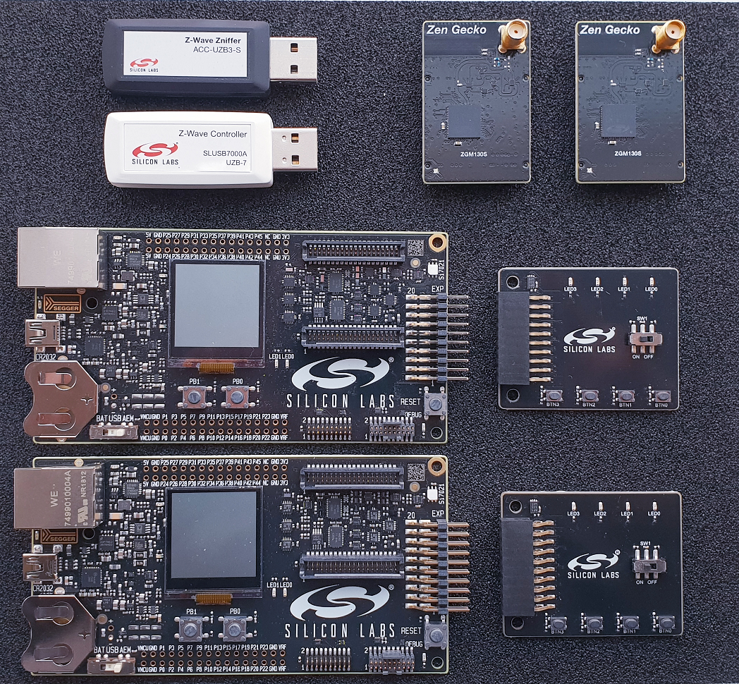
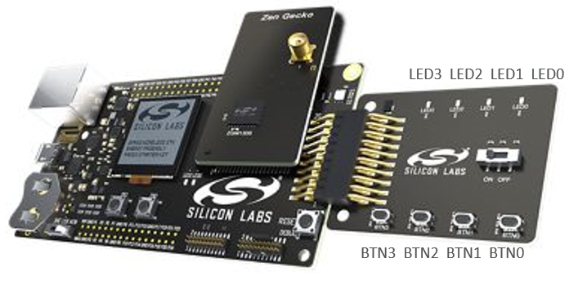
Development Kit
The hardware in the kit
WSTK Main Development Board, 2 pcs.
BRD4200A (BRD4202A) Radio Board with ZGM130S
BRD8029A EXP Board, 2 pcs.
UZB7 Controller USB Dongle
Zniffer USB Dongle
Notes:
The kit contains 2 WSTK Main Development Boards.
These are generic Silabs boards used for many different modules.
It contains a display, a temperature sensor, a Segger debugger and easy access to peripherals.
We then have 2 Expansion boards, with several buttons and LEDs that we use in the sample applications that ships with the Z-Wave SDK.
We have 2 radio boards with the Z-Wave SiP module, which can be used for both slave and controller development.
And finally we have a Zniffer to capture Z-Wave RF packages
And a Z-Wave Controller used to build a Z-Wave network.

Slide 29
Thank you!
silabs.com
End of Lesson 4: Embedded SDK
Notes:
This concludes the lesson on the Z-Wave Embedded SDK.

