Slide 1
EmberZnet and WSTK
2019
Notes:
Welcome to the training. In this training, we will introduce the SDK and starter kits of Silicon Labs’s Zigbee solution.

Slide 2
Agenda
Overview
Wireless Gecko Socs
Software
Development Tools
Notes:
Here is the agenda of this training. We will start with three aspects, the Socs, software and SDK and development tools.

Slide 3

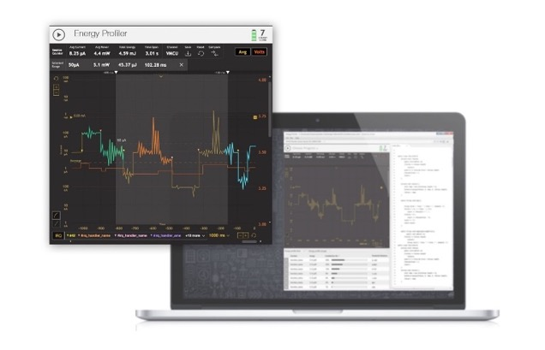
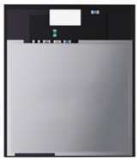

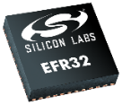
Zigbee Portfolio
SoCs + Modules
Software
Development Tools
Notes:
Silicon Labs provides IoT solutions that include hardware, software and tools.
Lets take a look at the Wireless Gecko series Socs first

Slide 4






Wireless Gecko Socs
 | Mighty Gecko 256 to 1024 kB 40+ Parts | 2.4 GHz | 2.4 GHz | 2.4 GHz | 2.4 GHz Sub-GHz
 | Blue Gecko 128 to 1024 kB 50+ Parts |  |  | 2.4 GHz | 2.4 GHz Sub-GHz
 | Flex Gecko 32 to 1024 kB 40+ Parts |  |  |  | 2.4 GHz Sub-GHz
Notes:
As you can see from this slide there are 3 different families in the Wireless Gecko portfolio that support different wireless standards.
Mighty Gecko is the superset part. While it is focused on 2.4 GHz mesh, including zigbee and Thread, it supports Bluetooth Low Energy and can support both 2.4 GHz and sub-GHZ for proprietary applications. This makes it a great option for customers that want a single design to support multiple options or want the capability for a single product in the field to support multiple protocols. With 256K to 1meg of Flash and over 40 parts, including SoCs and modules, it is the ideal multi-protocol solution.

Slide 5




Mighty Gecko SoC Comparison
 |  | EFR32MG1 | MG12 | MG13 | MG21-New
Protocols |  |  | + BT 5 (2 Mbps) | + BT 5 (2 Mbps & Long Range) | + BT 5 (2 Mbps)
Freq. Bands |  | 2.4GHz + Sub-GHz | → | → | →
Core |  | Cortex-M4 (40 MHz) | → | → | Cortex-M33 (80 MHz)
Max Flash |  | 256 kB | 1 MB | 512 kB | 1 MB
Max RAM |  | 32 kB | 256 kB | 64 kB | 96 kB
Security |  | AES-128/-256, ECC, SHA-1/-2 | + TRNG | → | + TRNG TrustZone
TX Power |  | +19 dBm | → | → | →
802.15.4 Sensitivity |  | -99 dBm | -102.7 dBm | → | -104 dBm
Active Current |  | ~60 µA/MHz | → | → | ~50.9 µA/MHz
Sleep Current |  | 2.5 µA | 1.5 μA | → | 4.5 μA
TX Current @ +0 dBm |  | 8.2 mA | 8.5 mA | → | 9.3 mA
RX Current (BLE) |  | 8.7 mA | 10.0 mA | → | 8.8 mA
Operating Voltage |  | +1.85 - 3.8V | +1.8 – 3.8V | → | +1.71 – 3.8V
Max GPIO |  | 31 | 65 | 31 | 20
Other |  | IDAC | VDAC, LESENSE, OPAMP, Cap Sense | VDAC, LESENSE, OPAMP, Cap Sense, PLFRCO
Notes:
Now let’s take a look at the Mighty gecko series products.
We have four device families in Mighty Gecko series, MG1, MG12, MG13 and MG21.
The transmitting power of each can be up to 19dbm.
For MG21 family, we have different flash size from 512KB, 768KB and 1MB.

Slide 6

EFR32MG12 Wireless Gecko
CPU and Memory
ARM Cortex-M4 w/ FPU + MPU | 1 MB Flash | ETM
Debug Interface | 256 kB RAM | LDMA Controller
Clock Management
High Freq Crystal Osc | High Freq RC Osc
Auxiliary RC Osc | Ultra Low Freq RC Osc
Low Freq Crystal Osc | Low Freq RC Osc
Energy Management
Voltage Regulator | Voltage Monitor
DC-DC Converter | Brown-out Detector
Power-on Reset
Security
Crypto AES, ECC, SHA
CRC32
TRNG
EM0
Run
Feature available down to Energy Mode
EM1
Sleep
32-bit bus
EM2
Deep Sleep
Peripheral Reflex System
EM3
Stop
Serial Interfaces
4x USART | Low Energy UART
2x I2C
I/O Ports
External Interrupt | Up to 65 GPIO (5V Tol)
Pin Reset | GPIO Wakeup
Timers and Triggers
4x Timer/ Counter | Low Energy Timer
LESENSE | Watchdog
Pulse Counter | Protocol Timer
RTC | Cryotimer
Analog Modules
ADC | 2x Analog Comparators
IDAC
VDAC & OPAMP | Cap Sense
Radio
2.4 GHz (int. balun) | Sub-GHz
Integrated PA | Radio Controller
Packet Trace | Radio Crypto
EM4H
Hibernate
EM4S
Shutoff
Notes:
As you can see from the block diagram, Mighty Gecko is a full featured MCU and wireless SoC.
The part shown is the EFR32MG12 that was launched in March of 2017, but there are other products in the portfolio that provide developers with the exact features set they need.
The MCU is based on Gecko technology so not only does it provide a rich set of peripherals, but also offers exceptional low power capabilities. Low power is more then just low active and sleep states. It is about how the entire system operates in these modes and how quickly it can switch between them. The shaded blocks show what operating modes the feature can operate in. You will notice that a significant amount of blocks can work in the deeper sleep modes, which dramatically reduces power consumption of the system. Features like LESENSE and PRS allow for autonomous operating of peripherals, lowering system power consumption.
With up to 1024k of Flash and 256k of RAM developers have the memory to support not only multi-protocols, but also complex applications. Advanced energy management provides for voltage support for from 1.8 to 3.8 volts and the DCDC ensure low active and sleep currents.
Serial I/O includes up to 4 USARTs, 2 I2C and even a low energy UART that is supported all the way down to deep sleep. The device can support both 16-bit and 32-bit timers with up to 3 PWM per timers.
Features like LESENSE and Pulse counters are ideal for flow meters while the integrated cap sense provides a great option for removing mechanical switches from applications.
The radio has options for both 2.4 GHz and sub-GHz with output power up to +20 dBm and excellent sensitivity eliminates the need for costly front end modules.
And of course, no system is complete without the necessary security blocks to offload the cryptos required for IoT devices.
Wireless Gecko brings together all the critical components for the ultimate IoT hardware platform.

Slide 7
Software
SoCs + Modules
Software
Development Tools
Notes:
Now let talk about Zigbee software and stack.

Slide 8
Silicon Labs Zigbee Options
Network Co-Processor
SoC
Host
Application Profiles
(defined by Zigbee and OEMs)
Initiate and Join Network
Manage Network
System-on-Chip (SoC)
Determine Device Relationships
Send and Receive Messages
- IEEE 802.15.4 compliant radio
- Integrated microcontroller
- Integrated peripherals (ADC, encryption engine, GPIO, etc.)
- Lowest system cost
EZSP
Network Organization
Zigbee Pro Feature Set
NCP
Zigbee
(defined by Zigbee Alliance)
- Self-contained Zigbee Stack
- Dedicated function device
Route Discovery
Message Relay
Device Discovery
Security
Radios
(defined by IEEE 802.15.4)
Medium Access
Physical RF
Notes:
Silicon Labs provides two models for Zigbee design: the SoC model, and the NCP model.
In the SoC model, all stack layers as well as the application are implemented on a single chip, with lower level stack functions implemented in hardware as peripherals of the microcontroller.
Access to the stack functionality here is generally provided as library API calls.
In NCP model, the stack and low-level radio functionality all reside on one chip for best integration and efficiency where the stack features are concerned.
However, the application interface to the stack is through a serial interface such as SPI or UART, rather than a library of function calls.
The host and NCP uses a proprietary serial protocol to exchange data. The protocol is named EZSP, which is short for EmberZnet serial protocol.
This model allows for great flexibility on the application design and the host processor architecture. It allows the application designer to ignore many implementation details about the stack itself. You may

Slide 9
Bootloader
Type
Bootloader-Xmodem-UART | Also called standalone bootloader. Mainly used on NCP.
EZSP-SPI-Bootloader | Similar to the above one, use SPI instead of UART. Mainly used on NCP.
Internal Storage Bootloader | Used on Soc. Store new image in internal flash.
External Storage Bootloader | Used on Soc. Store new image in SPI flash.
Type | Pre-built
Bootloader-Xmodem-UART | platform\bootloader\sample-apps\bootloader-uart-xmodem
EZSP-SPI-Bootloader | platform\bootloader\sample-apps\bootloader-spi-ezsp
Internal Storage Bootloader | platform\bootloader\sample-apps\bootloader-storage-internal-single
External Storage Bootloader | platform\bootloader\sample-apps\bootloader-storage-spiflash-single
Notes:
For Zigbee projects, we have four types of bootloader. The purpose of using a bootloader is to support upgrading.
First, Bootload-xmodem-uart and EZSP-SPI-Bootloader, also called as standalone bootloader. Normally used in NCP. When ncp needs to upgrade, it will reset and stay at bootloader stage. Then the host will transfer the new ncp image through xmodem and overwrite the current ncp image.
Then we have internal storage bootloader and external storage bootloader. These two are mainly used for Soc applications. The difference is where the new image is saved.
With internal storage bootloader, new image will be saved in internal flash.
With external storage bootloader, new image will be save in external flash.
We have already provided some pre-built bootloader for some of our starter kits.

Slide 10
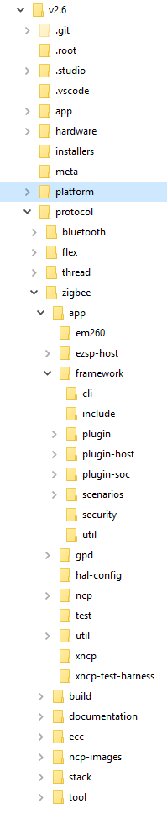
EmberZnet SDK
Resources
protocol\zigbee\documentation
protocol\zigbee\app\framework\plugin
protocol\zigbee\app\framework\plugin-host
protocol\zigbee\app\framework\plugin-soc
Notes:
This is the directory hierarchy of the SDK.
In the documentation folder, you can find many documents of our SDK. Those are good learning materials.
Most part of the SDK are provided by plugins, and most of the plugins are open-sourced.

Slide 11
Development Tools
SoCs + Modules
Software
Development Tools
Notes:
Now I will introduce our develop tools.

Slide 12




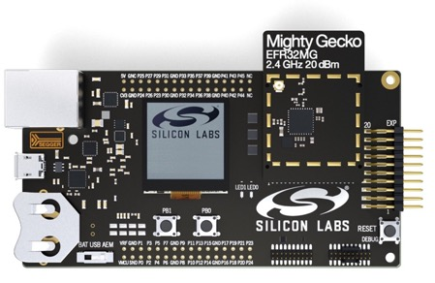
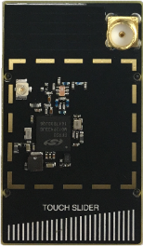
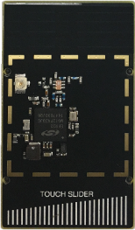
Wireless Starter Kit
+
Wireless Starter Kit
Swappable Radio Boards
Notes:
Silicon Labs has a great development platform based on the Wireless STK and radio boards.
The Wireless STK provides the starting point for development providing the hardware and access to mesh software.
Different radio boards for both SoCs and modules plug into the WSTK main boards, providing a unified development platform from both the hardware and software perspective.
The mother board of the starter kit can be used as a debugger. It can be used to debug custom board as well as our develop kits.

Slide 13
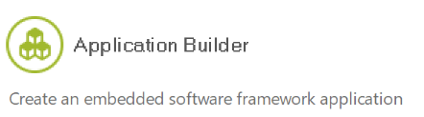
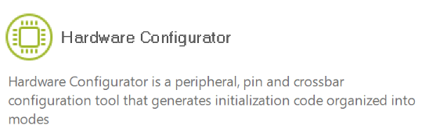

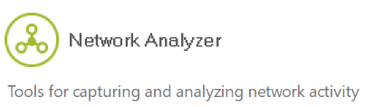
Tools
Notes:
Then we will talk about our tools. Our IoT projects are developed through Simplicity Studio, which is a super IDE, and many useful tools are integrated in it.
For Zigbee applications, we usually use AppBuilder, Hardware Configurator and Netowork Analyzer.

Slide 14
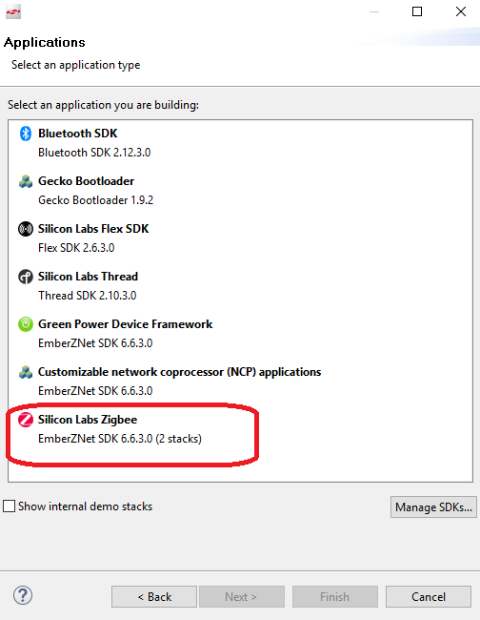
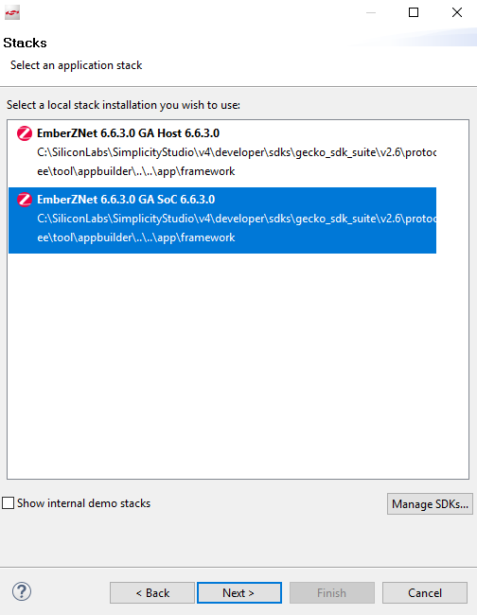
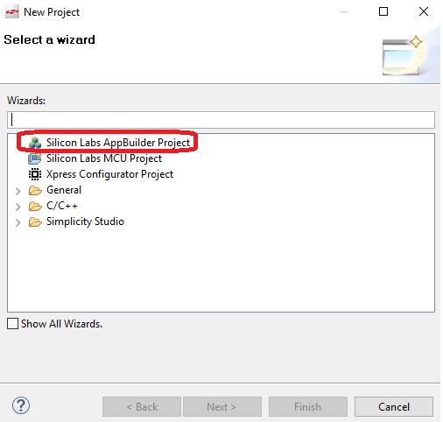
Create a Zigbee Project – 1/2
“File”→”New”→”Project”
Choose “Zigbee” Application
Choose “SoC” Architecture
Notes:
First I’ll show you how to create a Zigbee project.

Slide 15
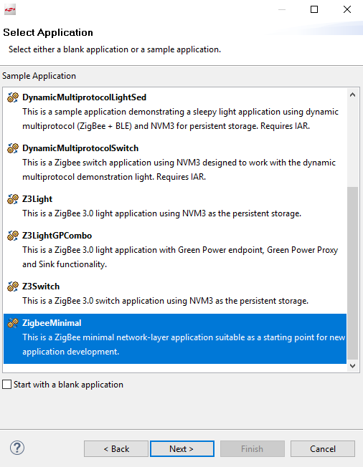
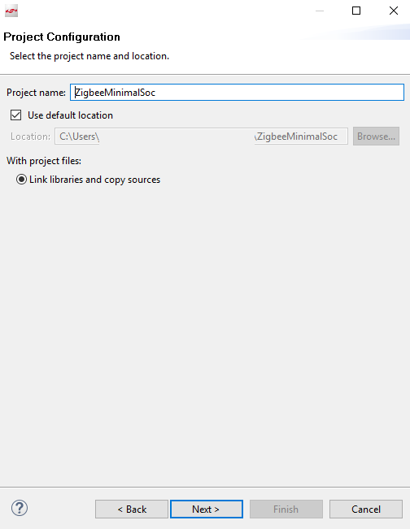
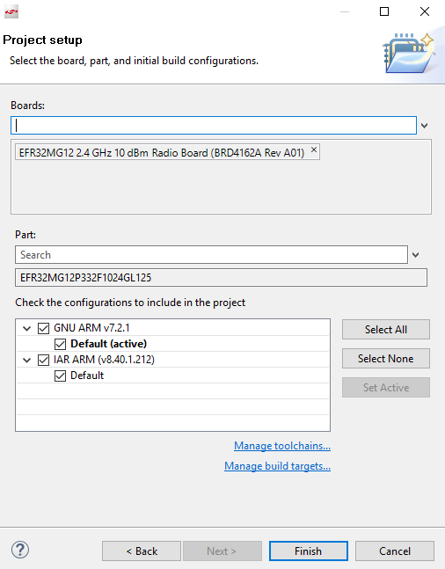
Create a Zigbee Project – 2/2
Choose example or start from minimal
Name project
Choose “Board”/”Part” and toolchain
Notes:
In the “Borads” field, if you are using a starter kit, you can just select one from the list. If you are using a custom board and you are familiar with Silicon Labs’s solution, you can leave this field empty and just select the part.
Otherwise, you should select a starter kit which has the closest part with yours.

Slide 16

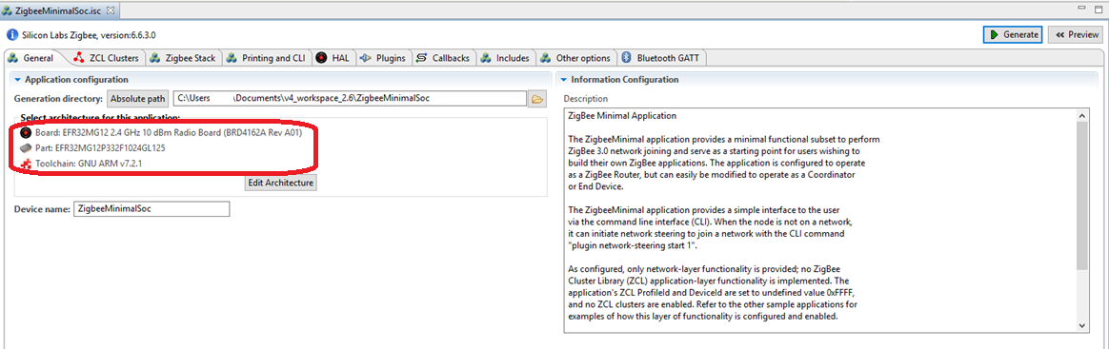
AppBuilder - General
Initial project files
Notes:
In “General” tab, you can see the board/part and toolchain. You can also change them here. Just remember that you need to save and generate the project after you changed.

Slide 17
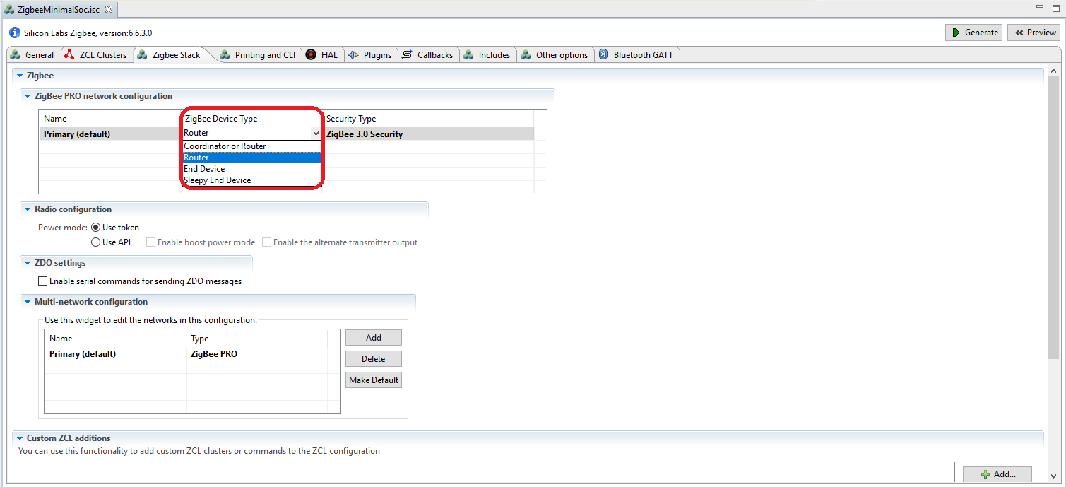
AppBuilder - Stack
Notes:
In the “stack” tab, you can choose the device type. Here you can choose it as a coordinator, router, end device or sleepy end device.

Slide 18
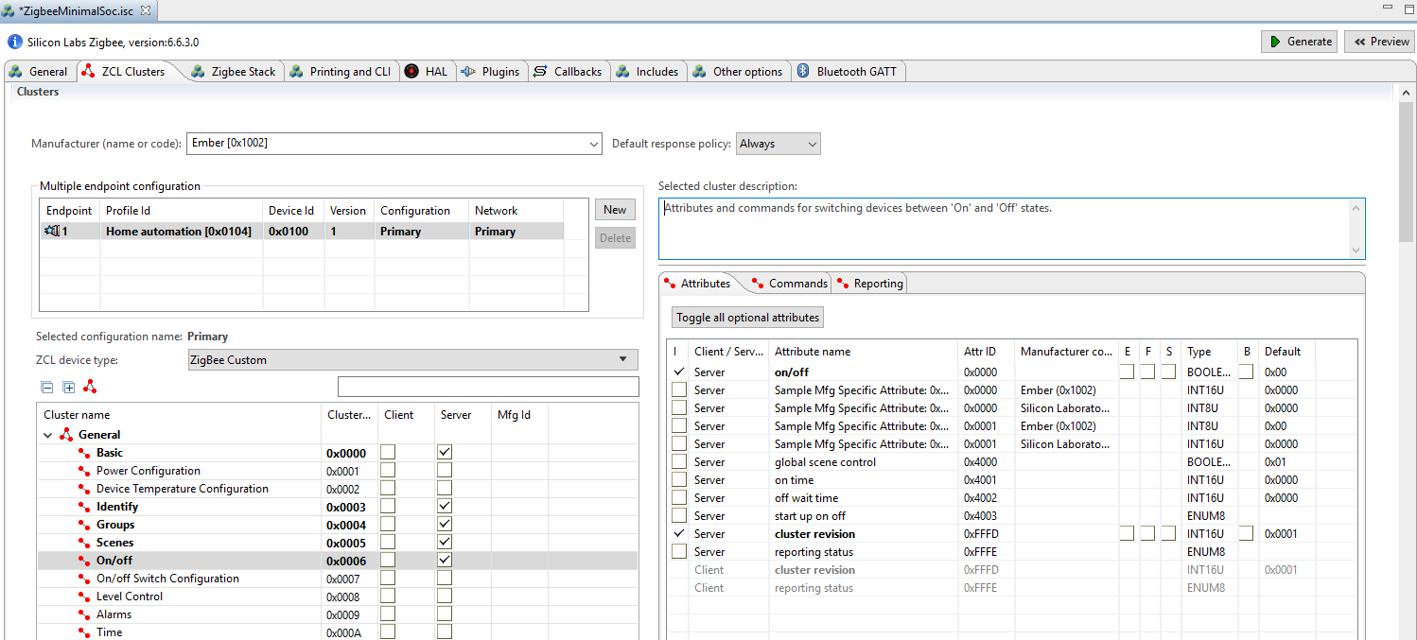
AppBuilder – Cluster Attributes
Notes:
In “ZCL Clusters” tab, you can configure the endpoint and clusters in the endpoint.
Each cluster has a client side and a server side. You need to select the right side according to your design.
You would also need to select the corresponding attributes.

Slide 19
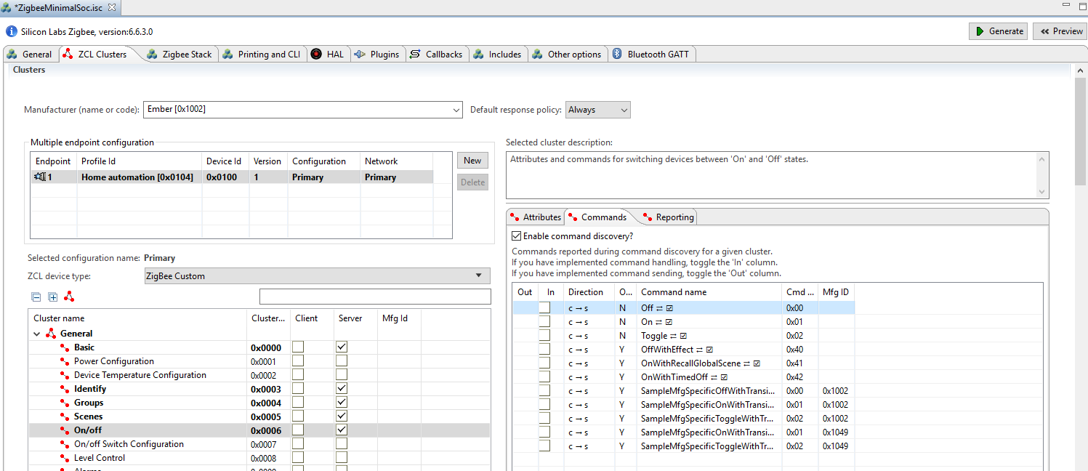
AppBuilder – Cluster Commands
Notes:
You would also need to select the corresponding commands of the selected clusters.

Slide 20
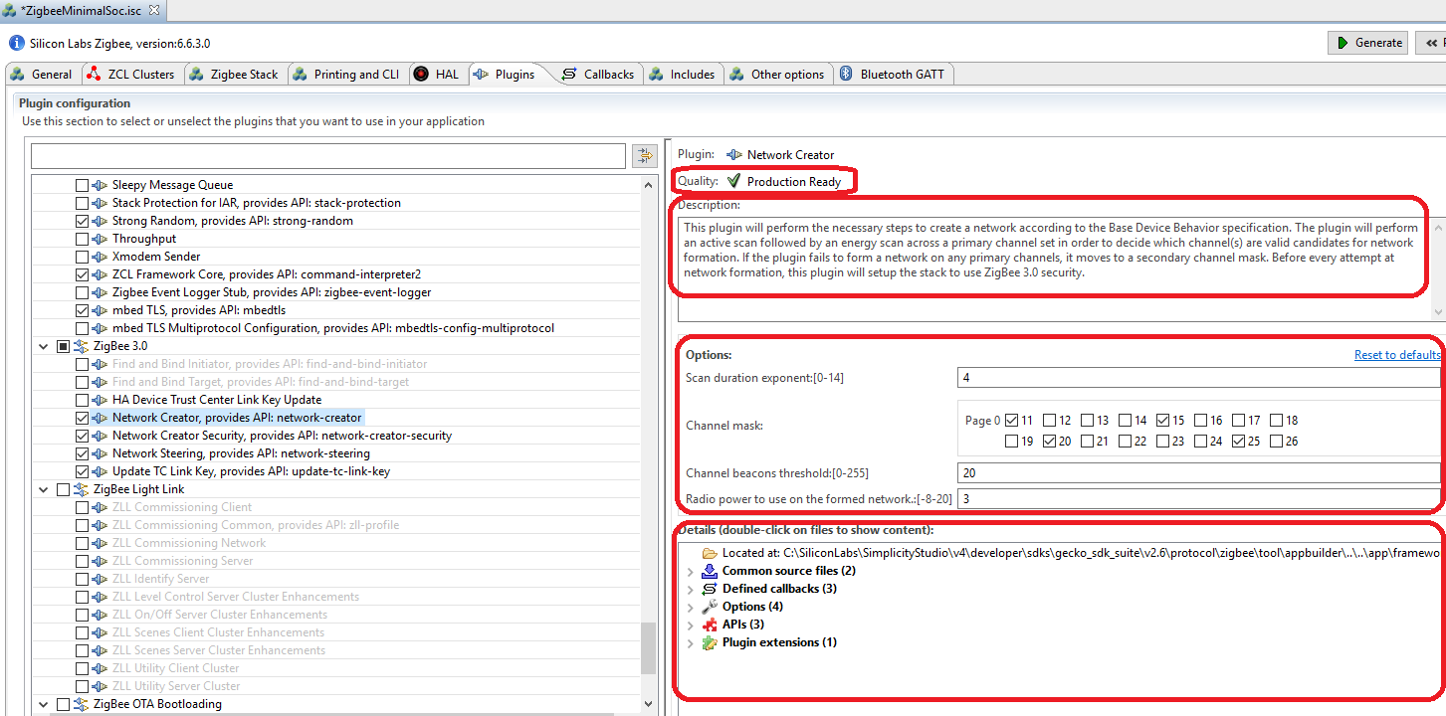
AppBuilder - Plugins
Notes:
As we talked before, the SDK is provided by many plugins. You can select the plugins you need in the “plugins” tab.
In the right side of the plugin, you can see the status of this plugin. Also the description of this plugin.
There might be some options of the plugin.
In the right bottom. You can find there is some properties of the plugin, like the source or library path of the plugin, the callbacks implemented and defined. You can also get the dependency of the plugin by the APIs field.

Slide 21
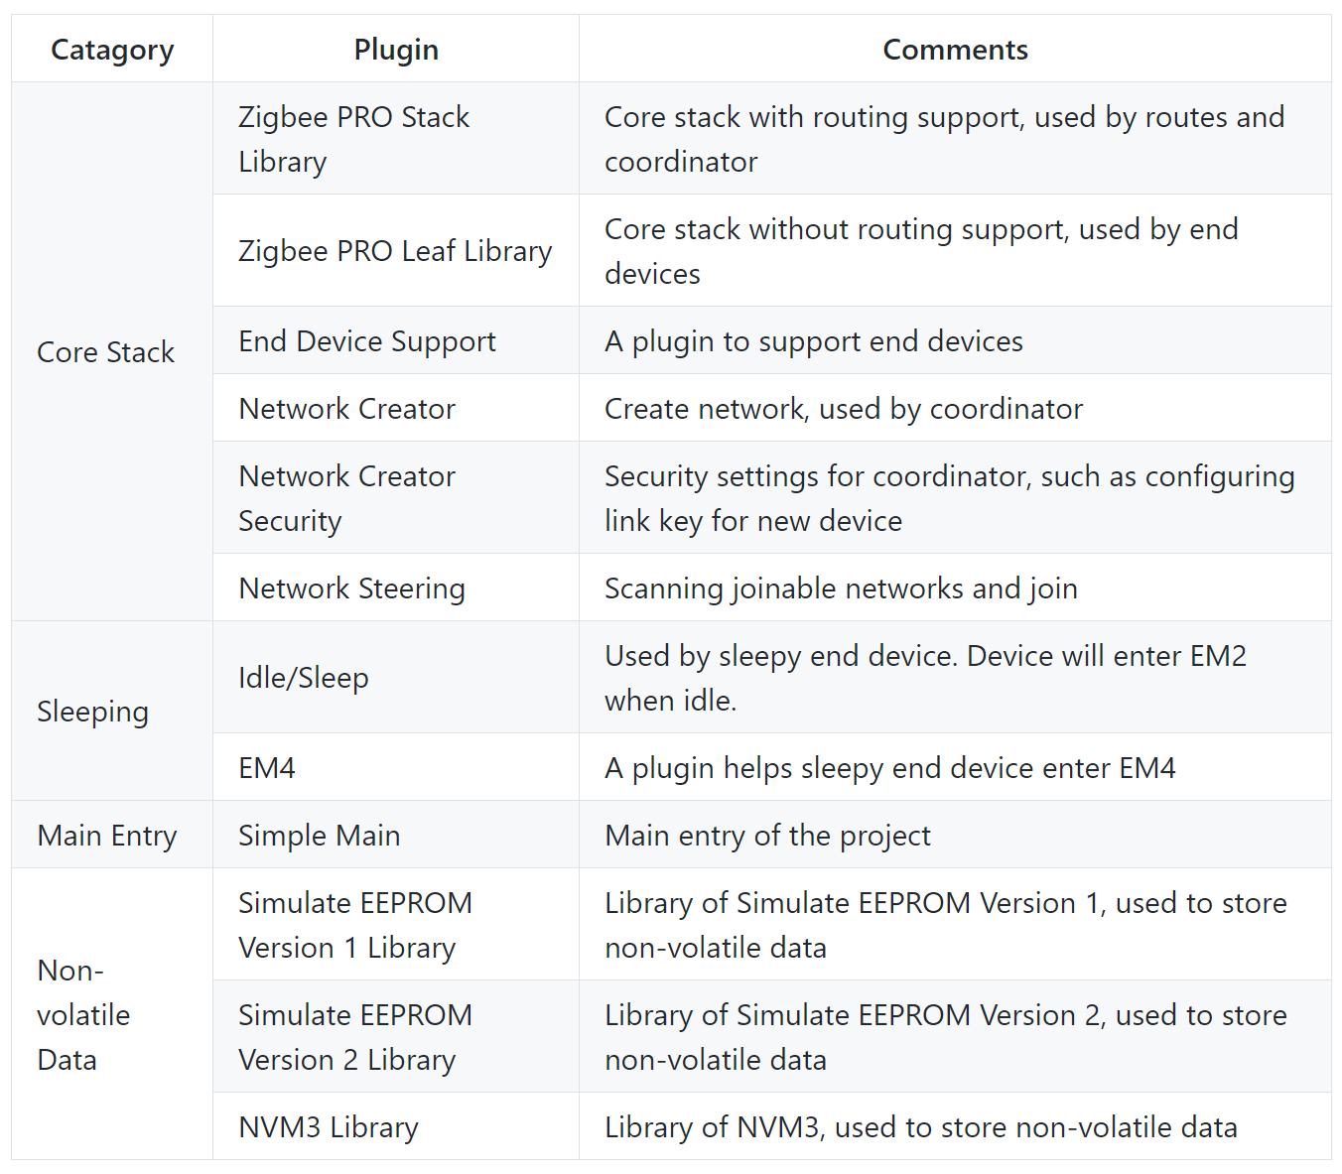
Frequently Used Plugins
Notes:
This is the most commonly used plugins.

Slide 22
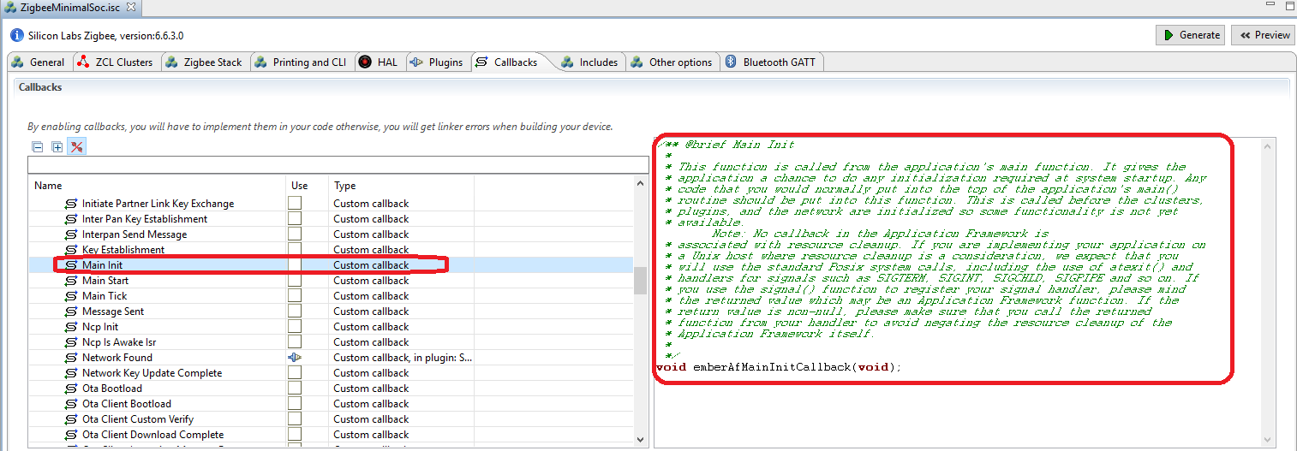
AppBuilder - Callbacks
Notes:
Silicon Labs recommends you to use callbacks to implement your application. Actually most of the source code has been finished by the framework. You can add your custom source code in the callbacks if you need.

Slide 23
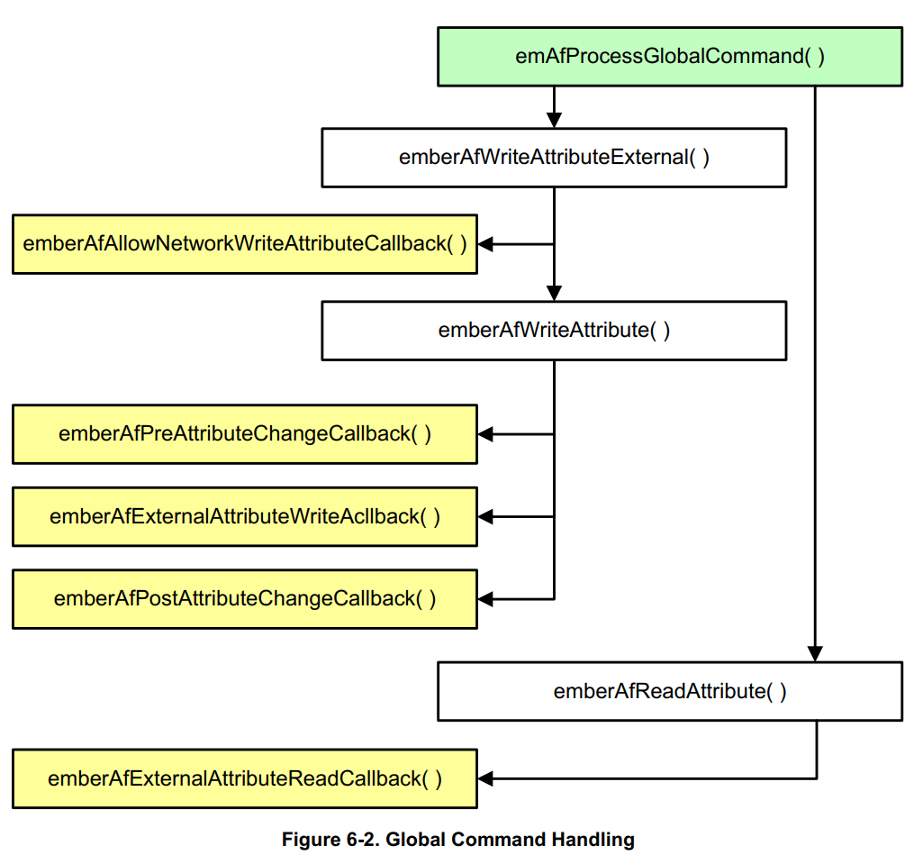
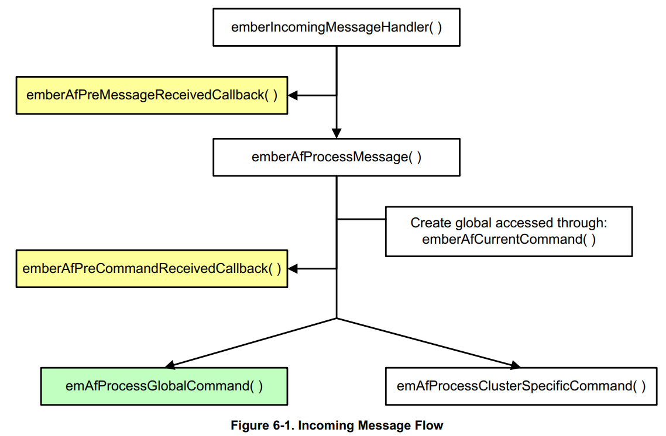
Callbacks Flow
Notes:
This is the call flow of the callbacks.

Slide 24
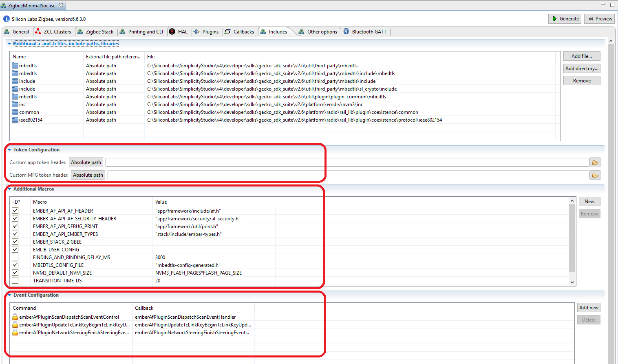
AppBuilder – Custom settings
Notes:
In “Includes” tab, you can add your custom macros, event and custom tokens.
In the hands-on part this afternoon, you will use them.

Slide 25
Generated Files
File | Description
<projectname>.h | main header file, plugin settings
<projectname>_callbacks.c | Customer implementation
<projectname>_endpoint_config.h | defines the endpoints and attributes
znet-cli.c/znet-cli.h | CLI command list
client-command-macro.h | macros which will be used in filling messages
call-command-handler.c | Cluster command process
attribute-id.h/attribute-size.h/attribute-type.h/att-storage.h | Attribute related
af-structs.h | Data structs
af-gen-event.h | Event/handler pair
hal-config.h | All hardware settings are generated in this file
Notes:
Show the generated files.

Slide 26
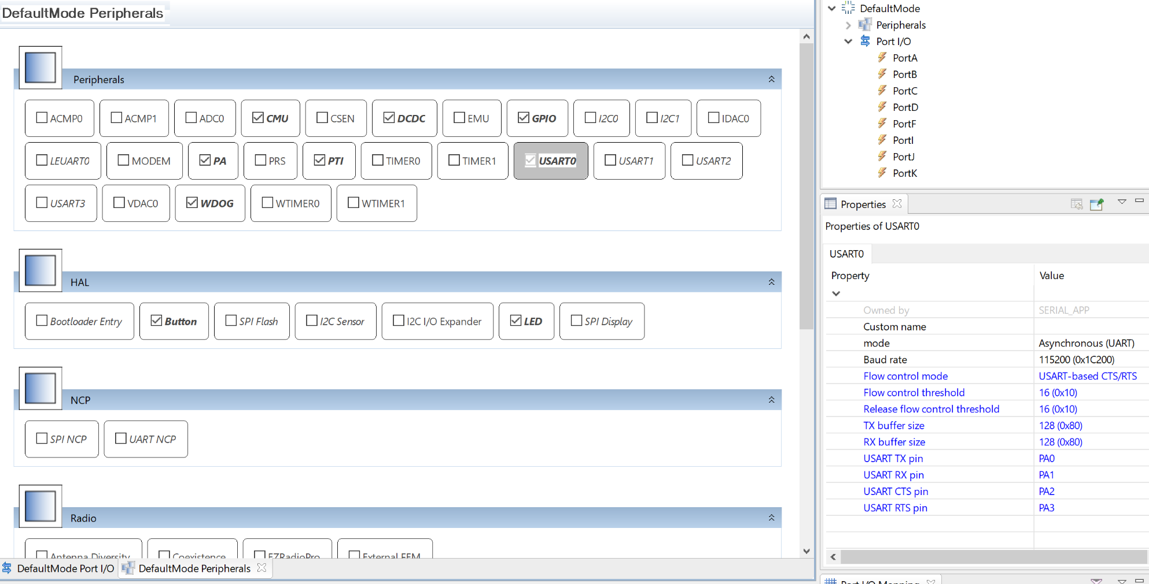
Hardware Configurator
Notes:
For custom board, you would need to change the hardware configuration according to your schematic.

Slide 27

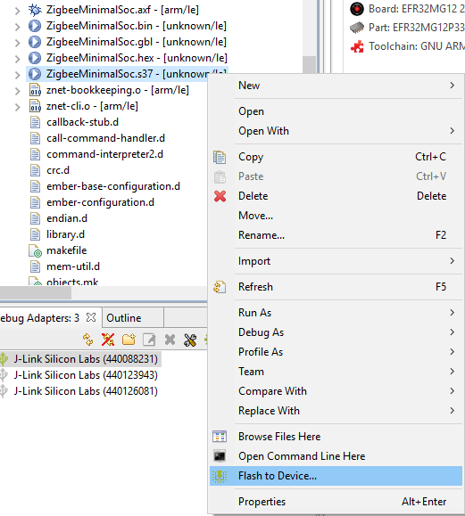
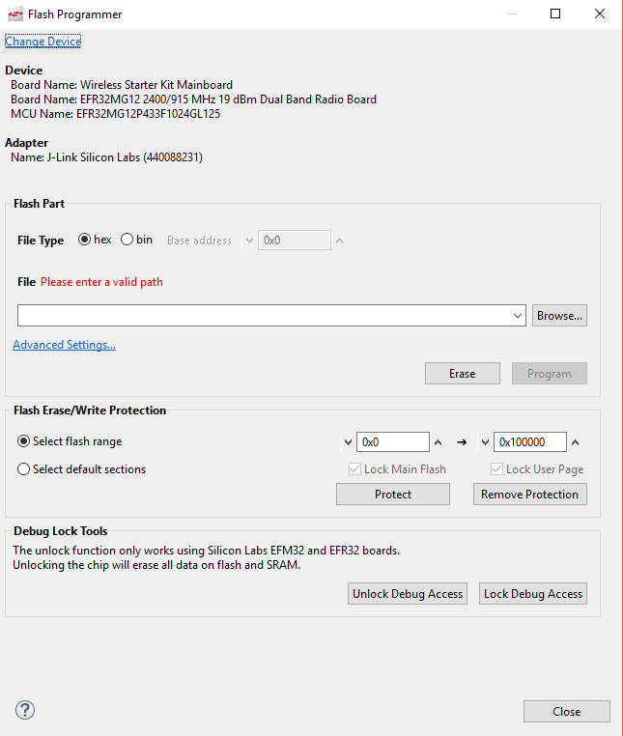
Flash/Program
Method 1:
Method 2:
Notes:
Let me show you the approaches of flashing programs.

Slide 28
CLI Commands
plugin network-creator form [useCentralizedSecurity:1] [panId:2] [radioTxPower:1] [channel:1]
Form a network with specified parameters.
useCentralizedSecurity - BOOLEAN - Whether or not to form a centralized network. If this value is false, the device will attempt to join a distributed network.
panId - INT16U - PanID of the network to be formed
radioTxPower - INT8S - Tx power of the network to be formed
channel - INT8U - channel of the network to be formed
plugin network-creator-security open-network
Open the network for joining.
plugin network-creator-security open-with-key [eui64:8] [joiningLinkKey:-1]
Open the network that would only allow the node with specified EUI and link key pair to join.
eui64 - IEEE_ADDRESS - The EUI64 of the joining device.
joiningLinkKey - OCTET_STRING - The link key that the joining device will use to enter the network.
Notes:
Here are some useful commands you would used during debugging and testing.
First, the command to create a network. You would need to specify four parameters, like the security model, PAN ID, power and channel.
Then you will need to open the network for new device to join.
With the first command, you tell the coordinator to use the well-known link key for new devices.
With the second command, you tell the coordinator to use the specified link key for the new device.

Slide 29
CLI Commands
plugin network-steering start [options:1]
Starts the network steering process.
options - INT8U - A mask of options for indicating specific behavior within the network-steering process.
zcl on-off toggle
send [id:2] [src-endpoint:1] [dst-endpoint:1]
Send a pre-buffered message from a given endpoint to an endpoint on a device with a given short address.
id - INT16U - short id of the device to send the message to
src-endpoint - INT8U - The endpoint to send the message from
dst-endpoint - INT8U - The endpoint to send the message to
Notes:
With the network-steeing command, you can start joining.
With the zcl command, you fill a message buffer with the command.
With the send command, you send the filled message buffer out.

Slide 30
Debug
emberAfCorePrint(…) - prints a single line without a carriage return
emberAfCorePrintln(…) - prints a single line with a carriage return
emberAfCorePrintBuffer( buffer, len, withspace ) – prints a given buffer as a series of hex values
emberAfCorePrintString( buffer ) – prints a given buffer as a string of characters
Notes:
To debug, you can use these print functions to print debug info in your application.

Slide 31
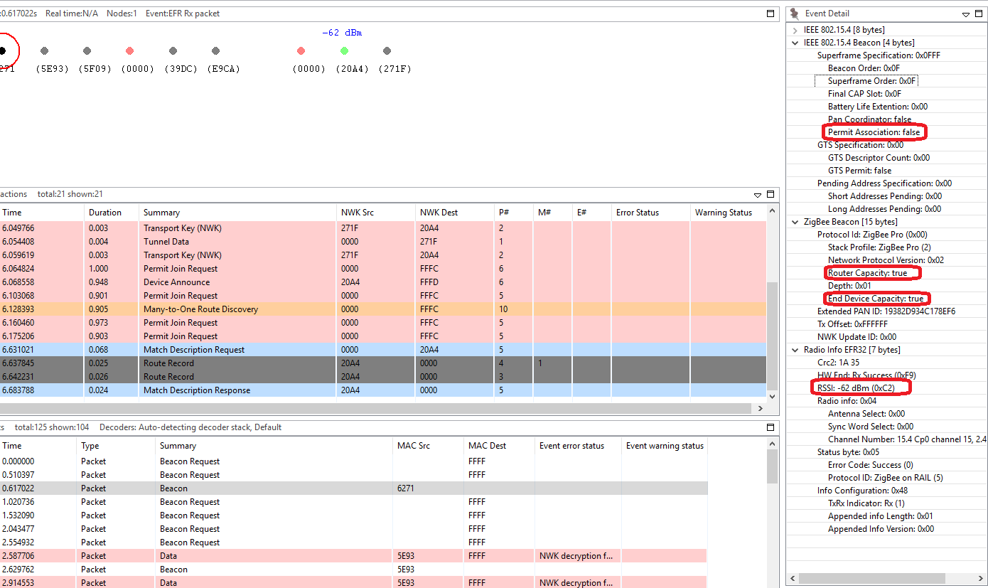
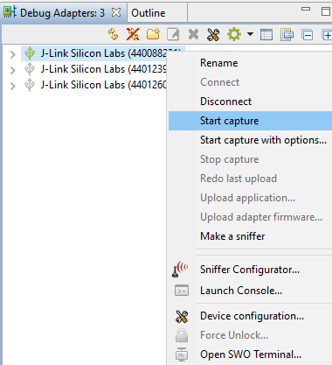
Network Analyzer
Start Capture
Notes:
Finally I will show you how to use Network Analyzer to start capture. It’s the most useful approach to debug a network issue.

Slide 32
Thank you!

