Slide 1
Gateway Basic and OTA
Jim Lin
Dec 10, 2019
Notes:
Welcome

Slide 2
Agenda
Hands-on : Control Zigbee Devices with MQTT Clients
Hands-on : OTA
Q & A
Notes:
Today we will have two hands-on.
The first one is to control Zigbee devices with MQTT clients. With this hands-on, we can learn how zigbee devices are controlled through web, Apps, and smart speakers.
The second one is about OTA upgrading.

Slide 3
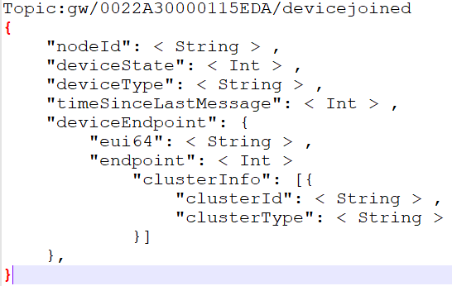
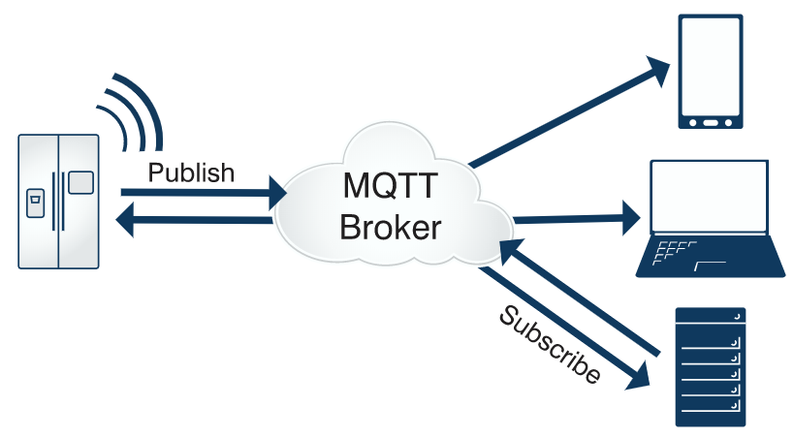
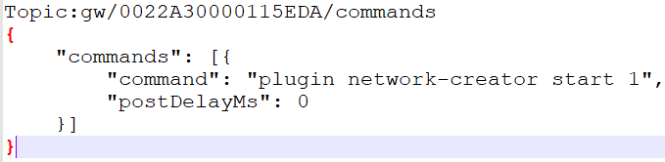
MQTT
Publish/Subscribe
Topic
Represents a message type
Also include the address info
Payload
Message content. (xml or JSON)
Notes:
This is a typical work flow of MQTT.
There is a MQTT broker which works as the server. Normally it’s deployed on the cloud.
Zigbee gateway is a MQTT client here. And the web client, client tool on PC and mobile phones can exchange messages with the gateway through the broker.
MQTT works with publish/subscribe method.
Clients can subscribe some MQTT topic. And then some client publishes messages of this topic, other clients who subscribed it can be notified.

Slide 4
MQTT Hands-on
Z3Gateway
Z3GatewayHost.exe
MQTT
Broker
MQTT Client
Zigbee Application
MQTT
Client
Host
UART/SPI
Mosquitto Broker
MQTTBox
Network
MAC
PHY
EFR32
ncp.s37
bootloader-xmodem-uart.s37
Zigbee
Light
Z3LightSoc.s37
bootloader-storage-internal-single-combined-Z3light.s37
Notes:
In this hands-on, we use Mosquitto Broker installed on your own PC and we use MQTTBox as the client tool on your PC.
For the gateway, we will use host + NCP mode.
You will need to build the host program and the NCP image.
For the light which we will control, we will use the pre-built image.

Slide 5
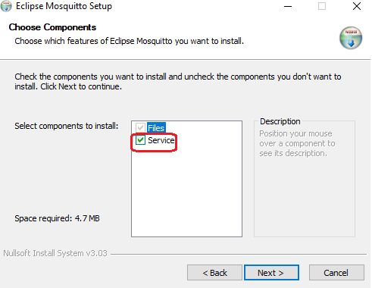
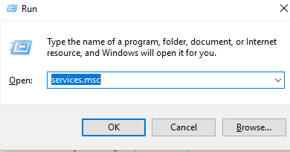
Hands-on: Install MQTT Broker --- Mosquitto
mosquitto-1.6.7-install-windows-x64.exe
Make sure the service “Mosquitto Broker” is running
“win+R” then input “services.msc” to start the service manager, then check the service state
If it’s not running, right click and select “start”
Notes:
In this hands-on, you need to install the provided Mosquitto as the broker.
You need to make sure the server is running before you start.

Slide 6
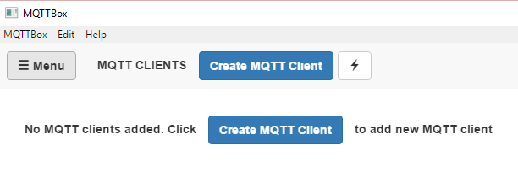
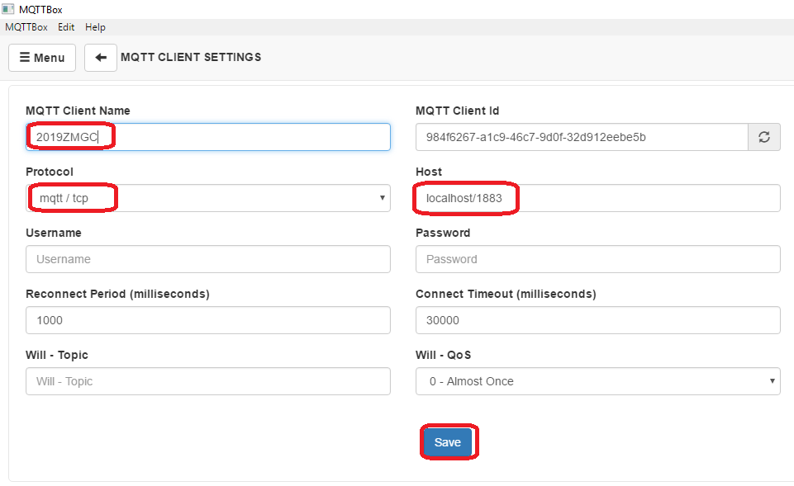
Hands-on: MQTT Client
Notes:
On the client side, first you need to set the parameter of the broker which you will connect.
In this hands-on, it’s on local machine.

Slide 7
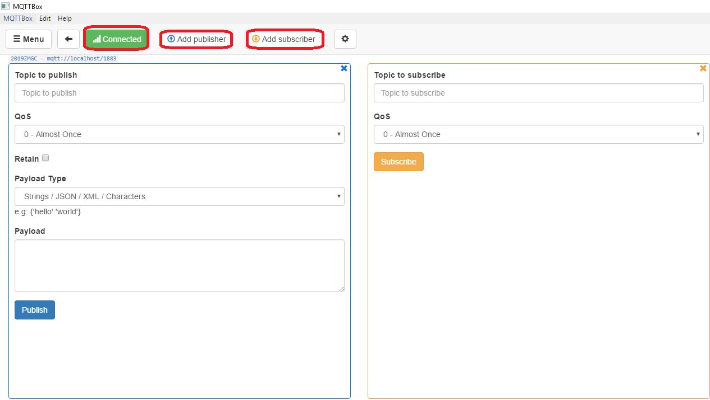
Hands-on: MQTT Client
Notes:
After that, you can subscribe a topic as described in the hands-on guide.
Also you need to publish a topic to control the light.

Slide 8
MQTT Client on Mobile Phone
IOS
https://github.com/mqtt/mqtt.github.io/wiki/mqtt_on_ios
Android
https://github.com/mqtt/mqtt.github.io/wiki/mqtt_on_the_android_platform
Notes:
There is also IoS MQTT client and Android MQTT client. You can install them on your phone so that you can control our Zigbee light with your phone.
But first, you need to make your PC as a WiFi hotspot and connect your phone to your PC through WiFi.

Slide 9
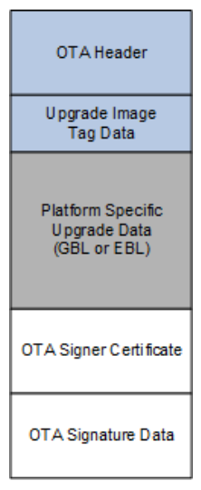
OTA Overview
V200
Build/exe/ota-files/Client.ota
Z3GatewayHost.exe
New image file will be transferred from server to client.
Client will split the GBL file out and save it to storage.
Z3Gateway
New image
Zigbee Application
MQTT
Client
SPI Flash
Host
OTA Client
UART/SPI
Network
MAC
PHY
EFR32
ncp.s37
bootloader-xmodem-uart.s37
V100 Client.s37
bootloader-storage-spiflash-single.s37
Notes:
Then we talk a little about the OTA hands-on.
In this hands-on, we will use the gateway we setup in the last hands-on as the OTA server. The new OTA image will be put on the filesystem of the host side.
On the client side, we will use SPI flash to store the new image.

Slide 10
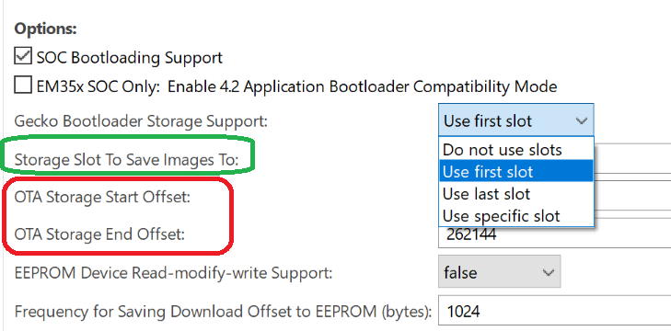
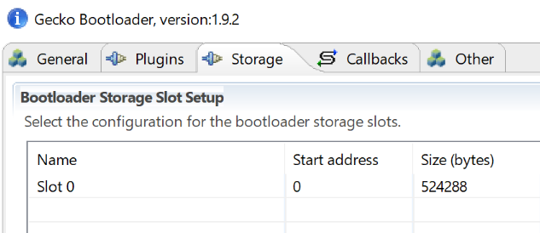
OTA Storage Setting
OTA file storage is implemented by bootloader. (Internal storage or SPI storage)
Plugin “OTA Simple Storage EEPROM Driver ”
Using slot-manager
Using address offset
Notes:
Here we talk a little bit about the storage settings in OTA.
There are two types of settings.
The first one is to use slot-manager. In this case, we need to specify the slot we will use in the properties of plugin “OTA Simple Storage EEPROM Driver”.
The offset of the slot will be set in bootloader.
The other one is to use direct offset of the storage. In this case, we just need to set the storage offset in the properties of plugin “OTA Simple Storage EEPROM Driver”.
We need to make sure the offset settings match one of the slot in bootloader.

Slide 11
OTA Procedure
OTA Server
OTA Client
Find OTA file according to
Hardware version
Image type
Manufacture ID
Firmware version
Query Next Image Request
Query Next Image Response
Erase the storage and prepare to receive new image
Image Block Request
Image Block Response
……
Save received data
Image Block Request
Image Block Response
Upgrade End Request
Check if received image is valid
Upgrade End Response
Reset and bootload the new image
Notes:
Here is the OTA upgrading procedure.
First OTA client will send a query to get the new image. In this request, the current firmware version, hardware version and image type, manufacture ID are carried in.
The server then find the corresponding OTA image according to these info, and respond it to the client.
After that, the client will request data of the new image block by block. Normally one block is 63 bytes.
When the transferring finished, the client will send a upgrade end request to the server.
The server then respond the time when the client will start to upgrade.
When it’s the time, the client will reset. And the bootloader will start to bootload to the new image.

Slide 12
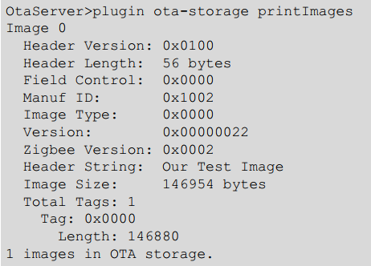
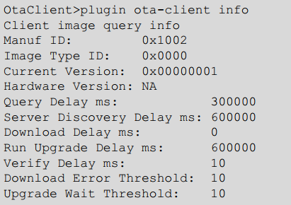
Commands
Show OTA images on server
Show version on client
Notes:
Here are some useful commands which will be used to query image info on client side and server side.

Slide 13
Q&A
Q&A
Notes:
Any questions?

Slide 14
Thank you!
Notes:
Thanks

