Slide 1
2019 ZMGC Zigbee Training
2019
Notes:
Main purpose of this course:
Help beginners to learn Zigbee basic concepts and silicon labs solutions, so that they can continue the learning by themselves.
Focus on Zigbee Application

Slide 2
Agenda
2019-12-09
09:30 ~ 11:00 | Zigbee Basic Introduction
11:00 ~ 11:15 | Break
11:15 ~ 12:00 | EmberZnet SDK and WSTK
12:00 ~ 13:30 | Lunch
13:30 ~ 17:30 | Hands-on : Forming and Joining
 | Hands-on : Sending on/off commands
 | Hands-on : Using event
 | Hands-on : Non-volatile Storage
17:30 ~ 18:00 | Summary
2019-12-10
09:30 ~ 12:00 | Hands-on: Sleepy End Device
12:00 ~ 13:30 | Lunch
13:30 ~ 15:00 | Hands-on : Control Zigbee Device with MQTT
15:00 ~ 16:30 | Hands-on : OTA Upgrading
16:30 ~ 17:00 | Quiz
17:00 ~ 17:30 | Summary
Notes:
Agenda of this training.

Slide 3
Q&A
Q&A

Slide 4
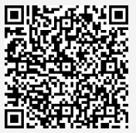
Survey – Day1
https://forms.office.com/Pages/ResponsePage.aspx?id=ItjbVDFSIEuUTW9KvNVB-_gYgvSbceFAppvKGwjVr_1UOTdNMkFBTzBWS0xHQVJGV1NBQlA3VFpSWi4u

Slide 5
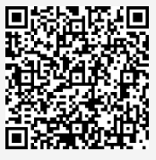
Survey – Day2
https://forms.office.com/Pages/ResponsePage.aspx?id=ItjbVDFSIEuUTW9KvNVB-_gYgvSbceFAppvKGwjVr_1UMVJLS01FSUhDQURDMFJJRkYxRUVSV0tUSS4u

Slide 6
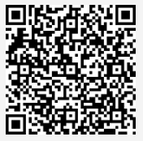
Quiz
https://forms.office.com/Pages/ResponsePage.aspx?id=ItjbVDFSIEuUTW9KvNVB-_gYgvSbceFAppvKGwjVr_1UMFc2WUpQT1I5TVZEUEM5M1pYVkMyUEZEMi4u

Slide 7
Thank you!
Notes:
Thanks

