Slide 1
Lesson 3: Security

Slide 2
Agenda
Security S2
Smart Start
Notes:
This lesson will introduce you to the Security2 (S2) standard and SmartStart

Slide 3
Security 2
Notes:
Also refer to KBs for (more?) information
https://www.silabs.com/community/wireless/z-wave/knowledge-base.entry.html/2018/12/21/secure_s2_key_exchan-tJVf
https://www.silabs.com/community/wireless/z-wave/knowledge-base.entry.html/2018/12/21/secure_s2_dsk-hCCv
https://www.silabs.com/community/wireless/z-wave/knowledge-base.entry.html/2018/12/21/why_use_s2-unauthent-uj37
https://www.silabs.com/community/wireless/z-wave/knowledge-base.entry.html/2018/12/21/is_s2-access_morese-4W7u

Slide 4

Device-To-Cloud Security with Z-Wave Security
Notes:
S2 Goals
S2 is built on industry standard components that are well known from other technologies, and reviewed by independent security experts
Protection against
Man in the middle attacks
Inclusion of rogue nodes
Deciphering of the keys
Sniff, replay, and delay attacks
Supports
Out-of-band authentication
Elliptic Curve Diffie-Hellman key exchange
Strong AES 128 encryption
Unique/nonce transmissions
Jamming detection
Energy efficient security and low latency with single frame transmission
50% less energy than challenge-response mechanism

Slide 5
Improved Key sharing
In S0 concept
Uses a “standard” temporary Key to encrypt the Network Key, & send to the joining node.
This temporary Key can be easily known ( or guess ), and hence reduce the security robustness.
In S2 concept
Uses Elliptic Curve Diffie Hellman ( ECDH ) key exchange Protocol to establish a shared secret over an insecure channel
ECDH work on the principal of a Public and a Private Key pair
All S2 devices had a set of Public and Private key
Public key are exchanged between 2 devices during inclusion
Public + Private keys = Temporary Key
Temporary key -> Encrypt the Network key
Every inclusion -> Different Temporary key
Notes:
S2 relies on private public/public ke y encryption to establish a secure channel for exchange preventing anyone from decrypting the key exchange.
The temp key is unique for the pair of nodes, as it is depending on the private public key.
For controllers the inclusion mode keypair is updated for each inclusion to further protect against attacks.

Slide 6
Authentication
Prevent key exchange with unintended Z-wave nodes.
Node being included strips out part of DSK
Stripped out part is exchanged out of band
DSK is not enough to derive Private key, PRK
Notes:
DSK, device specific key is derived from the PUK, Public key of the Z-wave device

Slide 7
Nonce Mechanism
Prevents replay attacks
Node1
Node 2
In S2, a Nonce is exchanged ONCE
It is used to compute subsequent
Singlecast PANs (SPAN) and
Multicast PANs (MPAN)
Nonce Get
Nonce Report
Nonce table
#1 Nonce1
#2 Nonce2
#3 Nonce3
.
#32 Nonce32
Nonce table
#1 Nonce1
#2 Nonce2
#3 Nonce3
.
#32 Nonce32
S2 Message #x = Nonce #x
+ Encrypted Message #x
+ other information
S2 Message #1
Decrypt S2 using
Nonce #x
S2 Message #2
S2 Message #3
Notes:
once is an arbitrary number that can be used just once in a cryptographic communication
Nonce is not a secret as such and is transmitted in plain text over the radio.
SPAN, Single cast pre-agreed nonce, prevents continuous nonce exchange as instead a nonce generator has identical inner states on receiving and transmitting end.

Slide 8
Nonce Mechanism
SPAN / MPAN table is out of sync when message did not reach destination
A new Nonce must be requested if the SPAN or MPAN get out of sync.

Slide 9
Nonce Mechanism
Node1
Node 2
Node1
Node 2
Nonce Get
S2 Message #4
Cannot decode
Nonce Report
Nonce Report
Reset Nonce Table
Nonce table
#1 Nonce1
#2 Nonce2
#3 Nonce3
.
#32 Nonce32
Nonce table
#1 Nonce1
#2 Nonce2
#3 Nonce3
.
#32 Nonce32
Nonce table
#1 Nonce1
#2 Nonce2
#3 Nonce3
.
#32 Nonce32
Nonce table
#1 Nonce1
#2 Nonce2
#3 Nonce3
.
#32 Nonce32
S2 Message #1
S2 Message #1
S2 Message #2
S2 Message #2
S2 Message #3
S2 Message #3
Fail to reach destination
Notes:
https://www.silabs.com/documents/login/miscellaneous/SDS13783-Z-Wave-Transport-Encapsulation-Command-Class-Specification.pdf figure 16 instead?

Slide 10
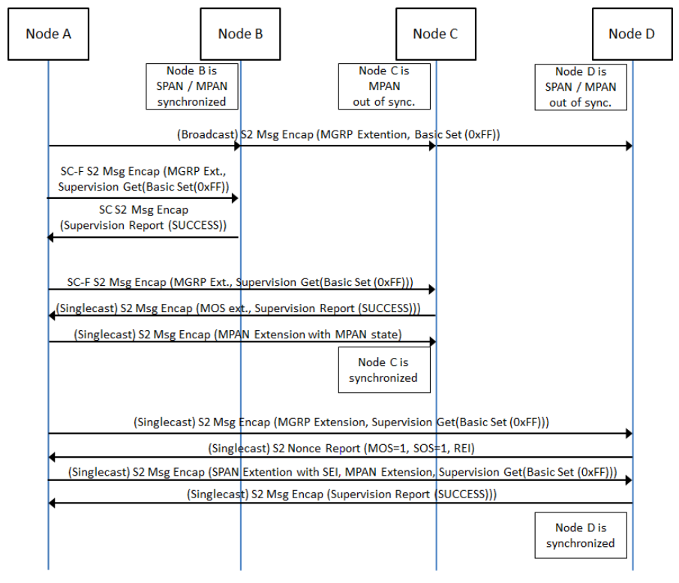
Multicast
Notes:
S2 supports multicast however our controller stack does not.
Coming soone to a Z-wave controller stack near you ☺
https://www.silabs.com/documents/login/miscellaneous/SDS13783-Z-Wave-Transport-Encapsulation-Command-Class-Specification.pdf figure 18

Slide 11
Security Levels
S2 offers 3 levels of security.:
Access Control (Highest level) is the most trusted class,
intended for home access control devices such as door locks and GDOs
Out-of-band DSK sharing for inclusion
Reserved for entry control devices
Authenticated (Mid level) is the 2nd most trusted class.
intended for dedicated security systems commissioned by experts. The class is intended for normal home control deployments.
Out-of-band DSK sharing for Inclusion
May be used by most applications
Unauthenticated (Lowest level) LEGACY
Does not require authentication of the joining node it supports constrained user interfaces on the controllers, allows more plug-and-play
No DSK needed
Intended for low cost devices
Notes:
On the 700 series nodes Smart Start is mandatory. This means that all nodes except access devices will use the ”authenticated” key.
The use of multiple key classes prevents an attacked from unlocking the door by compromising an non-critical devices like a lightbulb.
Unauthenticated continues to exist, but only advanced users will encounter this key. It may be used to segment a network further.
If a node requests, and is granted multiple keys, it can only be controlled at the highest level. The lower level key classes can be used to control other nodes which has this key classes. This could e.g. allow a doorlock to control an authenticated key class device through an association while the other way would not be possible.

Slide 12
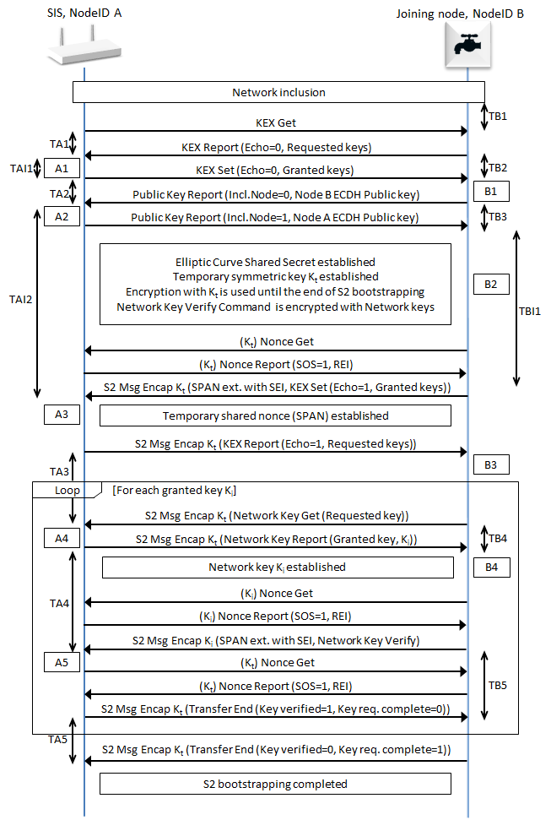
The S2 Inclusion Flow
Step 1 : Exchange PUBLIC KEY between Devices
Both nodes create PUBLIC KEY using ECDH and send to each other
The PUBLIC KEY can be entered manually to authenticate, or exchanged wirelessly
Once the PUBLIC KEY is exchanged, the node can created a SHARED KEY with their PRIVATE KEYs
Step 2 : Generate the TEMPORARY KEY
Exchange a shared Nonce ( Number Used Once ) between the nodes
Using the new SHARED KEY, a TEMPORARY KEY will be created
Using the new TEMPORARY KEY & Nonce, a SPAN* table will also be created
Encrypt the PERMANENT KEY ( using TEMPORARY KEY entry of SPAN table ) and send to the Joining Node
Step 3 : Verify the key using the PERMANENT KEY
Exchange more keys if device support more than 1 Security level
*SPAN - Singlecast Pre-Agreed Nonce

Slide 13
Smart Start
secure interoperability made easy

Slide 14

SmartStart Delivers Automatic Secure Inclusion
Notes:
Scan QR codes to initiate plug and play secure installation
Remove installation difficulty for mainstream users
Enable consistent quality of install, every time, for every device
Encourage shift from single device to whole home automation
Supply service providers with tools to increase productivity and ROI

Slide 15
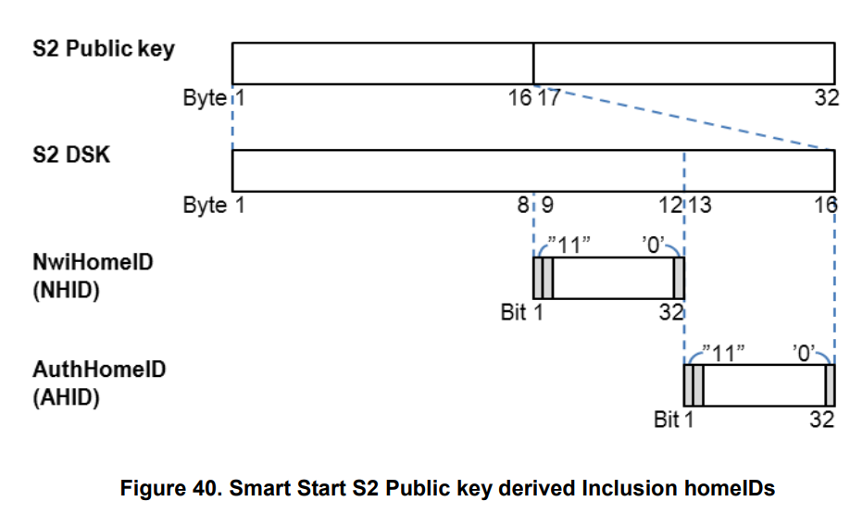
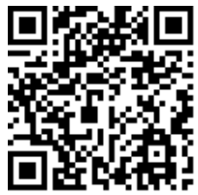
Smart Start
Allows provisioning of node before deployment
Contains rich information about the device type allowing to pupolate a controller UI pre-deployment.
Smart start devices must carry compliant QR code
Controllers must be able to scan QR code
Notes:
As service provide could ship a Z-wave node to a user and at the same time provision the Z-wave device to the users controller. This allows the enduser to just power up the the device, without having to do anything futher to include the device in the network.
Provisining data includes not only the DSK required for S2 but rich data about the device and it’s capabilities allowing the controller to show which types of devices have been provisioned by not yet included by the controller.

Slide 16
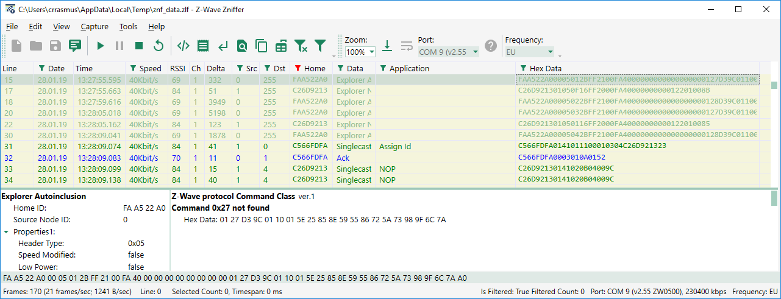
Working with Smart Start
Public key A6D0B14E766648B3BAA522A04566FDFBA392E1EDB7BB0CDBC881BEE11DC1994A
DSK 42704-45390-30310-18611-47781-08864-17766-65019
NWI Home ID (BAA522A0 OR C000000) AND FFFFFFFFE = FAA522A0
Auth Home ID (4566FDFB OR C000000) AND FFFFFFFFE = C566FDFA

Slide 17
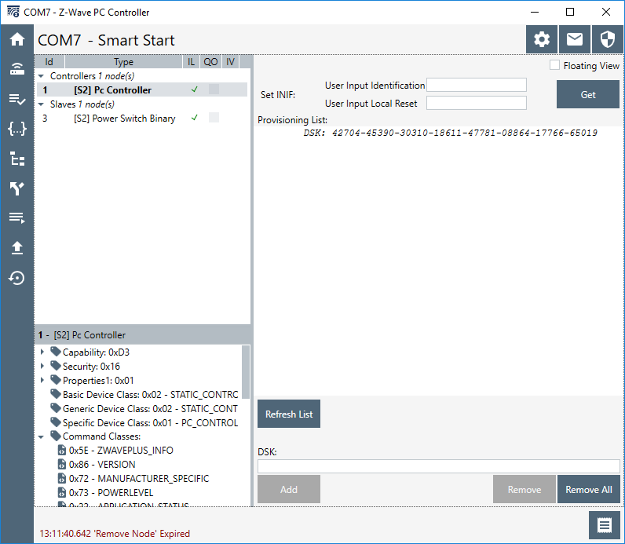
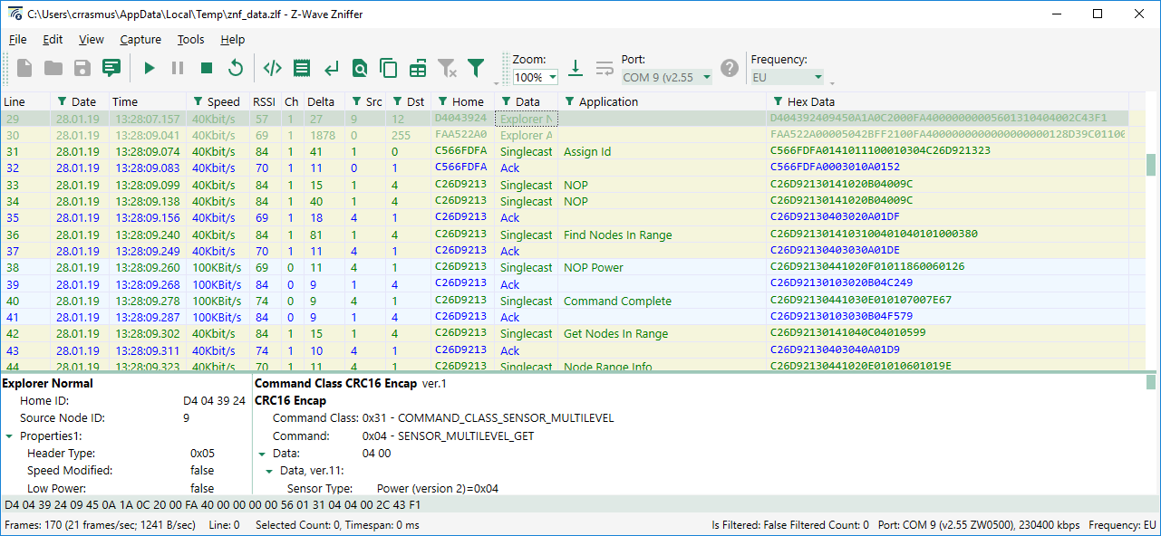
Working with Smart Start

Slide 18
Smart Start
Security measures
When using QR codes the entire over the air DSK is discarded (16 bytes) and the out of band DSK from the QR code is used.
Relies on two home IDs derived from the DSK to ensure only intended nods are included.
2^29 chance of starting Smart Start unintendedly
2^58 chance of assigning node and home ID.
For Smart Start secure inclusion must succeed otherwise nodes will reset automatically.

Slide 19
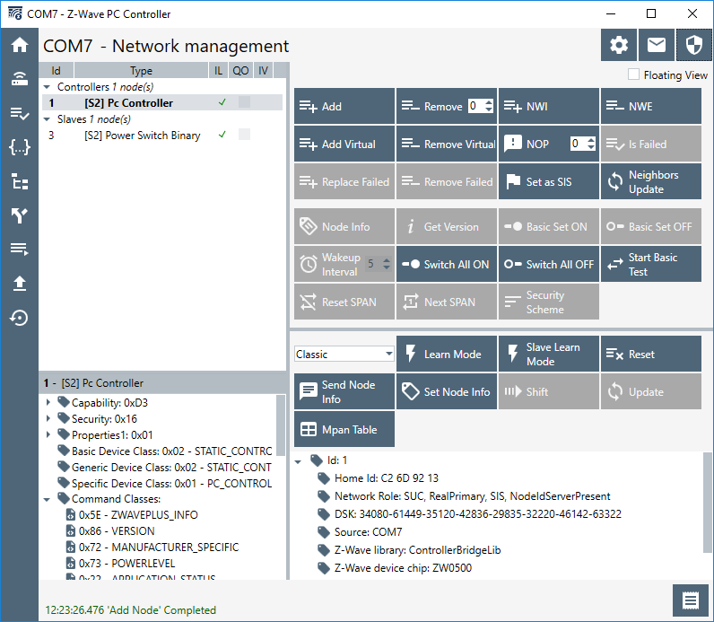
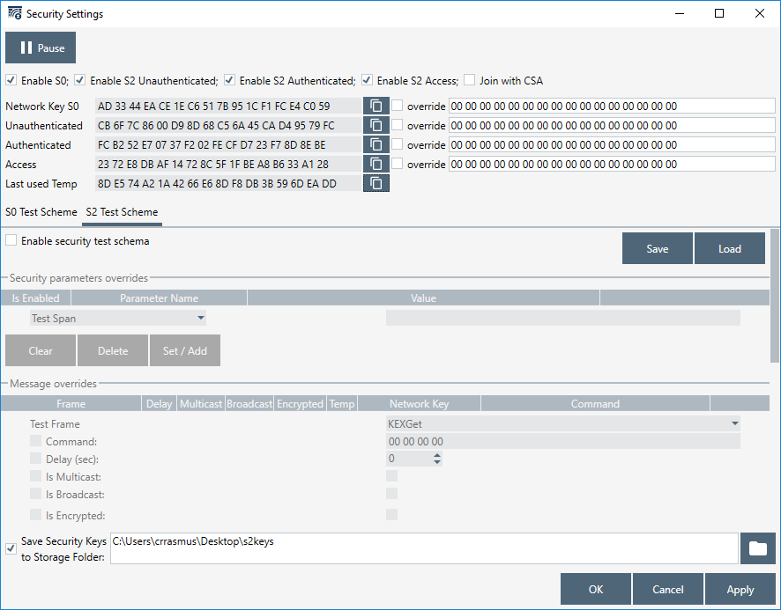
Working with security
Extracting network Keys
Keys
Key storage
Notes:
There must be a nonce exchange in the Zniffer trace!
Decrypting runtime communications
PC Controller can save keys
Decrypting inclusion
The PRK/PUK derived temp key can be seen in the PC Controller it is not stored!
If frames are sent out of sync due to retransmissions, the Zniffer may no be able to decode.

Slide 20
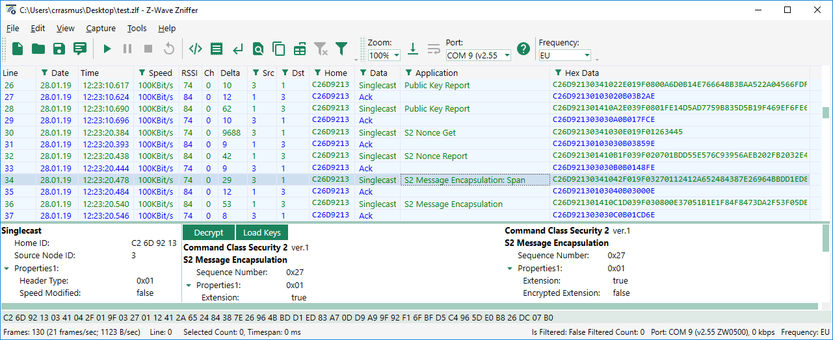
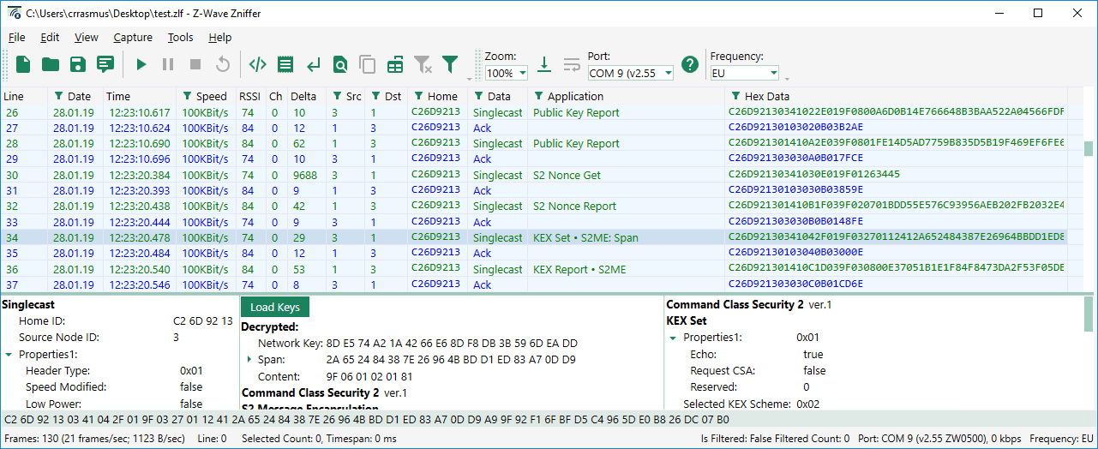
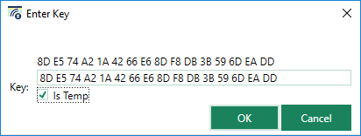
Working with security
Decrypting intial key exchange
Nonce exchange is essential to know the SPAN
Key must be taken from security dialogue

Slide 21
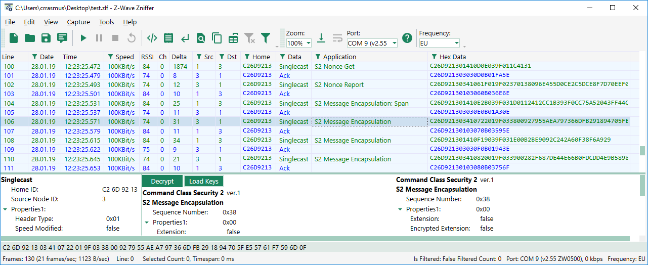
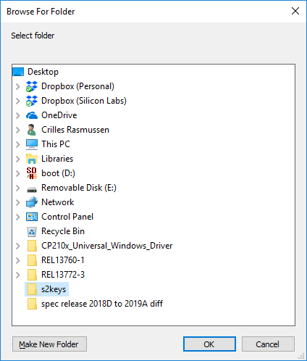
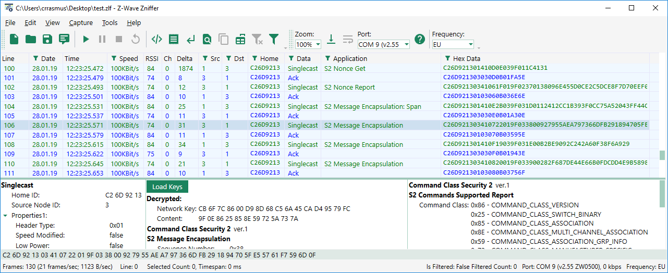
Working with security
Again nonce exchange is essential
Network keys are loaded from file or can be taken from security dialogue

Slide 22
Demonstration: SmartStart inclusion
Goal of Demonstration
Debugging Smart Start using Zniffer
Include nodes using Smart Start
What you will learn
Extract DSK using Simplicity Studio
Extract Home IDs used during Smart Start inclusion from DSK
Identify Smart Start frames on the Zniffer
Smart Start include nodes using Z-wave PC Controller

Slide 23
Limitations of legacy S0 security
S2 is designed to address the following limitations of S0:
1) Weak encrypted in-band key sharing doing device inclusion.
2) One level of security where all devices are using the same network key.
3) Additional 2 frames for each S0 message.
4) No Multicast feature

