Slide 1
Zigbee Basic
2019
Notes:
Welcome to Zigbee training. Today we will introduce the basic knowledge of Zigbee knowledge. This lesson will last for about 75 minutes.

Slide 2
Agenda
What’s Zigbee?
Protocol Overview
Physical Layer
MAC Layer
Network Basic Concepts and Procedure
Application Layer
Security
Q & A
Notes:
Here is the agenda of this training.
First we will talk a little bit about the question “What’s Zigbee”.
After that, we will introduce overview of Zigbee protocol.
Then, we will introduce physical layer, MAC layer, network layer and application layer.
Finally, we will talk a little about the security features in Zigbee.
If you have any questions during the presentation, please feel free to break me.
Now let’s start.

Slide 3
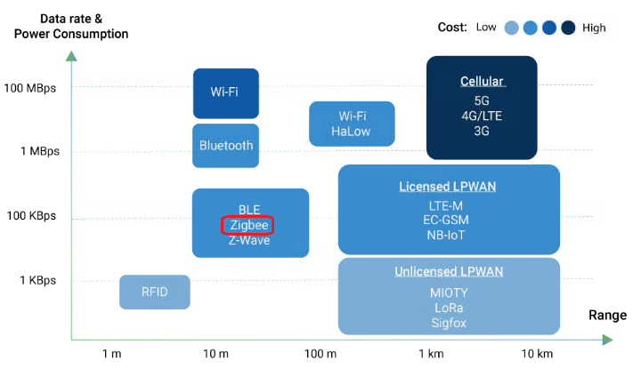
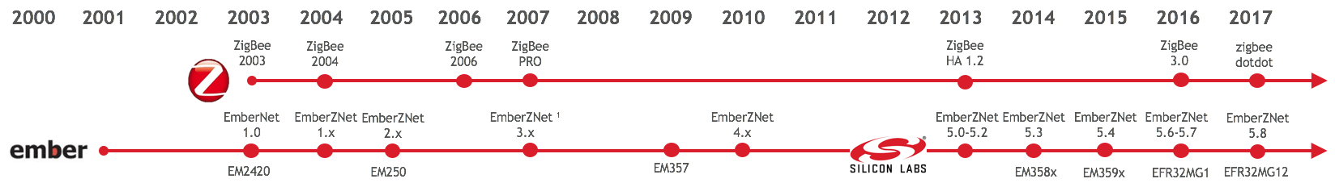
What is Zigbee?
Short Range (10 ~ 100)
Low Data Rate (max=250kbps)
Low Power (can be less than 5uA)
Mesh Topology (Maximum 65535 nodes)
Open Standard (Zigbee Alliance)
Zigbee Specification
Zigbee BDB Specification
Zigbee Cluster Library
Notes:
First let’s introduce what Zigbee is.
As we know, in the mainstream IoT technologies, there are two typical types. One is for WAN (Wide Area Network), the other is for PAN(Personal Area Network).
For the wireless technologies of WAN, we have LoRa, NB-IoT, 2G/3G/4G, etc. The common characteristics of these technologies are:
The radio can cover wider range, normally more than 1Km.
They work on licensed spectrum.
For the wireless technologies of PAN, we have WiFi, Bluetooth, BLE, Zigbee and Zwave. They are all short-ranged technologies.
For Zigbee, it started from 2003. Its characteristics includes:
Short range. – Normally the radio can conver from 10 to 100 meters;
Low data rate – the maximum data rate is 250 Kbps;
Low Power – a sleepy end device can use less than 5uA at sleep mode;
It’s a mesh technology – the network can be easily extended to very large. Theoretically maximum nodes number is 65535
Zigbee is also an open standard. The standard is maintained and published by Zigbee Alliance, which is an open organization. Any company can join the alliance.
The main specification of Zigbee includes:
Zigbee specification
Zigbee BDB specification
Zigbee Cluster Library
For Silicon Labs, we provides Zigbee solution when it was born. As you can see the time line at the bottom, we acquired ember at 2012 and inherit its Zigbee solution.

Slide 4
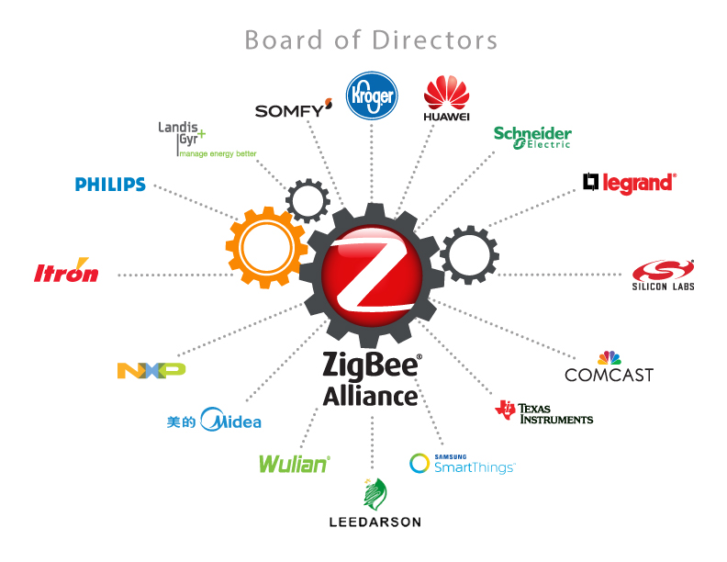
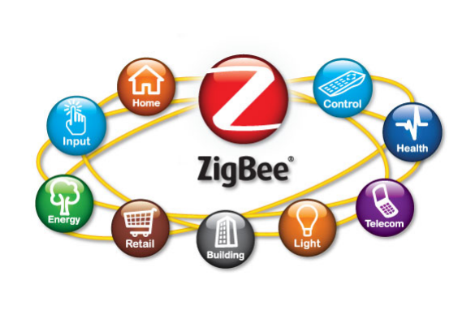

The Zigbee Alliance
Zigbee 3.0
Unification of Zigbee profiles (except Smart Energy and RF4CE)
Enhanced networking and security
Backwards compatible
Mandated since May 2017
Write/publish specifications
Certificate for compliant platforms/products
3.0
Notes:
Zigbee standard is defined by Zigbee Alliance. The main job of the Alliance is to make and improve the standard, also make sure the products are compliant with the standard by certificating them.
Silicon Labs is member of the promoter. We provide Zigbee 3.0 compliant platforms.
In 2016, Zigbee Alliance unified different Zigbee profiles and published the most popular standard Zibgee 3.0. Zigbee 3.0 also enhanced security features as it’s getting more and more important.
Zigbee 3.0 can be compatible with the previous standard. Now Zigbee 3.0 is a mandated since 2017.

Slide 5
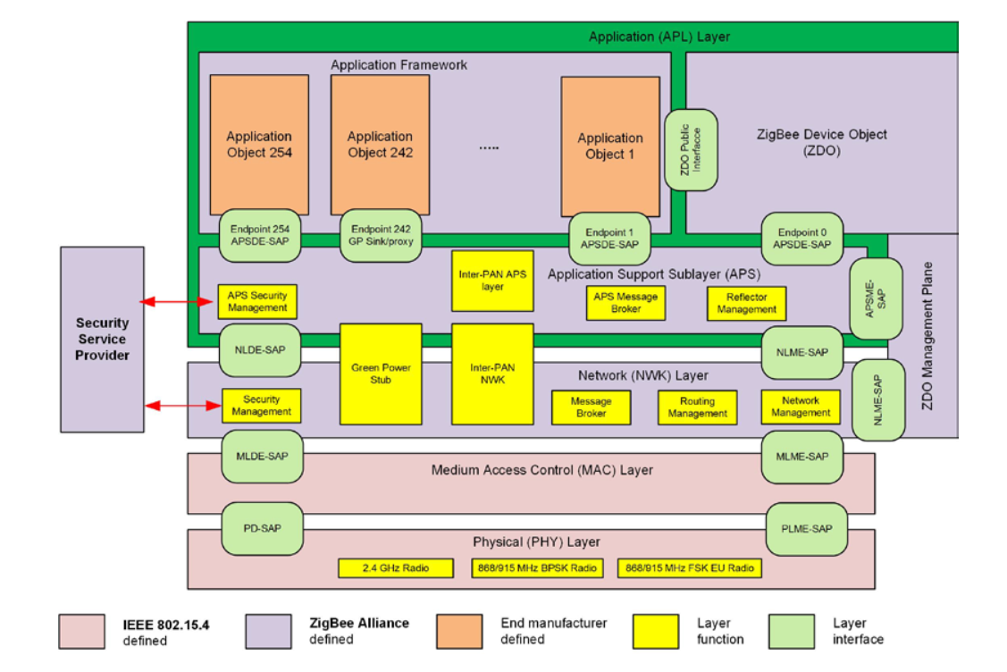
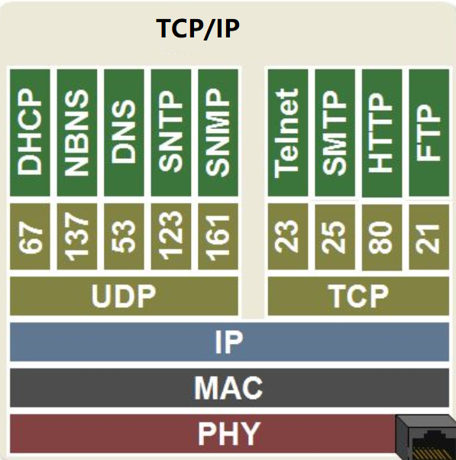
Overview
VS
Notes:
This is the protocol overview of Zigbee. To make it easier to understand, we make a comparison between Zigbee and TCP/IP.
First there are physical layer, which in charges of the radio management, like modulating/demodulating, signal strength detecting, etc.
Then the MAC layer, in charges of one-hop communication. We will talk about the details later.
Network layer, in charges of routing and also device management stuffs.
Application support layer and application layer, in charges of the user applications.
It’s quite similar to IP network in some aspects. For example, both routing functions are implemented in network layer (IP layer).
In Zigbee, endpoint is used to address for different applications instances. This is quite similar to udp/tcp port number in IP network.

Slide 6
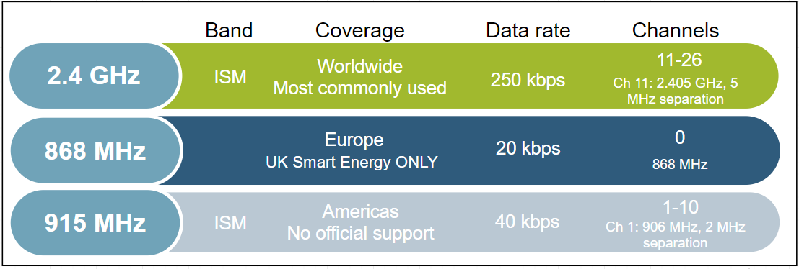
Physical Layer
Interface between physical radio and MAC layer
Radio On/ Off
Modulation / Demodulation
Channel selection
Link quality estimation
Energy detection
Range ~ 2 km line of sight
Notes:
Physical layer handles the transmission and reception of raw bits of data.
The PHY layer uses binary phase shift keying (BPSK) in the 868/915 MHz bands and offset quadrature phase shift keying (O-QPSK) at 2.4 GHz. The information is coded onto the carrier with direct sequence spread spectrum (DSSS), an inherently robust method of improving multipath performance and receiver sensitivity through signal processing gain. Note that 2.4 GHz is the most commonly used frequency band for Zigbee communication worldwide. The only official sub GHz support is for UK smart energy.
Output power:
802.15.4 is designed for low power, low data rate networks with a low-cost objective in mind. These are generally referred to as PANs or Personal Area Networks. The idea here is that these would be low to moderate radio range application designs. But amplification is also possible. It is possible to get up to roughly +20 dBm output power in most countries. In Europe it is regulated a little bit lower to around +10 dBm. But, that's enough to get you anywhere from about one to three kilometers, depending on what your link budget is and what kind of amplification you have and/or what kind of antenna you have.
Data rate:
The raw bit rate is 250 kilobits per second using the 2.4 GHz direct sequence spread spectrum Phy or DSSS. In the real world you are going to see about a quarter or fifth of that. The expected throughout is comparable to a 56k baud modem. Around 52700 kilobits per second on a single hop link. Once you put in multi-hop effects, things will take a little bit longer to propagate.
Open field range
With 2.4 GHz PHY, the ranges we mentioned could be roughly two kilometers with line of sight. This is with a fair amount of amplification and still within legal limits in most areas. And because of all the channels, you have robust communications such that you can avoid interference by making sure to pick channels that are not terribly noisy. Now if you do pick a channel and it becomes noisy, ZigBee has a high level response with what they call "frequency agility." So that some network manager can move the network to a different channel. The other advantage to the 2.4 GHz spectrum is that it's available globally which means you have a wide range install base for your product.

Slide 7
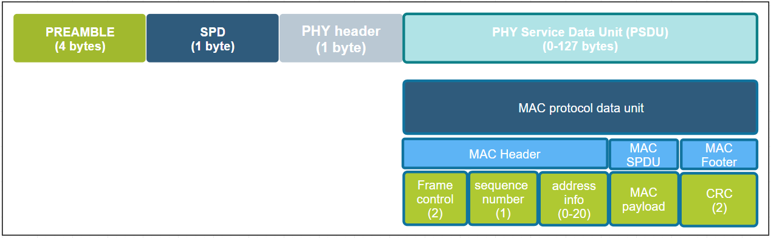
MAC Layer
Takes care of 1 hop communication and acknowledgements
Verifies integrity of packet using CRC
Uses data from the physical layer to sense activity and randomize message transmission (CSMA – CA)
4 MAC Frames
Beacon
Data
ACK
MAC Command
Notes:
We will be moving on to the MAC layer now.
The main function of the MAC layer is to ensure reliable one-hop message delivery by verifying the checksum and sending one-hop acknowledgements. The MAC PDU is shown in the picture. Here are some more details on these functions.
CSMA CA
802.15.4 allows for multiple networks to be on the same channel. Therefore there needs to be some way to avoid having packets from different networks collide over the air and cause errors in communication. MAC sub-layer controls access to the radio using CSMA-CA (Carrier sense multiple access with Collision avoidance). Collision avoidance is done by CCA (Clear Channel Assessment). Before transmitting, every node shall check to see if the airwaves are clear (RSSI below CCA threshold). If they are, the node shall go ahead and transmit after a small random backoff. If the CCA does not pass, then the node shall wait a number of back off periods before trying the process again. The random backoff allows multiple nodes to stagger transmissions so at some point they can find clear air to transmit. Although the bit rate is low, since packets are small (128 bytes), each node completes its transmission successfully even if the channel is fairly busy.
Acknowledgements:
MAC layer also provides a method for nodes to know that 1 hop unicast transmission have been successfully received by way of acknowledgements and that the integrity of the transmitted message has been preserved by verifying a CRC.
Multi hop transmissions shall be acknowledged on every hop. After the node performs the CCA check and transmits the message, it waits for a MAC acknowledgment. If it does not receive one, the node shall attempt to resend the message multiple times until it eventually succeeds, or the maximum retries have been exhausted. The Silabs Ember ZNet stack provides additional mac retries providing earlier corrective action for a failed message transmission instead of waiting until an end-end retry to kick in, which could take several seconds.

Slide 8
Network Layer Basic
Basic Concepts
Device Type
Network Address
PAN ID
Extend PAN ID
Device Address
Node ID
Eui64
Forming and Joining Procedure
Notes:
Here we come to network layer. As it’s a training for beginners, we only discuss some basic concepts here, including device types in Zigbee, and also addresses in Zigbee.
After that we will introduce a little bit about forming and joining procedure, so that you can get a basic understanding of how Zigbee works.

Slide 9
Device Type
Device Type
Coordinator
Router
End Device
Sleepy
End Device
Zigbee
FFD
Full Function Device
RFD
Reduced Function Device
IEEE-802.15.4
ZigBee Coordinator | ZigBee Router | ZigBee End Device
There can be only ONE! | Message routing | Leaf nodes
Always 0x0000 | Can also serve as end devices | Can be sleepy devices
Trust Center, Network Manager | Cannot be sleepy | Has parent
Acts as Router | Lives with the network | Parent responsibility
ZC
ZR
ZED
Notes:
First Let’s start with node types.
ZigBee has three types of basic node types. They are: the ZigBee coordinator or the ZC, the ZigBee router which we abbreviate as ZR, and the ZigBee end device - the ZED. The differences among these types of nodes or devices mainly come down to how they interact with other nodes in the network.
In the MAC layer, which is defined in IEEE802.15.4, we have two device types, full function device (FFD) and reduced function device (RFD). FFD includes coordinator and router. RFD includes end device and sleepy end device.
First we have the ZigBee coordinator. The coordinator is the most important part of the Centralized Zigbee Network. Only one coordinator is allowed per Network. It is the node that form the network. The shortID of the coordinator is always 0x0000.
Senondly we have Routers, they can relay messages from other nodes. It can not fall asleep. Usually it’s powered by a main supply. These devices should be planned to be powered as long as we want the network to function.
End devices are devices that don’t participate in any routing. The only concept of routing that they have is to send things to their parent or get things from their parent. When I say parent I mean there is some router node, potentially the coordinator, that is responsible for that end device, so it bears the responsibility of forwarding messages out and proxying messages in for that end device. An end device relies on its parent for communication to the network. If that communication is lost, the end device then has to go out and find a new parent, and re-attach itself to the network through this new parent.

Slide 10
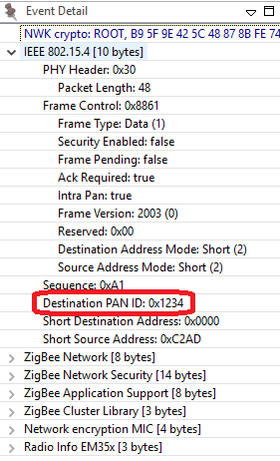
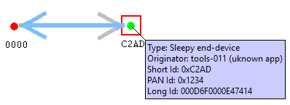
Addressing in Zigbee: PAN ID
PAN ID – Personal Area Network Identifier
Identifies the network
MAC layer filters messages meant for the network
Coordinator picks a random value
Should be unique but conflicts can happen
Stack resolves conflicts -> xPAN ID
Notes:
The PAN, or Personal Area Network, is separated from other networks through its PAN ID. This is a 16-bit identifier that all nodes in the same PAN will share. So it’s something akin to a subnet mask in the Ethernet world in that you generally would only be communicating with devices within your local network, which is the PAN in this case. This identifier is placed into the low-level MAC-layer header in every out-going packet, and it allows devices that receive the packet to filter out the messages that don’t pertain to their network. They can compare it against their own PAN ID, and decide if this is a message from someone in their own network, or if it’s from someone in a different network that just happens to be on this channel so there’s no need to try to decode or decrypt it.
The PAN ID is chosen by the coordinator upon network formation. Because the PAN ID is the distinguishing factor between one network and another, it should be random to unsure its uniqueness. It’s recommended that you select a random 16-bit value for your PAN ID that keeps your network from coinciding with any other network that happens to exist in the area.
Now, what if you happened to pick a PAN ID that’s already used by another network? Or what if you did pick a random PAN ID that wasn’t in conflict with any other network, but later another network grew to overlap with yours? If the PAN ID conflict ever happens, the stack can in fact detect such a conflict and can update its PAN ID automatically and inform all the nodes in its network to move to the new PAN ID, so that each node can continue communicating with nodes in its original network and exclude anyone on the conflicting network. You may be wondering how the stack does this.

Slide 11
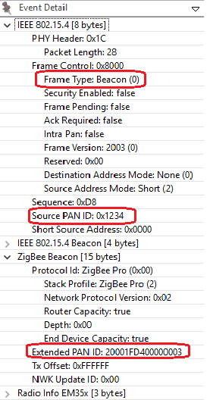
Addressing in Zigbee: Extended PAN ID
Extended PAN ID
Unique per PAN
64bit ID
known to all nodes in the PAN
Randomly generated by Coordinator at time of network formation
Only sent over-the-air in response to active scan.
Enhances network selection
PAN ID changed? Still recognize the network
Conflict results in unusable network
Notes:
Well, it is done through the use of the extended PAN ID, which is another network identifier known by all nodes in the PAN.
While the normal short 16-bit PAN ID is transmitted over the air in all the packets because it’s short and simple, the 64-bit extended PAN ID is rarely transmitted over the air. The extended PAN ID is also unique for every PAN, and it’s basically used as a backup criteria when the 16-bit PAN ID is not enough to always distinguish one network from another. For instance, when a PAN ID conflict occurs and you want to notify all devices in your network to move, the way that you distinguish your network from the conflicting network is, those devices in your network all share the same extended PAN ID. The extended PAN ID is highly unlikely to ever conflict because it has 64 bits compared to the 16 bits in the short PAN ID.
The extended PAN ID is also chosen by the coordinator during network formation. It’s only sent over the air in response to an Active Scan when nodes are soliciting the network, or when a PAN ID update is occurring.
It’s also a useful factor in allowing you to select the network. If you are trying to come into a network rather than form one, you might wonder how to tell which networks are available. The way the networks are distinguishable from one another is not only in the PAN ID but also in the extended PAN ID. You might want to do something special where you decide you are only going to use a certain subset of extended PAN IDs so that you can distinguish your networks from other networks, but just don’t limit yourself too much, because the more you limit this the more likely that you have a conflict, and if your extended PAN ID ever conflicts there’s really nothing you can do to fix that. It’s a little like a WiFi SSID, except that those can be the same between networks and this one can’t.

Slide 12

Addressing in Zigbee: Node ID
EUI – 64 address aka LongID / IEEE address
Assigned during manufacturing
Should be unique in the world.
IEEE assigns ID ranges to companies
Standardized to 64 bits
Can be changed at the cost of loosing uniqueness
Example ID
Network Address aka. Short ID/Node ID
Randomly chosen during runtime.
Can be conflicting
Resolution based on LongID
Size 16bits
Should be unique in the network to avoid conflicts
Example ID
Notes:
Besides their network-wide criteria, one node is distinguished from another by its individual node addresses.
A node has a short address and a long address. The long address is the IEEE-assigned MAC address, or EUI-64. It is a 64-bit address that is globally unique, meaning no two IEEE-based radios in the world should ever have the same EUI-64. This is generally assigned at manufacturing time. They are assigned when the chips come out of our manufacturing facility before they arrive to you, and they will never change. That’s how you tell one radio from another. But because 64 bits are a lot of data, this long address is not sent over the air very often.
Most of the time the much shorter, 16-bit address is used over the air. This is known as the node ID and unique within a network, similar to an IP address in Ethernet world. It is assigned as the node enters the network, and it’s supposed to be unique within that network. There may be two networks each of which has a node with the same node ID, but because they in different PANs, it doesn’t matter.
Note that it’s possible for two nodes to have chosen the same random node ID when they enter the network. If that happens, much like the PAN ID scheme, there is a method for conflict resolution. When the nodes notice the conflict, based on the EUI-64 information as a fallback, they can agree upon new addresses. So the nodes can change addresses at run-time if required, based on a conflict.
In addition to addresses of the node, there are also concepts of addresses within the node these are Endpoints and Clusters and they are explained in the “Clusters Endpoints Devices” training module.

Slide 13
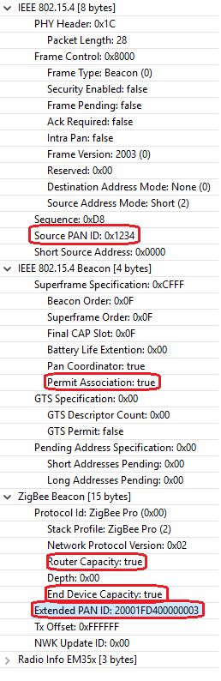
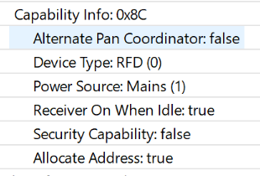
Forming and Joining a Network
Coordinator
Device
Four parameters of a network
PAN ID
Extend PAN ID
Channel
Tx Power
Form network
Send beacon request on every channel to find joinable networks
Beacon request
Beacon
Might receive multiple beacons
Choose the one with best RSSI
Association request
Association response
Got node ID
13
Notes:
To form a Zigbee network, you have to prepare 4 parameters:
PAN ID
Extend PAN ID
The working channel
Transmit power
You need to specify these four parameters.
If you don’t, the coordinator will randomly choose a PAN ID and an extended PAN ID.
If you don’t specify a channel, the coordinator will scan and pick a relatively quiet channel to work on.
After the network formed, new devices can start to join.
First, the new device will start to find the joinable network. In this phase, the new device will send beacon requests on each channel. Routers and coordinators will respond a beacon with the network info carried in the beacon frame. These info includes the PAN ID, the extend PAN ID and also some other properties of the router or coordinator, like if the device permit join, if the device has the capacity to let the new device join.
At this stage, the new device may receive multiple beacons from different devices. It will pick up one with the best signal quality and start to send association request. In this associaton request, the PAN ID is set to the chosen PAN and the destination node id is set to the node ID of the chosen device. In this frame, the capability of the new device will be carried on.
When the router or coordinator received this association request, it would pick up a node ID for the new device and respond with an association response.
Then the new device got its node ID and ideally it could communicate with the other devices in the same network.

Slide 14
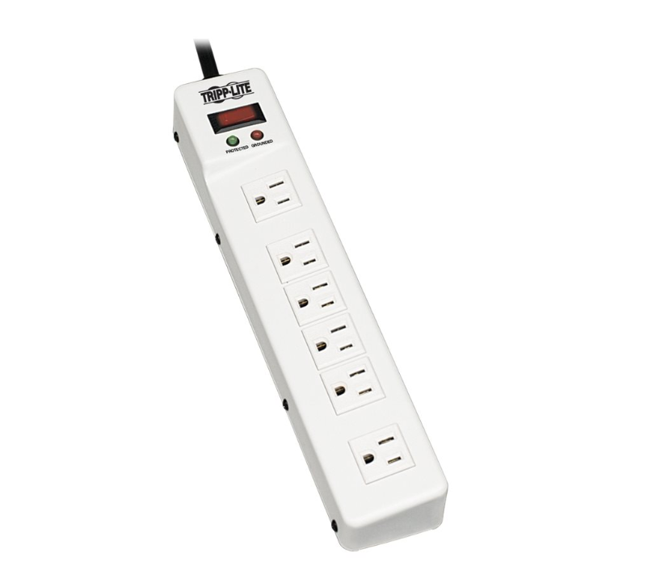
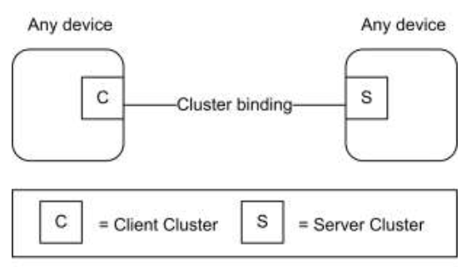
Overview of Application Layer
Endpoint: logical device
Endpoints 1-239 are available for user applications
Endpoints 0, 240-255 are reserved for special functions
Endpoint 0: Zigbee Device Object (ZDO); used for network config/admin
Endpoint 255: Used for Broadcasting a message for all endpoints
Cluster: communication model
Client/Server model
Defined in Zigbee Cluster Library (ZCL)
Cluster ID
Commands
Attributes
Power Strip
Endpoint 1
Endpoint 2
Endpoint 3
Endpoint 4
Endpoint 5
Endpoint 6
14
Notes:
In application layer, a physical device can be split to several logic devices by implementing multiple endpoints.
Each endpoint represents a logic device. For example, if we have a smart outlet adapter with 6 outlets on it. We can implement it with 6 endpoints so that we can switch on/off each outlet respectively.
The endpoint ID is a 8bit value, ranging from 0 to 255.
Endpoint 0 is reserved for Zigbee Device Object, mainly used for management purpose.
Endpoint 240 to 254 are reserved for special applications. Like Zigbee Green Power use dedicate endpoint 242.
Endpoint 255 is used for broadcasting.
Endpoint 1 to 239 can be used by user applications.
In each endpoint, we can configure several clusters. Zigbee cluster is actually a communication model.
It’s based on client/server mode and used to describe the application protocol between the two devices.
Each cluster has a cluster ID which is defined in Zigbee Cluster Library (ZCL).
A cluster may define several attributes and commands.

Slide 15
Example of Cluster
Color Control Light with 2 bulbs
Attribute | Value
On/Off | True/False
Device A
Command | Direction
On | Client to Server
Off | Client to Server
Toggle | Client to Server
Bulb 1
End point 1
Turn on/Turn off
On/Off Cluster
Brightness Control
Level ControlCluster
Color Control
Color Control Cluster
Attribute | Value
Current Level | 0-100
Bulb 2
End point 2
Command | Direction
Move to level | Client to Server
On/Off Cluster
Level ControlCluster
All standard clusters are defined in ZCL spec.
Clusters can be customized
Add new clusters
Add new attributes or commands to standard cluster
Color Control Cluster
15
Notes:
Let’s see an example of the cluster, so that we can understand it better.
For example we need to implement a Light with two bulbs.
We can define two endpoints in it. Each endpoint represents a bulb.
For the basic function, like turning on/off, we can use the on/off cluster. The light is the server side, and the switch is the client side.
There is an attribute “on/off” defined in the server side, indicating if the light is on or off.
There is also commands like “turn on”, “turn off”, “toggle” defined and should be sent from the client side to server side.
If we want more functionalities, like we need to support level control. We can use the level-control cluster.
In this cluster, there is an attribute “level” defined in the server side, indicating the brightness of the bulb.
There is also commands like “move to level” defined and should be sent from the client side to server side.
And if we need even more functionalities, for example we need to support color control, we can use the color control cluster.

Slide 16
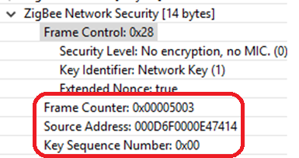
Network Layer Security
Symmetric Encryption/Decryption
All devices use the same key
Message Integrity Check
Replay Attack Protect
NWK Key Management
Unsecured
SYNC
PHY
HDR
MACHDR
NWKHDR
NWK Payload
Application of security suite adds auxiliary header and also an integrity code
Secured
SYNC
PHY
HDR
MACHDR
NWKHDR
Auxiliary
HDR
Encrypted NWK Payload
MIC
All the above NWK frame is integrity-protected
Notes:
OK, here we have introduced the basic knowledge about Zigbee. Seems devices can work well with the concepts we have talked about.
As Zigbee is a wireless technology, security is very important because hackers can sniffer those packets over the air. Imaging that you have a smart door lock.
If the hacker captured the packets of unlocking your door, then he could replay that to open your door. That would be dangerous.
To prevent that from happening, Zigbee defined many security features. Let talk about it.
First we will talk about network layer security. Look at the picture at upper left. It shows how an unsecured network frame is secured in network layer.
First, the network payload will be encrypted. After that, an security header will be added before the encrypted payload. Then calculate a hash value from the network header, security header and the encrypted payload. Finally appended the 32-bit hash value to the end of the frame. If any byte of the network header, security header and encrypted payload is changed, the hash value will be different. We call this value MIC, short for message integrity check.
The network encryption uses a symmetric encrypting algorithm, which means the same key is used for encryption and decryption. This is key is called network key.
For this reason, all devices in the same Zigbee network will use the same network key.
In the network security header, a field named “frame counter” and the source Eui64 of the node who encrypt the message are added to protect replay attack.
A key sequence number is added to support network key updating.

Slide 17
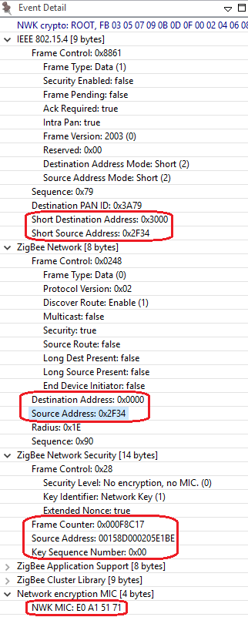
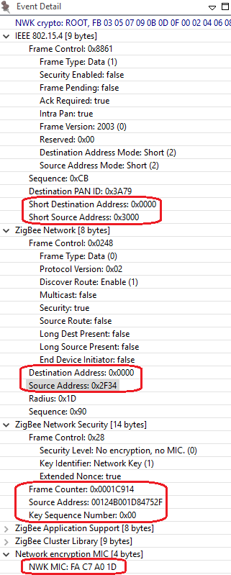
Network Layer Security – Hop-by-Hop Security
Incoming
0x2F34
00158D000205E1BE
MIC Check
1
Drop
0x3000
00124B001D84752F
Decrypt
2
To me?
0x0000
00124B000CC8983A
Process
Encrypt
Add Auxiliary HDR
Add MIC
1
2
Forward
Notes:
Network layer security is a hop-by-hop security.
The router node needs to decrypt the message, then encrypt it and replace the info in security header, after that send it out.
If the decrypting fails, the message will be dropped immediately.
The benefits of this is to drop the attacking messages as soon as we can.

Slide 18
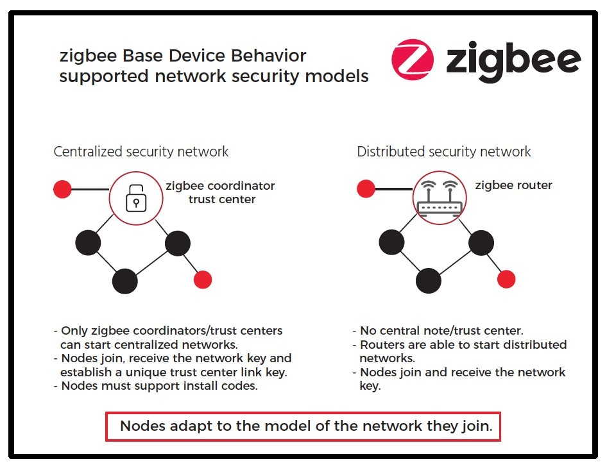
Network Layer Security – NWK Key
NWK key is a 16-byte octets
Randomly generated when network formed
Trust Center:
a network role who distribute NWK key to new devices
Centralized Security Model:
Only one Trust Center (Coordinator)
Distributed Security Model:
Every router can be Trust Center
NWK key transportation:
Secured in application layer
Notes:
As we talked in earlier, all devices are using the same network key. Network key is a 16 bytes octets.
Normally it’s randomly generated by coordinator when the network is formed.
When new devices join network, they must get a copy of the network key.
In Zigbee network, the role who distribute network key to new devices is called trust center. There are two typical security models, centralized security network and distributed security network.
In a centralized security network, there is only one trust center, normally it’s the coordinator. All new devices will get network key from coordinator.
In a distributed security network, every router is a trust center. New devices can get network key from every router.
As the network key needs to be transported from one device to another, the key value needs to be encrypted during transporting.
This encryption is done in application layer. We will talk about it later.

Slide 19
Network Layer Security – Frame Counter
Node A
Node B
Node C
Transmission side
Outgoing FC needs to increase
Outgoing FC needs to save in non-volatile memory and restore after reset
Reception side:
Need to save all frame counter of neighbors
Node | FC
B | 100
FC=100
Node | FC
B | 100
C | 200
FC=200
FC must be <= 0x80000000
Will wrap after a year if keep transmitting at a rate of 135pps.
NWK key MUST be updated before it wraps.
Node | FC
B | 100
C | 200
FC=100
Notes:
As we talked in the slides before, frame counter is added to prevent replay attacks. Let’s see how it works.
First, a node will record the frame counter of the received frame and the Eui64 of the node.
The frame counter of the next message from the same node must be bigger than the recorded.
Otherwise, the message will be considered to be a replay and will be dropped.
To achieve this, on the transmitting side, every node will save it’s outgoing frame counter.
On the reception side, nodes need to save frame counters of all neighbors.
As frame counter is a 32-bit value, it could wrap if the device keep running for a very long time. Apparently there could be a problem if the frame counter wraps.
To prevent this from happening, the network key must be updated before it wraps.
If the network key is updated, the frame counter could start from zero again.

Slide 20
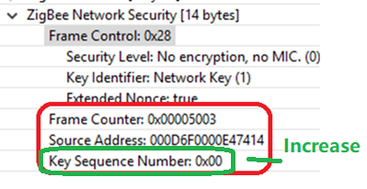
Network Layer Security – NWK Key Update
Trust Center
Device
Trust Center generate a new NWK key
Trust center broadcast the new NWK key to devices
Trust center broadcast a command to notify all devices to switch to the new key
For devices missed the update, they need to perform a rejoin process to get the new key
Generate new key
Broadcast new key
(encrypted by old key)
Save new key
Broadcast key switch command
New key take effect
Notes:
This is the procedure of network key updating.
First, coordinator generates a new network key.
Then coordinator broadcast new network key to all devices.
Devices will save the new key as a alternative key.
When coordinator is ready to switch the new key, it sends out a switch command and then all device starts to use the new key.
If any device missed the new key or the switch command, they will perform a rejoin process to get the latest network key.

Slide 21
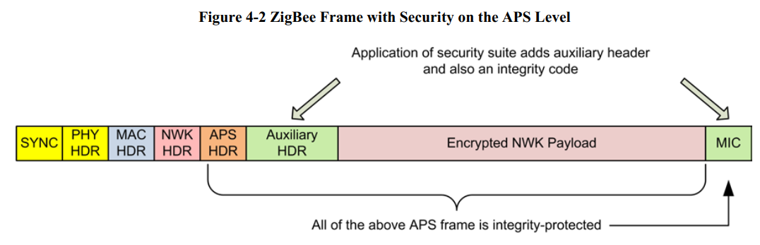
APS Layer Security
End to end security
Link key:
Trust center link key
Application link key – (Used in Smart Energy)
Centralized Model
Default global link key: ZigbeeAlliance09
Install code
Distributed Model
Global link key: will be offered by the Allience
Touch link key: will be offered by the Allience
Notes:
As we talked before, transporting network key is encrypted in application. Let’s see application layer security.
It’s quite similar to network security.
Also symmetric encrypting algorithm is used. The key is called link key. For most case, only the transporting network key message needs to be encrypted in application layer, and this only happens between trust center and the new device. So in this case, we also call it as trust center link key.
APS layer security is an end-to-end security because only the two peers which participate the communication know the link key.
Devices in the network can use the same link key or different link key.
If the devices use the same link key, this key is a global link key.
In distributed model, as every router could be a trust center, global link key will be used.
In centralized model, there is also a special global link key being used, which is the well-known link key. It’s the string “ZigbeeAlliance09”.
This is used in the standards before Zigbee 3.0 and is kept to keep backward compatibility.
The trust center link key must be preconfigured on the devices so that they can join and work.
It would be easy if they are using the well-know link key.
But what if they need to use different link key?
Zigbee defines an approach to configure the link key out of band. It’s the install code.

Slide 22
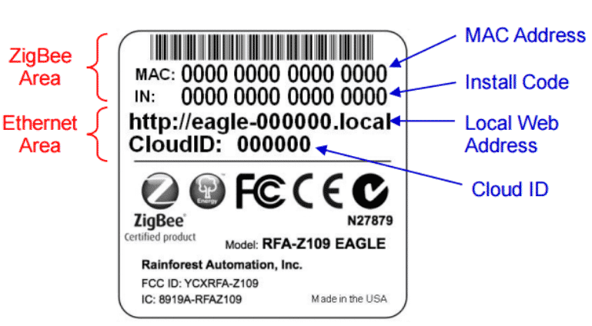
APS Layer Security – Install Code
Factory
Installation
TC link key is derived from install code
Install code is sent out of band.
Install code is mandatory of Zigbee 3.0.
Generate Install code
Program Install code to device
Put a note on the device
Derive TC link key from install code
Configure this link key for this device
Notes:
Install code is a 16 bytes polynomial + 2 bytes CRC
When device is manufactured, in the factory, an install code will be programmed into the device.
After that, on the label of the device, the install code and the Eui64 of the device will also be recorded.
When device is going to be installed, users get the install code and Eui64 from the label.
Then configure them to coordinator. The coordinator them derive a link key from the install code and set a table to use the link key for this specific device.
After that, this link key will be used to encrypt the message in application layer.
On the device side, it reads the install code from the flash and then derive a link key with the same algorithm. This link key should be the same with the derived link key on the coordinator side. So that they can communicate in application layer even if the message is encrypted.

Slide 23
Forming and Joining Procedure with Security -- Use Well-know Link Key
Coordinator
Device
Four parameters of a network
PAN ID
Extend PAN ID
Channel
Tx Power
Form network
Beacon request
Send beacon request on every channel to find joinable networks
Beacon
Might receive multiple beacons
Choose the one with best RSSI
Association request
Association response
Got node ID
Transport NWK key
Got NWK key
Encrypted with well-known link key
Device Announce
23
Notes:
Let’s see the joining procedure with security feature is added.
First, let’s see the joining procedure of joining with the well-known link key.
The first two phase, finding networks and getting node ID are the same as we talked before.
After the device got it’s node ID, the coordinator will transport the current NWK key to the new device.
This transporting message is encrypted in application layer with the well-known link key.
When the new device receives this message, it uses the well-known link key to decrypt the message and gets the network key.
After that, the device is really joined the network and is able to communicate with all other nodes in the network.
The device will send an announce message to notify the other nodes of the network to inform them that I’m joined.

Slide 24
Forming and Joining Procedure with Security -- Use Install Code
Coordinator
Device
Four parameters of a network
PAN ID
Extend PAN ID
Channel
Tx Power
Program Install Code to Device in Factory
Form network
Get the install code from the label of the device
Derive a link key from the install code
Configure this link key for this device
Beacon request
Send beacon request on every channel to find joinable networks
Beacon
Might receive multiple beacons
Choose the one with best RSSI
Association request
Association response
Got node ID
Transport NWK key
Derive link key from the pre-programmed install code, then decrypt the message with the derived link key. After that got the NWK key.
Encrypted with install code derived link key
Device Announce
24
Notes:
Also, let’s see the procedure of joining with install code.
The new device should have been programmed with the install code.
Before it joins, users need to get the install code and Eui64 of the new device, and then configure them on the coordinator.
The coordinator then derive a link key from the install code and set the coordinator to use this link key to encrypt the transport NWK key message for this new device.
When coordinator starts to transport network to the new device, it encrypt the message and transport it to the new device.
When the new device receives this message, it reads the install code from flash and derive a link key from it, then use this key to decrypt the message and get the network key.

Slide 25
Q&A
Q&A
25
Notes:
Any questions here?

Slide 26
Thank you!
Notes:
Thanks

