Slide 1
Jenkins Scalability Summit 2013
The Sony Mobile list to Santa Clause
Robert Sandell – Development Environment
© Sony Mobile Communications

Slide 2
Framework for masters to master communication
To be able to give a ”simple”/standard way for plugins to talk to itself and other parts of a remote Jenkins master
Trigger build when build finished on another master
Parameterized trigger (or build flow DSL) on remote Jenkins
Gerrit Trigger could coordinate approval with other masters that also triggered builds for the same change
Multi Slave config plugin could move/copy slaves in bulk between masters
Move and copy jobs between masters.
Some restrictions are needed, ”Logical Networking?”
For example three masters and one of them is special (protected)
Protected should be able to trigger a build when another build finishes on an ”open/none protected” Jenkins but not the other way around
Preferably made as a plugin so we don’t nessesarily need to upgrade core.

Slide 3
Computers (slaves) should be an ItemGroup or similar
Today when we list the files in .jenkins all we see is a big list of slave logs
Just as jobs are in individual directories beneeth .jenkins/jobs/ we would like to see the slaves treeted the same way for example .jenkins/computers/slave01/
In there is a confix.xml, logs etc.
No slave configuration in main Jenkins conf (it is big enough as it is)

Slide 4
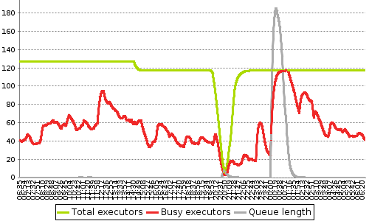
More Data!!
More and better stats to be able to take better descisions.
Like the ”Load Statistics” for slaves and labels needs an over haul
Existing graphs doesn’t tell me much
Averages/smooth lines
Lost after restart
idle == unavaliable?
Listener for queue events
To be able to externally or with a plugin get good data instead of snapshots

Slide 5
Exception: Unexpected termination of the channel.
Somewhere around >250 slaves and lots of builds we start to get broken connections in the middle of the build
The Ping Thread?
We’ve had to crank up the timeout for it to be able to handle that many slaves
Could that be the issue?
# hudson.remoting.Launcher.pingIntervalSec=1800: try to ping once every 30 minutes
# hudson.remoting.Launcher.pingTimeoutSec=1500: wait 25 minutes for ping before give up and disconnect
# hudson.slaves.ChannelPinger.pingInterval=25: wait 25 minutes for ping (the two above don't seem to work)
export HUDSON_OPTIONS="-Dhudson.Functions.autoRefreshSeconds=30 -Dhudson.DNSMultiCast.disabled=true\
-Dhudson.model.WorkspaceCleanupThread.disabled=true -Dhudson.remoting.Launcher.pingIntervalSec=1800\
-Dhudson.remoting.Launcher.pingTimeoutSec=1500 -Dhudson.slaves.ChannelPinger.pingInterval=25\
-Djava.awt.headless=true"
export CATALINA_OPTS="-Xms512m -Xmx24000m -XX:MaxPermSize=256m $HUDSON_OPTIONS"

Slide 6
Client Side form validation
Could lesser the load of server roundtrips

Slide 7
Long running Jobs
Keep Jobs running on the slave while master is restarting

