Slide 1
13,000 Jobs and counting…

Slide 2
Our System
Advertising
and
Data Platform
Notes:
First, I need to explain about our system. A lot of decisions that we made were based on the nature of our system.
Advertising & Data Platforms
We serve ads for Yahoo and external customer. A lot of ads.
We process all of Yahoo's data. That's more than 100 billion unique events per day.
Many dev teams
HUGE
We have an extremely diverse system. It has several hundred unique software components
home grown, acquisitions, 3rd party software
old tech stack, current stack, experimental stack.
We have Linux, we have FreeBSD, we even have Windows (through acquisitions).
We have Java, C++, JavaScript, Scala, Groovy, Perl, PHP, Pig, MapReduce, Oracle, MySQL, all kinds of data marting technologies, ....
Revenue bearing - there are billions of dollars flowing through this system
All of this needs to come together and work

Slide 3
Our Team
We provide Jenkins Infrastructure as service and develop tools related to Continuous Delivery
Product teams own and manage their CD pipelines, they configure jobs, etc
We don’t control what is in the job. It is shared resource and we trust our engineers to be smart.
There is enough monitoring to check the health of the infrastructure
Teams rely on this infrastructure for their deployments and they expect this infrastructure to be up

Slide 4
Jenkins Infrastructure At A Glance:
1 Primary Jenkins Master and 3 Backup Masters in 2 data centers
50 Jenkins Slaves in 3 data centers
400+ Executors
Hardware Configuration
2 x Xeon E5645 2.40GHz, 4.80GT QPI (HT enabled, 12 cores, 24 threads)
96G memory
1.2TB disk
Supports RHEL, FreeBSD and Mac Builds
20TB Filer Volume to store Jenkins Job and Build data

Slide 5
Key Metrics At A Glance:
13,000+ Jobs
8,000+ builds per day
2M+ builds per year
6TB build data
Average Build Status
80% Success
20% Failure

Slide 6
YOY – Number of Builds

Slide 7
Physical Architecture
CNAME
DNS Rotation
Jenkins Master
Primary
Server
Jenkins Master
Secondary
Server
Jenkins Master
Secondary
Server
Jenkins Master
Primary
Server
Jenkins Data
DC1 Filer Storage
DC2 Filer Storage
Jenkins Slaves
Jenkins Slaves
Jenkins Slaves
Jenkins Slaves
Jenkins Slaves
Jenkins Slaves
25 RHEL, FreeBSD and Mac Slaves
25 RHEL, FreeBSD and Mac Slaves
Snap Mirror Replication between DC1 and DC2 Filer
Jenkins Dasboard
DC1
DC2
MySQL
Database
Crawler

Slide 8
Issues and Solution Multiple Build Environments
Issues
Can’t scale if we run only one build on a slave
Running multiple builds at same time conflicts with each other
Solution
Use light weight container
In our case we use heavily augmented version of the standard UNIX command chroot
Notes:
Our light weight container is a heavily augmented version of the standard UNIX command chroot. While chroot merely changes your root, this tool also installs all the files required to create a functional, clean software environment, provides extra facilities for managing the virtual environments it create.

Slide 9
Issues and Solution JVM
Issues
Jenkins loads configuration of Jobs and their history into memory when it starts up.
JVM performance conundrum
Solution
Increased the memory on the master
Allotted JVM Heap: 48GB
JVM Heap Used:
Min: 5GB
Avg: 10GB
Max: 15.5GB
Notes:
JVM performance conundrum, which goes something like this:
If you provide too little memory to an application it will run out of memory. The JVM will not be able to free up memory space at the rate that your application needs it. Push too hard and eventually the JVM will throw an OutOfMemoryError and shut down completely. So you have to provide more memory to your applications.
If you increase the heap size for a response-time-sensitive application, the heap will eventually become fragmented. This is unavoidable if you don't restart your system or custom-architect your application. When fragmentation happens, an application can hang for anywhere from 100 millisecond to 100 seconds depending on the application, the heap size, and other JVM tuning parameters.

Slide 10
Issues and Solution High Availability
Issues
Loose data when Jenkins master crashes
If backup exists, takes many hours to setup new master from backup
Solution
Moved Jenkins configuration and data to filer, with mirror
Allowed us to switch to back up / Disaster Recovery (DR) Jenkins master in seconds.
4 masters behind DNS Rotation
2 Masters in each Prod and DR colo
99% uptime for master

Slide 11
Issues and Solutions Huge console log crash Jenkins
Issues
When console log gets too big, JVM crashes due to OOM
Solution
Used opensource ‘Log File Checker’ plugin to fail the job if console log reaches 200MB

Slide 12
Issues and Solutions JMX Plugin
Issues:
Jenkins API is not rich enough to monitor build queue and executors.
Solution
Jenkins plugin for exposing @Exported attributes of the application's data internal model via JMX.
The following is a list of MBeans exposed by this plugin
BusyExecutors - Total number of executor threads that were running a build
TotalExecutors - Total number of executor threads across all nodes
BuildableItemCount
BlockedItemCount
WaitingItemCount
ItemCount

Slide 13
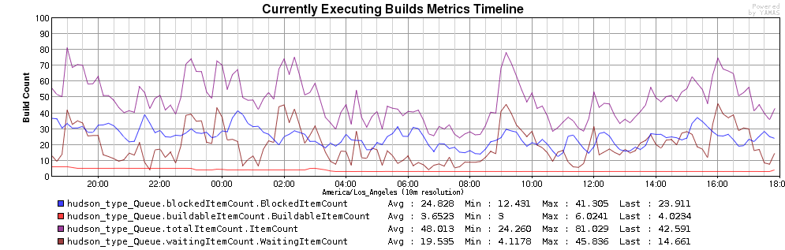
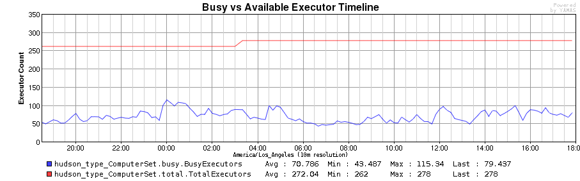
JMX Plugin

Slide 14
Issues and Solutions Cleanup
Issues:
Jenkins provides ‘Discard old builds’ feature. This controls the disk consumption of Jenkins by managing number of builds. But there are no feature to control disk consumption like managing workspace, chroot, jobs etc.
Solution
Added script to implement data retention policy

Slide 15
Data Retention / Backup
More than 35 thousands jobs and 6 million builds since beginning. All these data cant be kept since Jenkins loads Jobs and its history in memory. To address we needed to do the following data retention policy
Job Retention Policy: Jobs with no builds for 120 days are archived and removed.
Build Retention Policy: Keep only last 150 builds
Workspace Clean: Remove workspace from all slaves except where last build ran.
Chroot Clean Up Policy: Remove chroot 18 hrs or older.
The master configuration and all job configuration are backed up every 15 minutes.

Slide 16
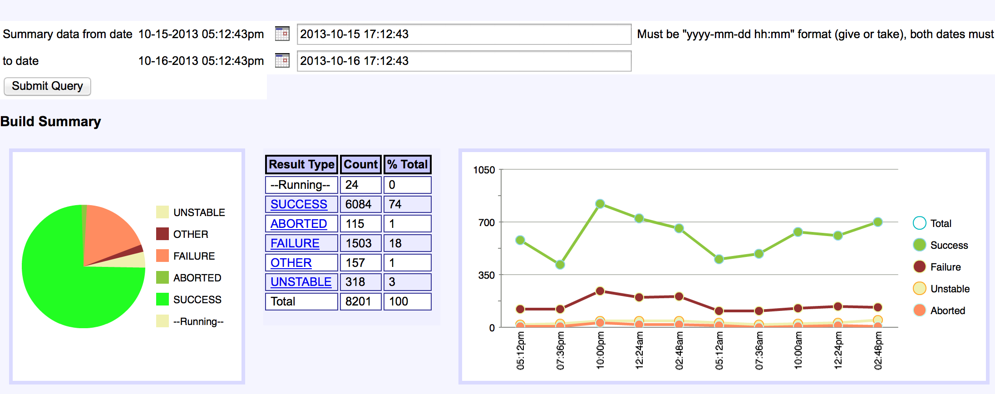
Jenkins Dashboard Build Summary

Slide 17
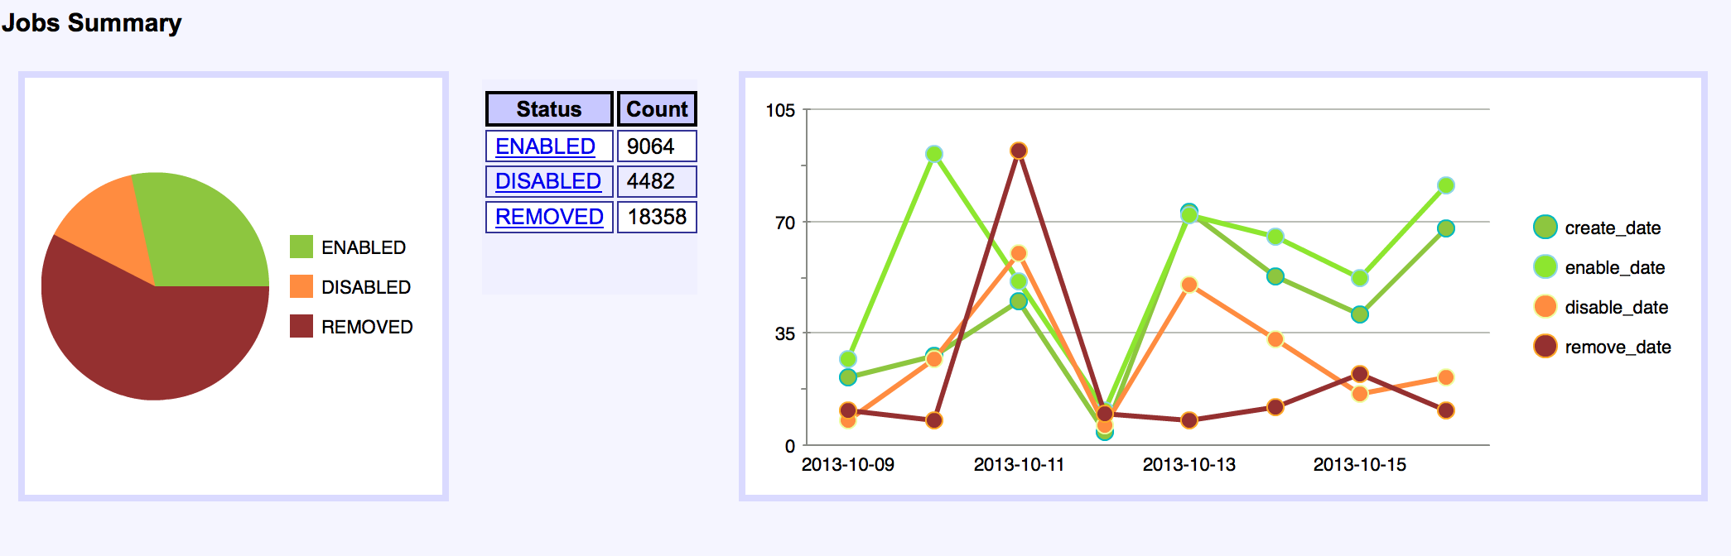
Jenkins Dashboard Job Summary

Slide 18
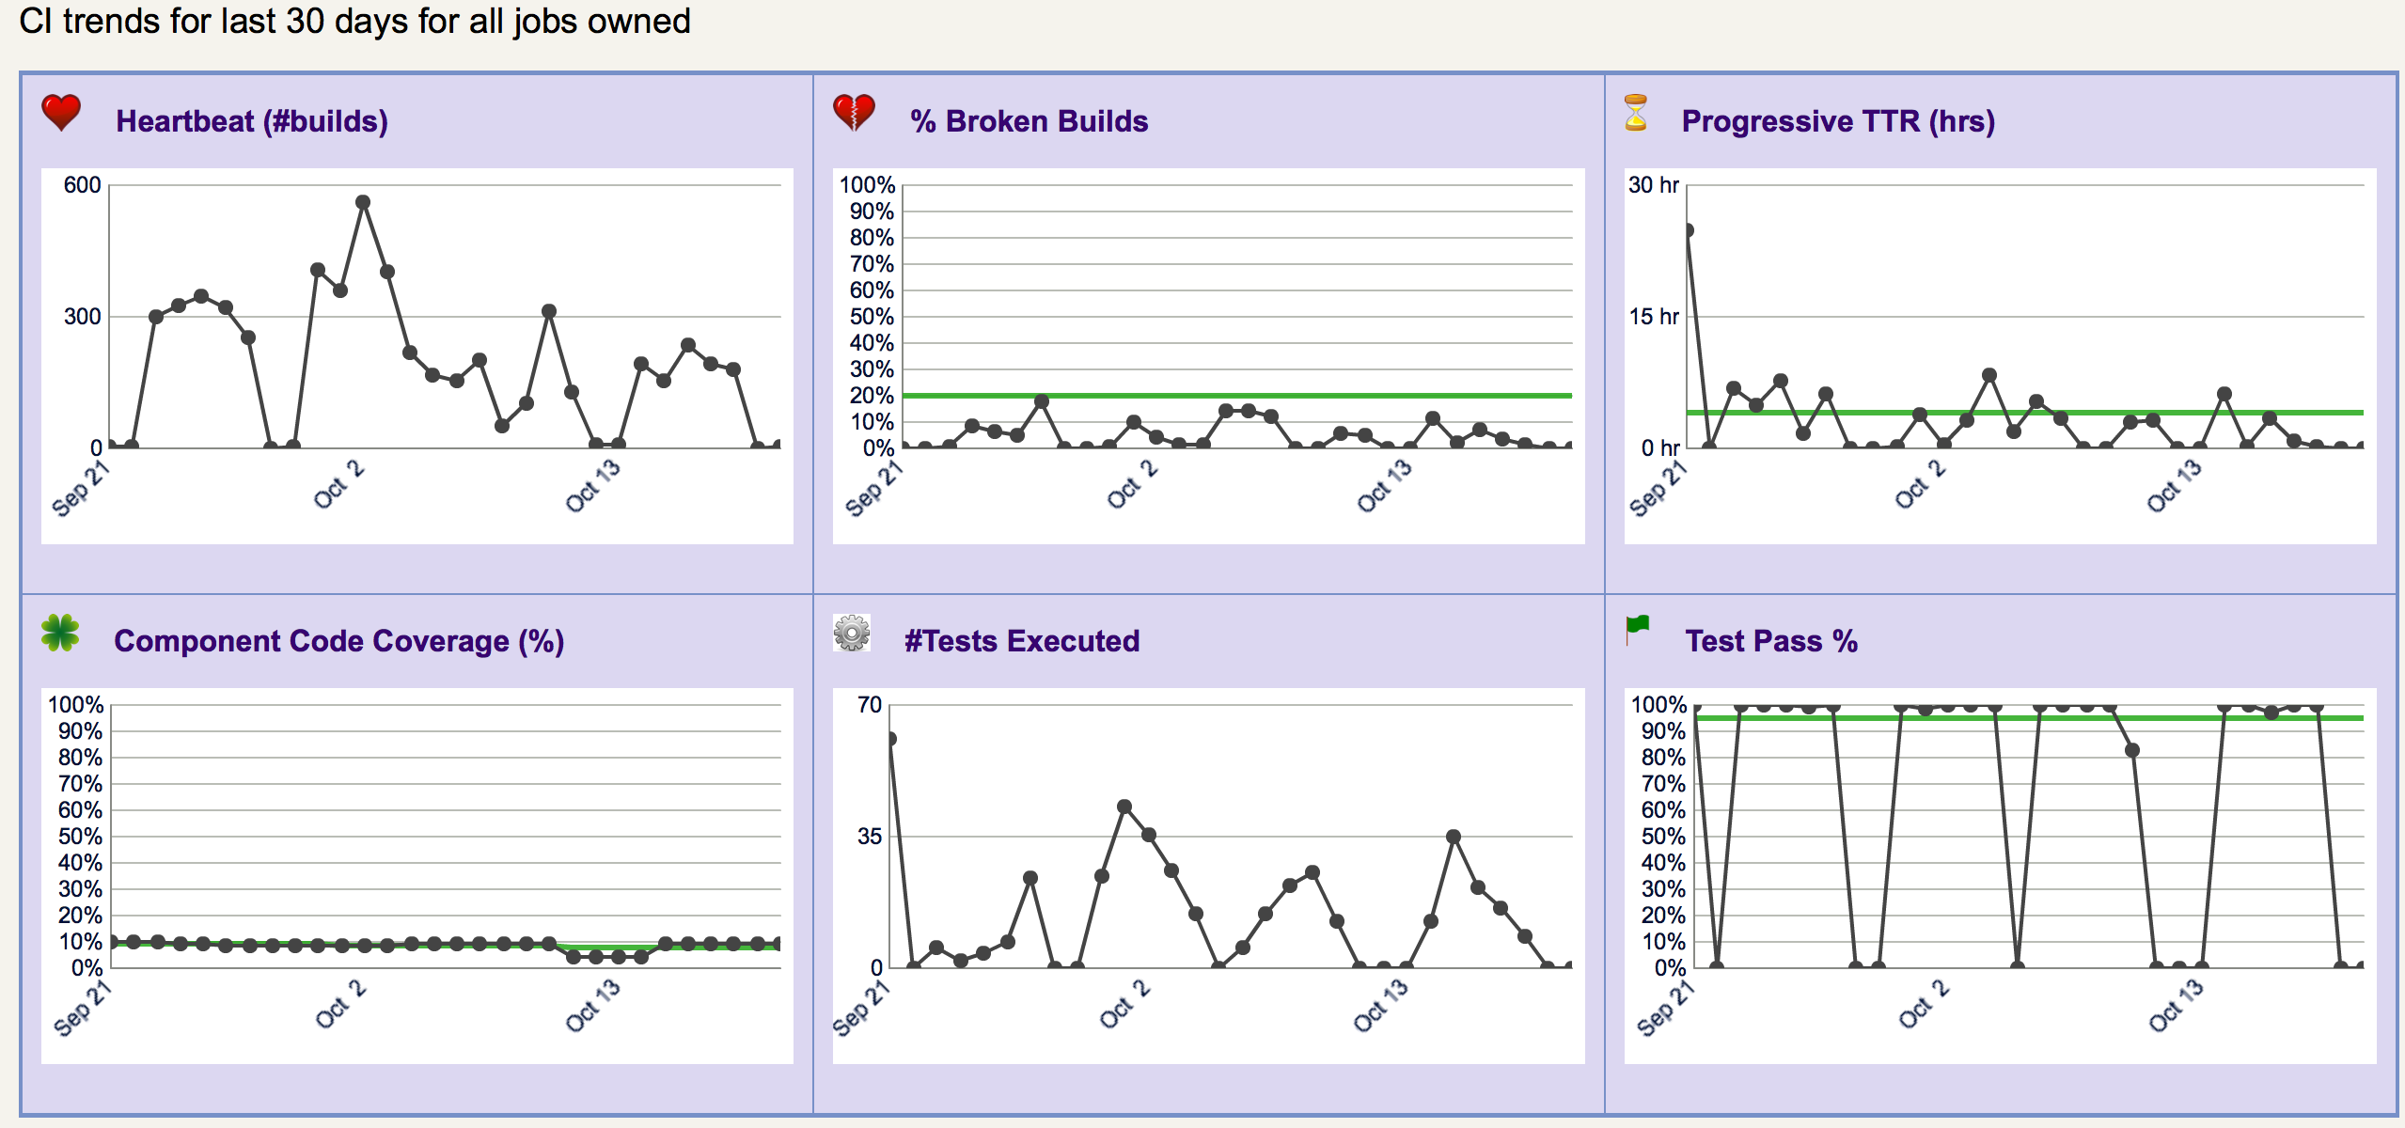
CI Metrics & Trends

Slide 19
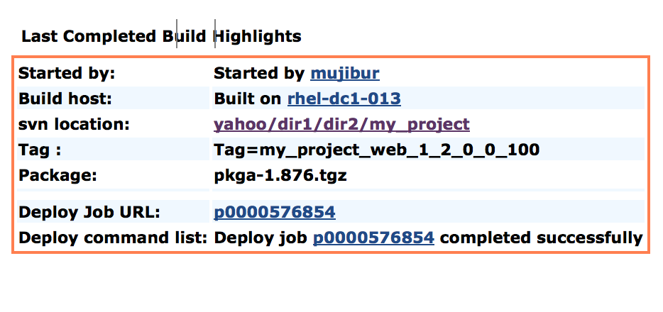
Build Highlights Plugin
Notes:
Modfy the content

Slide 20
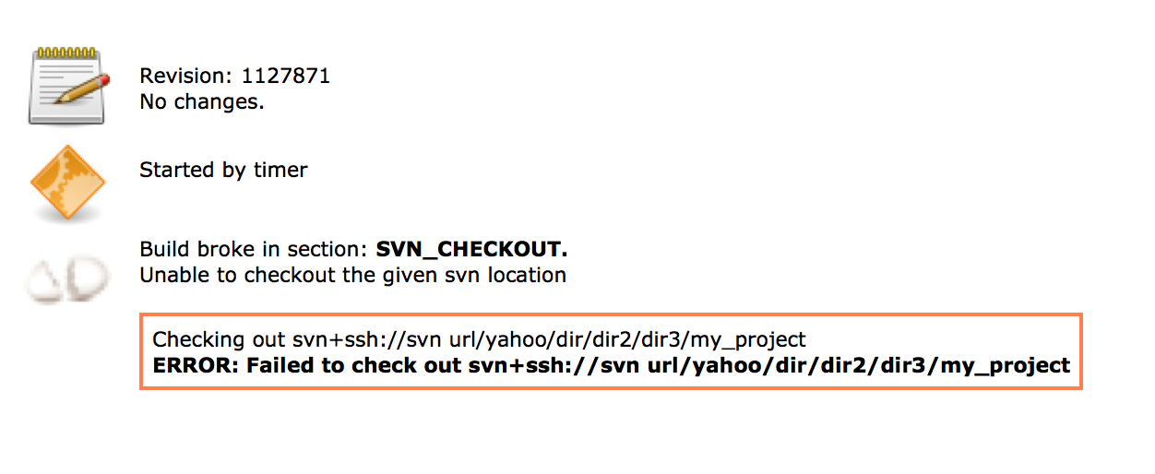
What Broke The Build Plugin

Slide 21
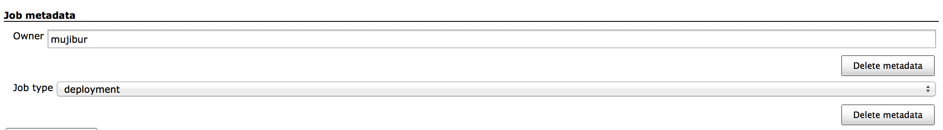
Job Meta data Plugin

Slide 22
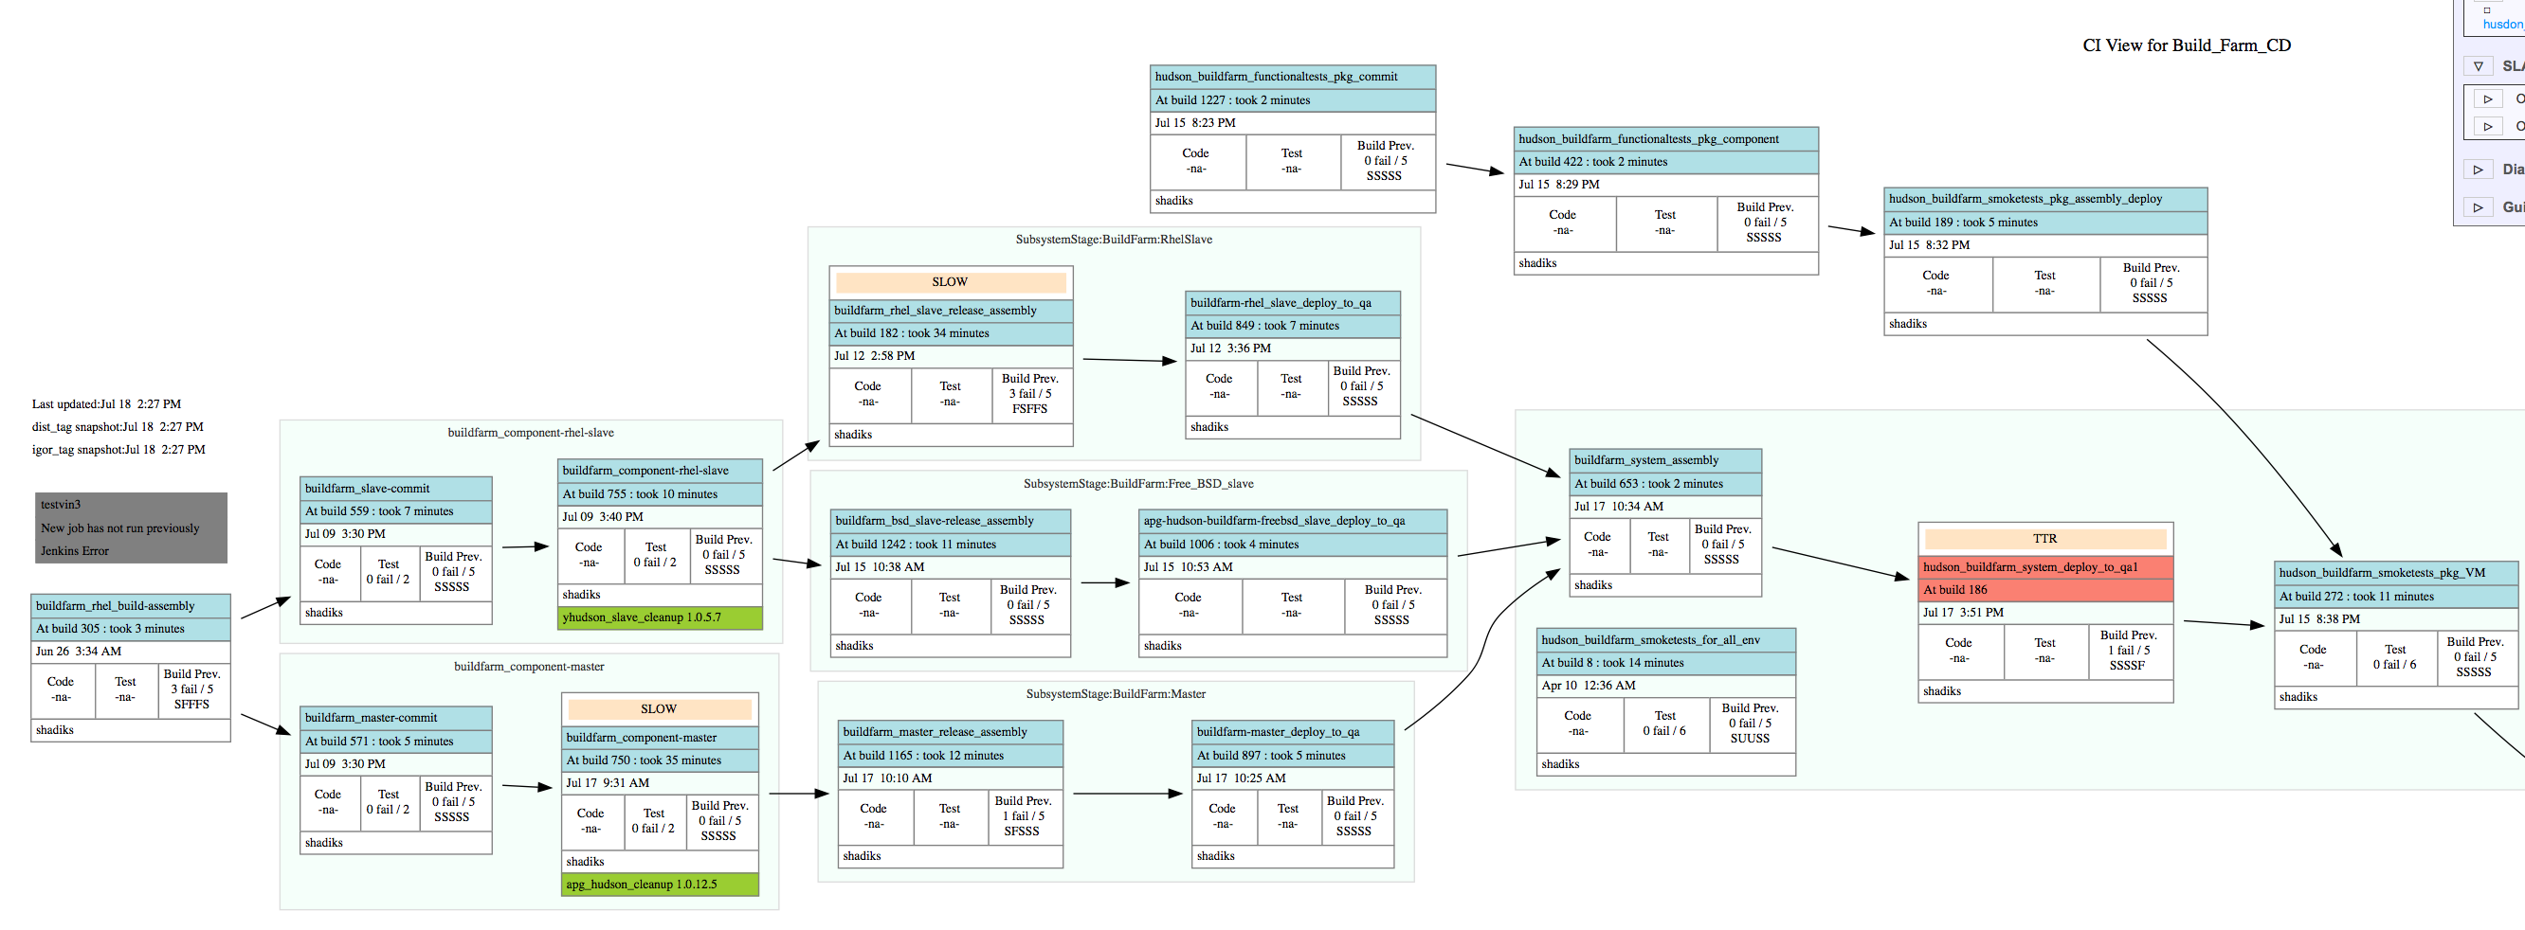
CD Pipeline

Slide 23
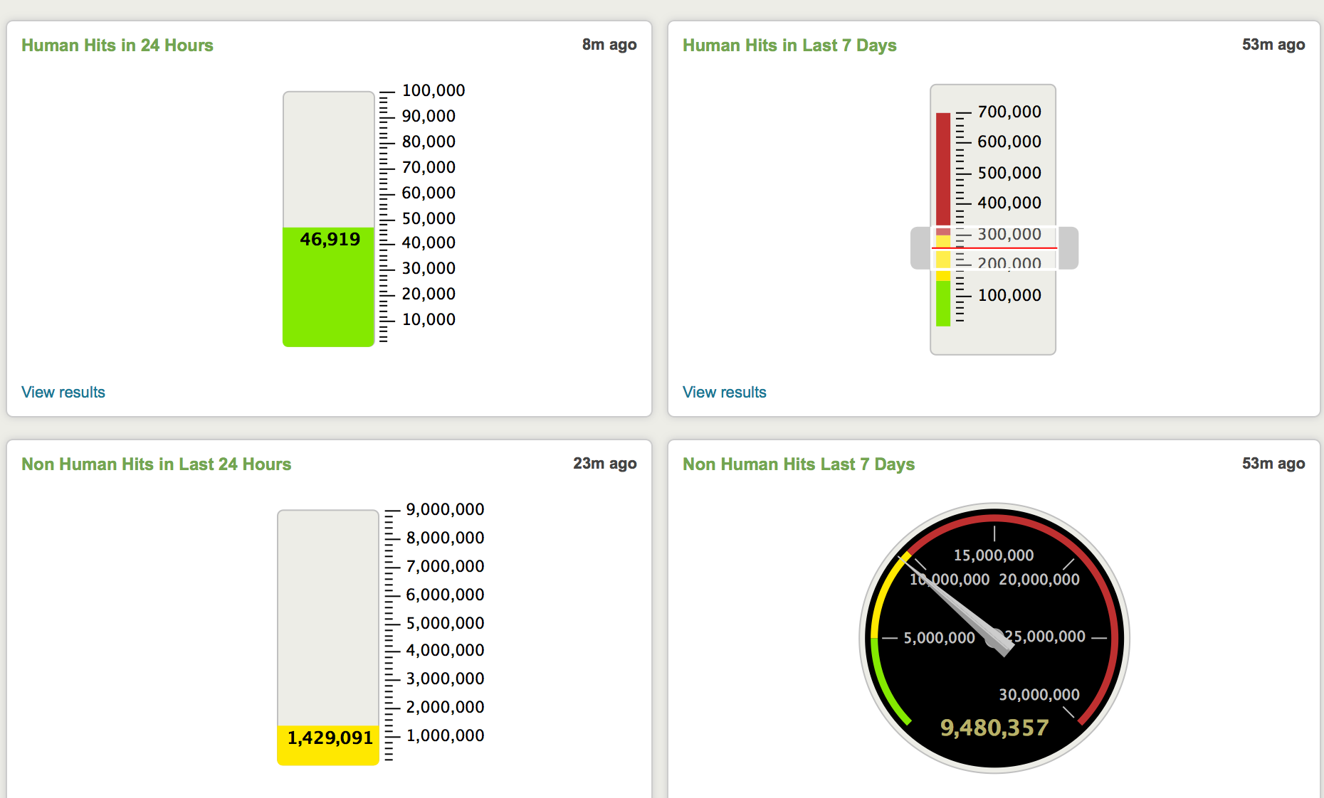
Splunk Dashboard

Slide 24
Problems
Multi master support
Load time and performance
Concept of pipeline
Resource consumption
Cross Jenkins instance trigger

