Slide 1


The Future, Connected.
Disclaimer: The information contained herein is proprietary to eInfochips Limited and may not be used, reproduced or disclosed to others except as specifically permitted in writing by eInfochips Limited. The recipient of this document, by its retention and use, agrees to protect the same and the information contained therein from loss or theft.
www.einfochips.com

Slide 2
JENKINS FOR CONTINUOUS INTEGRATION

Slide 3
Agenda
What is Continuous Integration?
Problems before Continuous Integration
Continuous Integration to the rescue
What is Jenkins?
Job creation and other build options
Different Master Slave Configurations in Jenkins
Demo

Slide 4
WHAT IS CONTINUOUS INTEGRATION
Continuous Integration (CI) is the practice of integrating changes from different developers in the team into a mainline as early as possible, in best cases several times a day.
This makes sure the code individual developers work on doesn’t divert too much. When you combine the process with automated testing, continuous integration can enable your code to be dependable.

Slide 5
PROBLEMS BEFORE CONTINUOUS INTEGRATION
Developer1
Source Code
Repo
Difficult
Integration
Developer2
Developer3
Late Acceptance Testing
Late Notification of bugs
This all leads to late releases

Slide 6
PROBLEMS BEFORE CONTINUOUS INTEGRATION
Problems for Developers:
Developers have to wait till the Complete Software is developed for the test results.
If the test fails then locating & fixing bugs is very difficult. Developers have to check the entire code of the software.
Software delivery process was slow

Slide 7
PROBLEMS BEFORE CONTINUOUS INTEGRATION
Problems for Testers:
i) Testers had to do the whole redundant work of testing again and again.
ii) Human tendency to overlook a few things if something is done again and again

Slide 8
Continuous Integration to the Rescue
Developer1
Developer2
Source Code
Repo
Build
Developer3
Build triggered for every commit
Acceptance
Tests
Notification of
bugs through mail
Continuous Feedback
CI Server

Slide 9
Continuous Integration to the Rescue
Before CI
After CI
i) The Entire Source Code was built and then tested
ii) Developers have to wait for test results
iii) No Continuous Feedback
i) Every commit made in the source code is built and tested
ii) Developers know the test result of every commit made in the source code on the run
iii) Continuous Feedback is present

Slide 10
WHAT IS JENKINS?
Jenkins is a self-contained, open source automation server which can be used to automate all sorts of tasks related to building, testing, and delivering or deploying software. A variety of plugins are available for this.
Jenkins supports version control tools, including CVS, Subversion, Git, etc.
Jenkins can be installed from Linux/Windows packages or you can download and run the application from Web Application Archive (WAR) files.
Builds can be triggered by various means for e.g by commit in a version control system like git.

Slide 11
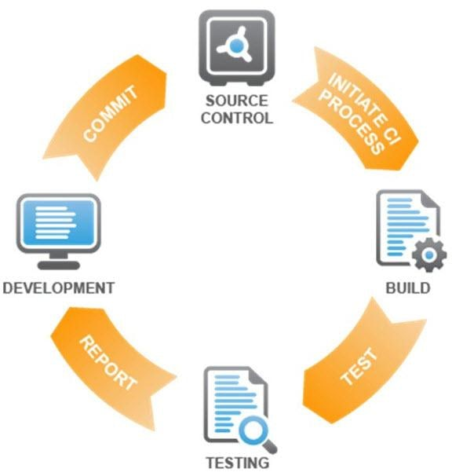
JENKINS WORKFLOW

Slide 12
Job creation, build options and other configurations
Job: particular task or step in your build process.
Build Triggers:
Trigger a job when some changes are made and committed
Trigger remotely using Authentication Token
Build Periodically (Nightly Builds)
Pre Build Actions and Post Build Actions
Jobs A->B->C
Either in Post Build Actions of A mention to trigger B and C
OR in Pre Build Actions of B and C mention to trigger after A

Slide 13
Job creation, build options and other configurations
Admin Privileges:
Manage Plugins
Manage Users
Manage Nodes
Configuring Security
User Account:
Can customize the access, like give access of certain jobs to a particular group
Eg. Developer can get permission of viewing developer jobs
Testers can get permission of viewing Tester jobs

Slide 14
Different Configurations In Jenkins
Master Slave Configurations:
Jenkins Master
Jenkins Slave (Node)
Jenkins Slave (Node)
Jenkins Slave
(Node)
Jenkins Slaves are usually needed to provide the desired environment. Works on the basis of requests received from the master.

Slide 15
Different Configurations In Jenkins
Testing in Different Environment
GitHub
Repository
Jenkins Server (Master)
Code Commit triggers CI
Jenkins Slave
Ubuntu
Jenkins Slave
MAC
Jenkins Slave
Windows
Tests

Slide 16
Different Configurations In Jenkins
Distributing load
Jenkins Server (Master)
GitHub
Repository
Slave1
Slave2
Slave3
Code commit triggers CI
Slave3
Build Machine for module1
Build Machine for module2
Build Machine for module3
Target
Target2
Target
Target
Target3
Test
Test
Test

Slide 17
Different Configurations In Jenkins
Jenkins Master:
Schedules Job
Dispatching jobs for building or execution on slave
Monitor Slaves
Record and Present the build result
Master instance of Jenkins can also execute build jobs directly.
Jenkins Slave:
Hears requests from Jenkins Master instance
Can run on variety of Operating Systems
Executing Jobs dispatched by Master

Slide 18
Demo
GitHub
Repository
Triggered when code committed
Cross Compiling Application and transferring it to slave
Executing Application
Raspberry Pi 3
Tests
X86 Machine

Slide 19
Flow of Demo
Build Triggered after commit in branch
Execute Build and run unit tests
If fail
If success
Integrate
Developer to make changes
Build Triggered after commit in master
Execute Build and run integration tests
Notify the result to the developer

Slide 20
SUMMARY
Catch Issues fast and resolve them
Everyone can see what’s happening
Stop waiting to find out if your code is working
In a nutshell “Continuous Integration doesn’t get rid of bugs, but it does make it dramatically easier to find and remove them”

Slide 21


Slide 22


