Slide 1
You Can Bee 2
Remote sensing for bee hives
Currently, the only way to monitor commercial beehives is to open the hive and look around. Beekeepers often don’t know what they’ll find until they open the lid and disturb their colonies.
What if there was a better way?
What if we could use new tech to make the bar for entry to bee keeping much lower?
Mark Ehler

Slide 2
Timeline
Remote beehive sensing equipment - 20
record a season of beehive activity
Monitoring app - 21
train data while offering a tool for professional keepers
Community app - 2?
retail hives available for rent
2-way app connects landowners with farmers

Slide 3
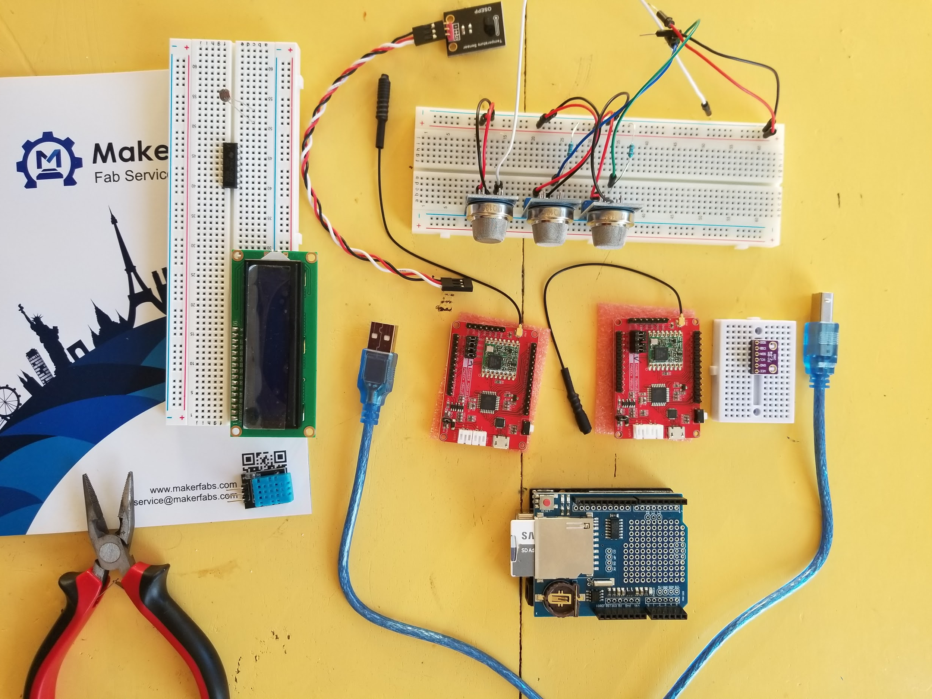
Prototyping

Slide 4
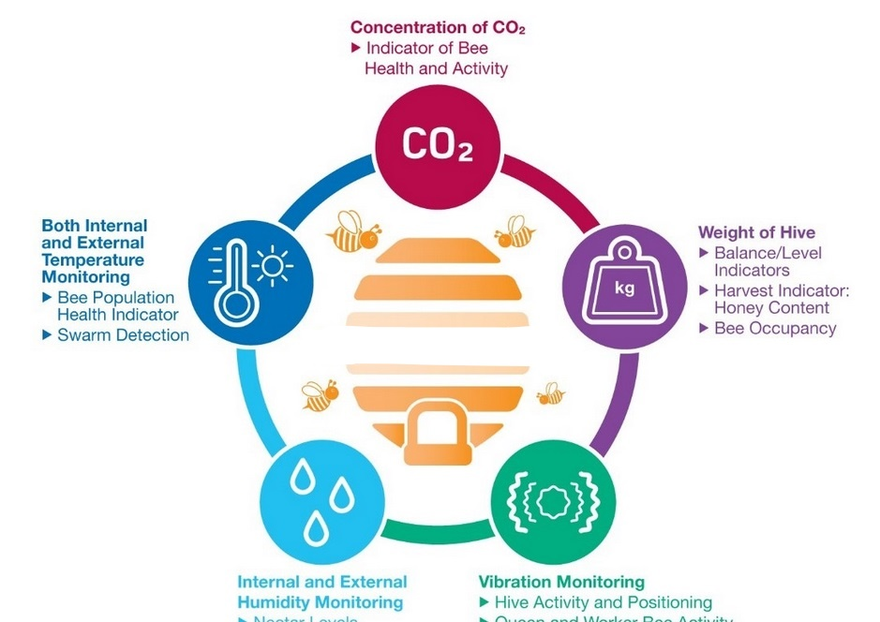
Arduino for Remote Sensing

Slide 5
The Story so Far
Young me struggled to make sense of farming in the modern age.
Spent time in Nepal as a Peace Corps Volunteer, I wanted to farm on a small scale.
I came home, back to the cities, away from idyllic agrarian communities. People seemed disconnected - from their food - from each other.
I didn’t see the perceived use for farming. I took a side step and developed skills in machine learning.
People 💛 bees - not everyone 💛 them enough to put on the beesuit but everyone 💛 the people who do.

Slide 6
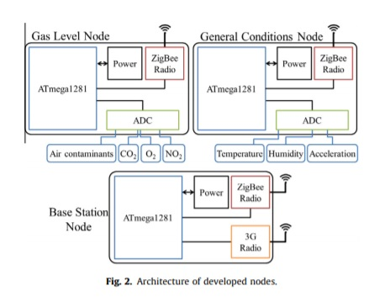
LoRa
LoRa
LoRa
WiFi

Slide 7
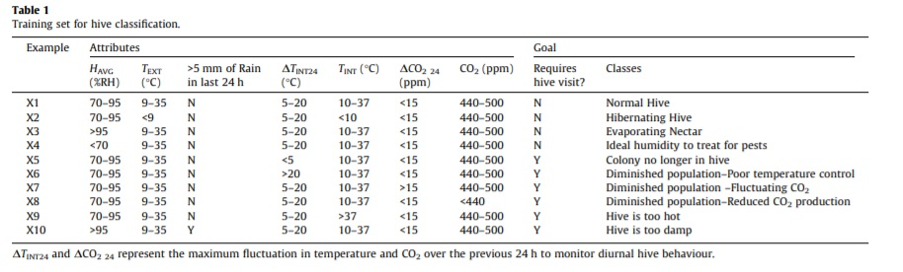

Slide 8
Hit the Boost
This product hinges on good data.
This project could benefit from assistance in the following:
Good sensors are needed to record good data.
developing prototype sensor bundles that fit seamlessly in beehives.
Future investment in front-end development for the app IP.

Slide 9
How can IMF help -describe the specifics of what services you need from IMF.
Type | Use | Manufacturer
High-Res 3D Printer | Build rigid and flexible parts and assemblies | Object Eden 350V
 | Precision, automated, high capacity and rapid machining of metals and plastics | Hurco VM1
NC milling machines | Automated multi-axis milling machine | Bridgeport EZ Trac
athes – various sizes | Turning and cutting cylindrical metal, wood and plastic | Leblond and Hardinge
Welder | MIG/TIG | Miller Syncrowave 250
Additional tools: Oscilloscopes, electronic fabrication and test equipment, sanders, grinders, benders, punches, jointers, routers, band and table saws, hydraulic presses, and drill presses.

