Slide 1
Apollo’s Demand for Project Management
Mark Endicott

Slide 2
Apollos Struggles
The workload is historically uneven or unreliable.
Issues with role communications or expectations.
Not a lot of incentive to do officer work.
Progress in projects mostly happens bi-monthly – VERY SLOW.

Slide 3
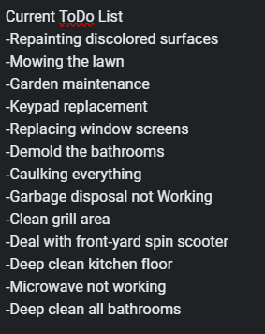

This is just facilities…
BOTTOM LINE: We need someone to pick up the slack

Slide 4
The role of Project Management
Organizes and monitors project progress.
Communicates with everyone to ensure stuff gets done.
Producing house progress reports.
Fills housework/officer gaps if no one else wants to fill it.

Slide 5


Slide 6
Requirements
$10+ an hour starting (house funds).
8-10 hours a week from me!
Initial 2 weeks of prepping and training.

