Slide 1

Telegram bot for devices store
By Yerasyl Usen from SE-2001

Slide 2


The main idea
My goal is to create a convenient way to browse the products available at an electronics store.

Slide 3
What is this bot doing?
The purpose of this bot is simple. When a client wants to purchase a particular device, he simply selects the type of product he wants.
Then the bot will display a list of firms producing the type of product that the client has chosen and the model of this device.
When the buyer chooses the device model, the bot will give a link to the site where the client can purchase it.

Slide 4
Progress

Slide 5
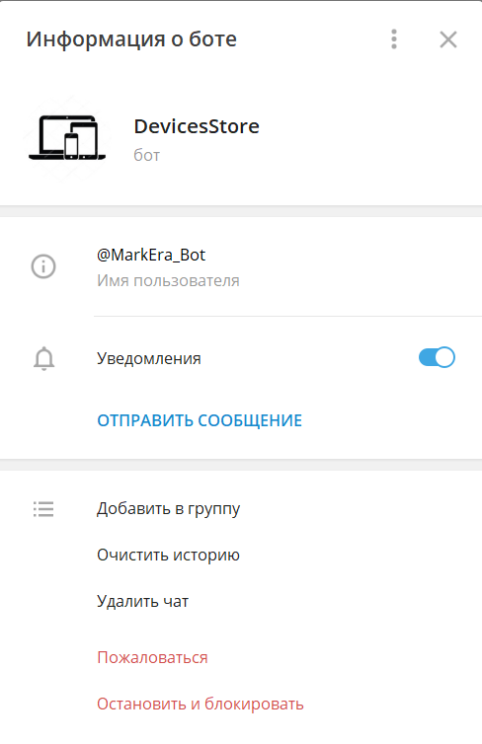
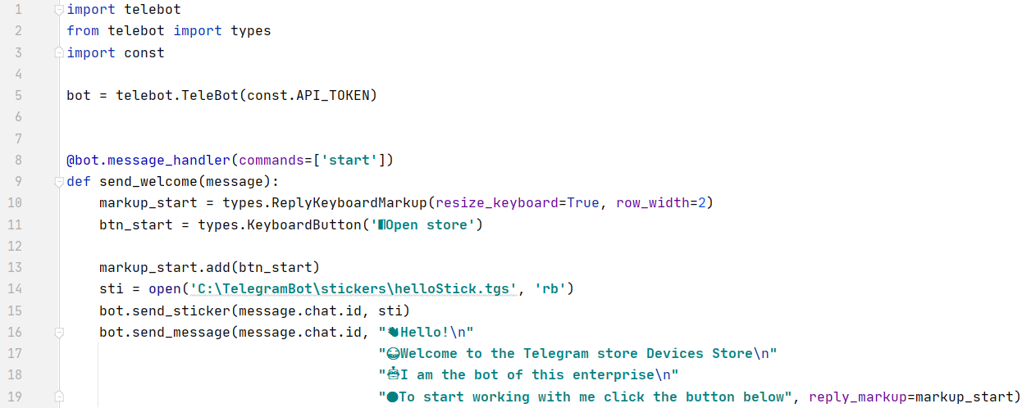
Some screenshots
Profile of the bot
Main part of the code

