Slide 1

Evolution of CQRS
CODE IMPACT 2017
Presented by Mark Ewer

Slide 2

Agenda
What is an CQRS+ES?
Typical Web Application Architecture
Make It Faster With Caching
Keep It Fast With Persistent Cache
Refactor Your Architecture Event Sourcing
CQRS!
Code Demo
Email: Mark@3w3r.com
Web: http://www.markewer.com
LinkedIn: http://www.linkein.com/in/markewer
Phone: (904) 238-7347

Slide 3
What is an CQRS+ES?
Command and Query Responsibility Separation (CQRS)
The idea that what makes a good and performant database for writing is not the same as what makes a good and performant database for reading.
Separating the Write database from the Read database means you can optimize them separately
Separating your Write application logic from your Read application logic means they can also be optimized separately
Meant to take advantage of “background work” that happens on the server outside of the user’s view
Event Sourcing (ES)
Instead of storing the current state of a data record, store all of the “events” that lead to the creation of that record so you can restore them to any point in time.
Gives you the ultimate “fall back” data and a 100% transaction log at the same time.
Also gives you a clear architectural pattern for mapping business concepts to data operations
CQRS and ES are best buddies!

Slide 4

Typical Web Application Architecture
I’m Burnin’ Up Over Here!
Angular JS Client
JSON REST Service (WebApi)
IRepository
POCO Entity
MS SQL Server
DataContext
Write
Read

Slide 5
Make It Faster With Caching
RAM Cache
This is faster, but I wish we didn’t have to keep re-loading the cache items.
Angular JS Client
JSON REST Service (WebApi)
View
Model
?
IRepository
POCO Entity
MS SQL Server
DataContext
Write
Read

Slide 6

Keep It Fast With Persistent Cache
View
Model
Angular JS Client
JSON REST Service (WebApi)
IRepository
ViewModel Manager
Persistent
ViewModel
Cache
POCO Entity
DataContext
MS SQL Server

Slide 7
Refactor Your Architecture Event Sourcing
View
Model
MS SQL Server
Angular JS Client
JSON REST Service (WebApi)
IRepository
ViewModel Manager
Persistent
ViewModel
Cache
POCO Entity
ViewModel Projection
DB Projection
DataContext
Event Stream
MS SQL Server
(Events)

Slide 8
CQRS!
ViewModel
MS SQL Server
Angular JS Client
JSON REST Service (WebApi)
IQueryFacade
ViewModel Manager
Persistent
ViewModel
Cache
POCO Entity
ViewModel Projection
DB Projection
IRepository
DataContext
Event Stream
MS SQL Server
(Events)

Slide 9
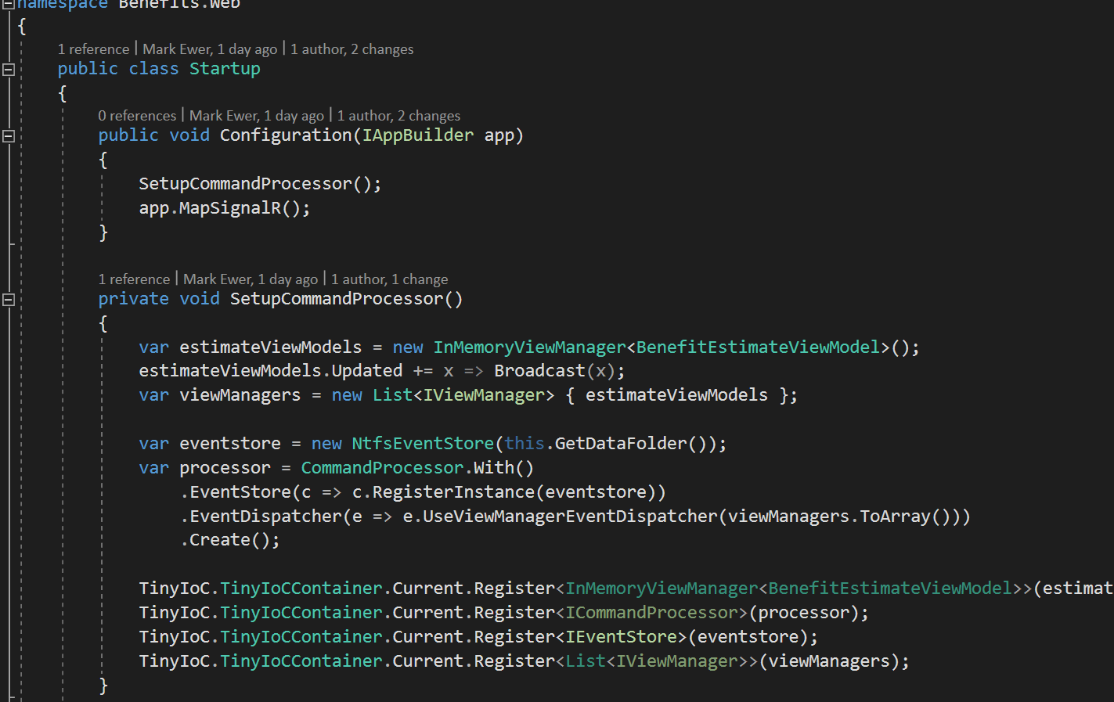
Code Demo

Slide 10
Thank YOU CODE IMPACT!
Sample code and slides available online via my GitHub repository:
https://github.com/MarkEwer/JaxDugSamples
______________________________
Email: Mark@3w3r.com Web: http://www.markewer.com LinkedIn: http://www.linkein.com/in/markewer Phone: (904) 238-7347

