Slide 1
BCC Iteration 2
Mark Fuller
Kevin Kulda
Connor Woodahl
Project Repository: https://github.com/MarkFuller1/BNU

Slide 2
Application Interface

Slide 3
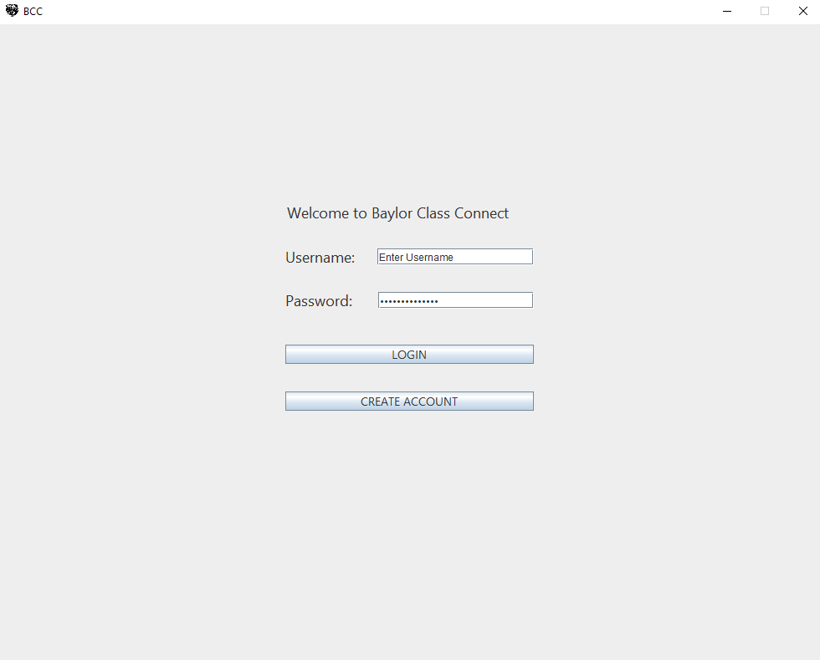
Login

Slide 4
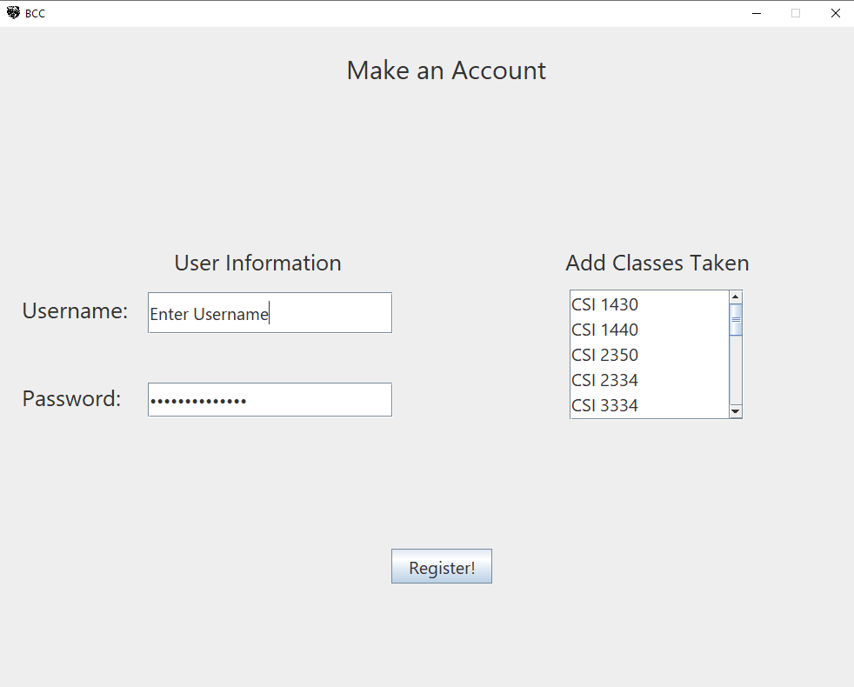
Register

Slide 5
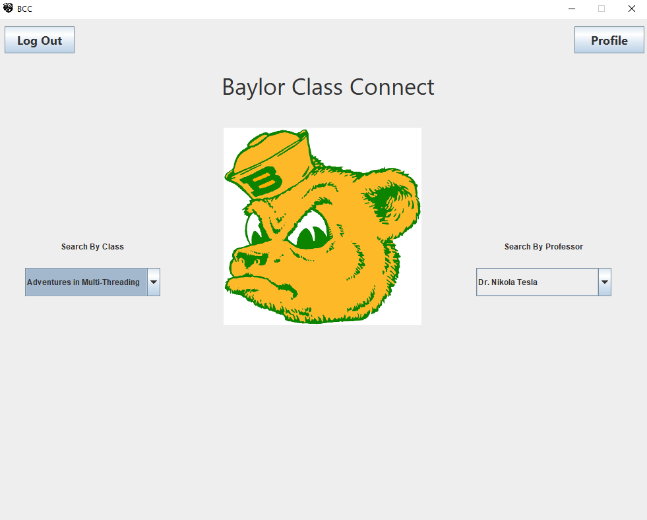
Main
Page

Slide 6
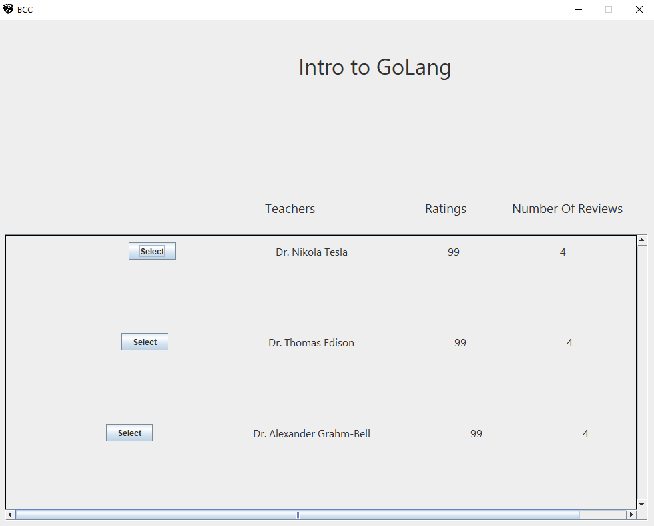
Search by Class

Slide 7
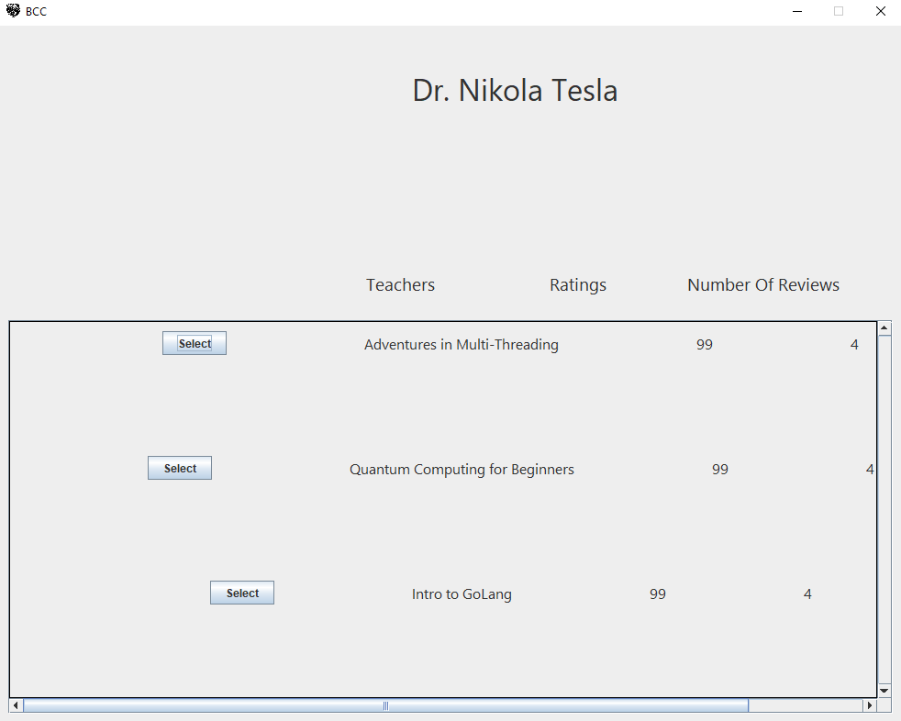
Search by Professor

Slide 8
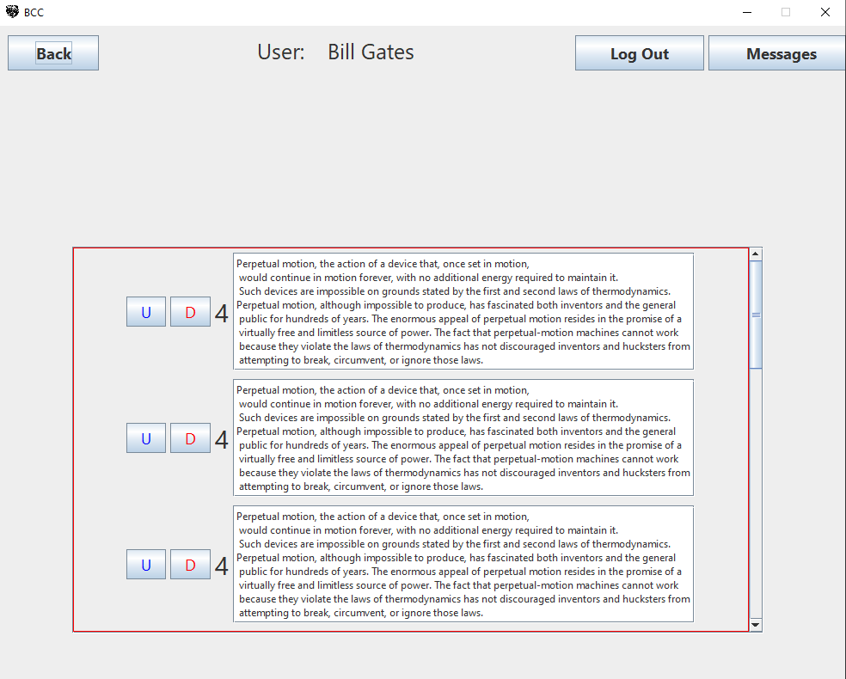
User Reviews

Slide 9
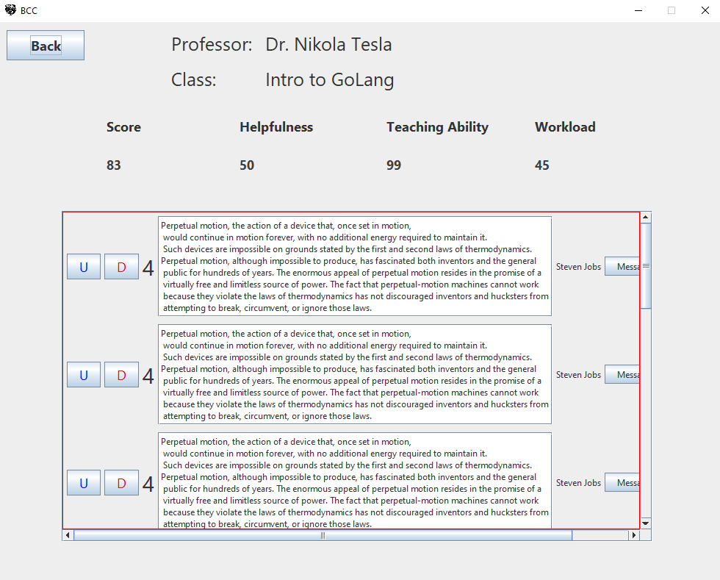
Class Reviews

Slide 10
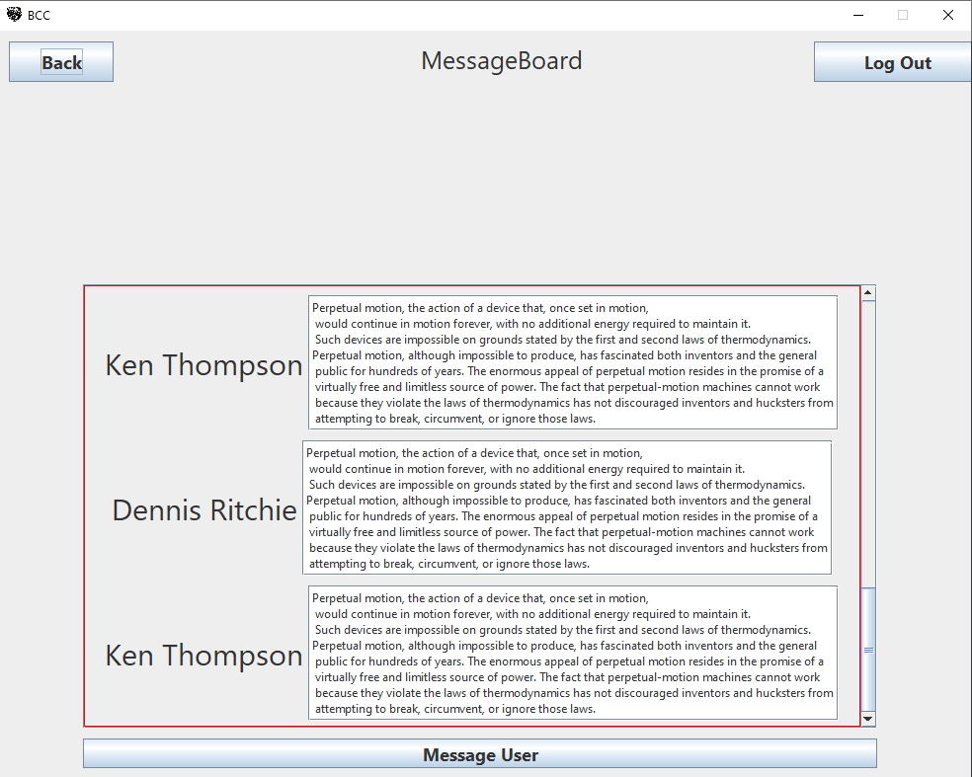
Message Board

Slide 11
Sequence Diagrams

Slide 12
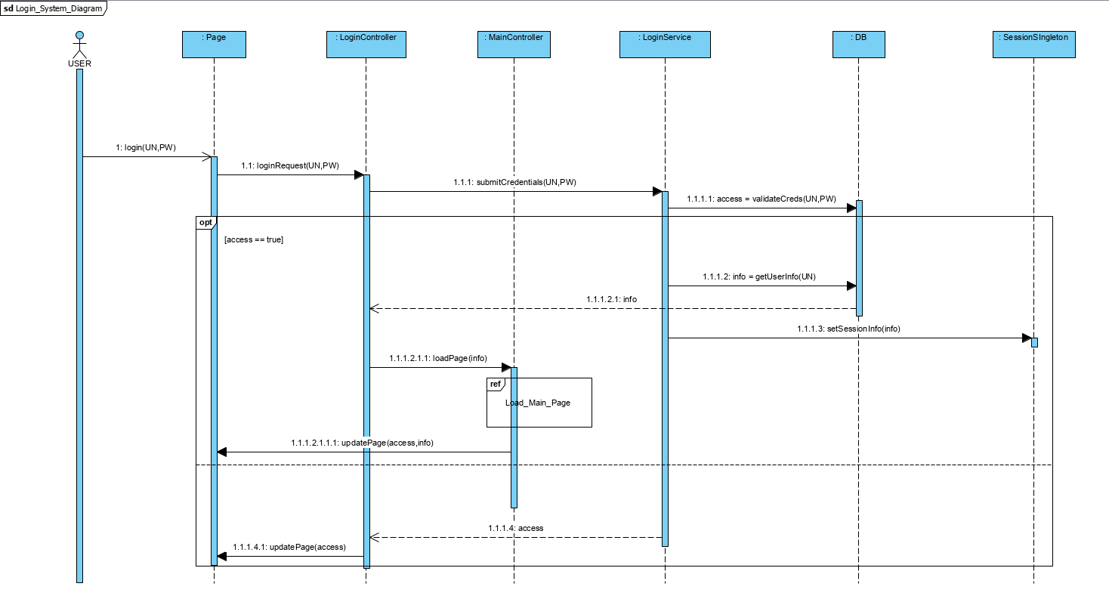

Slide 13
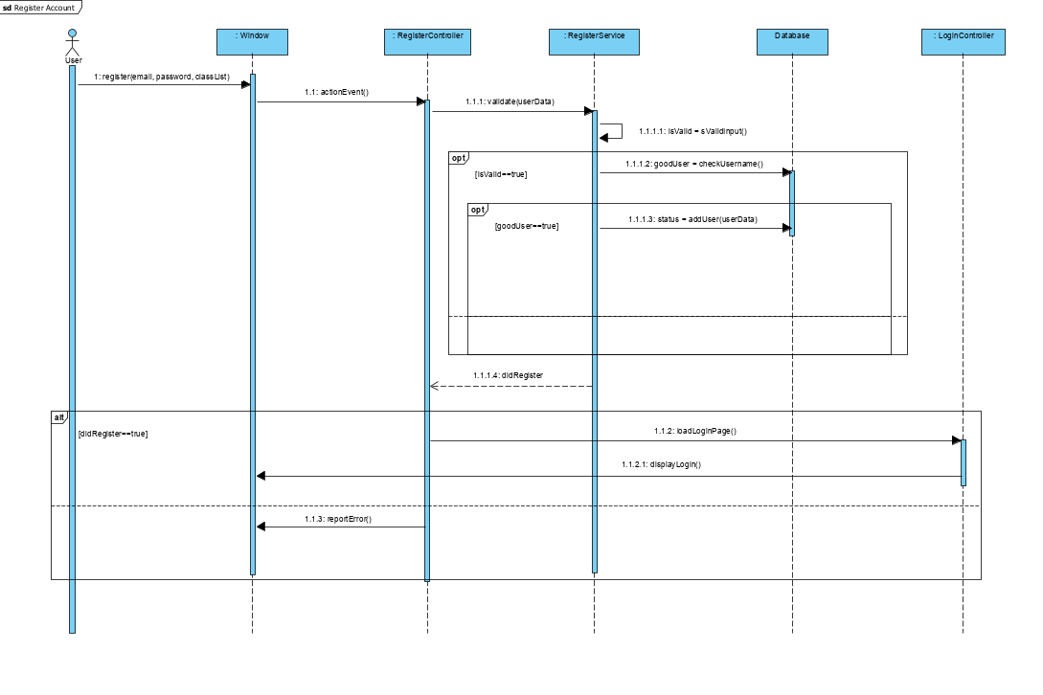

Slide 14
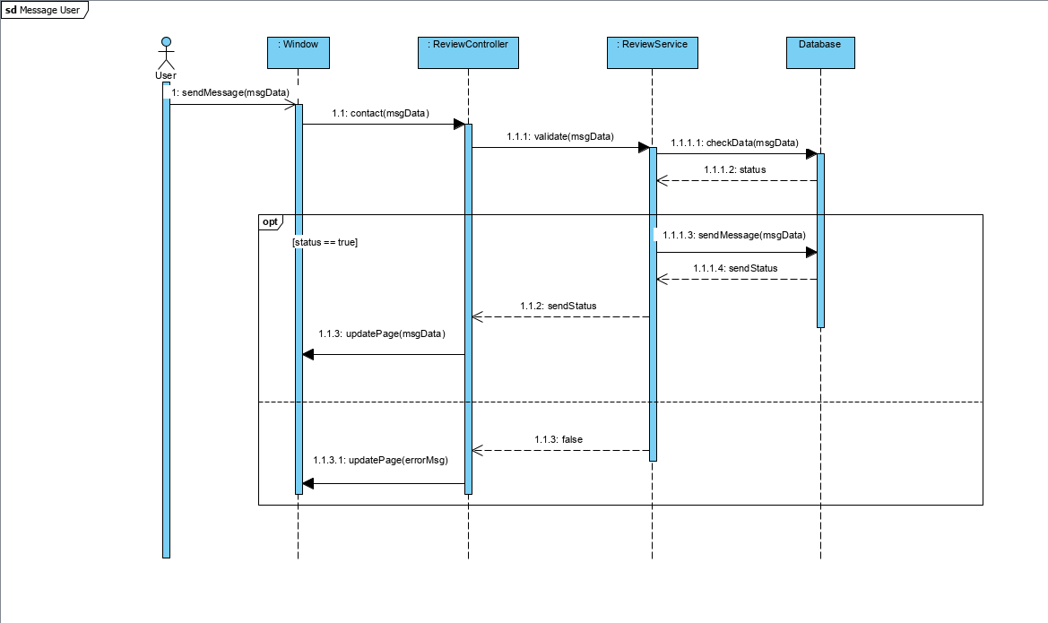

Slide 15
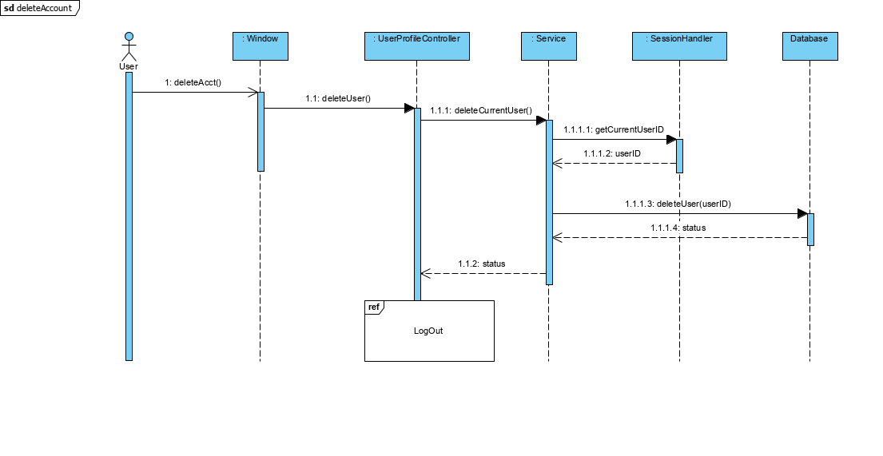

Slide 16
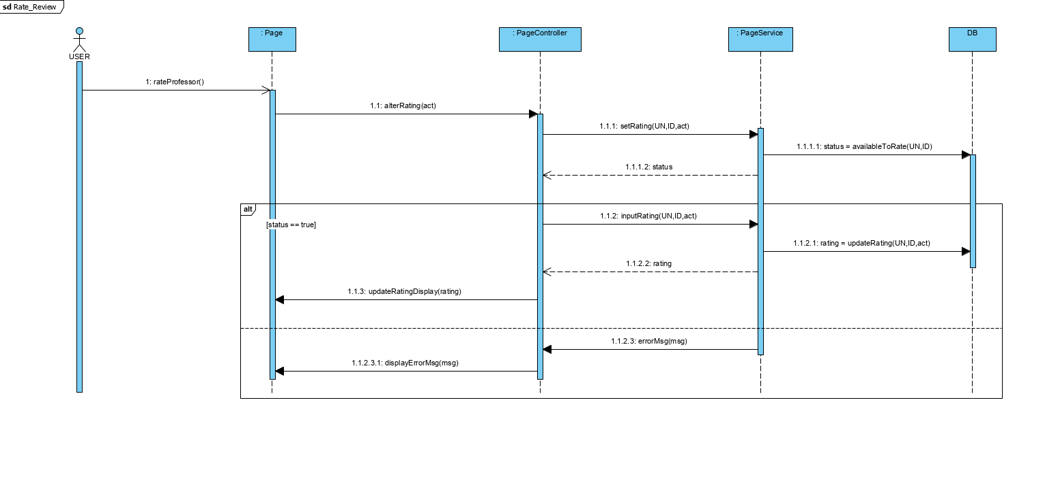

Slide 17
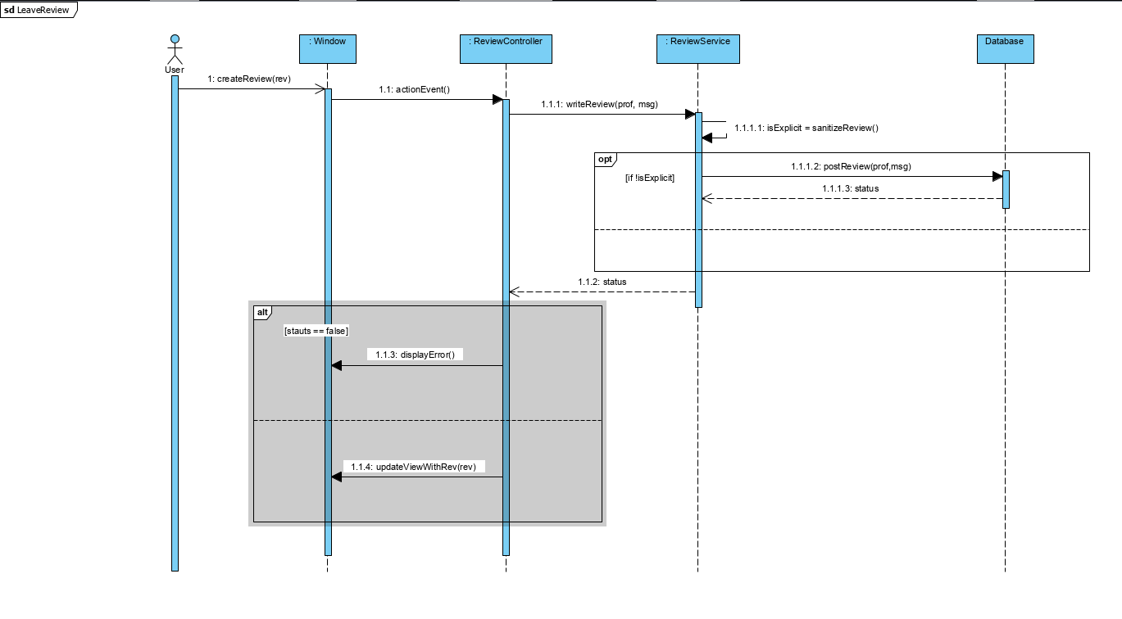

Slide 18
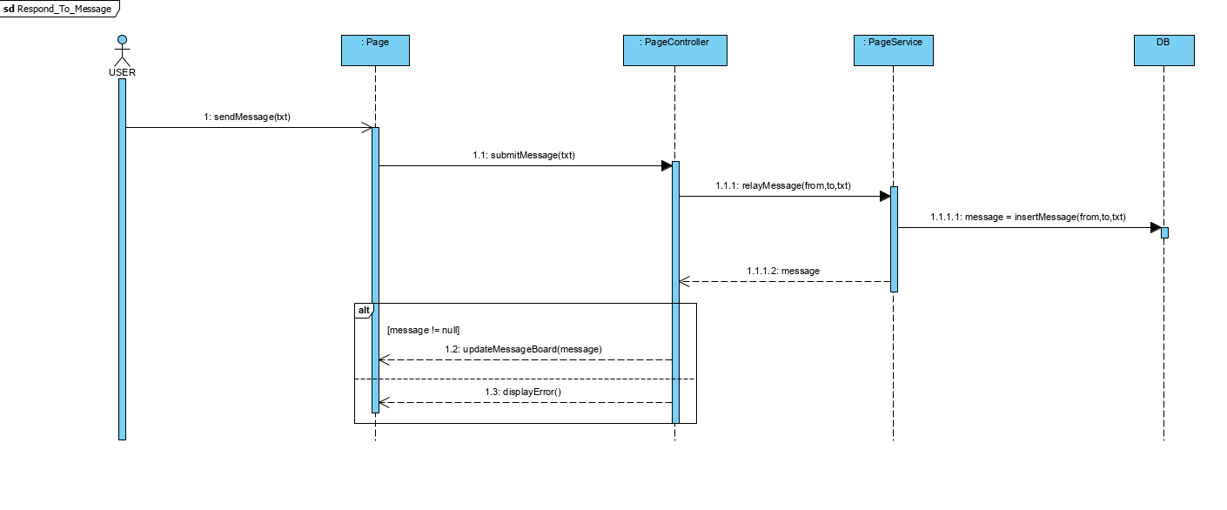

Slide 19
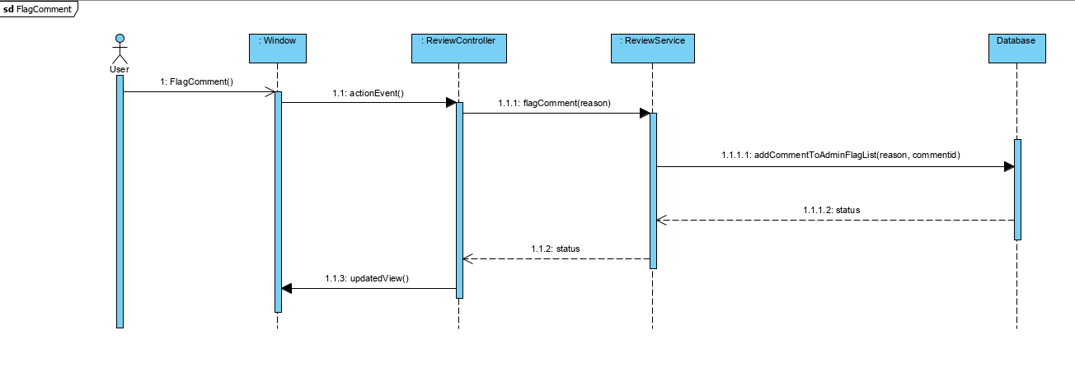

Slide 20
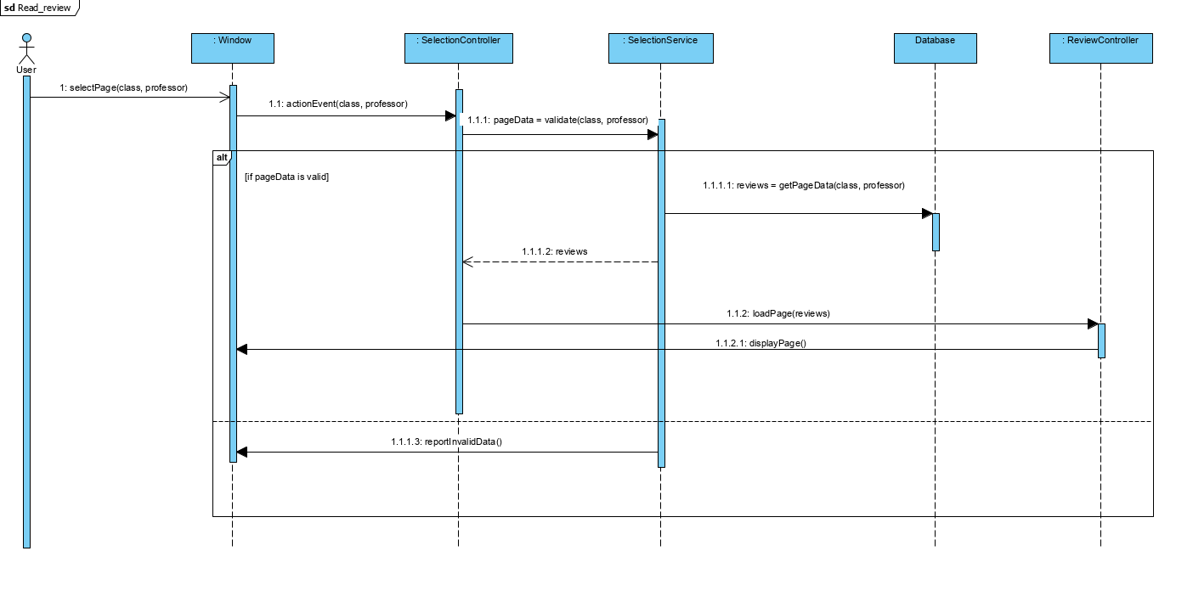

Slide 21
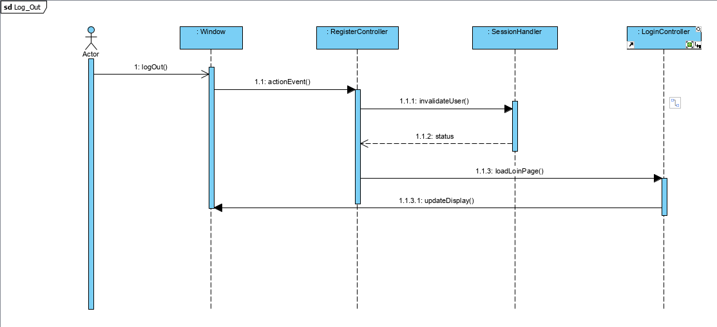

Slide 22
Design Class Diagram

Slide 23
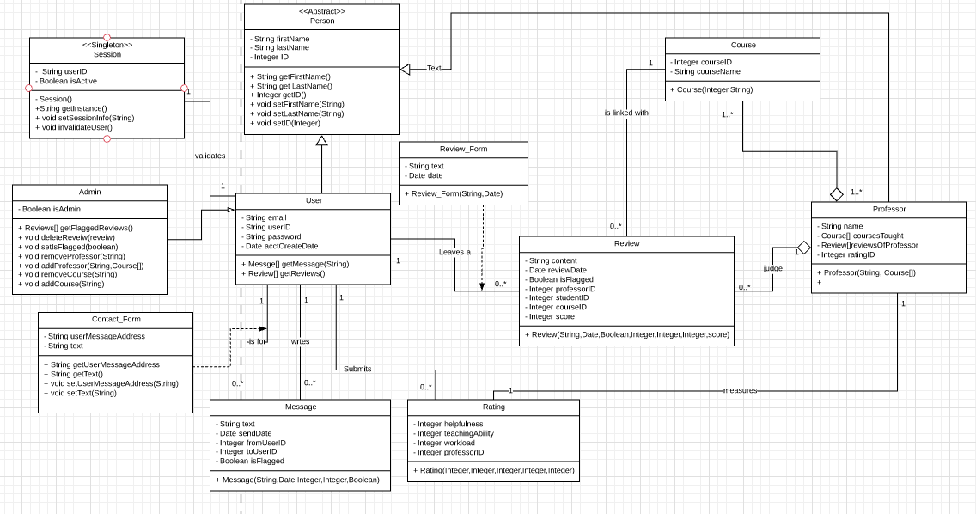
BCC Application

Slide 24
Package Diagram

Slide 25
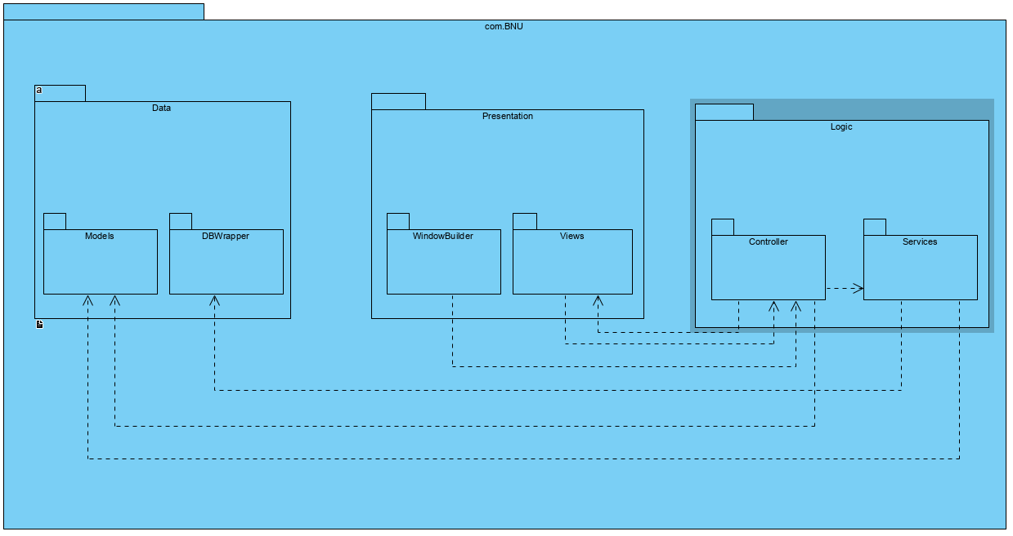

Slide 26
Doxygen Project Documentation

Slide 27
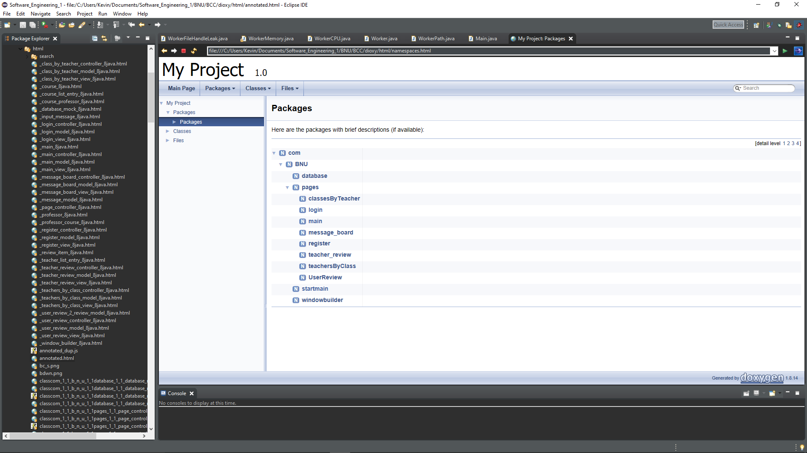

Slide 28
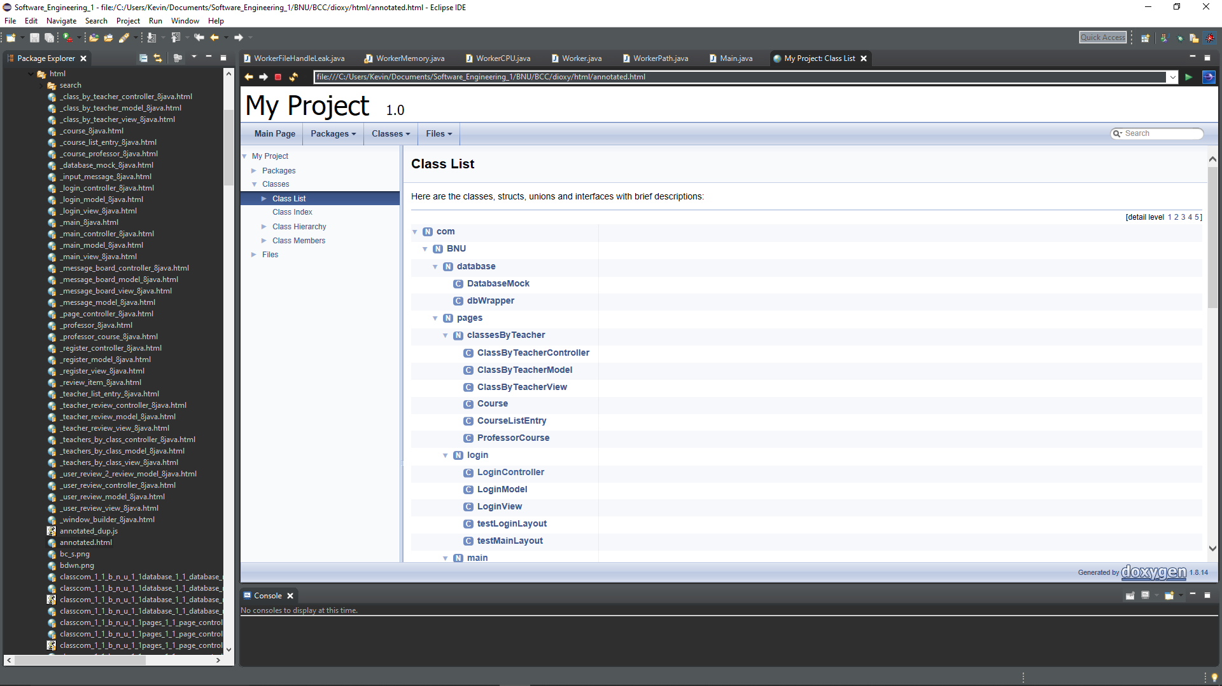

Slide 29
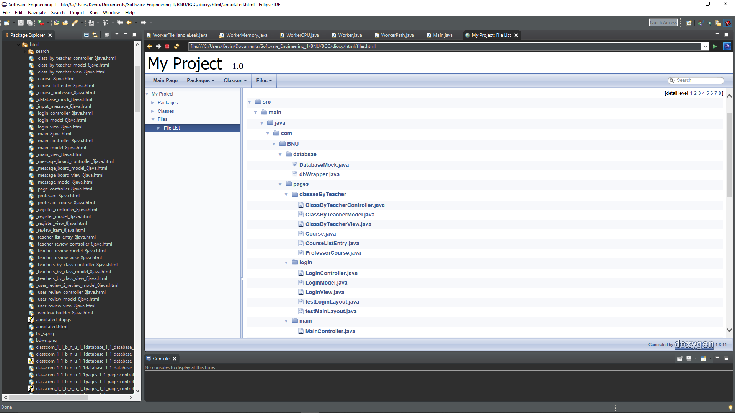

Slide 30
Project Planning

Slide 31
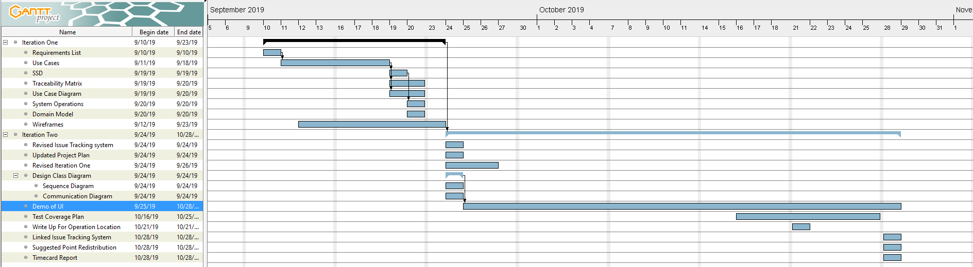

Slide 32
Grasp Justification
Each page is an individual package containing all the functionality needed required to load that page. Using the MVC model we are able to atomize the datatypes, logic, and view of each page.
Each pages Controller contains instances of the view, model, and panel that that page will display, as well as a reference to the database where data can be fetched for displaying.
Each Model contains the datatypes required to build the page. If the model represents a Java Swing pane then it contains mostly the JComponents that will be displayed on that page.
Each View builds the model JComponents into the pane that is stored by the Controller.
The database is currently wrapped with an API that will mimic the database when it is fully implemented. However it is currently hard-coded.

Slide 33
Coverage Plan
Each Controller and View will have test classes dedicated to them.
The Model currently has no implementation other than getters and setters, therefore does not need a testing suite.
The View of each page will be tested for loading errors by mocking the Controller for values.
The Controller will be tested using a mocked view to check for valid GUI generation and exception handling, It will also have tests for the functionality it contains within itself for database query routing.

Slide 34
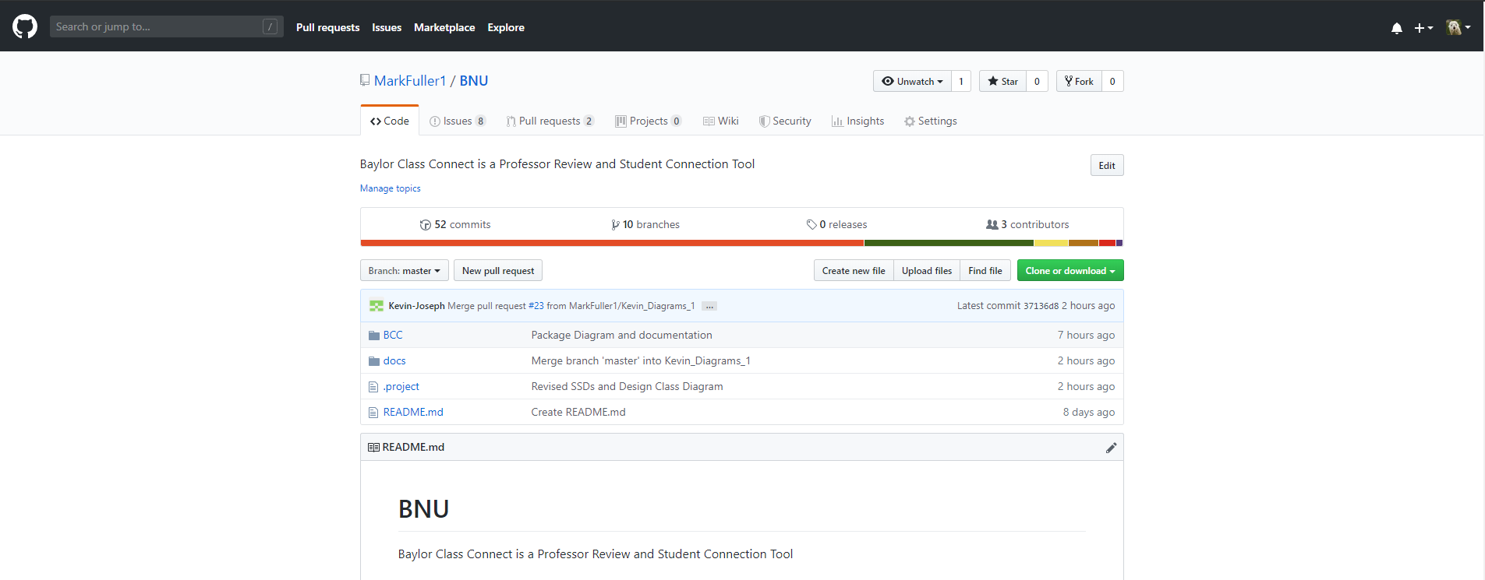
Git Repository
Repository Link: https://github.com/MarkFuller1/BNU/

Slide 35
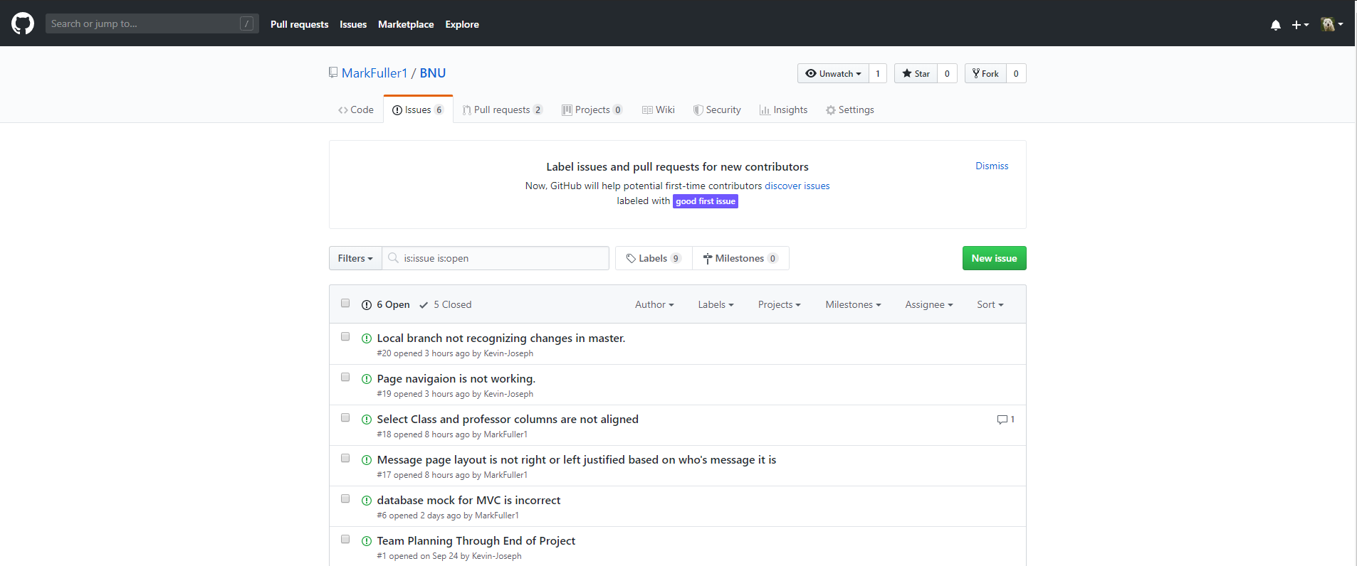
Issue Tracking
Repository Link: https://github.com/MarkFuller1/BNU/issues

Slide 36
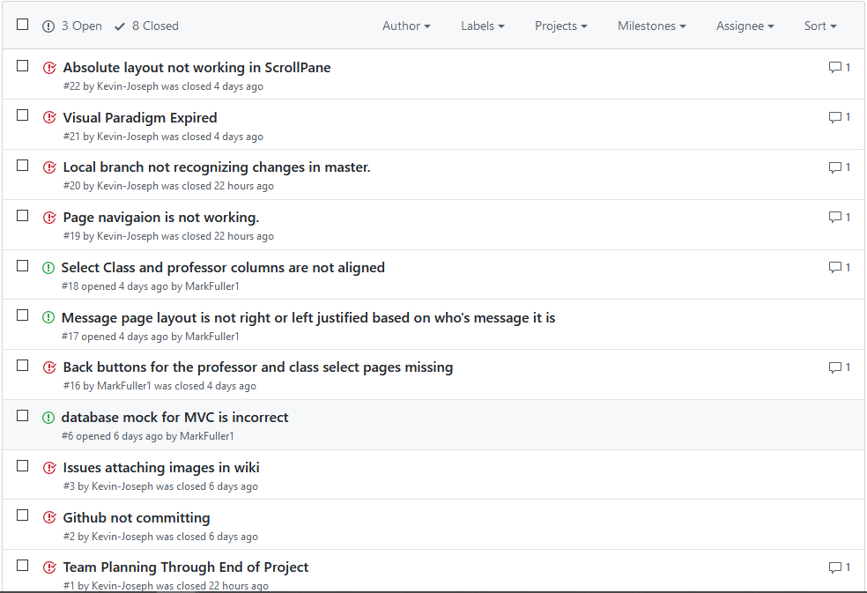
Repository Link: https://github.com/MarkFuller1/BNU/issues

Slide 37
Please See Revised Iteration 1 In Separate File
Revised Sequence Diagrams and Revised Use Case Diagram

Slide 38
Point Redistribution
Mark Fuller: 36.0%
Kevin Kulda: 36.0%
Connor Woodahl: 28.0%

Slide 39
Timecard
Mark Fuller: 30 hours
Kevin Kulda: 28 hours
Connor Woodahl: 25 hours

