Slide 1



Slide 2
What will we cover today?
School experience
UCAS registration
Researching training options and providers
Application
Your work and school experience statements
Personal statement
Getting your references ready
Application completed, fee paid and submitted
Skills test
Interview

Slide 3
School experience
You'll need to gain as much experience in the classroom as possible to strengthen your application and prepare you for potential interviews.
There are two options for arranging school experience:
School Experience Programme
database of 100s of schools across the country offering places
joining is straightforward, call the Get Into Teaching line on 0800 389 2500
Arrange your own school experience
contact local schools to see if they can accommodate you
EduBase can be used to identify local schools
use personal contacts to secure a place
Notes:
Check with your chosen provider or school as to how much experience they expect you to have pre-application as this varies.

Slide 4
UCAS application overview
Register to use ‘Apply’
Log in to complete your personal details
Provide additional information (UK applicants only)
Add your programme choice
Details of your education
Details of your school and work experience
Write your personal statement
Provide two references
Pay your fee and submit your application
https://www.ucas.com/ucas/teacher-training/apply-and-track/filling-your-application

Slide 5
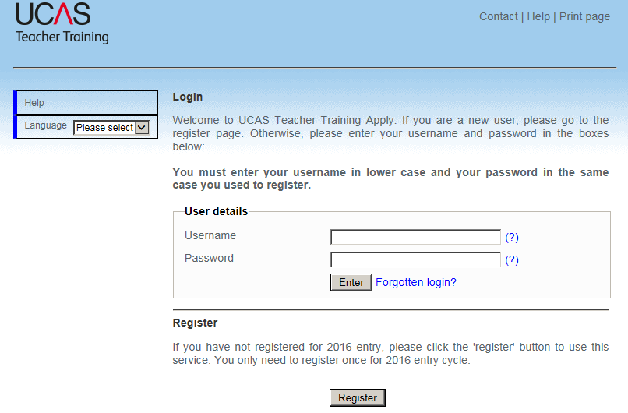
UCAS registration screen
https://www.ucas.com/ucas/teacher-training

Slide 6
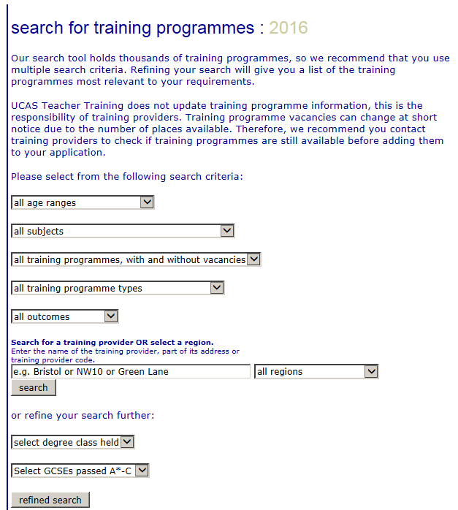
Researching training options and providers
Training programmes search tool

Slide 7
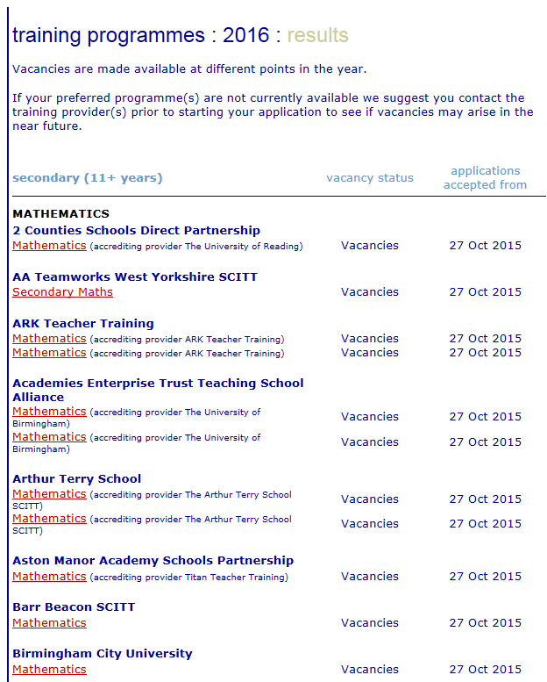
Training programmes search tool - results

Slide 8
All teacher training courses include:
A minimum of 24 weeks in at least two schools to give you practical classroom experience
Academic study to give you the knowledge and understanding to teach successfully
In addition to qualified teacher status (QTS) many post graduate teacher training courses lead to a post graduate certificate in education (PGCE) and/or Master’s level credits.

Slide 9
University-led teacher training
Courses run full-time over one year or part-time over two years.
Training will include spending time at the university or college, working with other trainees and being taught by university colleagues.
You’ll also spend plenty of time in placement schools – a minimum of 24 weeks. This will help you develop your practical teaching skills and ability to manage and plan classes effectively.

Slide 10
School-led teacher training
51% of trainees in 2015/16 are on a school-led route.
School-led training gives you the chance to learn on the job in at least two schools.
You’ll work as part of the teaching team throughout your training, learning from experienced colleagues and putting your new skills into practice with their support and encouragement.
Notes:
51% of trainees figure from the recently published ITT census.

Slide 11
School-led teacher training
School-led courses generally last a year and result in the award of QTS. Most include a postgraduate qualification, which is likely to carry with it master’s-level credits.
You should check the exact details of individual courses on UCAS Teacher Training.
School-led courses are referred to as the SCITT (school-centred initial teacher training) programme and School Direct programme on UCAS Teacher Training, and you should use these terms when you search for a course.

Slide 12
School-led teacher training - School Direct (salaried) route
Earn a salary while you train.
Schools recruit you directly as a trainee, often with a job in mind.
General requirement to have been working for at least three years since graduation, sometimes less in hard-to-fill subjects. Readiness for more challenge in the speed and intensity of your training
Cost of your training to become a qualified teacher is covered by the school, you should check if this also includes a PGCE.
Notes:
You can select more than 1 route on your application, in fact many people do apply for a combination of university, SCITT and School Direct routes.
There are additional routes into teaching including Teach First, Assessment only and researchers into schools. You can find more information on these on our website.

Slide 13
Application – Your work and school experience statements
Add as many examples of relevant school and work experience as you like.
Include work placements, lesson observations and paid and unpaid work.
For each example you can provide a description of up to 500 characters.
If the 500 character limit isn’t enough to describe your experience, you can send a copy of your CV/work history summary to your chosen training providers once you have applied as you will need to include your Personal ID.

Slide 14
Application – personal statement
Space on the form is limited to 4,000 characters, split across a maximum of 47 lines, including spaces and line breaks – so use it wisely!
It is a good idea to cover these key points:
your reasons for wanting to teach
your transferable skills
what you’ve learnt during your school experience

Slide 15
Example of a good opening application statement
I want to teach because I enjoy working with young people and I find seeing people gain new skills and progressing extremely rewarding. I am applying to teach biology because I find it fascinating and relevant to everyday life as well as to STEM careers and I would like the opportunity to convey my enthusiasm for the subject to children. I have particularly enjoyed working with secondary school aged children as a STEM ambassador, both in schools and at public events, and on a one-to-one basis as a mentor and counsellor. I enjoy the challenges they pose and the questions they ask.

Slide 16
Getting your references ready
You will need two references to support your application.
You can’t submit your application until two references are attached to it.
You need to submit the names and contact details of your referees to UCAS, they will then ask them to provide a reference.
To speed up the process, contact your referees and ask them to respond as soon as possible.
Explain to them your choices, the reasons why you want to apply, and make sure they understand the deadlines.

Slide 17
Your referees
Currently at university, or got your degree within the last five years | Left university more than five years ago
One reference must be from someone at your university who can make comments about your academic ability. This could be a tutor or head of department. | If you left university more than five years ago, you can choose two professional referees who can comment on your suitability for teaching - but you must not use family or friends as referees. You can still use an academic referee if you think it’s right for you.
Your second reference can be from someone who you know from work, or who can provide an insight into your character and potential – but you must not use family or friends as referees.
If you're applying for a School Direct (salaried) course, one of your references must be from an employer.
Notes:
If you use a referee from a school you have worked at it must be the headteacher.

Slide 18
Application completed, paid and submitted
Once both referees have completed the online form, UCAS will notify you.
You cannot send your application until your two references have been submitted online.
You will then be required to pay the £23 fee.
You will then be able to submit your application.
The application goes to all selected providers at the same time so be prepared to get called to several interviews in quick succession.
Notes:
You can't send your application until two references have been submitted online.
Who you choose as a referee is up to you, but there’s lots of advice about what to consider on our References for teaching page.
Download our UCAS Teacher Training step-by-step guide to requesting a reference
Once you’ve added your referee’s details, they’ll be sent an email requesting information. If you want to send your application off quickly, get in touch with your referees before sending the reference request, to make sure they’re prepared.
The application goes to all 3 providers at the same time so be prepared to get called to several interviews in quick succession.

Slide 19
Professional skills tests
You will need to take the numeracy and literacy skills tests as part of the application process.
You will need to pass both of these tests before you start your course.
You must submit your application with UCAS before you can take the skills tests.
You can book your skills test with learndirect via the Get into Teaching website.
Allow yourself time to revise and take the practice tests available on the Get into Teaching website.

Slide 20
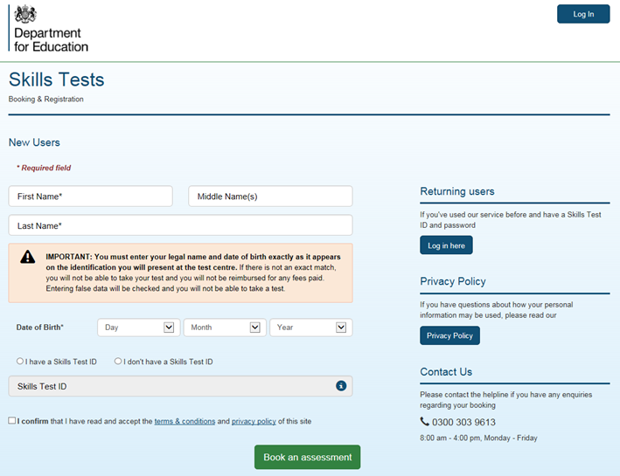
Skills test booking screenshot

Slide 21
Preparing for an interview
Research the school or university thoroughly.
Research current policies and practices in education and teaching in general.
Think carefully about your reasons for applying for the course and your interest in becoming a teacher.
Think about how you can apply transferable skills from any previous employment to teaching.
Reflect on your time in school and what you have learnt from the experience.

Slide 22
What to expect at an interview
Interview formats do vary, they can include some, or all, of the following:
a group task or discussion
a short presentation
an individual interview, which could be one-to-one or with a panel
a written task which could involve a literacy test and/or subject-based test

Slide 23
Premier Plus*
A comprehensive programme of support throughout the application process for eligible priority secondary applicants:
Personalised one-to-one advice from a named adviser on becoming a teacher, including support with your application.
Help in securing school experience, including a placement for up to 10 days on our School Experience Programme.
Regular communications with important news, application hints and tips and updates.
*Available to those who those who hold (or are predicted) a first class, 2:1 or 2:2 degree and are interested in teaching secondary biology, geography, maths, physics, chemistry, languages or computing.

Slide 24
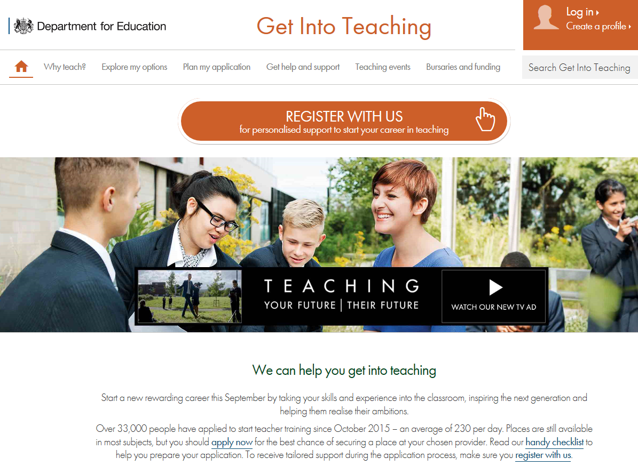
Further information and advice
Search “get into teaching” to visit our website or
call us on 0800 389 2500 to speak to the Teaching Line.

