Slide 1
Encapsulation - revisited
As a general rule:
Attributes are declared private
Methods are declared public
This is so that other classes may use methods belonging to another class but may not see their attributes.
This is called ‘data hiding’ or encapsulation.
Notes:
<number>

Slide 2
Abstraction - revisited
Abstraction by generalisation is a grouping by common characteristics.
Once we start thinking about classes in this way, we can start to consider hierarchical relationships of the ‘is a kind of’ type.
Notes:
<number>

Slide 3
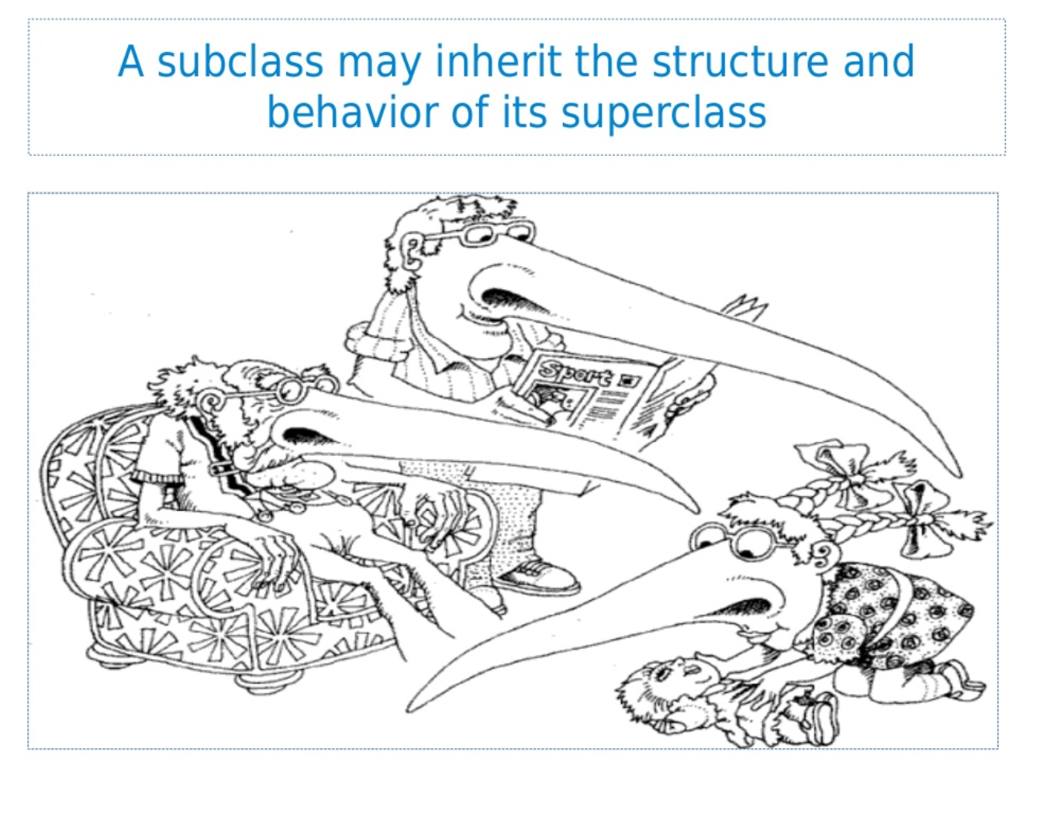

Slide 4
Inheritance
Sub-classes of a parent (super) class can have their own attributes and methods but also use those of the parent.
Sub-classes are also known as derived classes.
Notes:
<number>

Slide 5
Superclass
Animal
Age
Gender
Communicate()
Communicate() is overridden
Subclass
Frog
Cat
Dog
SpawningPool
Colouring
Breed
Communicate()
Communicate()
Communicate()

