Slide 1

Stacks and postfix notation using Forth
CAS London 2020 Conference
Hardip Mothada
Notes:
Feel free to edit these slides any way you see fit. I would suggest removing the first 4 and any other reference to specs that aren’t relevant to your school, they’re just here for me to present the session to you.

Slide 2
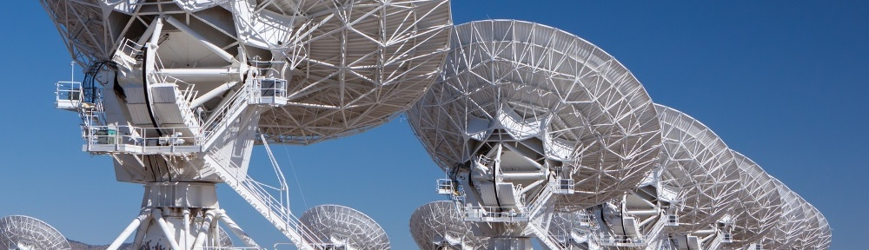
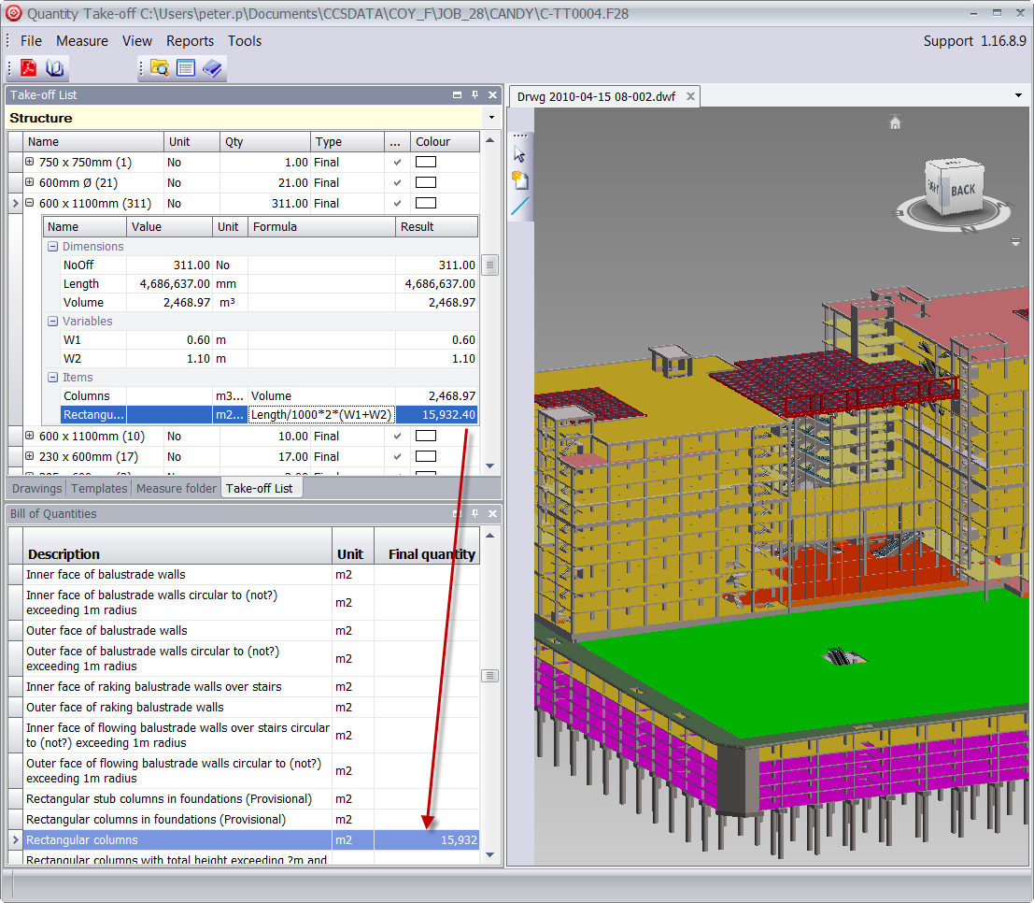

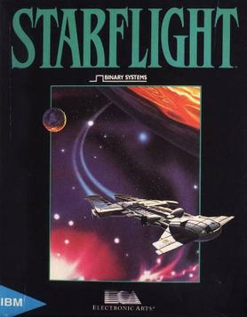
Notes:
Charles Moores’ first commercial projects were telescopes, and there is a long list of NASA projects that have used Forth on a CPU that could run Forth instructions natively (the RTX2000 –”Radiation hardened” so it could be used reliably in space). https://www.forth.com/resources/space-applications/
Starflight was a game for the PC written in 1986 mostly in Forth with some assembler where speed was critical.
Open Firmware was a Forth based portable firmware system used on Sun workstations, Apple Macs and One Laptop Per Child XO to boot systems like BIOS on PCs. http://wiki.laptop.org/go/Open_Firmware
CCS Candy is a current Windows application featuring 1.2Millions lines of Forth code, used in huge construction projects, e.g. building airports.
Forth has been described as a language, compiler, interpreter, OS and IDE all in one.
Its niche is that it is very compact, runs fast, and allows a lot of freedom, so is well suited to embedded systems.

Slide 3
Stacks - OCR
1.4.2 Data Structures – The stack
2.2.1 Programming Techniques - Recursion
2.2.2 Computational Methods - Backtracking
2.3.1 e) Algorithms for the main data structures, and breadth-first traversal of trees
1.2.1 Interrupts, the role of interrupts and Interrupt Service Routines (ISR), role within the Fetch-Decode-Execute Cycle
Notes:
The stack appears all over the AQA and OCR specifications and also in BTEC Level 3 Computer Science (Unit 2).
As it appears in different parts of the specification, it can be difficult to have an overall picture of the different strands.

Slide 4
Stacks - AQA
4.1.1.15 Role of stack frames in subroutine calls
4.1.1.16 Recursive techniques
4.2.1.4 Abstract data types/structures
4.2.3.1 Stacks
4.3.1 Graph traversal
4.3.2 Tree traversal
4.3.3 Reverse Polish Notation
4.7.3.6 Interrupts
Notes:
This is the order as presented in the specification, experience has taught me it is not the order it should be taught in!

Slide 5

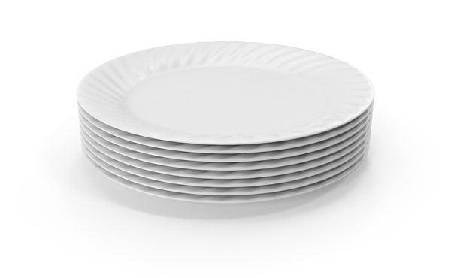
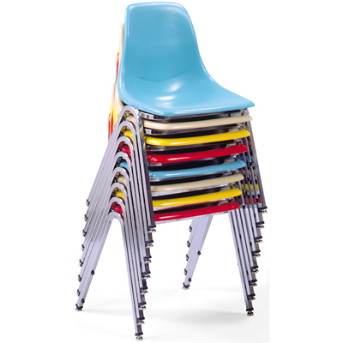

Notes:
Whilst it’s always a good thing to use images when introducing concepts, these images will only go so far in helping students to understand not just what a stack is, but what it is used for, and also that there is a high level stack and a low level one.

Slide 6
Stacks as a data structure
Top of stack
9
4
12
Notes:
IsEmpty() operations may be needed by your code to decide whether for example a tree has been traversed or whether any more items can be put on the stack.
IsFull() should not in normal circumstances occur, but as a defensive programming technique, we need to check whether it is as an indicator that something may have already gone wrong.

Slide 7
Stacks as a data structure
Top of stack
17
9
4
12
PUSH 17
Notes:
PUSH will add an element to the top of the stack

Slide 8
Stacks as a data structure
Top of stack
9
4
12
POP
Notes:
POP will remove the element that is currently on top of the stack

Slide 9
Stacks as a data structure
Top of stack
9
4
12
PEEK
Notes:
PEEK will return the element that is currently on top of the stack, without removing it. In reality it might actually make a copy of the item on top of the stack and return that.

Slide 10
Stacks as a data structure
Top of stack
4
12
POP
Notes:
IsFull()
IsEmpty() operations may be needed by your code to decide whether for example a tree has been traversed or whether any more items can be put on the stack.

Slide 11
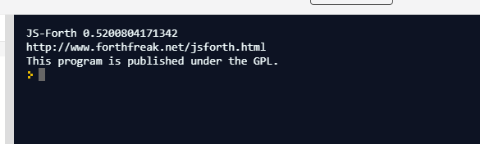
https://repl.it/languages/forth
Top of stack
9
4
12
PUSH 17
Top of stack
17
9
4
12
POP
POP
Top of stack
4
12
Notes:
Walk through the first page of the tasks sheet with the students. Then allow them to complete task 1 independently. It should take less than 10 minutes.

Slide 12
Task 1 Answers
12 + 2 12 2 +
7 + 15 + 31 7 15 + 31 +
67 - 23 67 23 -
8 * 7 8 7 *
24 / 6 24 6 /
(3+9)*4 3 9 + 4 *
(3+9) * (4+6) 3 9 + 4 6 + *
((12-4) / 4 ) + 3 12 4 - 4 / 3 +
( ((3*9) - 7 )/ 4)+2 3 9 * 7 - 4 / 2 +
(12 + 3 +7 ) / (17 - (3*2)) 12 3 + 7 + 17 3 2 * - /

Slide 13
Trees can be used to evaluate mathematical expressions. This particular tree represents the infix expression 3 + 8 * 5
+
3
*
8
5
What would be the order of traversal for in order and post order traversal?
Type the post order traversal into Forth and see what result you get
Notes:
This is the sort of representation we might see during the syntax analysis phase of compilation. It’s more straightforward for a machine to parse postfix (and prefix) than the infix representation we humans are used to.
2 + 8 * 5 gives 43
3 8 5 * + gives 43

Slide 14
-
/
+
8
-
2
1
4
2
Perform a post order traversal and type the expression into Forth to see the result
Would an in order traversal produce the same result?
Notes:
In order 8 / 4 – 2 – 2 + 1 gives -1 as it will evaluate 8/4-2 as 0, then subtract 2 and add 1
Post order 8 4 2 - / 2 1 + - gives 1
What is the issue here? The tree has been built for a post fix evaluation, and the infix notation will not get the same result as the postfix unless brackets are used.
This is an important point. Expression trees should be built for in order or post order traversal. It is easier to both build and process a post order expression tree.

Slide 15
Task 2 Answers
2a,b
3 8 5 * +
Gives 43 which is the same as infix
2c,d
In order 8 / 4 – 2 – 2 + 1 gives -1 as it will evaluate 8/4-2 as 0, then subtract 2 and add 1
Post order 8 4 2 - / 2 1 + - gives 1
The trees do not produce the same result as the tree has been built for postfix traversal not infix.

Slide 16
RPN advantages
Simpler for a machine/computer to evaluate
Do not need brackets to show correct order of evaluation/calculation
Operators appear in the order required for computation
No need for order of precedence of operators
No need to backtrack when evaluating

Slide 17
Task 3
push put an item on the stack
pop remove an item from the stack
peek return the item from the top of the stack without removing it
isEmpty return a boolean telling us if the stack is empty or not
isFull return a boolean telling us if the stack is full or not
: push ( n -- n ) ;
Notes:
Defining a function to push a number on the stack needs to do nothing. Type the push code into the editor and press the run button, then try putting a few numbers on the stack , e.g. 4 push 9 push 12 push. Then have a go at writing the next 3.

Slide 18
Task 3 Answers
: push ;
: pop . ;
: peek dup . ;
: isEmpty depth 0 = ;

Slide 19
Task 4
Take two numbers and multiply them together
Take a number of centimeters and convert to millimeters
Take a number and test whether it is even ( leave -1 on the stack if it is, 0 if it isn't)
Take a number and multiply it by itself.

Slide 20
Task 4
Take two numbers and multiply them together
: mult * ;
Take a number of centimeters and convert to millimeters
: cm>mm 10 * ;
Take a number and test whether it is even ( leave -1 on the stack if it is, 0 if it isn't)
: isEven 2 mod 0 = ;
Take a number and multiply it by itself.
: square dup * ;

Slide 21
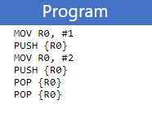
https://peterhigginson.co.uk/ARMlite/

Slide 22
MOV R0,#isr1
STR R0,.PinISR
MOV R0,#1
STR R0,.PinMask
STR R0,.InterruptRegister
start: mov r0,#0
outer: add r0,r0,#1
mov r1,#0
inner: add r1,r1,#1
cmp r1,#12
str r0,.WriteUnsignedNum
bne inner
cmp r0,#12
bne outer
b start
isr1: push {r0}
mov r0,#1
str r0,testLocation
pop {r0}
rfe
testLocation: .WORD 0xffffffff

Slide 23
Suggested teaching strategy
FDE
Abstract data type
Reverse Polish Notation (AQA)
Tree traversal
Depth first graph traversal
Subroutines
Interrupt Service Routines
The stack frame
Recursion
Notes:
In terms of sequencing the teaching, assuming you have already taught the FDE I would recommend covering the stack as a high level abstract data type first, then RPN (AQA explicitly, but OCR also mention in stages of compilation topic), then move on to low level, subroutines first then interrupt service routines. Finally the stack frame, AQA explicitly but OCR also in recursion. Round it all off with a tasty mindmap to bring it all together into stack based nirvana.

Slide 24
(OCR) Reflect – how do the following relate to the stack?
2.2.1 Programming Techniques - Recursion
2.2.2 Computational Methods - Backtracking
2.3.1 e) Algorithms for the main data structures, (stacks, queues, trees, linked lists, depth-first (post-order) and breadth-first traversal of trees
1.2.1 Interrupts, the role of interrupts and Interrupt Service Routines (ISR), role within the Fetch-Decode-Execute Cycle

Slide 25
(AQA) Reflect – how do the following relate to the stack?
4.1.1.15 Role of stack frames in subroutine calls
4.1.1.16 Recursive techniques
4.2.1.4 Abstract data types/structures
4.3.1 Graph traversal
4.3.2 Tree traversal
4.3.3 Reverse Polish Notation
4.7.3.6 Interrupts

Slide 26
The stack is:
A data structure you can use in high level programming languages to do backtracking, manage tree traversal and other tasks
A way of passing parameters to subroutines
A way of storing return addresses in subroutines and during recursion
A way of saving register values during interrupt service routines

