Slide 1
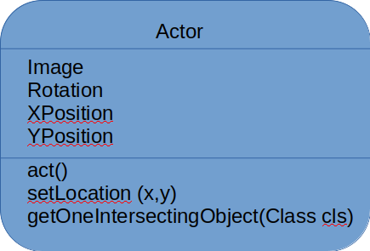
Superclass
Ship
Subclass
NoOfCratesCollected
act()
Submarine
NoOfShipsSunk
act() is overridden
act()

Slide 2
Pseudocode
class Actor
  private image
  private rotation, x, y
  public procedure act()
  endprocedure
  public function getOneIntersectingObject(Class cls)
  endfunction
  endclass

Slide 3
Pseudocode
class Ship inherits Actor
  private NoOfCreatesCollected
  public procedure act()
    move(5)
    if xPos > 599 || xPos < 1 then
      Turn(180)
      endif
  endprocedure
  endclass

Slide 4
public class MyWorld extends World
{
public MyWorld()
{
// Create a new world with 600x400 cells with a cell size of 1x1 pixels.
super(600, 400, 1);
addObject (new Ship(), 300, 200);
addObject (new Crate(), 30, 200);
addObject (new Crate(), 300, 20);
addObject (new Submarine(),40, 500);
}
}

