Slide 1
Stacks
Simplicity is a great virtue but it requires hard work to achieve it and education to appreciate it.
And to make matters worse: complexity sells better.
Dijkstra (1984) On the nature of Computing Science

Slide 2
Stacks - OCR
1.4.2 Data Structures – The stack
2.2.1 Programming Techniques - Recursion
2.2.2 Computational Methods - Backtracking
2.3.1 e) Algorithms for the main data structures, and breadth-first traversal of trees
1.2.1 Interrupts, the role of interrupts and Interrupt Service Routines (ISR), role within the Fetch-Decode-Execute Cycle
Notes:
The stack appears all over the AQA and OCR specifications and also in BTEC Level 3 Computer Science (Unit 2).
As it appears in different parts of the specification, it can be difficult to have an overall picture of the different strands.

Slide 3

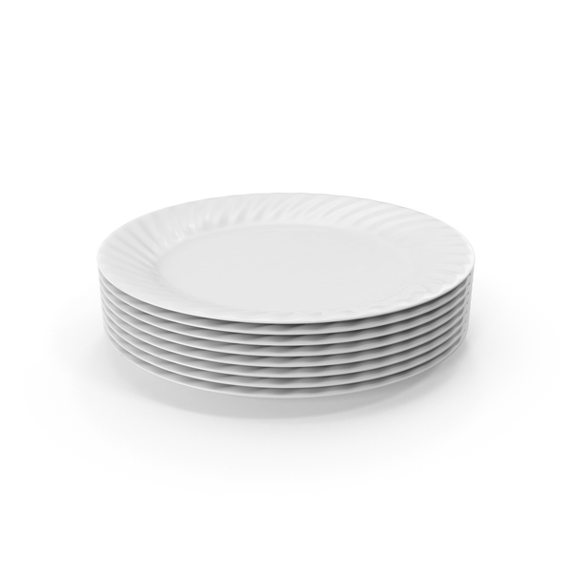


Notes:
Whilst it’s always a good thing to use images when introducing concepts, these images will only go so far in helping students to understand not just what a stack is, but what it is used for, and also that there is a high level stack and a low level one.

Slide 4
Stacks as a data structure
Top of stack
9
4
12
Notes:
IsEmpty() operations may be needed by your code to decide whether for example a tree has been traversed or whether any more items can be put on the stack.
IsFull() should not in normal circumstances occur, but as a defensive programming technique, we need to check whether it is as an indicator that something may have already gone wrong.

Slide 5
Stacks as a data structure
Top of stack
17
9
4
12
PUSH 17
Notes:
PUSH will add an element to the top of the stack

Slide 6
Stacks as a data structure
Top of stack
9
4
12
POP
Notes:
POP will remove the element that is currently on top of the stack

Slide 7
Stacks as a data structure
Top of stack
9
4
12
PEEK
Notes:
PEEK will return the element that is currently on top of the stack, without removing it. In reality it might actually make a copy of the item on top of the stack and return that.

Slide 8
Stacks as a data structure
Top of stack
4
12
POP
Notes:
IsFull()
IsEmpty() operations may be needed by your code to decide whether for example a tree has been traversed or whether any more items can be put on the stack.

Slide 9
Stacks as a data structure
Either: sudo apt install gforth -y
Or goto repl.it and open a Forth project
Notes:
IsFull()
IsEmpty() operations may be needed by your code to decide whether for example a tree has been traversed or whether any more items can be put on the stack.

Slide 10
Task 1 Answers
12 + 2 12 2 +
7 + 15 + 31 7 15 + 31 +
67 - 23 67 23 -
8 * 7 8 7 *
24 / 6 24 6 /
(3+9)*4 3 9 + 4 *
(3+9) * (4+6) 3 9 + 4 6 + *
((12-4) / 4 ) + 3 12 4 - 4 / 3 +
( ((3*9) - 7 )/ 4)+2 3 9 * 7 - 4 / 2 +
(12 + 3 +7 ) / (17 - (3*2)) 12 3 + 7 + 17 3 2 * - /

