Slide 1
Computers
Art Form
Turtle Graphics
Programming
Sequences
Python
Decomposition
Loops

Slide 2
Introduction
Computers are all around us. Can you think of any examples?
  Smartphones
  Tablets
  Traffic Lights
  CCTV
  School Bus

Slide 3

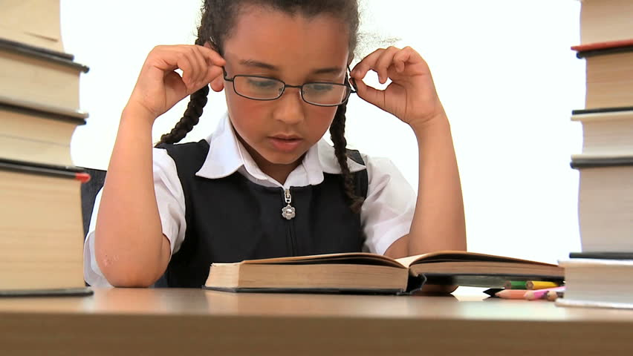

Programming
But how can we get them to do what do what want?
Computers read something
called Machine Code
….we prefer English

Slide 4




Programming
Computer programming languages use special instructions understandable to both humans and computers.
Have you heard of any computer programming languages?

Slide 5
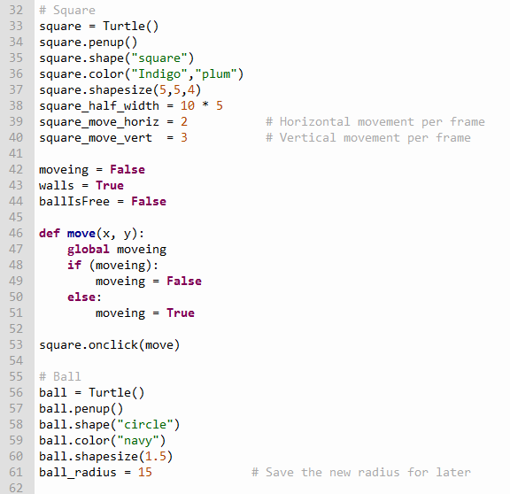
Computer code

Slide 6
Programming
A computer programmer needs to break tasks down into a series of small steps that can form the special instructions understandable to the computer.
For example, suppose we wanted to draw a square on the screen. What are the steps we might need?

Slide 7
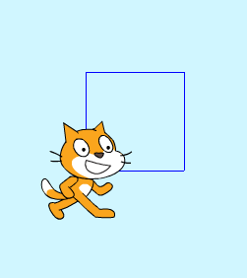
Drawing a square

Slide 8
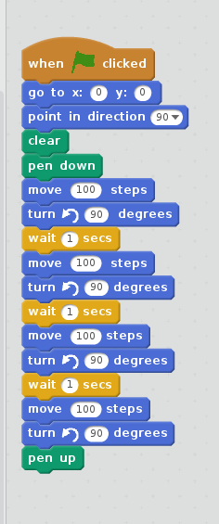
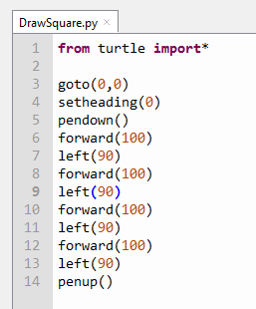
Turing into computer code
Start
Go to screen centre
Face right
Draw line for 100 pixels
Turn 90° left
Draw line for 100 pixels
Turn 90° left
Draw line for 100 pixels
Turn 90° left
Draw line for 100 pixels
Turn 90° left
Stop

Slide 9
Programming in Python
Open ‘Thonny’ which is a python coding environment.
Save each task competed in a new Python file in your work area.
Task 1 – Draw a square on the screen.
  Choose the colours used.
  Choose the pen size used.

Slide 10
Python commands
Drawing
# To bring turtle graphics into your python code:
from turtle import*
# To go to an X,Y screen position:
goto(0,0) # 0,0 is the middle
# To start drawing on the screen:
pendown()
# To go forwards a number of pixels:
forward(100)
# To turn left a number of degrees:
left(90)
# To stop drawing on the screen:
penup()
Colours
# To set the colour of the background screen:
bgcolor(‘BurlyWood’)
# To set the colour of the pen being used:
pencolor(‘IndianRed’)
# To set the width of the pen being used:
pensize(3)
# To set the colour inside the shape:
fillcolor(‘Cornsilk’)
begin_fill()
circle(80) # draw a shape
end_fill()

Slide 11
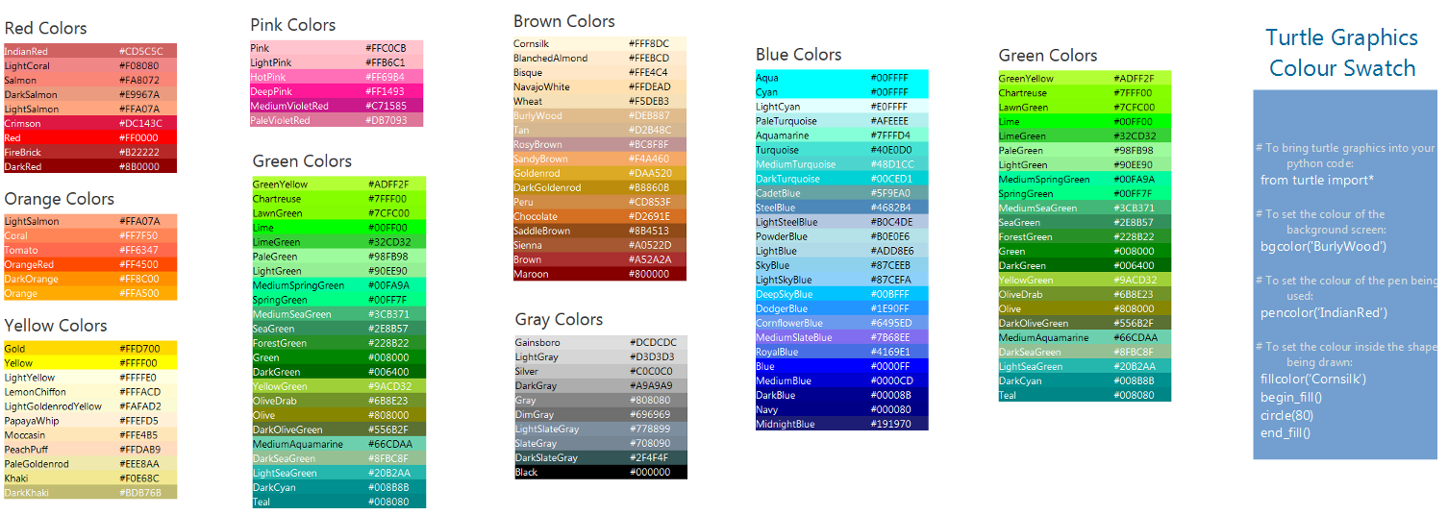
Use the colour swatch, be creative!

Slide 12
Less is more!
Start
Go to screen centre
Face right
Drawn all
sides?
Yes
Stop
No
Draw line for 100 pixels
Turn 90° left

Slide 13
Programming in Python
Task 2 – Add a another square or rectangle on a different part of the screen.

Slide 14
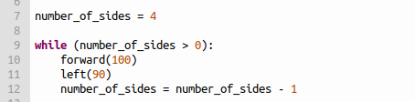
Programming in Python
Task 3 – Add a loop to repeat the line drawing.
number_of_sides is
a variable set to 4
number_of_sides
reduced by one

