Slide 1
Translators
What’s being translated?
Why do we need translators?
Compilers
Interpreters
Assemblers
Notes:
Candidates need to understand the need for
translators when writing programs.
They need to have knowledge of the differences in
operation of interpreters and compilers, from these
they need to be able to assess the benefits and
drawbacks of using each type, and recommend
with justification which should be used in a specific
scenario.
Candidates need to understand the role of an
assembler and how it differs from interpreters and
compilers.

Slide 2
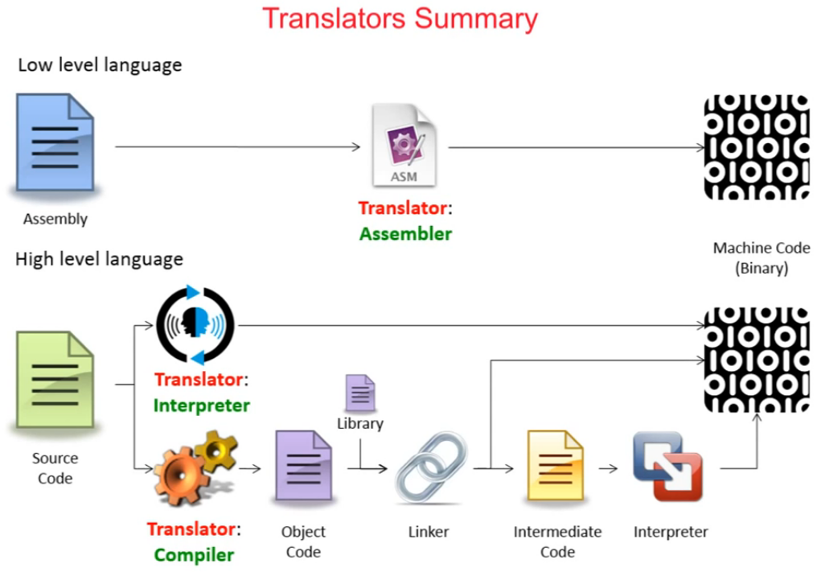

Slide 3
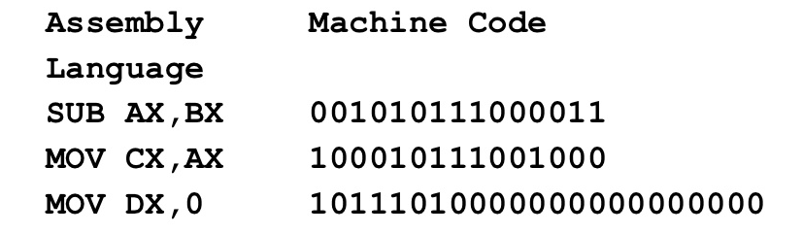
Assemblers
Benefits
Drawbacks
When is their use appropriate
Notes:
Candidates need to understand the need for
translators when writing programs.
They need to have knowledge of the differences in
operation of interpreters and compilers, from these
they need to be able to assess the benefits and
drawbacks of using each type, and recommend
with justification which should be used in a specific
scenario.
Candidates need to understand the role of an
assembler and how it differs from interpreters and
compilers.

Slide 4
Interpreters
Benefits
Drawbacks
When is their use appropriate
Notes:
Candidates need to understand the need for
translators when writing programs.
They need to have knowledge of the differences in
operation of interpreters and compilers, from these
they need to be able to assess the benefits and
drawbacks of using each type, and recommend
with justification which should be used in a specific
scenario.
Candidates need to understand the role of an
assembler and how it differs from interpreters and
compilers.

Slide 5
Compliers
Benefits
Drawbacks
When is their use appropriate
Notes:
Candidates need to understand the need for
translators when writing programs.
They need to have knowledge of the differences in
operation of interpreters and compilers, from these
they need to be able to assess the benefits and
drawbacks of using each type, and recommend
with justification which should be used in a specific
scenario.
Candidates need to understand the role of an
assembler and how it differs from interpreters and
compilers.

Slide 6
