Slide 1
Getting Started With MIPS - 2

Slide 2
Objectives
• Load MIPS programs (assembly language) and execute them
• Examine memory locations
• Examine registers
• Execute programs step by step
• Learn how to use breakpoint

Slide 3
Step 1
Load Example2.s in your SPIM simulator
PS: you can find Example2.s in Blackboard

Slide 4
Step 2
Let’s assume you don’t want to step through the program. Instead, you want to stop every time right before some instruction is executed. This allows you to see what is in memory or in registers right before the instruction is executed. You can use breakpoint to do it.
In MARS, after compilation, you can simply click the Bkpt checkbox before the instruction you want to set breakpoint.
Both step and breakpoint are very useful technique to debug your program, they are supported by almost all the programming language(e.g. Java, C, C++) and their IDE.

Slide 5
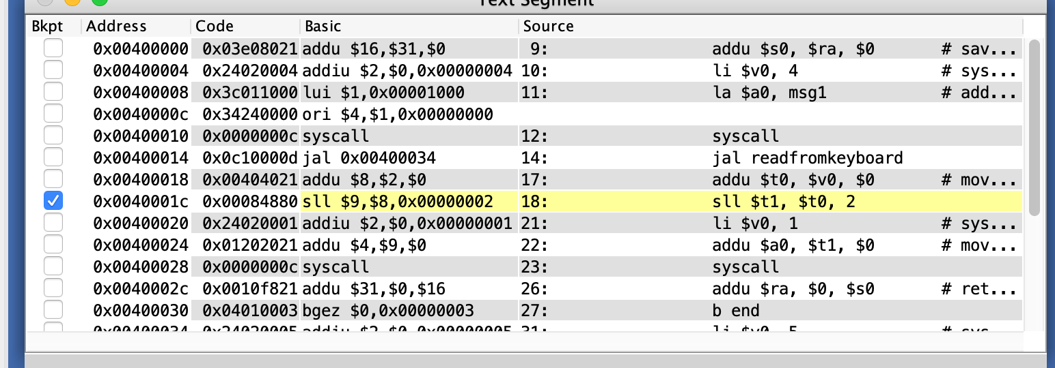
Step 3
Set the breakpoint at sll $t1, $t0, 2
Click run button, input the number whatever you want
you will see the register state before executing this instruction

Slide 6
Step 4
Click Single Step button, you will see the register state after execute sll $t1, $t0, 2
Then you can click step button, execute this program step by step or click run button execute all the rest instructions

Slide 7
Step 5
Register number | Register name | Before sll $t1, $t0, 2 | After sll $t1, $t0, 2 | Changed
PC | PC | 40001c | 400020 | ✓
0 | $r0 | 0 | 0
1 | $at | 10000000 | 10000000
2 | $vo | 4 | 4
3 | $v1 | 0 | 0
4 | $a0 | 10000000 | 10000000
5 | $a1 | 0 | 0
6 | $a2 | 0 | 0
7 | $a3 | 0 | 0
8 | $t0 | 4 | 4
9 | $t1 | 0 | 10 | ✓
10 | $t2 | 0 | 0
11 | $t3 | 0 | 0
12 | $t4 | 0 | 0
Fill the following table
(2points)
Explain the function of this syscall
(2points)

Slide 8
Step 5
Register number | Register name | Before sll $t1, $t0, 2 | After sll $t1, $t0, 2 | Changed
13 | $t5 | 0 | 0
14 | $t6 | 0 | 0
15 | $t7 | 0 | 0
16 | $s0 | 0 | 0
17 | $s1 | 0 | 0
18 | $s2 | 0 | 0
19 | $s3 | 0 | 0
20 | $s4 | 0 | 0
21 | $s5 | 0 | 0
22 | $s6 | 0 | 0
23 | $s7 | 0 | 0
24 | $t8 | 0 | 0
25 | $t9 | 0 | 0
26 | $k0 | 0 | 0
Fill the following table
(2points)
Explain the function of this syscall
(2points)

Slide 9
Step 5
Fill the following table
(2points)
Explain the function of this syscall
(2points)
Register number | Register name | Before sll $t1, $t0, 2 | After sll $t1, $t0, 2 | Changed
27 | $k1 | 0 | 0
28 | $gp | 10008000 | 10008000
29 | $sp | 7fffeffc | 7fffeffc
30 | $s8 | 0 | 0
31 | $ra | 400018 | 400018
sll : shift data to left or multiply data with 2^n

Slide 10
Step 6
You can also set multiple breakpoints
For example:
set the breakpoint at the first lui $1, 0x00001000
set the breakpoint at jal readfromkeyboard
set the breakpoint at jr $ra
(You can input whatever you want )

Slide 11
Step 7~9
Register number | Register name | Before lui $1, 0x00001000 | After lui $1, 0x00001000 | Changed | Before jal readfromkeyboard | After jal readfromkeyboard | Changed | Before jr $ra | After jr $ra | Changed
PC | PC | 400008 | 40000c | ✓ | 400014 | 400034 | ✓ | 40003c | 400018 | ✓
0 | $r0 | 0 | 0 |  | 0 | 0 |  | 0 | 0
1 | $at | 0 | 10000000 | ✓ | 10000000 | 10000000 |  | 10000000 | 10000000
2 | $vo | 4 | 4 |  | 4 | 4 |  | 4 | 4
3 | $v1 | 0 | 0 |  | 0 | 0 |  | 0 | 0
4 | $a0 | 0 | 0 |  | 10000000 | 10000000 |  | 10000000 | 10000000
5 | $a1 | 0 | 0 |  | 0 | 0 |  | 0 | 0
6 | $a2 | 0 | 0 |  | 0 | 0 |  | 0 | 0
7 | $a3 | 0 | 0 |  | 0 | 0 |  | 0 | 0
8 | $t0 | 0 | 0 |  | 0 | 0 |  | 0 | 0
9 | $t1 | 0 | 0 |  | 0 | 0 |  | 0 | 0
10 | $t2 | 0 | 0 |  | 0 | 0 |  | 0 | 0
11 | $t3 | 0 | 0 |  | 0 | 0 |  | 0 | 0
12 | $t4 | 0 | 0 |  | 0 | 0 |  | 0 | 0

Slide 12
Step 7~9
Register number | Register name | Before lui $1, 0x00001000 | After lui $1, 0x00001000 | Changed | Before jal readfromkeyboard | After jal readfromkeyboard | Changed | Before jr $ra | After jr $ra | Changed
13 | $t5 | 0 | 0 |  | 0 | 0 |  | 0 | 0
14 | $t6 | 0 | 0 |  | 0 | 0 |  | 0 | 0
15 | $t7 | 0 | 0 |  | 0 | 0 |  | 0 | 0
16 | $s0 | 0 | 0 |  | 0 | 0 |  | 0 | 0
17 | $s1 | 0 | 0 |  | 0 | 0 |  | 0 | 0
18 | $s2 | 0 | 0 |  | 0 | 0 |  | 0 | 0
19 | $s3 | 0 | 0 |  | 0 | 0 |  | 0 | 0
20 | $s4 | 0 | 0 |  | 0 | 0 |  | 0 | 0
21 | $s5 | 0 | 0 |  | 0 | 0 |  | 0 | 0
22 | $s6 | 0 | 0 |  | 0 | 0 |  | 0 | 0
23 | $s7 | 0 | 0 |  | 0 | 0 |  | 0 | 0
24 | $t8 | 0 | 0 |  | 0 | 0 |  | 0 | 0
25 | $t9 | 0 | 0 |  | 0 | 0 |  | 0 | 0
26 | $k0 | 0 | 0 |  | 0 | 0 |  | 0 | 0

Slide 13
Step 7~9
Register number | Register name | Before lui $1, 0x00001000 | After lui $1, 0x00001000 | Changed | Before jal readfromkeyboard | After jal readfromkeyboard | Changed | Before jr $ra | After jr $ra | Changed
27 | $k1 | 0 | 0 |  | 0 | 0 |  | 0 | 0
28 | $gp | 10008000 | 10008000 |  | 10008000 | 10008000 |  | 10008000 | 10008000
29 | $sp | 7fffeffc | 7fffeffc |  | 7fffeffc | 7fffeffc |  | 7fffeffc | 7fffeffc
30 | $s8 | 0 | 0 |  | 0 | 0 |  | 0 | 0
31 | $ra | 0 | 0 |  | 0 | 400018 | ✓ | 400018 | 400018
lui : T Load upper immediate, the immediate value is shifted left 16 bits and stored in the register. The lower 16 bits are zeroes.
jal : jump to the target label and save the next instruction address
/ store the address of target label to $pc and save the next instruction address
jr : jump to the address store in the register
/ move the value store in the register to $pc

Slide 14
Step 10
Explain the difference between jal and jr(4points)
jr only jumps
jal will both jump and save the next instruction address in $ra (return address)

Slide 15
Please answer all these questions in a sperate .doc file
Due: Next Thursday before Lab

