Slide 1
Performance
P&H (1.6 thru 1.12)

Slide 2
Outline
What does performance mean?
What to measure for performance?
Cycle time
Clock rate
CPI
MIPS
What affects performance?
The power wall
Performance benchmarks (SPEC)
Fallacies and pitfalls

Slide 3
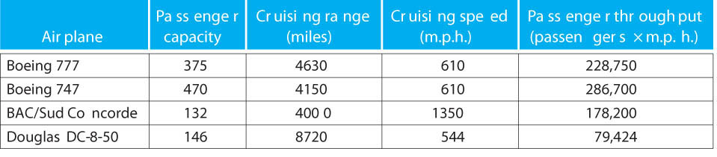
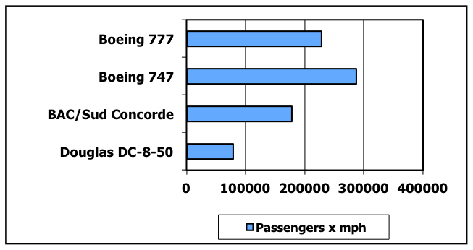
Which airplane is “best”?
Airplane
Passenger capacity
Cruising range (miles)
Cruising speed (mph)
Passenger throughput (passengers x mph)

Slide 4
Response Time and Throughput
Response time
How long it takes to do a task
Throughput
Total work done per unit time
e.g., tasks/transactions/… per hour
How are response time and throughput affected by
Replacing the processor with a faster version?
Adding more processors?

Slide 5
Relative Performance
Define Performance = 1/Execution Time
“X is n time faster than Y”
Example: time taken to run a program
10s on A, 15s on B
Execution Time_{B} / Execution Time_{A} = 15s / 10s = 1.5
So A is 1.5 times faster than B

Slide 6
Design Tradeoffs
Performance is rarely the sole factor
Cost is important too
Energy/power consumption is often critical
Frequently used compound metrics
Performance/Cost (throughput/$)
Performance/Power (throughput/watt)
Work/Energy (total work done per joule)
for battery-powered devices

Slide 7
Measuring Execution Time
Elapsed time
Total response time, including all aspects
Processing, I/O, OS overhead, idle time
Determines system performance
CPU time
Time spent processing a given job
Discounts I/O time, other jobs’ shares
Comprises user CPU time and system CPU time
Different programs are affected differently by CPU and system performance

Slide 8
CPU Clocking
Operation of digital hardware governed by a constant-rate clock
Clock period
Clock (cycles)
Data transfer and computation
Update state
Clock period: duration of a clock cycle
e.g., 250ps = 0.25ns = 250×10^{–12}s
Clock frequency (rate): cycles per second
e.g., 4.0GHz = 4000MHz = 4.0×10⁹Hz

Slide 9
CPU Time
Performance improved by
Reducing number of clock cycles
Increasing clock rate
Hardware designer must often trade off clock rate against cycle count

Slide 10
CPU Time Example
Computer A: 2GHz clock, 10s CPU time
Designing Computer B
Aim for 6s CPU time
Can do faster clock, but causes 1.2 × clock cycles
How fast must Computer B clock be?

Slide 11
Instruction Count and CPI
Instruction Count for a program
Determined by program, ISA and compiler
Average cycles per instruction
Determined by CPU hardware
If different instructions have different CPI
Average CPI affected by instruction mix

Slide 12
CPI Example
Computer A: Cycle Time = 250ps, CPI = 2.0
Computer B: Cycle Time = 500ps, CPI = 1.2
Same ISA
Which is faster, and by how much?
A is faster…
…by this much

Slide 13
CPI in More Detail
If different instruction classes take different numbers of cycles
Weighted average CPI
Relative frequency

Slide 14
CPI Example
Alternative compiled code sequences using instructions in classes A, B, C
Class | A | B | C
CPI for class | 1 | 2 | 3
IC in sequence 1 | 2 | 1 | 2
IC in sequence 2 | 4 | 1 | 1
Sequence 1: IC = 5
Clock Cycles = 2×1 + 1×2 + 2×3 = 10
Avg. CPI = 10/5 = 2.0
Sequence 2: IC = 6
Clock Cycles = 4×1 + 1×2 + 1×3 = 9
Avg. CPI = 9/6 = 1.5

Slide 15
Performance Summary
Performance depends on
Algorithm: affects IC, possibly CPI
Programming language: affects IC, CPI
Compiler: affects IC, CPI
Instruction set architecture: affects IC, CPI, T_{c}

Slide 16
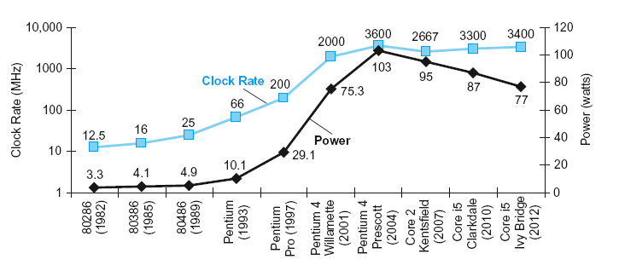
Power Trends
In CMOS IC technology
×30
5V → 1V
×1000

Slide 17
Reducing Power
Suppose a new CPU has
85% of capacitive load of old CPU
15% voltage and 15% frequency reduction
The power wall
We can’t reduce voltage further
We can’t remove more heat
How else can we improve performance?

Slide 18
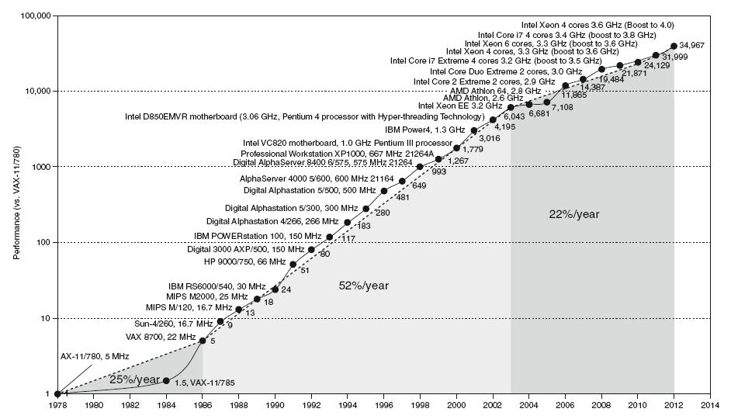
Uniprocessor Performance
Constrained by power, instruction-level parallelism, memory latency

Slide 19
Multiprocessors
Multicore microprocessors
More than one processor per chip
Requires explicitly parallel programming
Compare with instruction level parallelism
Hardware executes multiple instructions at once
Hidden from the programmer
Hard to do
Programming for performance
Load balancing
Optimizing communication and synchronization

Slide 20
SPEC CPU Benchmark
Programs used to measure performance
Supposedly typical of actual workload
Standard Performance Evaluation Corp (SPEC)
Develops benchmarks for CPU, I/O, Web, …
SPEC CPU2006
Elapsed time to execute a selection of programs
Negligible I/O, so focuses on CPU performance
Normalize relative to reference machine
Summarize as geometric mean of performance ratios
CINT2006 (integer) and CFP2006 (floating-point)

Slide 21
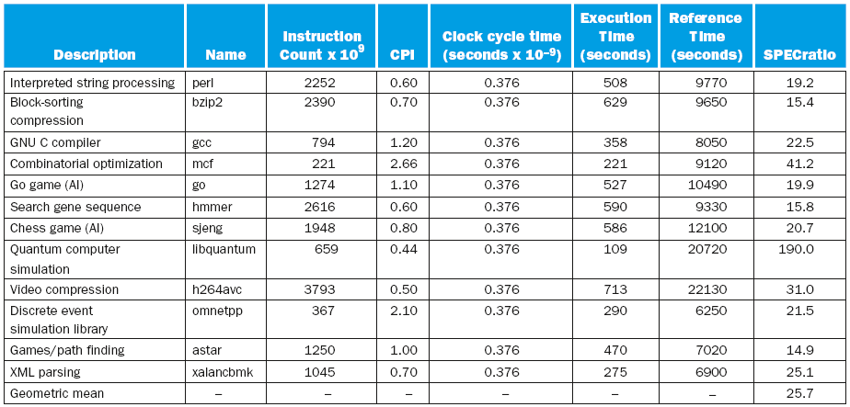
CINT2006 for Intel Core i7 920

Slide 22
SPEC Power Benchmark
Power consumption of server at different workload levels
Performance: ssj_ops/sec
Power: Watts (Joules/sec)

Slide 23
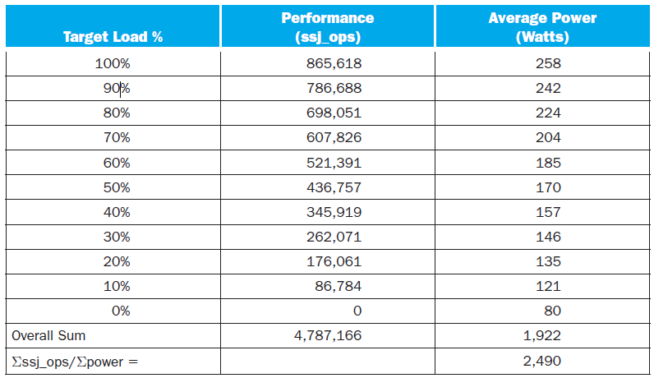
SPECpower_ssj2008 for Xeon X5650

Slide 24
Pitfall: Amdahl’s Law
Improving an aspect of a computer and expecting a proportional improvement in overall performance
Example: multiply accounts for 80s/100s
How much improvement in multiply performance to get 5× overall?
Can’t be done!
Corollary: make the common case fast

Slide 25
Fallacy: Low Power at Idle
Look back at i7 power benchmark
At 100% load: 258W
At 50% load: 170W (66%)
At 10% load: 121W (47%)
Google data center
Mostly operates at 10% – 50% load
At 100% load less than 1% of the time
Consider designing processors to make power proportional to load

Slide 26
Pitfall: MIPS as a Performance Metric
MIPS: Millions of Instructions Per Second
Doesn’t account for
Differences in ISAs between computers
Differences in complexity between instructions
CPI varies between programs on a given CPU

Slide 27
Concluding Remarks (P&H Chapter 1)
Cost/performance is improving
Due to underlying technology development
Hierarchical layers of abstraction
In both hardware and software
Instruction set architecture
The hardware/software interface
Execution time: the best performance measure
Power is a limiting factor
Use parallelism to improve performance

