Slide 1
Processor design Pipelining
Chapter 4.5

Slide 2
Outline
Fundamentals
Pipelining performance
Hazards
Structure
Data
Control

Slide 3
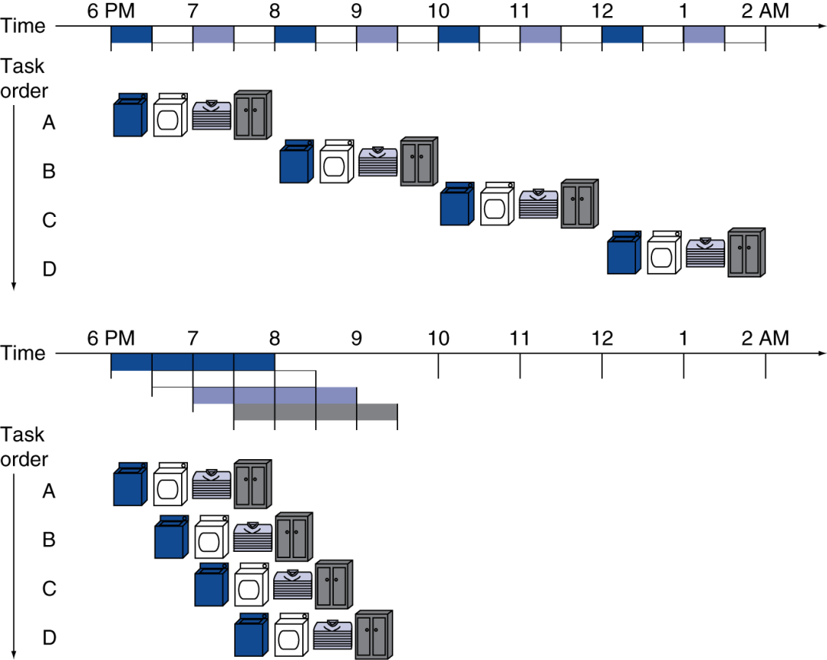
Pipelining Analogy
Pipelined laundry: overlapping execution
Parallelism improves performance
§4.5 An Overview of Pipelining
Four loads:
Speedup = 8/3.5 = 2.3
Notes:
How to express the speed up in terms of n, the number of stages?
How do you draw the picture for parallel processing?

Slide 4
MIPS Pipeline
Five stages, one step per stage
IF: Instruction fetch from memory
ID: Instruction decode & register read
EX: Execute operation or calculate address
MEM: Access memory operand
WB: Write result back to register

Slide 5
Pipeline Performance
Assume time for stages is
100ps for register read or write
200ps for other stages
Compare pipelined datapath with single-cycle datapath
Instr | Instr fetch | Register read | ALU op | Memory access | Register write | Total time
lw | 200ps | 100 ps | 200ps | 200ps | 100 ps | 800ps
sw | 200ps | 100 ps | 200ps | 200ps |  | 700ps
R-format | 200ps | 100 ps | 200ps |  | 100 ps | 600ps
beq | 200ps | 100 ps | 200ps |  |  | 500ps

Slide 6
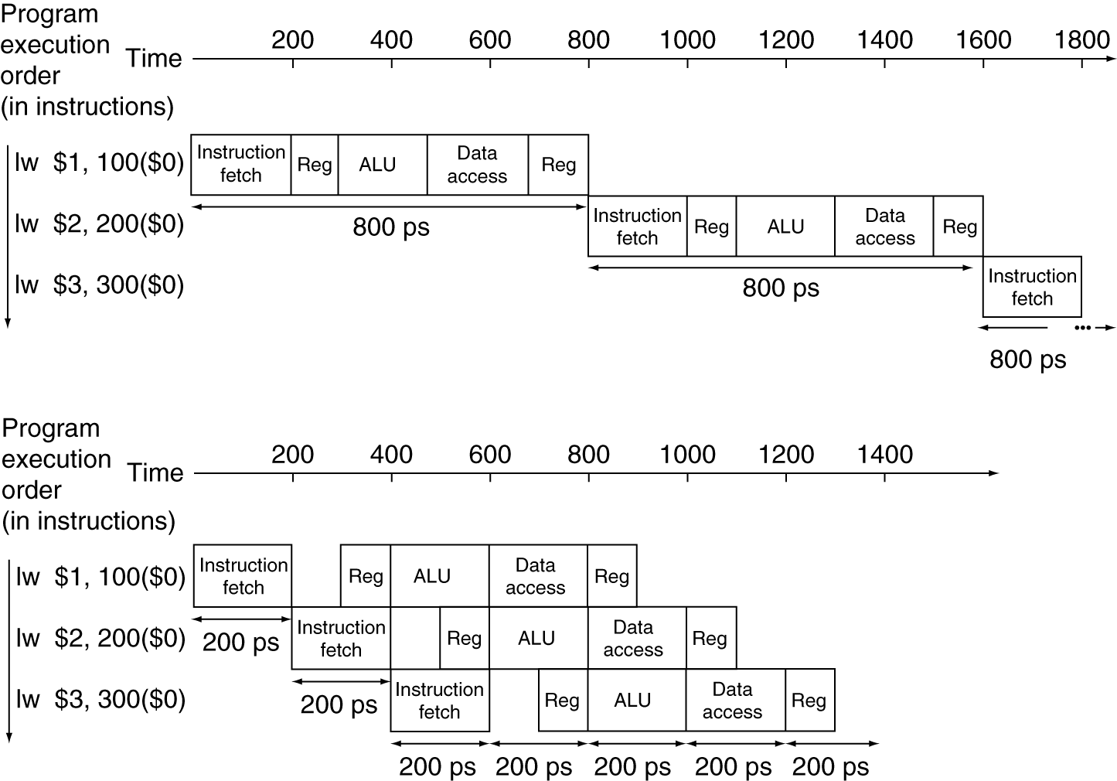
Pipeline Performance
Single-cycle (T_{c}= 800ps)
Pipelined (T_{c}= 200ps)

Slide 7
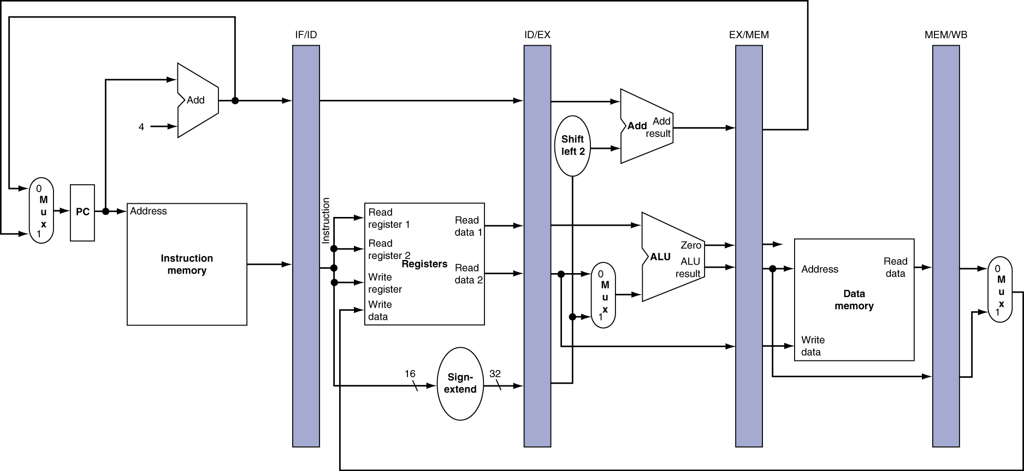
Pipeline registers
Need registers between stages
To hold information produced in previous cycle

Slide 8
Pipeline Speedup
If all stages are balanced
i.e., all take the same time
Time between instructions_{pipelined} = Time between instructions_{nonpipelined} Number of stages
If not balanced, speedup is less
Speedup due to increased throughput
Latency (time for each instruction) does not decrease

Slide 9
Pipelining and ISA Design
MIPS ISA designed for pipelining
All instructions are 32-bits
Easier to fetch and decode in one cycle
c.f. x86: 1- to 17-byte instructions
Few and regular instruction formats
Can decode and read registers in one step
Load/store addressing
Can calculate address in 3rd stage, access memory in 4th stage
Alignment of memory operands
Memory access takes only one cycle

Slide 10
Hazards
Situations that prevent starting the next instruction in the next cycle
Structure hazards
A required resource is busy
Data hazard
Need to wait for previous instruction to complete its data read/write
Control hazard
Deciding on control action depends on previous instruction

Slide 11
Structure Hazards
Conflict for use of a resource
In MIPS pipeline with a single memory
Load/store requires data access
Instruction fetch would have to stall for that cycle
Would cause a pipeline “bubble”
Hence, pipelined datapaths require separate instruction/data memories
Or separate instruction/data caches
Notes:
Draw the picture using the stages (resources) as the y-axis

Slide 12
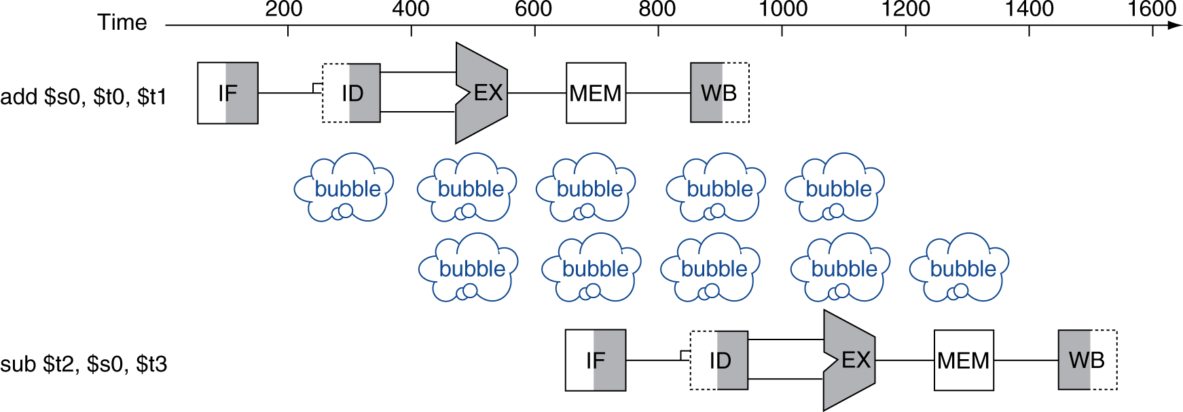
Data Hazards
An instruction depends on completion of data access by a previous instruction
add $s0, $t0, $t1 sub $t2, $s0, $t3

Slide 13
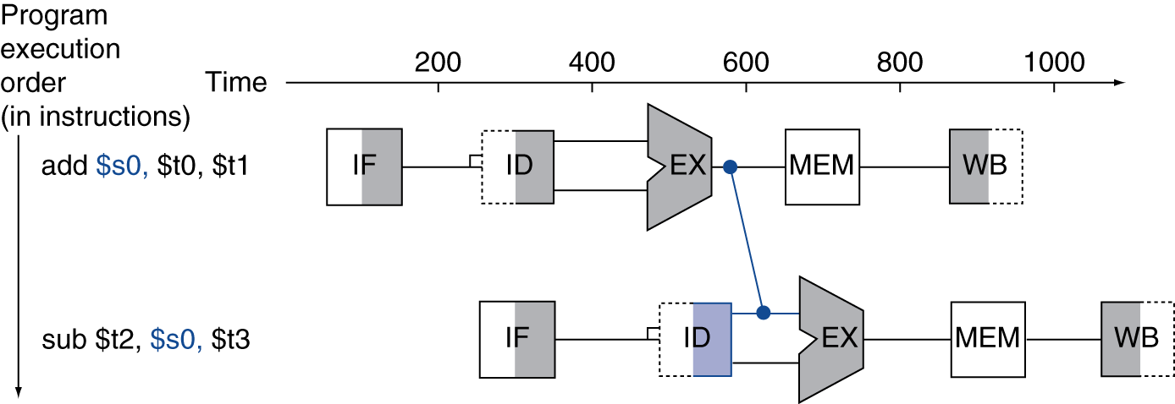
Forwarding (aka Bypassing)
Use result when it is computed
Don’t wait for it to be stored in a register
Requires extra connections in the datapath

Slide 14
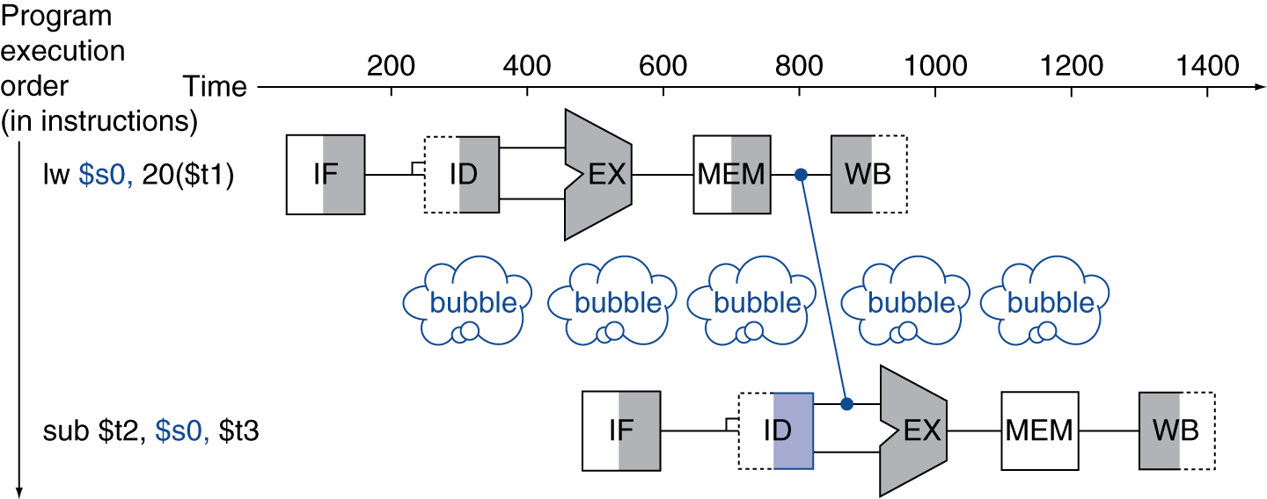
Load-Use Data Hazard
Can’t always avoid stalls by forwarding
If value not computed when needed
Can’t forward backward in time!

Slide 15
Code Scheduling to Avoid Stalls
Reorder code to avoid use of load result in the next instruction
C code for A = B + E; C = B + F;
lw $t1, 0($t0)
lw $t2, 4($t0)
add $t3, $t1, $t2
sw $t3, 12($t0)
lw $t4, 8($t0)
add $t5, $t1, $t4
sw $t5, 16($t0)
lw $t1, 0($t0)
lw $t2, 4($t0)
lw $t4, 8($t0)
add $t3, $t1, $t2
sw $t3, 12($t0)
add $t5, $t1, $t4
sw $t5, 16($t0)
stall
stall
13 cycles
11 cycles

Slide 16
Control Hazards
Branch determines flow of control
Fetching next instruction depends on branch outcome
Pipeline can’t always fetch correct instruction
Still working on ID stage of branch
In MIPS pipeline
Need to compare registers and compute target early in the pipeline
Add hardware to do it in ID stage

Slide 17
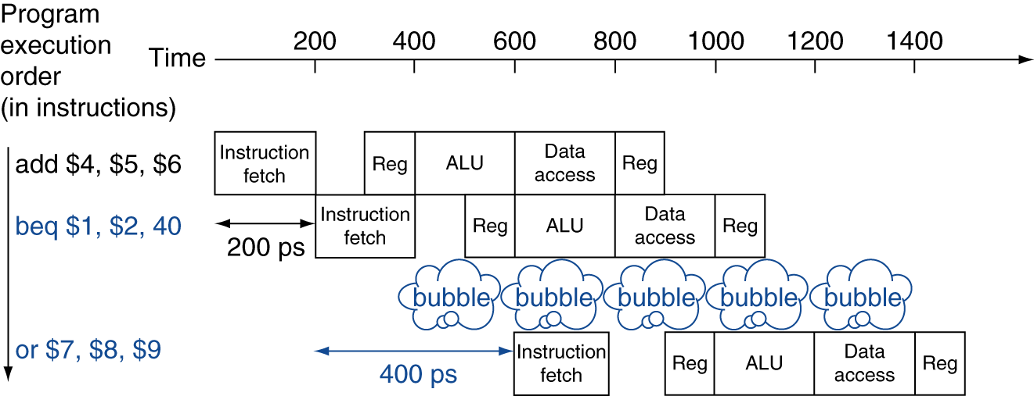
Stall on Branch
Wait until branch outcome determined before fetching next instruction

Slide 18
Branch Prediction
Longer pipelines can’t readily determine branch outcome early
Stall penalty becomes unacceptable
Predict outcome of branch
Only stall if prediction is wrong
In MIPS pipeline
Can predict branches not taken
Fetch instruction after branch, with no delay

Slide 19
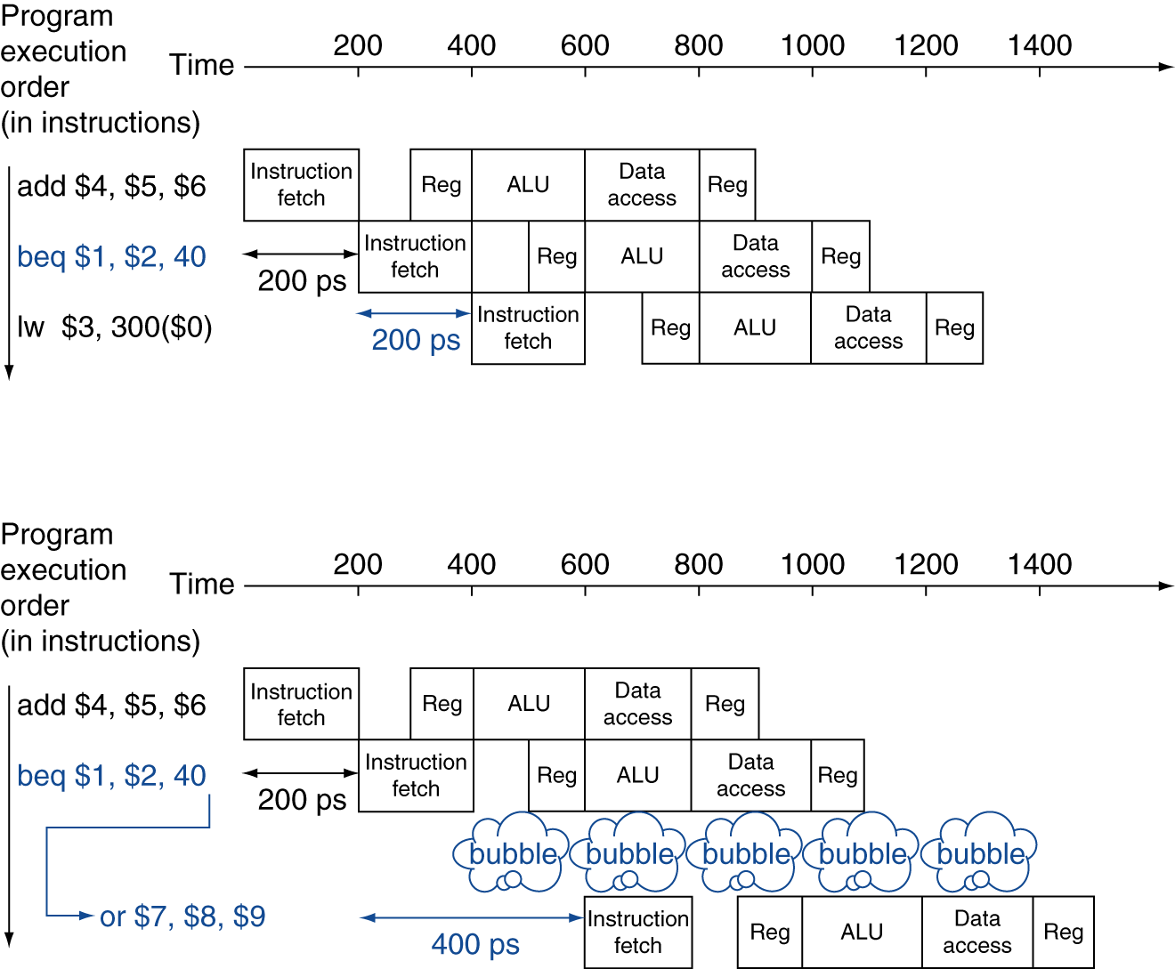
MIPS with Predict Not Taken
Prediction correct
Prediction incorrect

Slide 20
More-Realistic Branch Prediction
Static branch prediction
Based on typical branch behavior
Example: loop and if-statement branches
Predict backward branches taken
Predict forward branches not taken
Dynamic branch prediction
Hardware measures actual branch behavior
e.g., record recent history of each branch
Assume future behavior will continue the trend
When wrong, stall while re-fetching, and update history

Slide 21
Pipeline Summary
The BIG Picture
Pipelining improves performance by increasing instruction throughput
Executes multiple instructions in parallel
Each instruction has the same latency
Subject to hazards
Structure, data, control
Instruction set design affects complexity of pipeline implementation

