Slide 1
HW 1: Insertion and Merge Sort
Mark Gameng – A20419026

Slide 2
Analysis
Insertion Sort time complexity is O(n^2)
It iterates over the array while checking if the elements to the left are less than the current one, if so swaps
Worst case is when array is reversely sorted
Merge Sort time complexity is O(nlog(n)) or T(n) = 2T(n/2)+O(n)
Divides itself into two halves, and recurses for the two halves and then merges the two together to get a fully sorted array. Takes linear time to merge the two, so it’s just nlog(n)
No worst case. Time complexity is O(nlog(n)) for everything –worst, average, best case.

Slide 3
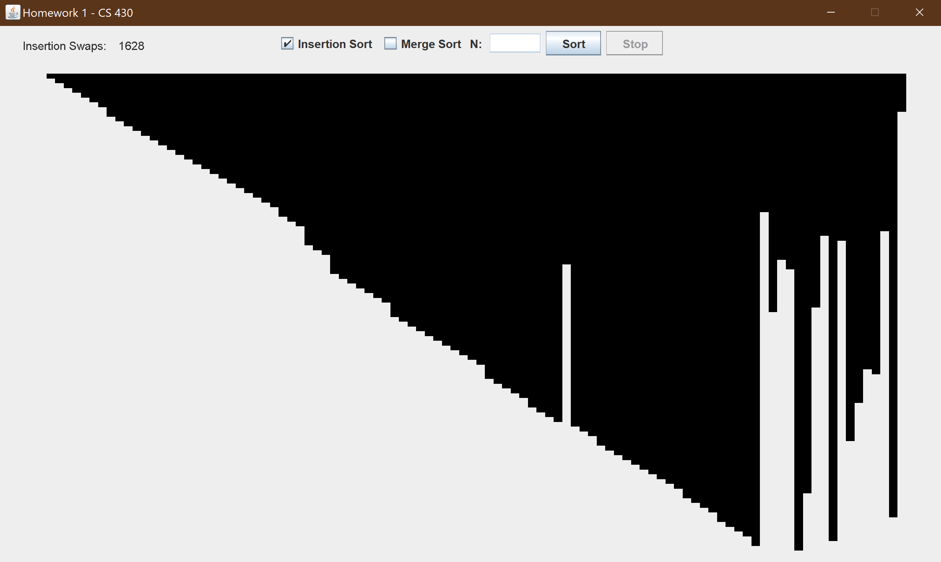
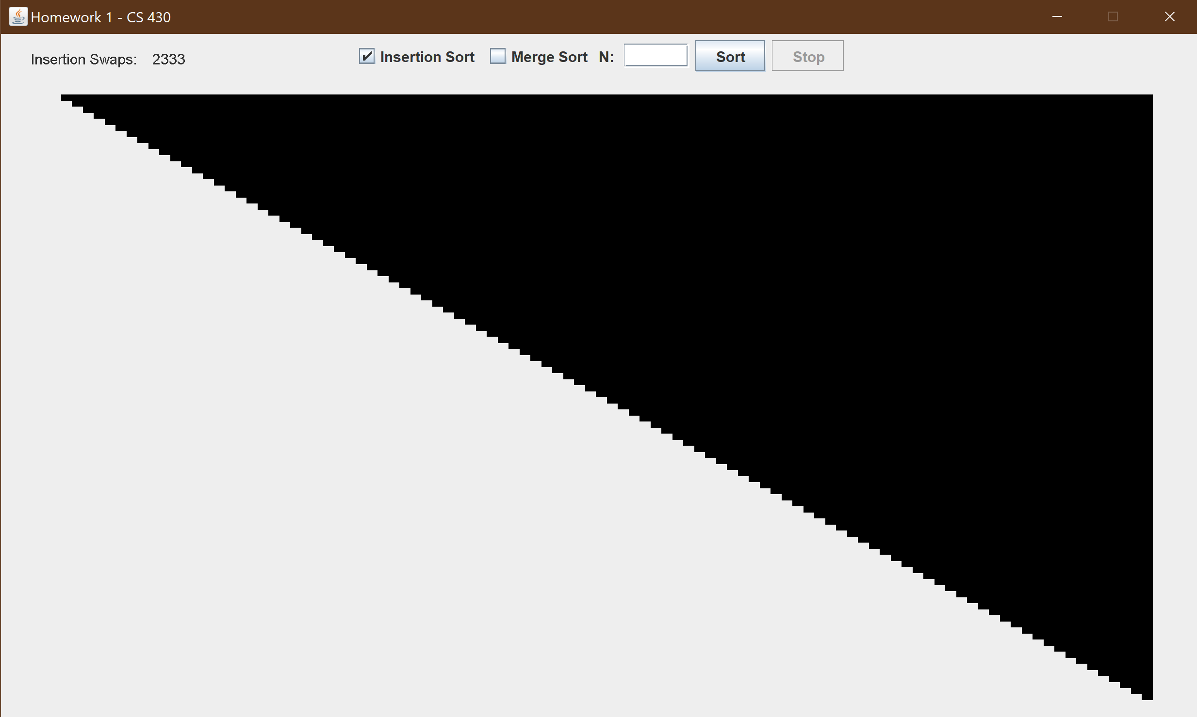
Insertion Sort (Default n = 100)

Slide 4
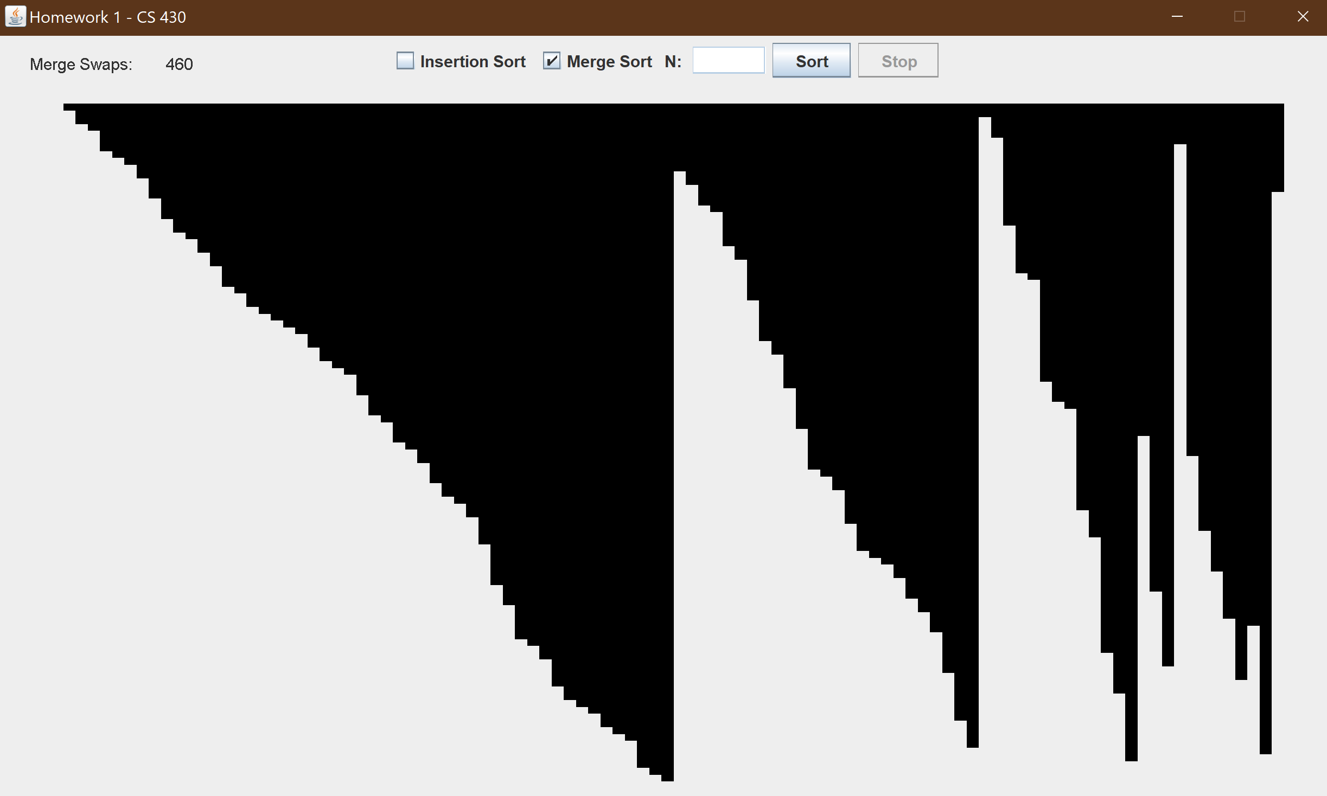

Merge Sort (Default n = 100)

Slide 5
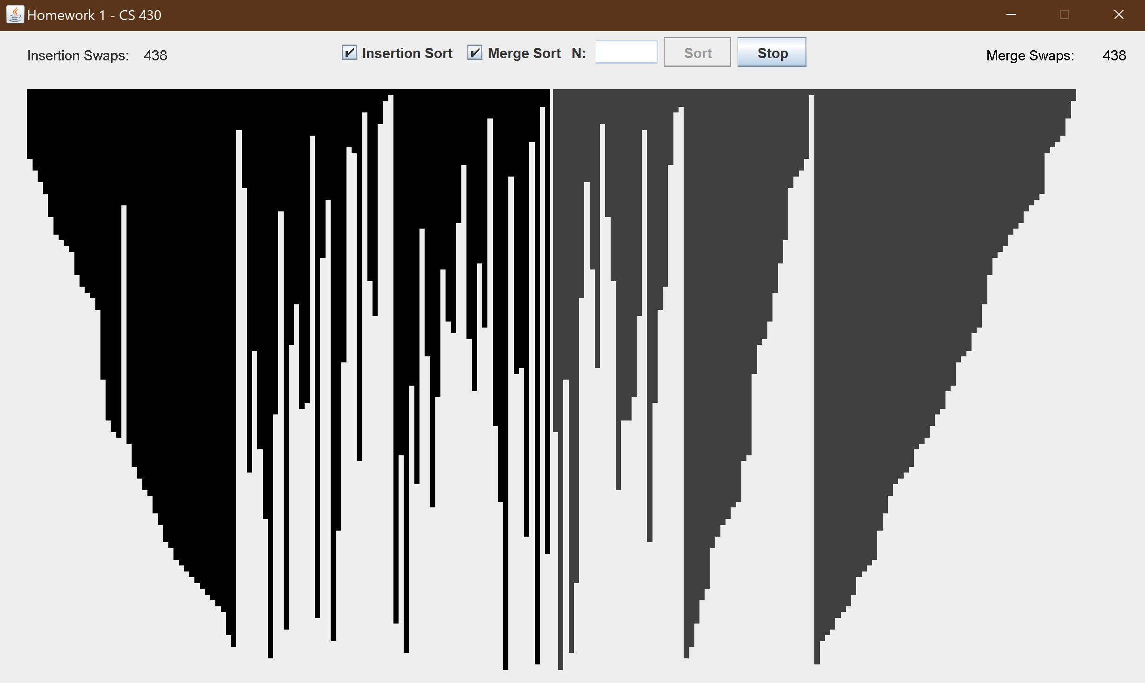
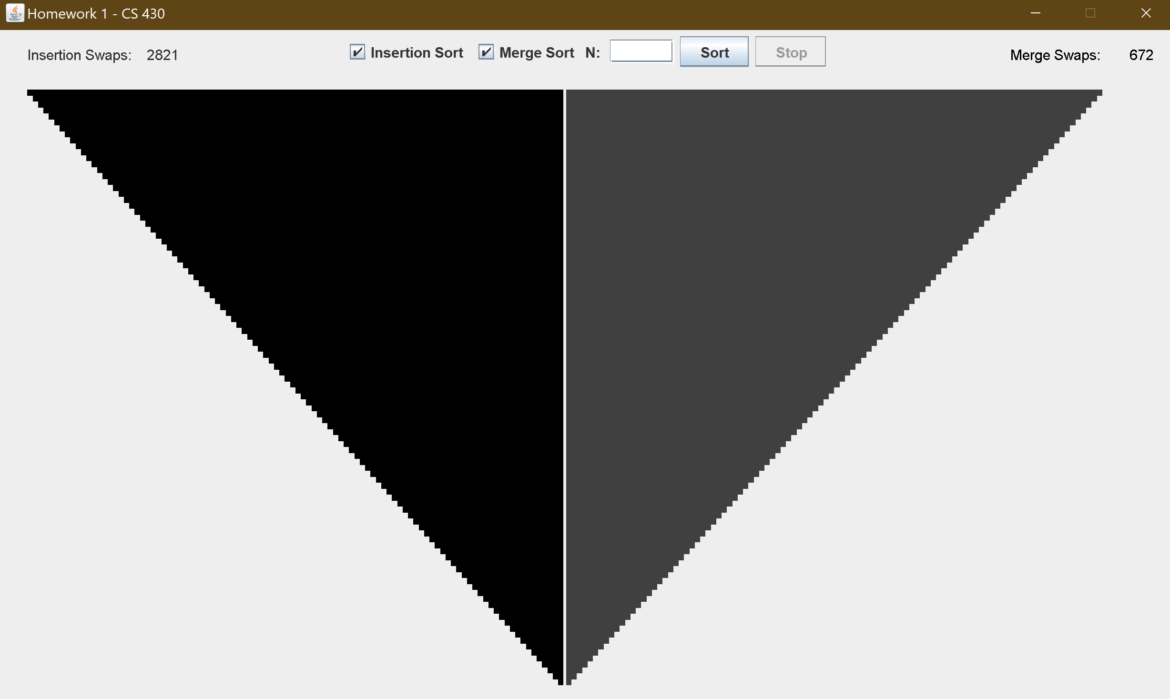
Comparing Insertion and Merge (Default n = 100)
Both are sorting the same array

Slide 6
To start the program
Just run the code
Clicking sort without any checked algorithm just makes a new random array
Click either algorithm or both to compare and click sort for the program to sort
You can click stop to make the animation stop, and then sort to continue
You can adjust n, the array length, by typing it in and clicking sort

