Slide 1
HW 3
Mark Gameng, Seat 23, mgameng1@hawk.iit.edu

Slide 2
Heap Sort
First build a max heap from the elements in the array using heapify
Then swap the root with the last element and then heapify again but excluding the last element
Heapify takes O(log n) but since it’s doing heapify for each element in the array, O(n), Heap sort takes O(nlogn)
The best, worst, and average case are the same – O(nlogn)

Slide 3
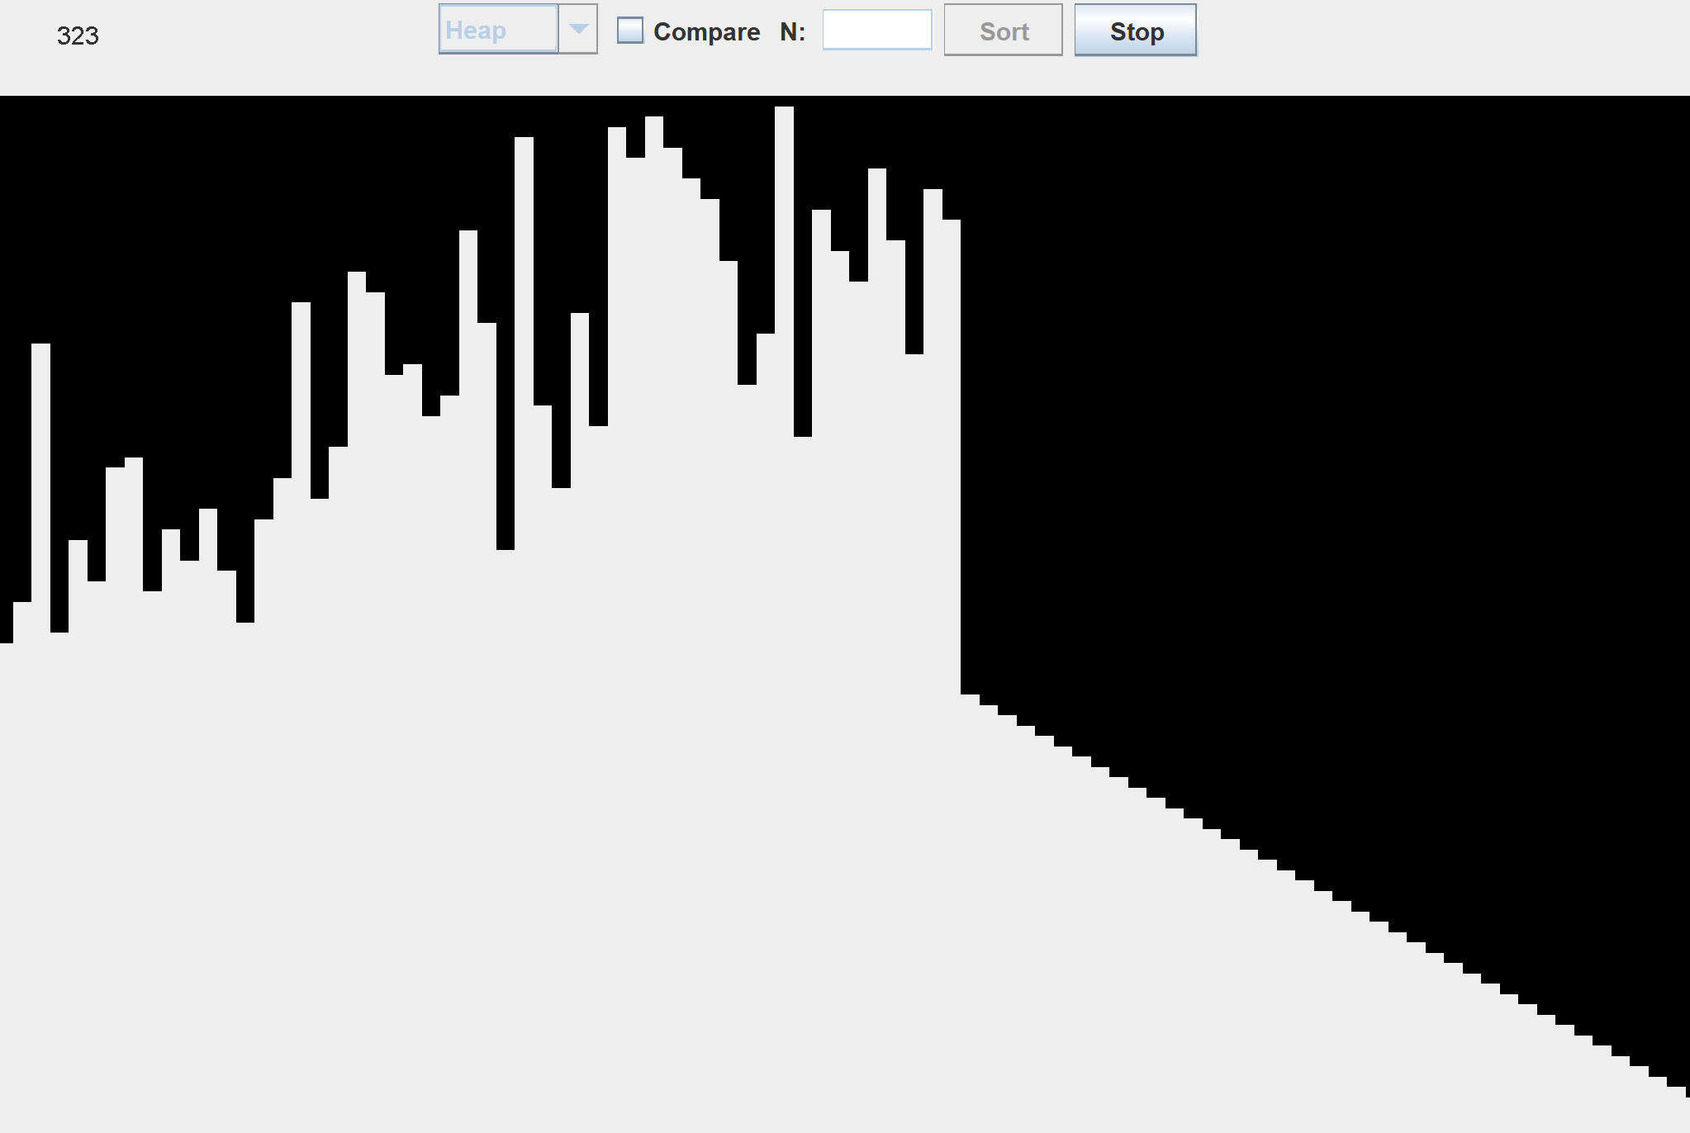
Heap Sort cont.

Slide 4
Quick Sort
A divide and conquer algorithm
Selects a pivot element and partitions the other elements based on if they are less or greater than the pivot. The partitioned sub arrays are then sorted.
Partition is linear time but adding the recursive call for the elements before and after the pivot, the time complexity is – O(nlogn)
Best and average case are the same but worst case is O(n^2). This happens when each partition, the pivot is always the smallest or largest element.

Slide 5
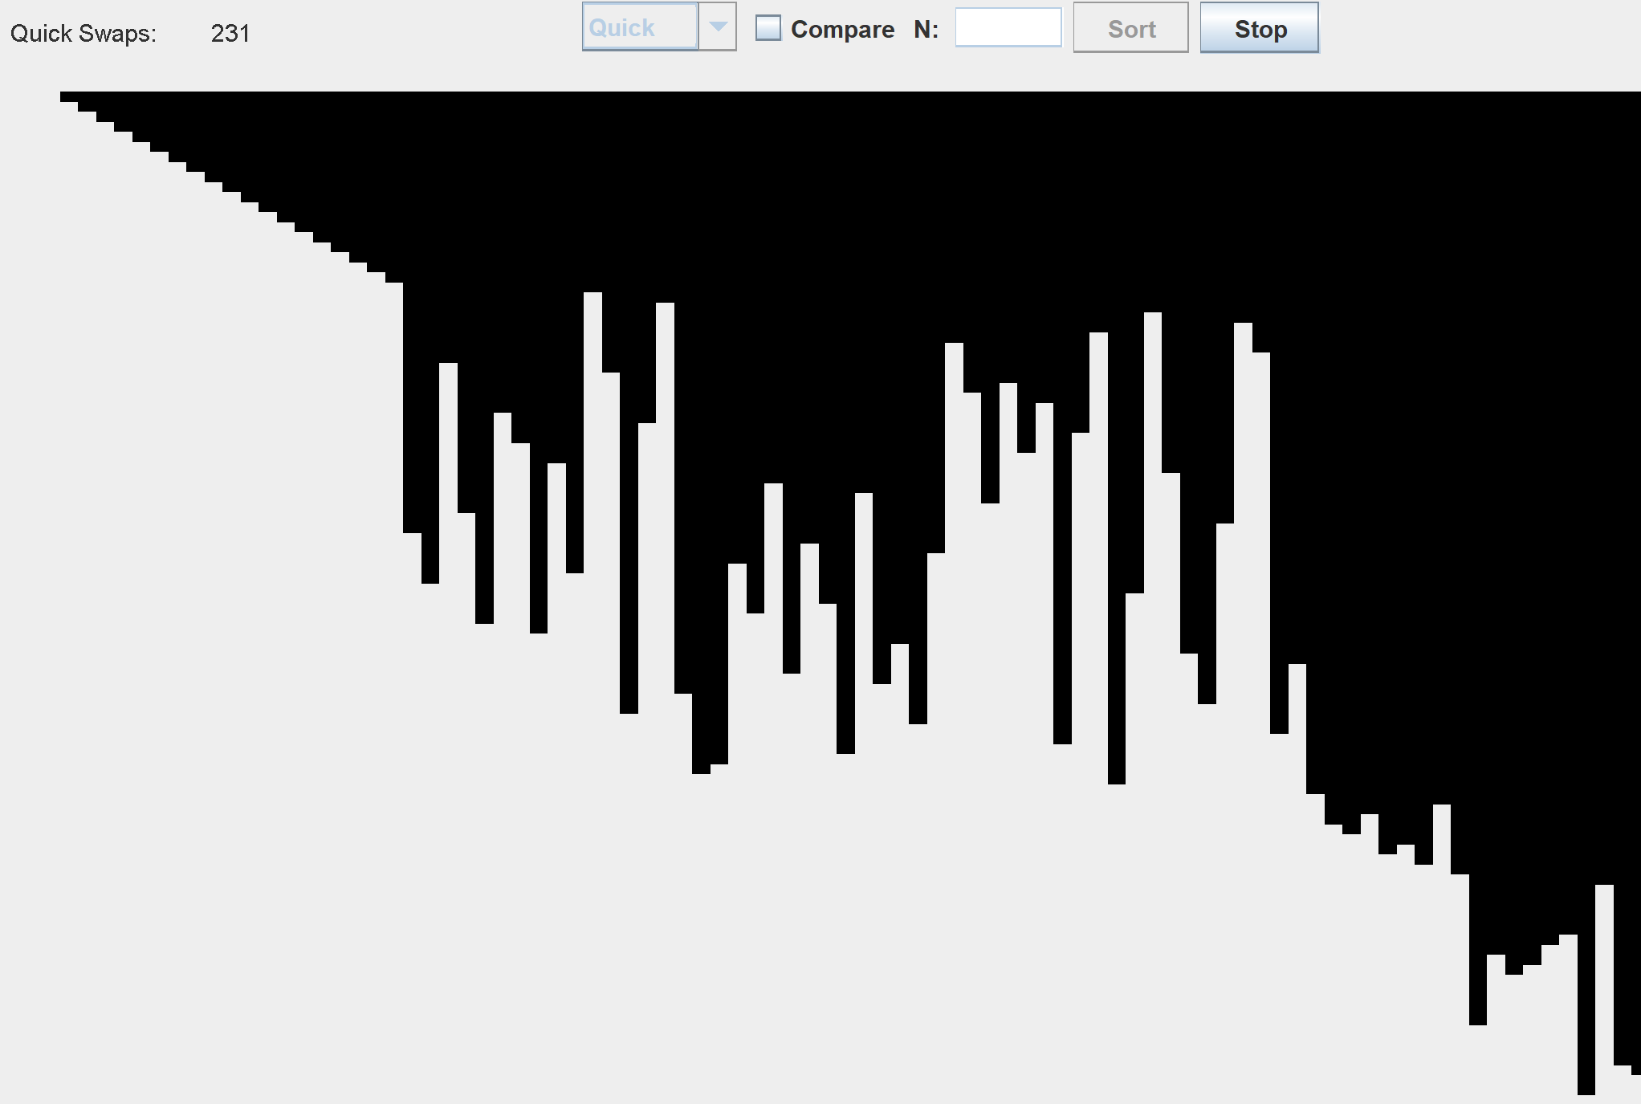
Quick Sort cont.

Slide 6
Comparing via the gui
Comparing between the two, quick sort is generally better than heap sort.
I added a timer, for how long each algorithm took, and in general quick sort was faster. The time differs each time even if it is the same array because it depends on what the computer is prioritizing at the given time, but most of the time quick sort was faster
Also quick sort has a lot less swaps than heap sort which makes sense and is probably the reason it is generally faster than heap sort
Thus, quick sort is a better sorting algorithm than heap sort

Slide 7
Program Instructions
Run from window class
Select the algorithm from the dropdown box
Click compare if you want to keep the arrays the same, so you can compare between algorithms
Click sort to sort, and stop if you want.
Can also change the size of the array in the text box

