Slide 1
Classification: Probabilistic Generative Model

Slide 2
Slide credits
Most of these slides were adapted from:
Hung-yi Lee (National Taiwan University)
Kris Kitani (Carnegie Mellon University).
Noah Snavely (Cornell University).
Fei-Fei Li (Stanford University).

Slide 3
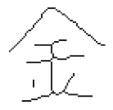

Classification
Function
$$x$$
Class n
Credit Scoring
Input: income, savings, profession, age, past financial history ……
Output: accept or refuse
Medical Diagnosis
Input: current symptoms, age, gender, past medical history ……
Output: which kind of diseases
Handwritten character recognition
Face recognition
Input: image of a face, output: person
output:
Input:
金

Slide 4
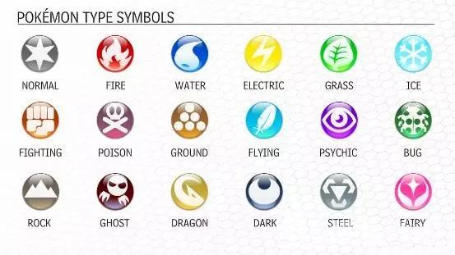









Example Application
$$f\left( \right)=$$
$$f\left( \right)=$$
$$f\left( \right)=$$

Slide 5
Example Application
pokemon games (NOT pokemon cards or Pokemon Go)
HP: hit points, or health, defines how much damage a pokemon can withstand before fainting
Attack: the base modifier for normal attacks (eg. Scratch, Punch)
Defense: the base damage resistance against normal attacks
SP Atk: special attack, the base modifier for special attacks (e.g. fire blast, bubble beam)
SP Def: the base damage resistance against special attacks
Speed: determines which pokemon attacks first each round
35
55
40
50
50
90
Can we predict the “type” of pokemon based on the information?

Slide 6
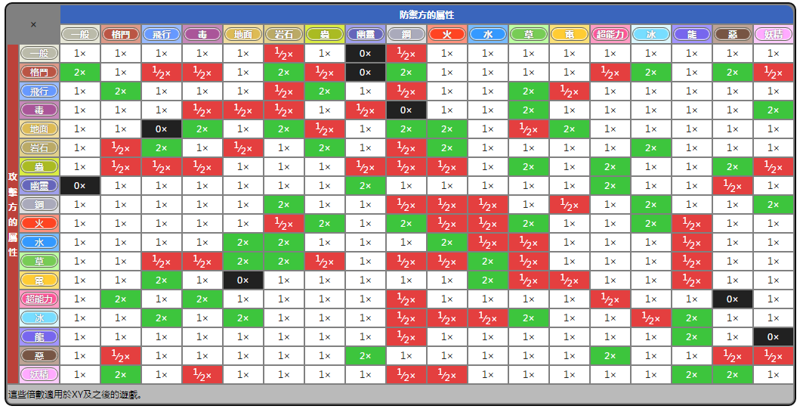
Example Application

Slide 7




How to do Classification
Training data for Classification
$$\left(x^{1},{\hat{y}}^{1}\right)$$
$$\left(x^{2},{\hat{y}}^{2}\right)$$
$$……$$
$$\left(x^{N},{\hat{y}}^{N}\right)$$
Classification as Regression?
Binary classification as example
Training: Class 1 means the target is 1; Class 2 means the target is -1
Testing: closer to 1 $→$ class 1; closer to -1 $→$ class 2

Slide 8
b + w₁x₁ + w₂x₂ = 0
to decrease error
Class 2
Class 2
-1
-1
Multiple class: Class 1 means the target is 1; Class 2 means the target is 2; Class 3 means the target is 3 …… problematic
1
1
x₂
x₂
Class 1
Class 1
>>1
y = b + w₁x₁ + w₂x₂
error
x₁
x₁
Penalize to the examples that are “too correct” …
(Bishop, P186)

Slide 9
Ideal Alternatives
$$f\left(x\right)$$
Function (Model):
Loss function:
Find the best function:
Example: Perceptron, SVM
$$g\left(x\right)>0$$
Output = class 1
$$x$$
$$else$$
Output = class 2
$$L\left(f\right)=\sum_{n}{δ\left(f\left(x^{n}\right)≠{\hat{y}}^{n}\right)}$$
The number of times f get incorrect results on training data.
Not Today

Slide 10
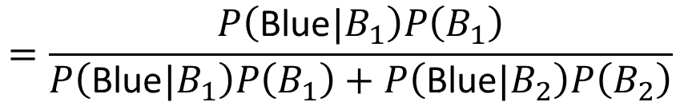
Two Boxes
Box 1
Box 2
P(B₁) = 2/3
P(B₂) = 1/3
P(Blue|B₁) = 4/5
P(Blue|B₁) = 2/5
P(Green|B₁) = 1/5
P(Green|B₁) = 3/5
from one of the boxes
Where does it come from?
$$=\frac{P\left(\text{Blue}|B_{1}\right)P\left(B_{1}\right)}{P\left(\text{Blue}|B_{1}\right)P\left(B_{1}\right)+P\left(\text{Blue}|B_{2}\right)P\left(B_{2}\right)}$$
P(B₁ | Blue)

Slide 11
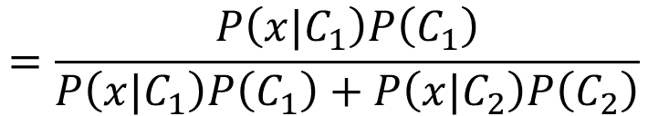



Two Classes
Estimating the Probabilities
From training data
Class 1
Class 2
P(C₁)
P(C₂)
P(x|C₁)
P(x|C₂)
Given an x, which class does it belong to
$$=\frac{P\left(x|C_{1}\right)P\left(C_{1}\right)}{P\left(x|C_{1}\right)P\left(C_{1}\right)+P\left(x|C_{2}\right)P\left(C_{2}\right)}$$
$$P\left(C_{1}|x\right)$$
Generative Model
$$P\left(x\right)$$
$$=P\left(x|C_{1}\right)P\left(C_{1}\right)+P\left(x|C_{2}\right)P\left(C_{2}\right)$$

Slide 12
Prior
Class 1
Class 2
P(C₁)
P(C₂)
Water
Normal
Water and Normal type with ID < 400 for training, rest for testing
Training: 79 Water, 61 Normal
P(C₁) = 79 / (79 + 61) =0.56
P(C₂) = 61 / (79 + 61) =0.44

Slide 13



Probability from Class
P(x|C₁) = ?
P( |Water)
= ?
Each Pokémon is represented as a vector by its attribute.
feature
79 in total
Water
Type

Slide 14
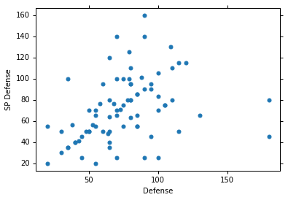


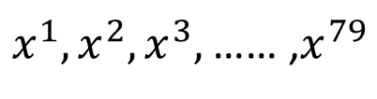

Probability from Class - Feature
Considering Defense and SP Defense
$$\left[\begin{aligned}48 \\ 50\end{aligned}\right]$$
$x^{1},x^{2},x^{3},$ …… ,$x^{79}$
$$\left[\begin{aligned}65 \\ 64\end{aligned}\right]$$
P(x|Water)=?
0?
Assume the points are sampled from a Gaussian distribution.
$$\left[\begin{aligned}103 \\ 45\end{aligned}\right]$$
Water
Type

Slide 15
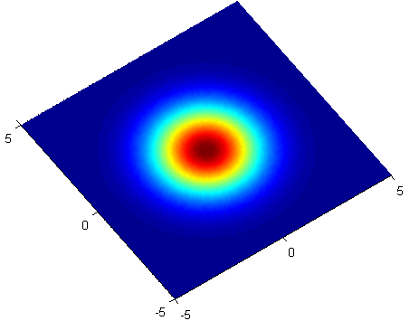
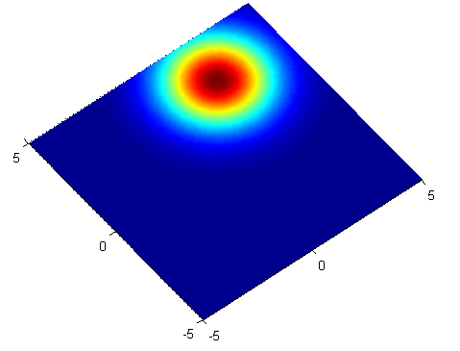

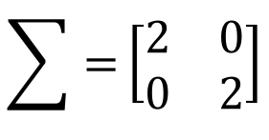


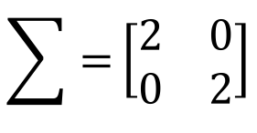
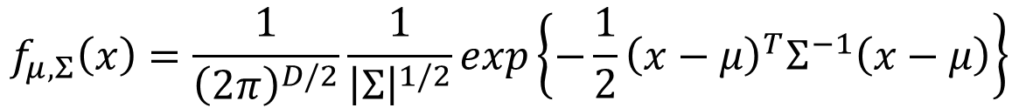

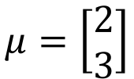
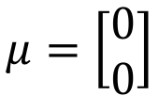

Gaussian Distribution
https://blog.slinuxer.com/tag/pca
$$f_{μ,Σ}\left(x\right)=\frac{1}{{\left(2π\right)}^{D/2}}\frac{1}{{\left|Σ\right|}^{1/2}}exp\left\{−\frac{1}{2}{\left(x−μ\right)}^{T}Σ^{−1}\left(x−μ\right)\right\}$$
Input: vector x, output: probability of sampling x
The shape of the function determines by mean $μ$ and covariance matrix $Σ$
$$\sum{=}\left[\begin{matrix}2 & 0 \\ 0 & 2\end{matrix}\right]$$
$$μ=\left[\begin{aligned}2 \\ 3\end{aligned}\right]$$
$$\sum{=}\left[\begin{matrix}2 & 0 \\ 0 & 2\end{matrix}\right]$$
$$μ=\left[\begin{aligned}0 \\ 0\end{aligned}\right]$$
$$x_{2}$$
$$x_{2}$$
$$x_{1}$$
$$x_{1}$$

Slide 16
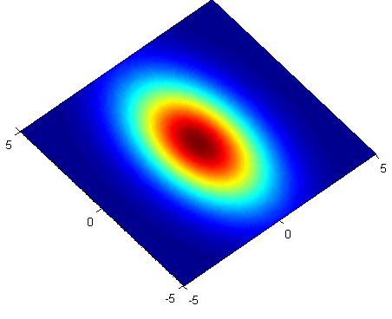
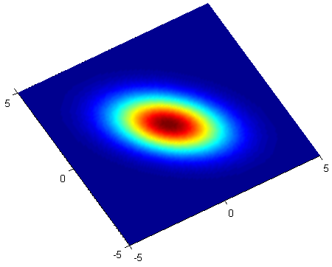


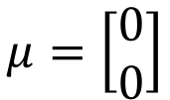
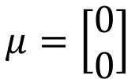
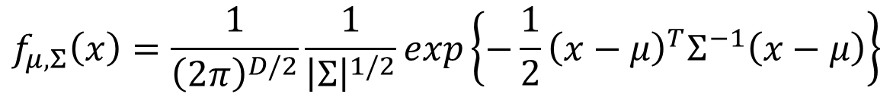


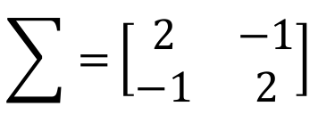
Gaussian Distribution
https://blog.slinuxer.com/tag/pca
$$f_{μ,Σ}\left(x\right)=\frac{1}{{\left(2π\right)}^{D/2}}\frac{1}{{\left|Σ\right|}^{1/2}}exp\left\{−\frac{1}{2}{\left(x−μ\right)}^{T}Σ^{−1}\left(x−μ\right)\right\}$$
Input: vector x, output: probability of sampling x
The shape of the function determines by mean $μ$ and covariance matrix $Σ$
$$μ=\left[\begin{aligned}0 \\ 0\end{aligned}\right]$$
$$\sum{=}\left[\begin{matrix}2 & 0 \\ 0 & 6\end{matrix}\right]$$
$$\sum{=}\left[\begin{matrix}2 & −1 \\ −1 & 2\end{matrix}\right]$$
$$μ=\left[\begin{aligned}0 \\ 0\end{aligned}\right]$$
$$x_{2}$$
$$x_{2}$$
$$x_{1}$$
$$x_{1}$$

Slide 17

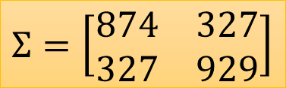

Probability from Class
Assume the points are sampled from a Gaussian distribution
Find the Gaussian distribution behind them
Probability for new points
$x^{1},x^{2},x^{3},$ …… ,$x^{79}$
New x
$$μ=\left[\begin{aligned}75.0 \\ 71.3\end{aligned}\right]$$
$$Σ=\left[\begin{matrix}874 & 327 \\ 327 & 929\end{matrix}\right]$$
How to find them?
Water
Type
$$f_{μ,Σ}\left(x\right)=\frac{1}{{\left(2π\right)}^{D/2}}\frac{1}{{\left|Σ\right|}^{1/2}}exp\left\{−\frac{1}{2}{\left(x−μ\right)}^{T}Σ^{−1}\left(x−μ\right)\right\}$$

Slide 18
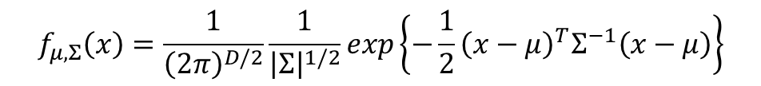
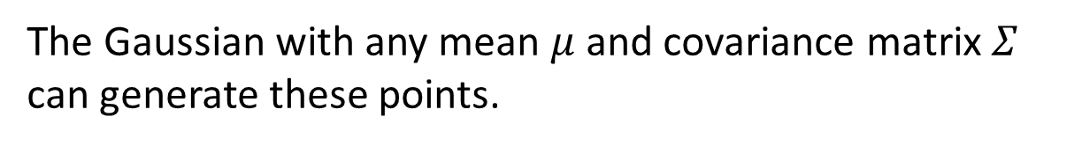
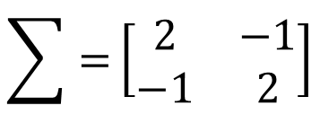
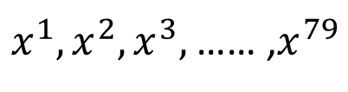
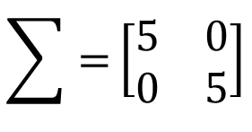
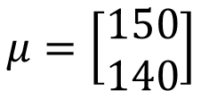
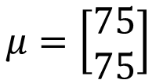

Maximum Likelihood
$$f_{μ,Σ}\left(x\right)=\frac{1}{{\left(2π\right)}^{D/2}}\frac{1}{{\left|Σ\right|}^{1/2}}exp\left\{−\frac{1}{2}{\left(x−μ\right)}^{T}Σ^{−1}\left(x−μ\right)\right\}$$
$$\sum{=}\left[\begin{matrix}5 & 0 \\ 0 & 5\end{matrix}\right]$$
$x^{1},x^{2},x^{3},$ …… ,$x^{79}$
$$μ=\left[\begin{aligned}150 \\ 140\end{aligned}\right]$$
$$\sum{=}\left[\begin{matrix}2 & −1 \\ −1 & 2\end{matrix}\right]$$
$$μ=\left[\begin{aligned}75 \\ 75\end{aligned}\right]$$
The Gaussian with any mean $μ$ and covariance matrix $Σ$ can generate these points.
Different Likelihood
Likelihood of a Gaussian with mean $μ$ and covariance matrix $Σ$
= the probability of the Gaussian samples $x^{1},x^{2},x^{3},$ …… ,$x^{79}$
$$L\left(μ,Σ\right)$$
$$=f_{μ,Σ}\left(x^{1}\right)f_{μ,Σ}\left(x^{2}\right)f_{μ,Σ}\left(x^{3}\right)……f_{μ,Σ}\left(x^{79}\right)$$

Slide 19
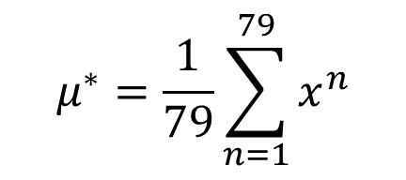
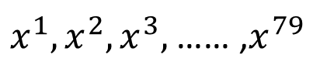
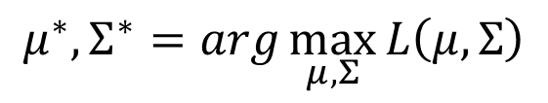




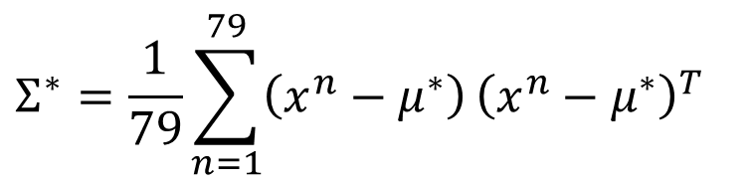
Maximum Likelihood
We have the “Water” type Pokémons:
$x^{1},x^{2},x^{3},$ …… ,$x^{79}$
We assume $x^{1},x^{2},x^{3},$ …… ,$x^{79}$ generate from the Gaussian ($μ^{∗},Σ^{∗}$) with the maximum likelihood
$$L\left(μ,Σ\right)$$
$$=f_{μ,Σ}\left(x^{1}\right)f_{μ,Σ}\left(x^{2}\right)f_{μ,Σ}\left(x^{3}\right)……f_{μ,Σ}\left(x^{79}\right)$$
$$f_{μ,Σ}\left(x\right)=\frac{1}{{\left(2π\right)}^{D/2}}\frac{1}{{\left|Σ\right|}^{1/2}}exp\left\{−\frac{1}{2}{\left(x−μ\right)}^{T}Σ^{−1}\left(x−μ\right)\right\}$$
$$μ^{∗},Σ^{∗}=arg\max_{μ,Σ}{L\left(μ,Σ\right)}$$
$$μ^{∗}=\frac{1}{79}\sum_{n=1}^{79}{x^{n}}$$
$$Σ^{∗}=\frac{1}{79}\sum_{n=1}^{79}{\left(x^{n}−μ^{∗}\right)}{\left(x^{n}−μ^{∗}\right)}^{T}$$
average

Slide 20
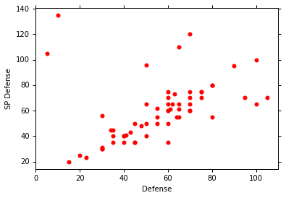
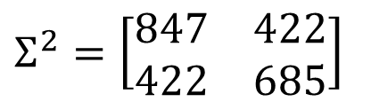
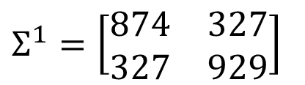
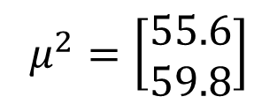
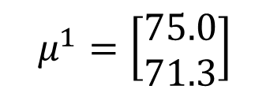
Maximum Likelihood
Class 1: Water
Class 2: Normal
$$μ^{1}=\left[\begin{aligned}75.0 \\ 71.3\end{aligned}\right]$$
$$Σ^{1}=\left[\begin{matrix}874 & 327 \\ 327 & 929\end{matrix}\right]$$
$$μ^{2}=\left[\begin{aligned}55.6 \\ 59.8\end{aligned}\right]$$
$$Σ^{2}=\left[\begin{matrix}847 & 422 \\ 422 & 685\end{matrix}\right]$$

Slide 21

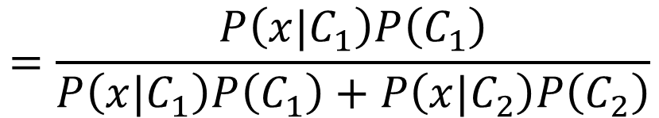

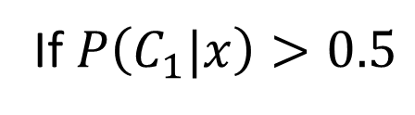



Now we can do classification ☺
$$f_{μ^{1},Σ^{1}}\left(x\right)=\frac{1}{{\left(2π\right)}^{D/2}}\frac{1}{{\left|Σ^{1}\right|}^{1/2}}exp\left\{−\frac{1}{2}{\left(x−μ^{1}\right)}^{T}{\left(Σ^{1}\right)}^{−1}\left(x−μ^{1}\right)\right\}$$
P(C1)
= 79 / (79 + 61) =0.56
$$μ^{1}=\left[\begin{aligned}75.0 \\ 71.3\end{aligned}\right]$$
$$Σ^{1}=\left[\begin{matrix}874 & 327 \\ 327 & 929\end{matrix}\right]$$
$$=\frac{P\left(x|C_{1}\right)P\left(C_{1}\right)}{P\left(x|C_{1}\right)P\left(C_{1}\right)+P\left(x|C_{2}\right)P\left(C_{2}\right)}$$
$$P\left(C_{1}|x\right)$$
$$f_{μ^{2},Σ^{2}}\left(x\right)=\frac{1}{{\left(2π\right)}^{D/2}}\frac{1}{{\left|Σ^{2}\right|}^{1/2}}exp\left\{−\frac{1}{2}{\left(x−μ^{2}\right)}^{T}{\left(Σ^{2}\right)}^{−1}\left(x−μ^{2}\right)\right\}$$
P(C2)
= 61 / (79 + 61)
=0.44
$$μ^{2}=\left[\begin{aligned}55.6 \\ 59.8\end{aligned}\right]$$
$$Σ^{2}=\left[\begin{matrix}847 & 422 \\ 422 & 685\end{matrix}\right]$$
If $P\left(C_{1}|x\right)>0.5$
x belongs to class 1 (Water)

Slide 22
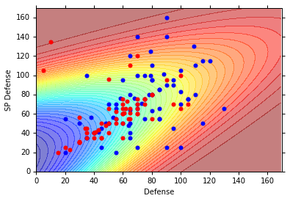
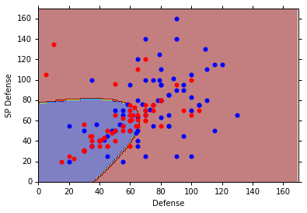
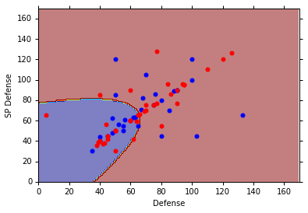





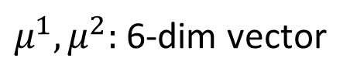

$$P\left(C_{1}|x\right)$$
$$>0.5$$
$$P\left(C_{1}|x\right)$$
$$P\left(C_{1}|x\right)<0.5$$
Blue points: C₁ (Water), Red points: C₂ (Normal)
How’s the results?
$$P\left(C_{1}|x\right)$$
$$>0.5$$
Testing data: 47% accuracy ☹
All: hp, att, sp att,
de, sp de, speed (6 features)
$μ^{1},μ^{2}:$ 6-dim vector
$Σ^{1},Σ^{2}:$ 6 x 6 matrices
$$P\left(C_{1}|x\right)<0.5$$
64% accuracy …

Slide 23
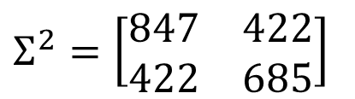
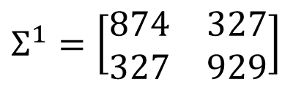
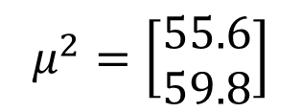
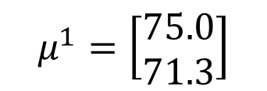

Modifying Model
Class 1: Water
Class 2: Normal
$$μ^{1}=\left[\begin{aligned}75.0 \\ 71.3\end{aligned}\right]$$
$$Σ^{1}=\left[\begin{matrix}874 & 327 \\ 327 & 929\end{matrix}\right]$$
$$μ^{2}=\left[\begin{aligned}55.6 \\ 59.8\end{aligned}\right]$$
$$Σ^{2}=\left[\begin{matrix}847 & 422 \\ 422 & 685\end{matrix}\right]$$
The same $Σ$
Less parameters

Slide 24








Modifying Model
Ref: Bishop, chapter 4.2.2
Maximum likelihood
“Water” type Pokémons:
“Normal” type Pokémons:
$x^{1},x^{2},x^{3},$ …… ,$x^{79}$
$x^{80},x^{81},x^{82},$ …… ,$x^{140}$
$$μ^{1}$$
$Σ$
$$μ^{2}$$
Find $μ^{1}$, $μ^{2}$, $Σ$ maximizing the likelihood $L\left(μ^{1}\text{,}μ^{2}\text{,}Σ\right)$
$$L\left(μ^{1}\text{,}μ^{2}\text{,}Σ\right)=f_{μ^{1},Σ}\left(x^{1}\right)f_{μ^{1},Σ}\left(x^{2}\right)⋯f_{μ^{1},Σ}\left(x^{79}\right)$$
$$×f_{μ^{2},Σ}\left(x^{80}\right)f_{μ^{2},Σ}\left(x^{81}\right)⋯f_{μ^{2},Σ}\left(x^{140}\right)$$
$μ^{1}$ and $μ^{2}$ is the same
$Σ=\frac{79}{140}Σ^{1}+\frac{61}{140}Σ^{2}$

Slide 25

Modifying Model
The boundary is linear
The same covariance matrix
All: hp, att, sp att, de, sp de, speed
54% accuracy
73% accuracy

Slide 26




Three Steps
Function Set (Model):
Goodness of a function:
The mean $μ$ and covariance $Σ$ that maximizing the likelihood (the probability of generating data)
Find the best function: easy
$$P\left(C_{1}|x\right)=\frac{P\left(x|C_{1}\right)P\left(C_{1}\right)}{P\left(x|C_{1}\right)P\left(C_{1}\right)+P\left(x|C_{2}\right)P\left(C_{2}\right)}$$
$$x$$
If $P\left(C_{1}|x\right)>0.5$, output: class 1
Otherwise, output: class 2

Slide 27





Probability Distribution
You can always use the distribution you like ☺
$$P\left(x|C_{1}\right)$$
$$=P\left(x_{1}|C_{1}\right)$$
$$P\left(x_{2}|C_{1}\right)$$
……
$$P\left(x_{k}|C_{1}\right)$$
……
$$\left[\begin{aligned}x_{1} \\ x_{2} \\ ⋮ \\ x_{k} \\ ⋮ \\ x_{K}\end{aligned}\right]$$
1-D Gaussian
For binary features, you may assume they are from Bernoulli distributions.
If you assume all the dimensions are independent, then you are using Naive Bayes Classifier.

Slide 28






Posterior Probability
$$P\left(C_{1}|x\right)=\frac{P\left(x|C_{1}\right)P\left(C_{1}\right)}{P\left(x|C_{1}\right)P\left(C_{1}\right)+P\left(x|C_{2}\right)P\left(C_{2}\right)}$$
$$=\frac{1}{1+\frac{P\left(x|C_{2}\right)P\left(C_{2}\right)}{P\left(x|C_{1}\right)P\left(C_{1}\right)}}$$
$$=\frac{1}{1+exp\left(−z\right)}$$
$$=σ\left(z\right)$$
Sigmoid function
$$z=ln\frac{P\left(x|C_{1}\right)P\left(C_{1}\right)}{P\left(x|C_{2}\right)P\left(C_{2}\right)}$$

Slide 29
Warning of Math

Slide 30






Posterior Probability
$$z=ln\frac{P\left(x|C_{1}\right)P\left(C_{1}\right)}{P\left(x|C_{2}\right)P\left(C_{2}\right)}$$
$$P\left(C_{1}|x\right)$$
$$=σ\left(z\right)$$
sigmoid
$$\frac{\frac{N_{1}}{N_{1}+N_{2}}}{\frac{N_{2}}{N_{1}+N_{2}}}$$
$$z=ln\frac{P\left(x|C_{1}\right)}{P\left(x|C_{2}\right)}+ln\frac{P\left(C_{1}\right)}{P\left(C_{2}\right)}$$
$$=\frac{N_{1}}{N_{2}}$$
$$P\left(x|C_{1}\right)=\frac{1}{{\left(2π\right)}^{D/2}}\frac{1}{{\left|Σ^{1}\right|}^{1/2}}exp\left\{−\frac{1}{2}{\left(x−μ^{1}\right)}^{T}{\left(Σ^{1}\right)}^{−1}\left(x−μ^{1}\right)\right\}$$
$$P\left(x|C_{2}\right)=\frac{1}{{\left(2π\right)}^{D/2}}\frac{1}{{\left|Σ^{2}\right|}^{1/2}}exp\left\{−\frac{1}{2}{\left(x−μ^{2}\right)}^{T}{\left(Σ^{2}\right)}^{−1}\left(x−μ^{2}\right)\right\}$$

Slide 31




$$z=ln\frac{P\left(x|C_{1}\right)}{P\left(x|C_{2}\right)}+ln\frac{P\left(C_{1}\right)}{P\left(C_{2}\right)}$$
$$=\frac{N_{1}}{N_{2}}$$
$$P\left(x|C_{1}\right)=\frac{1}{{\left(2π\right)}^{D/2}}\frac{1}{{\left|Σ^{1}\right|}^{1/2}}exp\left\{−\frac{1}{2}{\left(x−μ^{1}\right)}^{T}{\left(Σ^{1}\right)}^{−1}\left(x−μ^{1}\right)\right\}$$
$$P\left(x|C_{2}\right)=\frac{1}{{\left(2π\right)}^{D/2}}\frac{1}{{\left|Σ^{2}\right|}^{1/2}}exp\left\{−\frac{1}{2}{\left(x−μ^{2}\right)}^{T}{\left(Σ^{2}\right)}^{−1}\left(x−μ^{2}\right)\right\}$$
$$ln\frac{\frac{1}{{\left(2π\right)}^{D/2}}\frac{1}{{\left|Σ^{1}\right|}^{1/2}}exp\left\{−\frac{1}{2}{\left(x−μ^{1}\right)}^{T}{\left(Σ^{1}\right)}^{−1}\left(x−μ^{1}\right)\right\}}{\frac{1}{{\left(2π\right)}^{D/2}}\frac{1}{{\left|Σ^{2}\right|}^{1/2}}exp\left\{−\frac{1}{2}{\left(x−μ^{2}\right)}^{T}{\left(Σ^{2}\right)}^{−1}\left(x−μ^{2}\right)\right\}}$$
$$=ln\frac{{\left|Σ^{2}\right|}^{1/2}}{{\left|Σ^{1}\right|}^{1/2}}exp\left\{−\frac{1}{2}\left[{\left(x−μ^{1}\right)}^{T}{\left(Σ^{1}\right)}^{−1}\left(x−μ^{1}\right)−{\left(x−μ^{2}\right)}^{T}{\left(Σ^{2}\right)}^{−1}\left(x−μ^{2}\right)\right]\right\}$$
$$=ln\frac{{\left|Σ^{2}\right|}^{1/2}}{{\left|Σ^{1}\right|}^{1/2}}−\frac{1}{2}\left[{\left(x−μ^{1}\right)}^{T}{\left(Σ^{1}\right)}^{−1}\left(x−μ^{1}\right)−{\left(x−μ^{2}\right)}^{T}{\left(Σ^{2}\right)}^{−1}\left(x−μ^{2}\right)\right]$$

Slide 32






$$z=ln\frac{P\left(x|C_{1}\right)}{P\left(x|C_{2}\right)}+ln\frac{P\left(C_{1}\right)}{P\left(C_{2}\right)}$$
$$=\frac{N_{1}}{N_{2}}$$
$$=ln\frac{{\left|Σ^{2}\right|}^{1/2}}{{\left|Σ^{1}\right|}^{1/2}}−\frac{1}{2}\left[{\left(x−μ^{1}\right)}^{T}{\left(Σ^{1}\right)}^{−1}\left(x−μ^{1}\right)−{\left(x−μ^{2}\right)}^{T}{\left(Σ^{2}\right)}^{−1}\left(x−μ^{2}\right)\right]$$
$${\left(x−μ^{1}\right)}^{T}{\left(Σ^{1}\right)}^{−1}\left(x−μ^{1}\right)$$
$=x^{T}{\left(Σ^{1}\right)}^{−1}x−x^{T}{\left(Σ^{1}\right)}^{−1}μ^{1}−{\left(μ^{1}\right)}^{T}{\left(Σ^{1}\right)}^{−1}x$ $+{\left(μ^{1}\right)}^{T}{\left(Σ^{1}\right)}^{−1}μ^{1}$
$$=x^{T}{\left(Σ^{1}\right)}^{−1}x−2{\left(μ^{1}\right)}^{T}{\left(Σ^{1}\right)}^{−1}x+{\left(μ^{1}\right)}^{T}{\left(Σ^{1}\right)}^{−1}μ^{1}$$
$${\left(x−μ^{2}\right)}^{T}{\left(Σ^{2}\right)}^{−1}\left(x−μ^{2}\right)$$
$$=x^{T}{\left(Σ^{2}\right)}^{−1}x−2{\left(μ^{2}\right)}^{T}{\left(Σ^{2}\right)}^{−1}x+{\left(μ^{2}\right)}^{T}{\left(Σ^{2}\right)}^{−1}μ^{2}$$
$$z=ln\frac{{\left|Σ^{2}\right|}^{1/2}}{{\left|Σ^{1}\right|}^{1/2}}$$
$$−\frac{1}{2}x^{T}{\left(Σ^{1}\right)}^{−1}x+{\left(μ^{1}\right)}^{T}{\left(Σ^{1}\right)}^{−1}x−\frac{1}{2}{\left(μ^{1}\right)}^{T}{\left(Σ^{1}\right)}^{−1}μ^{1}$$
$$+\frac{1}{2}x^{T}{\left(Σ^{2}\right)}^{−1}x−{\left(μ^{2}\right)}^{T}{\left(Σ^{2}\right)}^{−1}x+\frac{1}{2}{\left(μ^{2}\right)}^{T}{\left(Σ^{2}\right)}^{−1}μ^{2}$$
$$+ln\frac{N_{1}}{N_{2}}$$

Slide 33
End of Warning

Slide 34










$$P\left(C_{1}|x\right)$$
$$=σ\left(z\right)$$
$$z=ln\frac{{\left|Σ^{2}\right|}^{1/2}}{{\left|Σ^{1}\right|}^{1/2}}$$
$$−\frac{1}{2}x^{T}{\left(Σ^{1}\right)}^{−1}x+{\left(μ^{1}\right)}^{T}{\left(Σ^{1}\right)}^{−1}x−\frac{1}{2}{\left(μ^{1}\right)}^{T}{\left(Σ^{1}\right)}^{−1}μ^{1}$$
$$+\frac{1}{2}x^{T}{\left(Σ^{2}\right)}^{−1}x−{\left(μ^{2}\right)}^{T}{\left(Σ^{2}\right)}^{−1}x+\frac{1}{2}{\left(μ^{2}\right)}^{T}{\left(Σ^{2}\right)}^{−1}μ^{2}$$
$$+ln\frac{N_{1}}{N_{2}}$$
$$Σ_{1}=Σ_{2}=Σ$$
$$z={\left(μ^{1}−μ^{2}\right)}^{T}Σ^{−1}x−\frac{1}{2}{\left(μ^{1}\right)}^{T}Σ^{−1}μ^{1}+\frac{1}{2}{\left(μ^{2}\right)}^{T}Σ^{−1}μ^{2}+ln\frac{N_{1}}{N_{2}}$$
$$w^{T}$$
$$b$$
$$P\left(C_{1}|x\right)=σ\left(w∙x+b\right)$$
How about directly find w and b?
In generative model, we estimate $N_{1},$ $N_{2}$, $μ^{1}$, $μ^{2}$, $Σ$
Then we have w and b

Slide 35
Reference
Bishop: Chapter 4.1 – 4.2
Data: https://www.kaggle.com/abcsds/pokemon
Useful posts:
https://www.kaggle.com/nishantbhadauria/d/abcsds/pokemon/pokemon-speed-attack-hp-defense-analysis-by-type
https://www.kaggle.com/nikos90/d/abcsds/pokemon/mastering-pokebars/discussion
https://www.kaggle.com/ndrewgele/d/abcsds/pokemon/visualizing-pok-mon-stats-with-seaborn/discussion

