Slide 2
Chef Server API
Care, Feeding and Use
Notes:
Welcome to ChefConf 2020. Let’s start off with a new Chef user as she jumps into using Chef at a large Enterprise Chef installation.

Slide 3

Meet Rachel
New to Chef Infra
Needs to manage a server
Has a Chef Manage URL
Smart and capable. Expects to use the Chef Manage URL get access and start using Chef to manage the server
Notes:
Rachel is a composite of real users.
She is new to Chef. Rachel has a list of servers her team owns. The servers can be found by looking them up in a Service-Now configuration management database. Service Now doesn’t know anything about Chef Infra nodes, organizations or users.
Users are frequently “given” access to Chef Infra via Okta. That means they can login to Chef Manage which will create a chef user for them and may give them some other options.
Let’s see what happens when Rachel logs into Chef Manage and tries to use Chef.

Slide 4
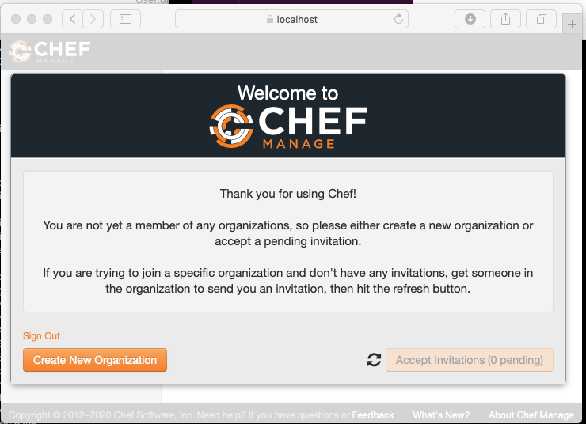
Chef Manage Experience
Notes:
Rachel has an existing server, red0015, where the Chef Infra client is running. The server is defined in a Chef organization and she wants to be part of that organization.
Rachel logs into Chef Manage. She expects to be able to find her server and be part of the right organization.
Few people read the thank you and the notes until the third or fourth time they login and then only out of frustration. Words = TLDR.
There is only one live button, Rachel will click it and create an organization
She will realize that there is nothing useful in the newly created organization and she will have to clean that up eventually. 30% of users, the more capable and confident they are, the more likely they are to create a new organization on this screen.
Rachel realizes
She has no easy way from this screen to find the server and its organization.
She has no way to get a list of organizations.
Rachel probably needs an organization administrator and there is no easily available list.
Even if she finds an organization admin. It’s long odds they have much better things to do than be interrupted to invite users.
That Rachel ends up here with her workflow now depending on responses from other people is partly due to how Chef Manage works and partly how Chef was implemented where she works. Reasonable choices were made in both implementations that lead to a not so good outcome.

Slide 5
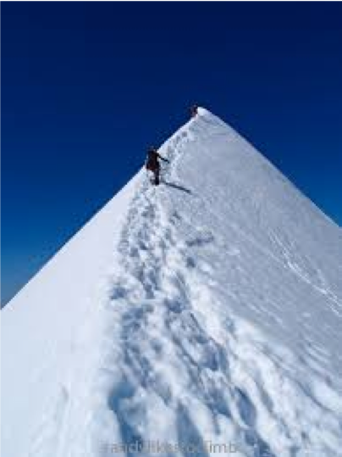
User Experience
Apparent Chef Infra Learning Curve
Notes:
Rachel runs into obstacles right at the start. We hope to start people off on an easier path.
El Dorado Peak in the North Cascades. ½ Mile down on the left, 1 mile down on the right. Chef feels like this for some people.

Slide 6
Agenda
Rachel Tries to Use Chef
Chefapi Demo - Rachel Gets Going
Environment.
Demo API Applications
Notes:
Here’s what we hope to cover.
Rachel tries to use Chef and gets stopped by obstacles at the very first screen. During this talk we’ll see how we can use the Chef Server to make the initial process of using Chef easier. We can get around these obstacles. The solutions presented here use the Chef Infra Server API to provide services not easily available to unauthorized Chef users.
Most of the issues Rachel runs into are caused by the environment Chef Server is running in. We’ll look at some of the Corporate requirements that drive the environmental restrictions. Your needs and constraints will likely be different.
We’ll describe the demonstration applications for this talk and a few other possible applications that could be created using the Chef Server API.

Slide 7
Agenda
Chef Server API Documentation
Documentation location and how to use it.
How to Use the Chef Server API
API basics
Chef Server API Client Packages
Support for using the Chef Infra Server API in different languages
Summary and Acknowledgements
Links
Sources and code for the example applications
Notes:
We’ll review the API documentation and how to use it.
The API endpoints almost always use a very limited set of patterns. Some examples will be discussed.
People have written API Client packages to to the heavy lifting for using the API in a few languages, these packages will be reviewed briefly.
Live questions or slack would be good places to ask about the demo code. The links to source materials and the demonstration code are at the end of the presentation. These slides will be in github at MarkGibbons/chefapi_chefconf2020.

Slide 8
Rachel Gets Going
Notes:
Let’s help Rachel find her server and get started.

Slide 9
Chefapi Demo
Login to the demo application
Create a Chef Infra User
Find the node
Find the organization
Join the organization
Change node attributes
Notes:
Rachel starts using the chefapi demonstration code to get access to manage the node.
Uses external authentication for:
Login
Authorization to create a user
Finding the node
Joining the organization
External authentication and authorization for doing things inside Chef is the key point to all of this talk. Trying to bootstrap user authentication from inside Chef doesn’t work in my corporate environment.
The Chef API applications make it easy to find a node and its organization. The applications will also let Rachel add herself as a Chef user and join an organization to be able to manage the node.
LIVE DEMO!! The slides show the high points.
Login
Find red0015
Find rachel user => create user, copy key
Show types of user lists
Add rachel to organization
Find node
Update it
First web application, all told REST APIs, Web apps, authentication and authorization pieces took about 2 weeks.

Slide 10
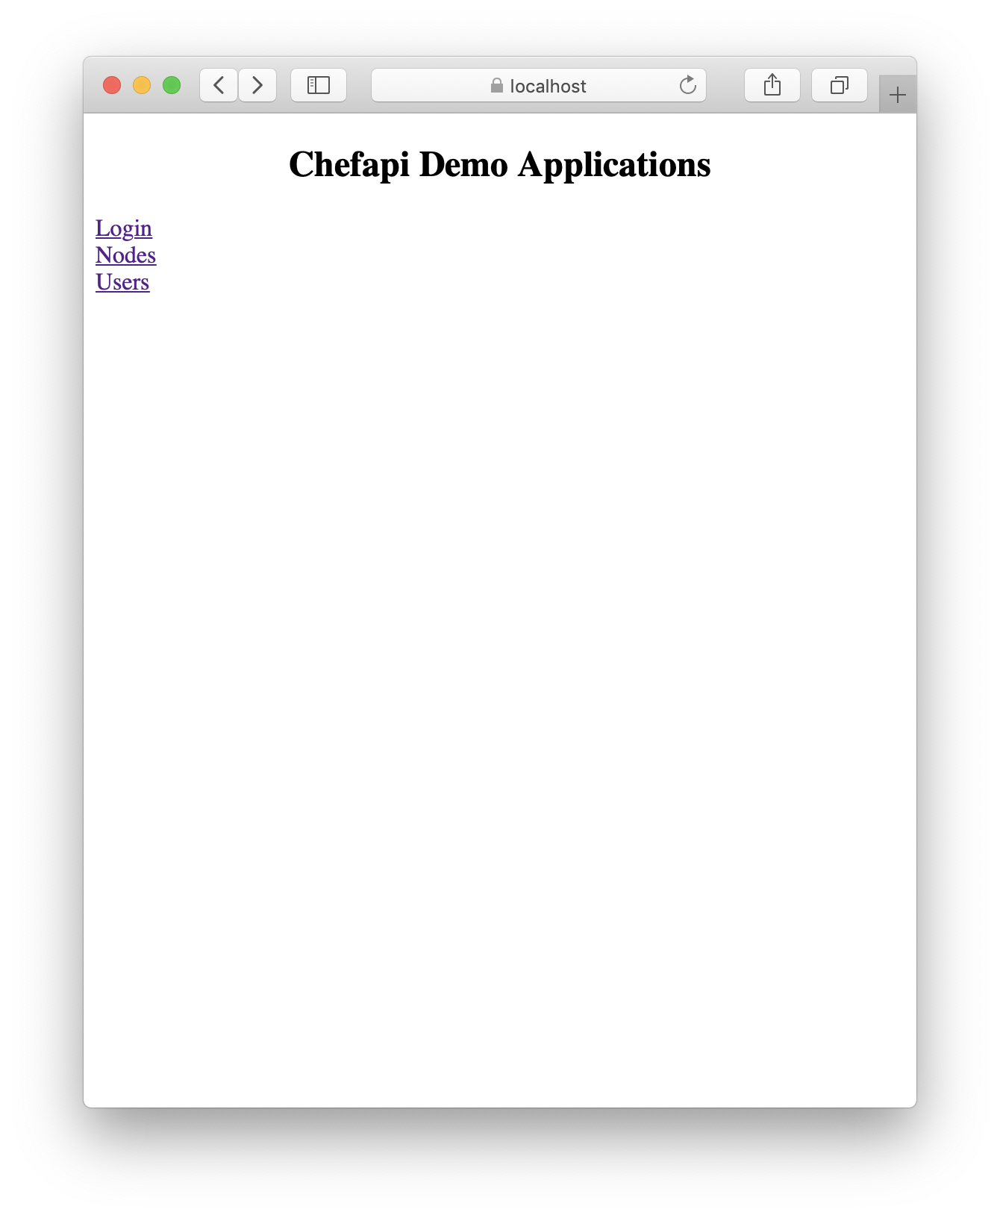
Demo Applications
Three options are available.
Login - to get a JSON Web Token(JWT).
Nodes - to display and manage nodes.
Users - to create users and add them to organizations.
Notes:
To use the application the user has to login. Login is to an external authentication system, not to the Chef Server. Nordstrom uses Okta to provide a common login experience and to control access to applications. Authorization to do things is commonly controlled by being a member of an Active Directory group. For these demonstration applications we have another service that checks authorizations.

Slide 11
Login
Login using external authorization

Slide 12
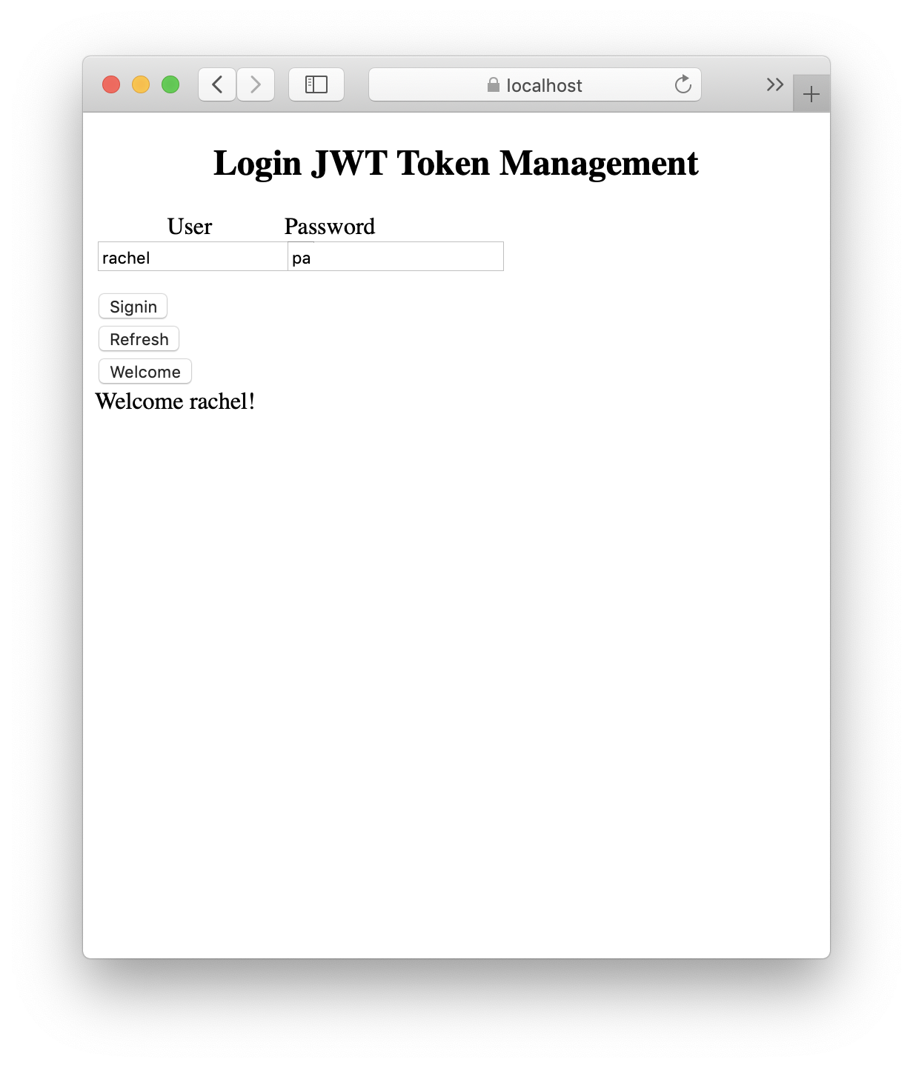
LOGIN
Verifies the user against an external server
Creates a JWT (JSON Web Token) to pass between applications.
HTML, Javascript application calls a login REST interface.
Demo Applications
Notes:
At the login screen Rachel can get authenticated and grab a token for using the other applications.
The login application uses HTML and Javascript to call a REST interface to get the JSON Web Token.
The REST interface could just as easily be called by a script as part of an automated onboarding process. The REST interface for the demonstration authenticates any user that enters a password of “pa”.
For purposes of the demo the JWT lives for 1 hour.

Slide 13
Find Node and Organization
Use the demo nodes application
Find Rachel’s server
Find the related organization
Notes:
We will use the nodes application to find Rachel’s server. That will tell us which organization the server is in.
Finding the organization a server is managed from is a problem that Chef Manage doesn’t address.
In a company with many Chef organizations finding the right organization is a challenging.

Slide 14
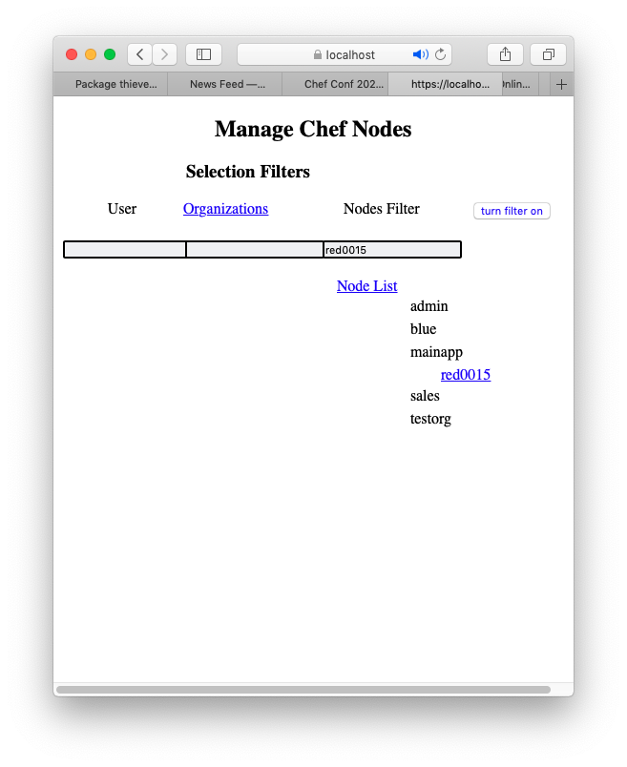
Find a Node
Rachel wants to manage node red0015. She needs to find its organization.
Using the filters we see it turns up in the mainapp organization.
The HTML, Javascript application calls the Node and Organizations REST interface.
Notes:
Rachel is looking for a particular server, red0015. We have a few organizations and servers so we can use a node filter to narrow down the search.
This page calls a demonstration nodes REST interface written in Go which in turn calls the Chef Server REST API to get lists of organizations and nodes.

Slide 15
Join the Organization
Self service join an organization
Find an admin user for an organization
Notes:
Once Rachel knows which organization the server is part of Rachel can:
Join that organization
Manage the node

Slide 16
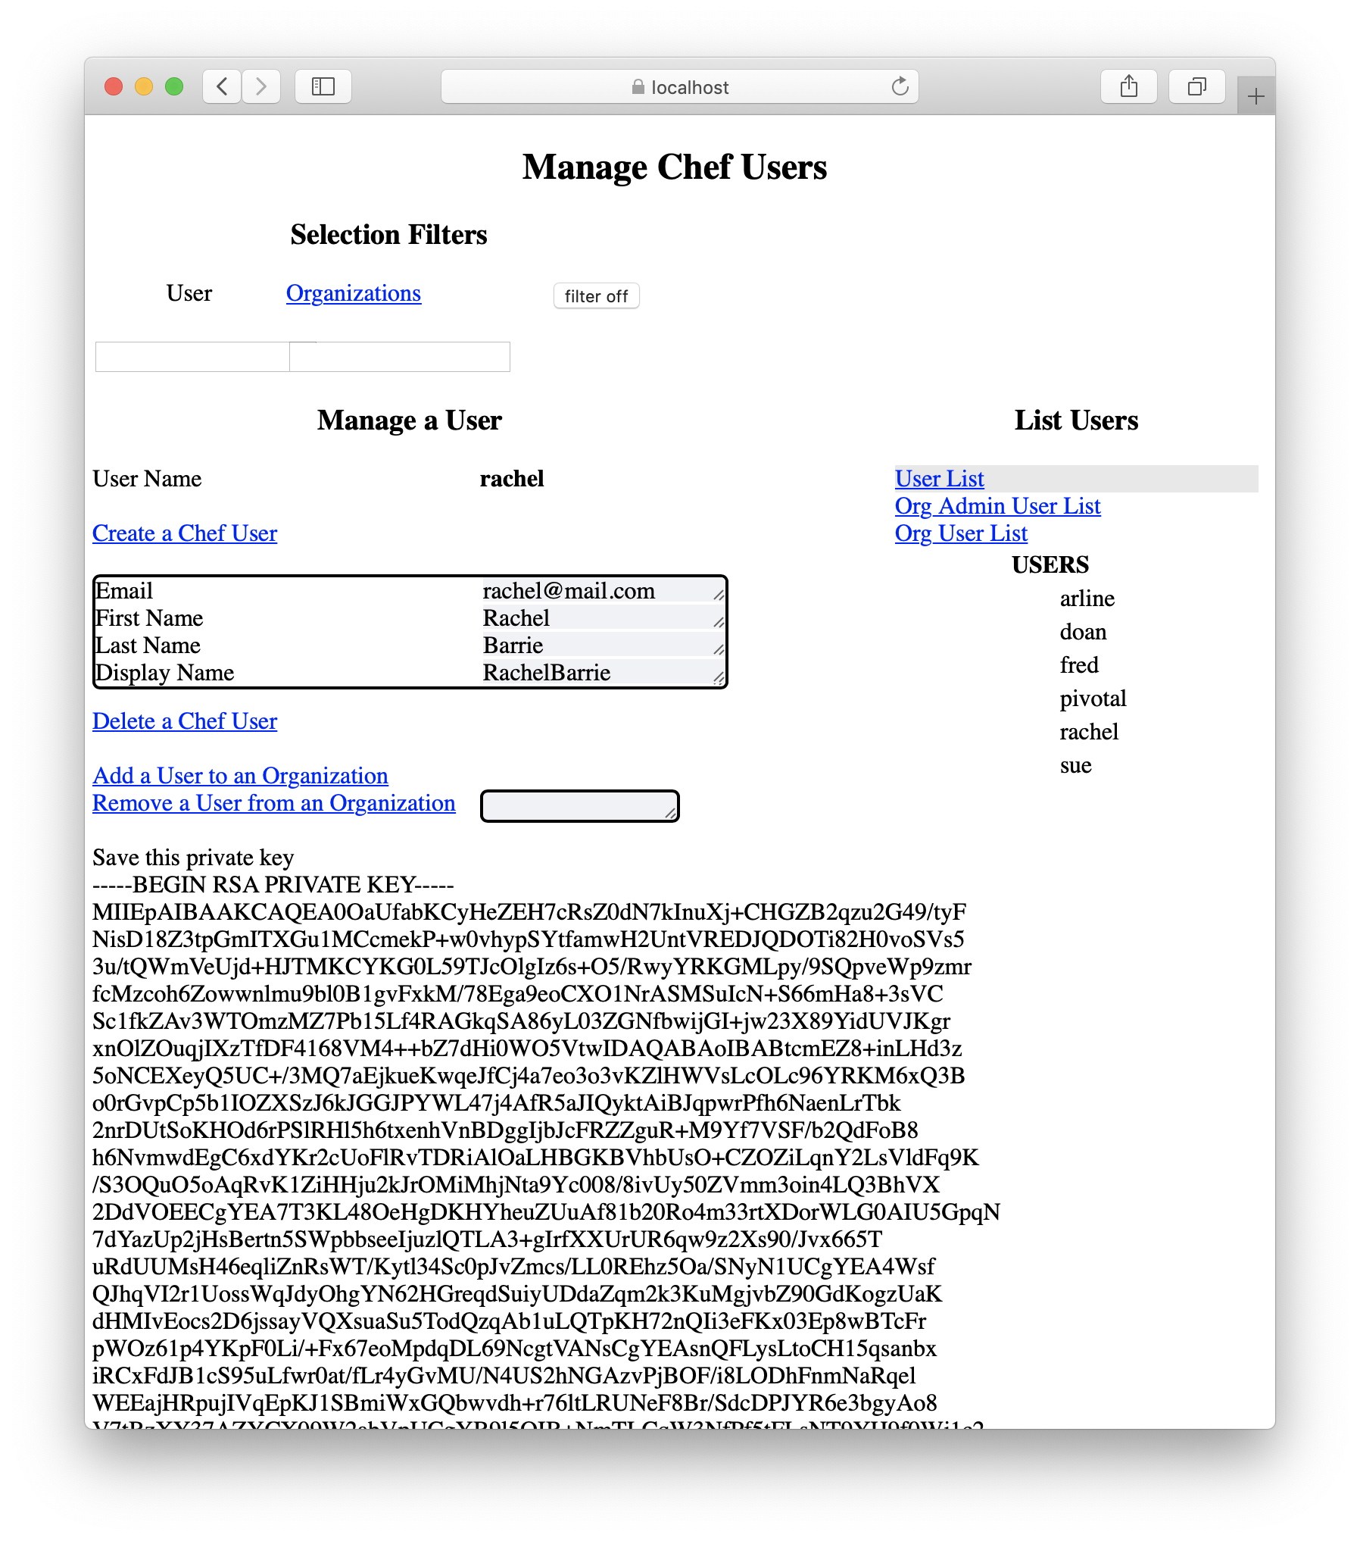
Create a User for Rachel
Notes:
One preliminary step, Rachel wants to be a Chef user. Being a Chef user will let her authenticate to chef and download cookbooks while testing. Chef users are defined outside of the Chef organization structure, users are a global Chef construct, so that Chef users can belong to many organizations.
The Users application uses go and the go-chef client api to send REST requests to the Chef Server. The Users application runs with super user credentials in order to create and delete users. Without Chef Manage creating users involves Chef Server Admins logging into the Chef Server and running chef-server-ctl commands to add new users.

Slide 17
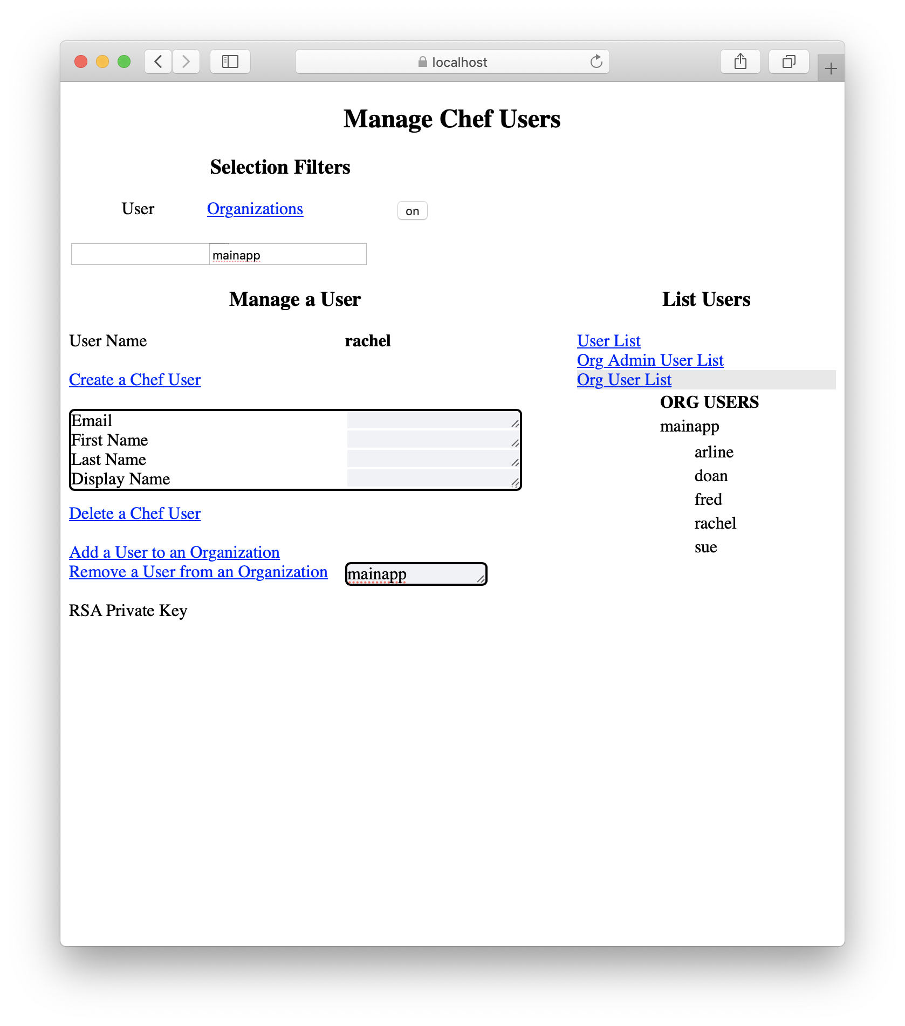
Join the mainapp organization
Mainapp is a read-only organization and anyone can join it.
Notes:
At Nordstrom some organizations are read-only organizations. Anyone can join, operations are performed using CI/CD Pipelines. Mainapp is a read-only organization. When Rachel tries to join mainapp a call will be made to an authorization service to make sure Rachel is authorized to join the organization before she is added.

Slide 18
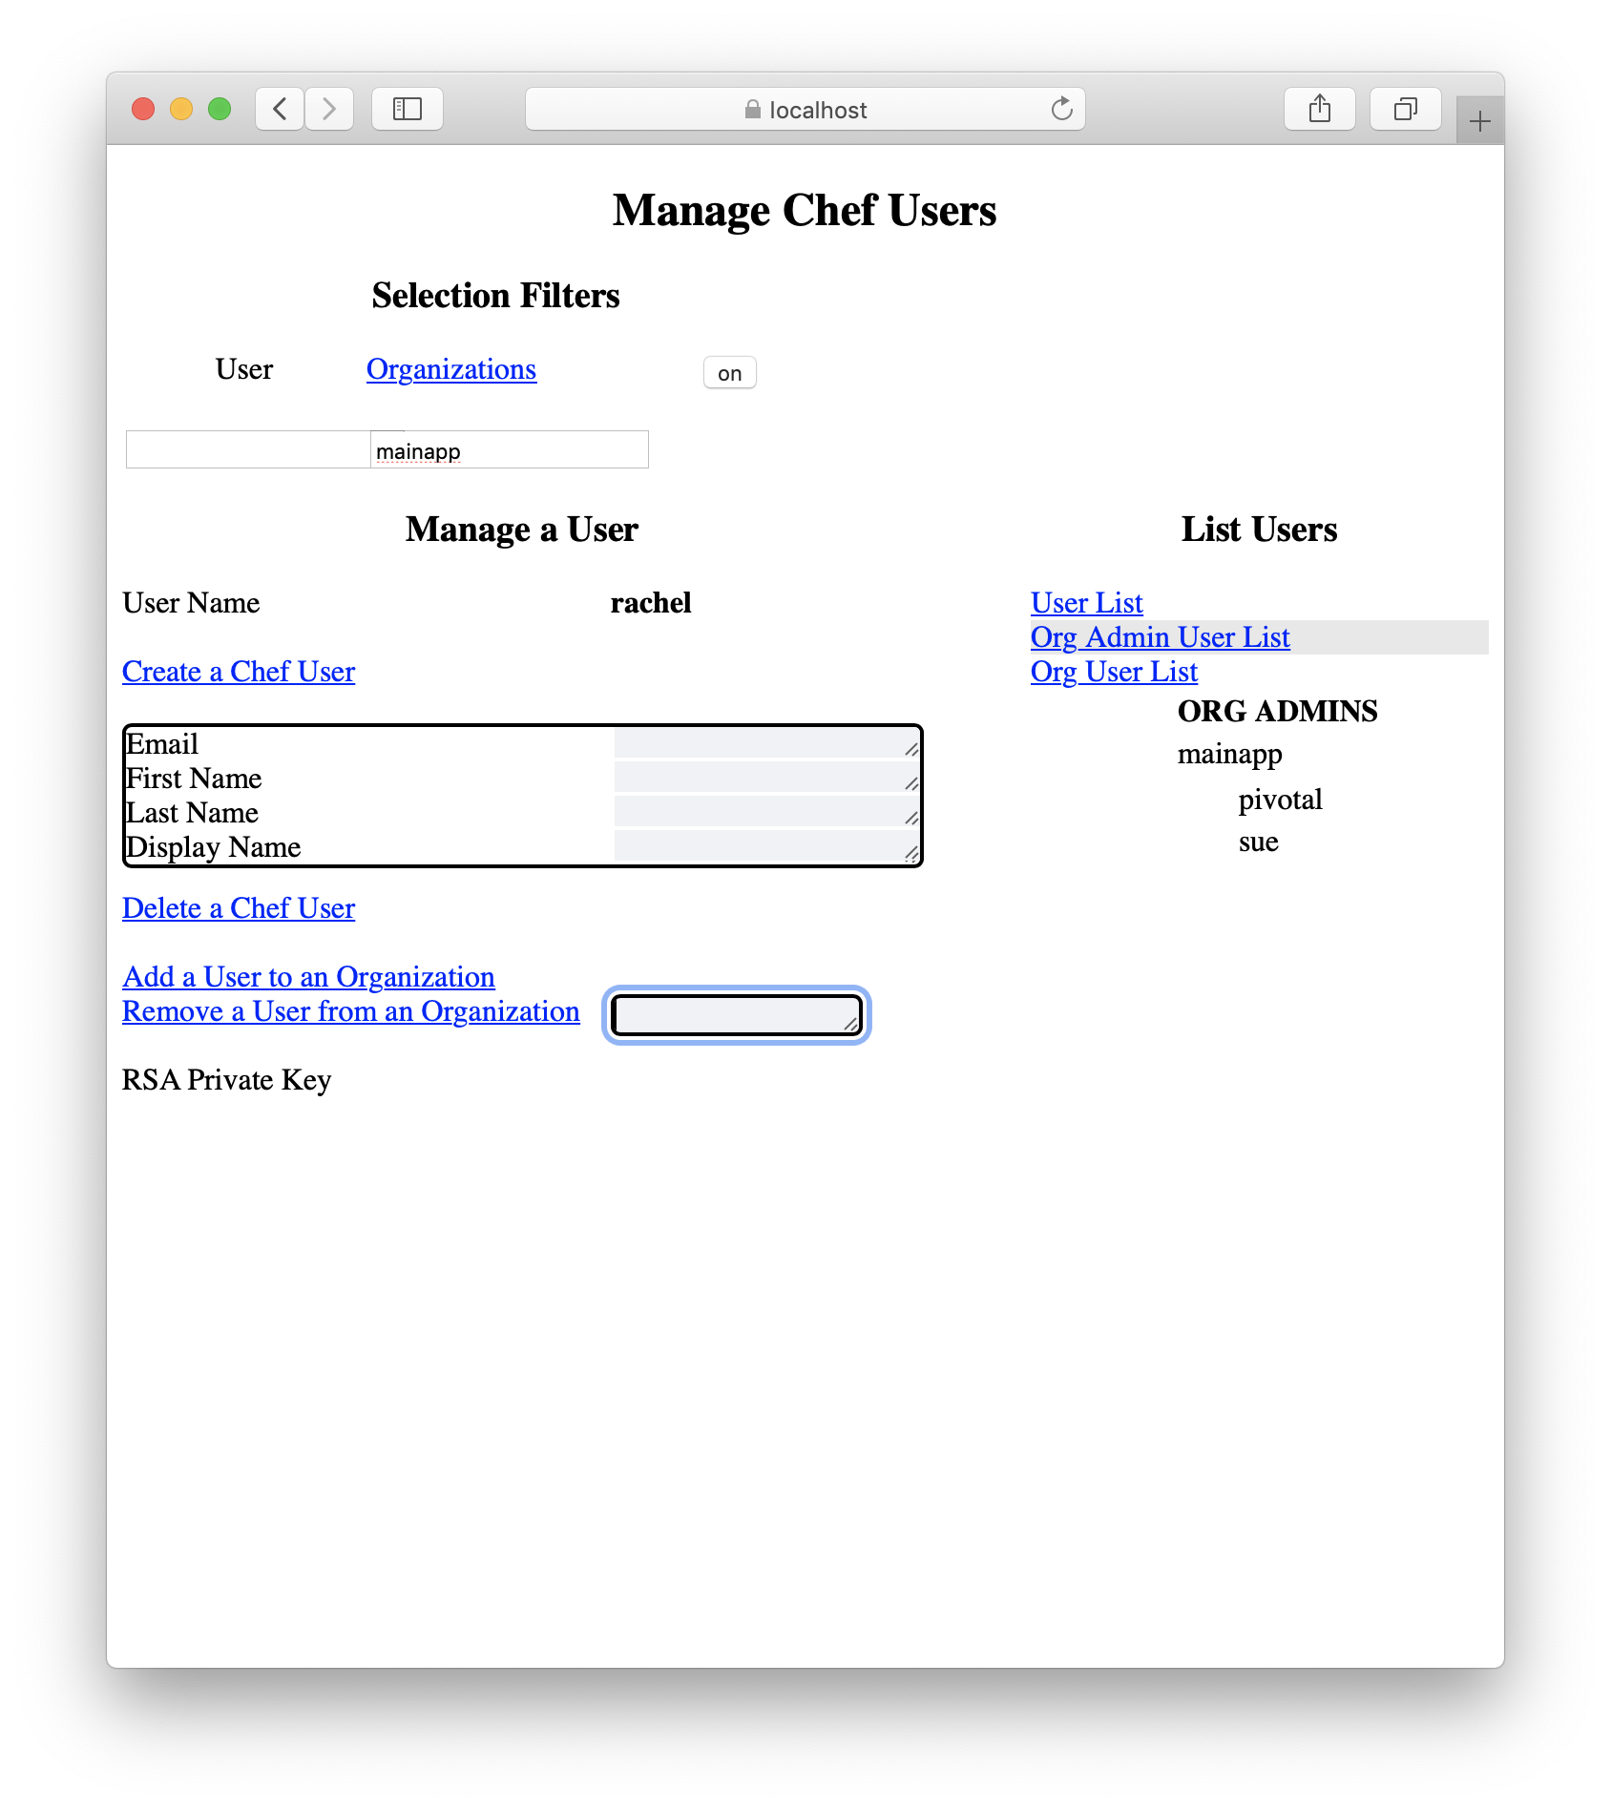
Find an Organization Admin
The three options are under List Users.
User list shows the users defined to Chef.
Org Admin List shows the admin users for each organization.
Org User List shows the users in each organization.
The lists displayed can be filtered by username or by origin.
Notes:
Suppose Rachel has problems with the organization. The Org Admin User LIst will display the admins for each organization. User list shows the Chef users.
Org Admin List shows the admin users for each organization.
Org User List shows the users in each organization.
The demonstration applications don’t handle nested groups in the membership lists. I have another service, not part of this demonstration, that handles that part.

Slide 19
Change the Node
Edit the node using the demo application
Notes:
Rachel notices that the node needs to be in the production environment instead of _default.

Slide 20
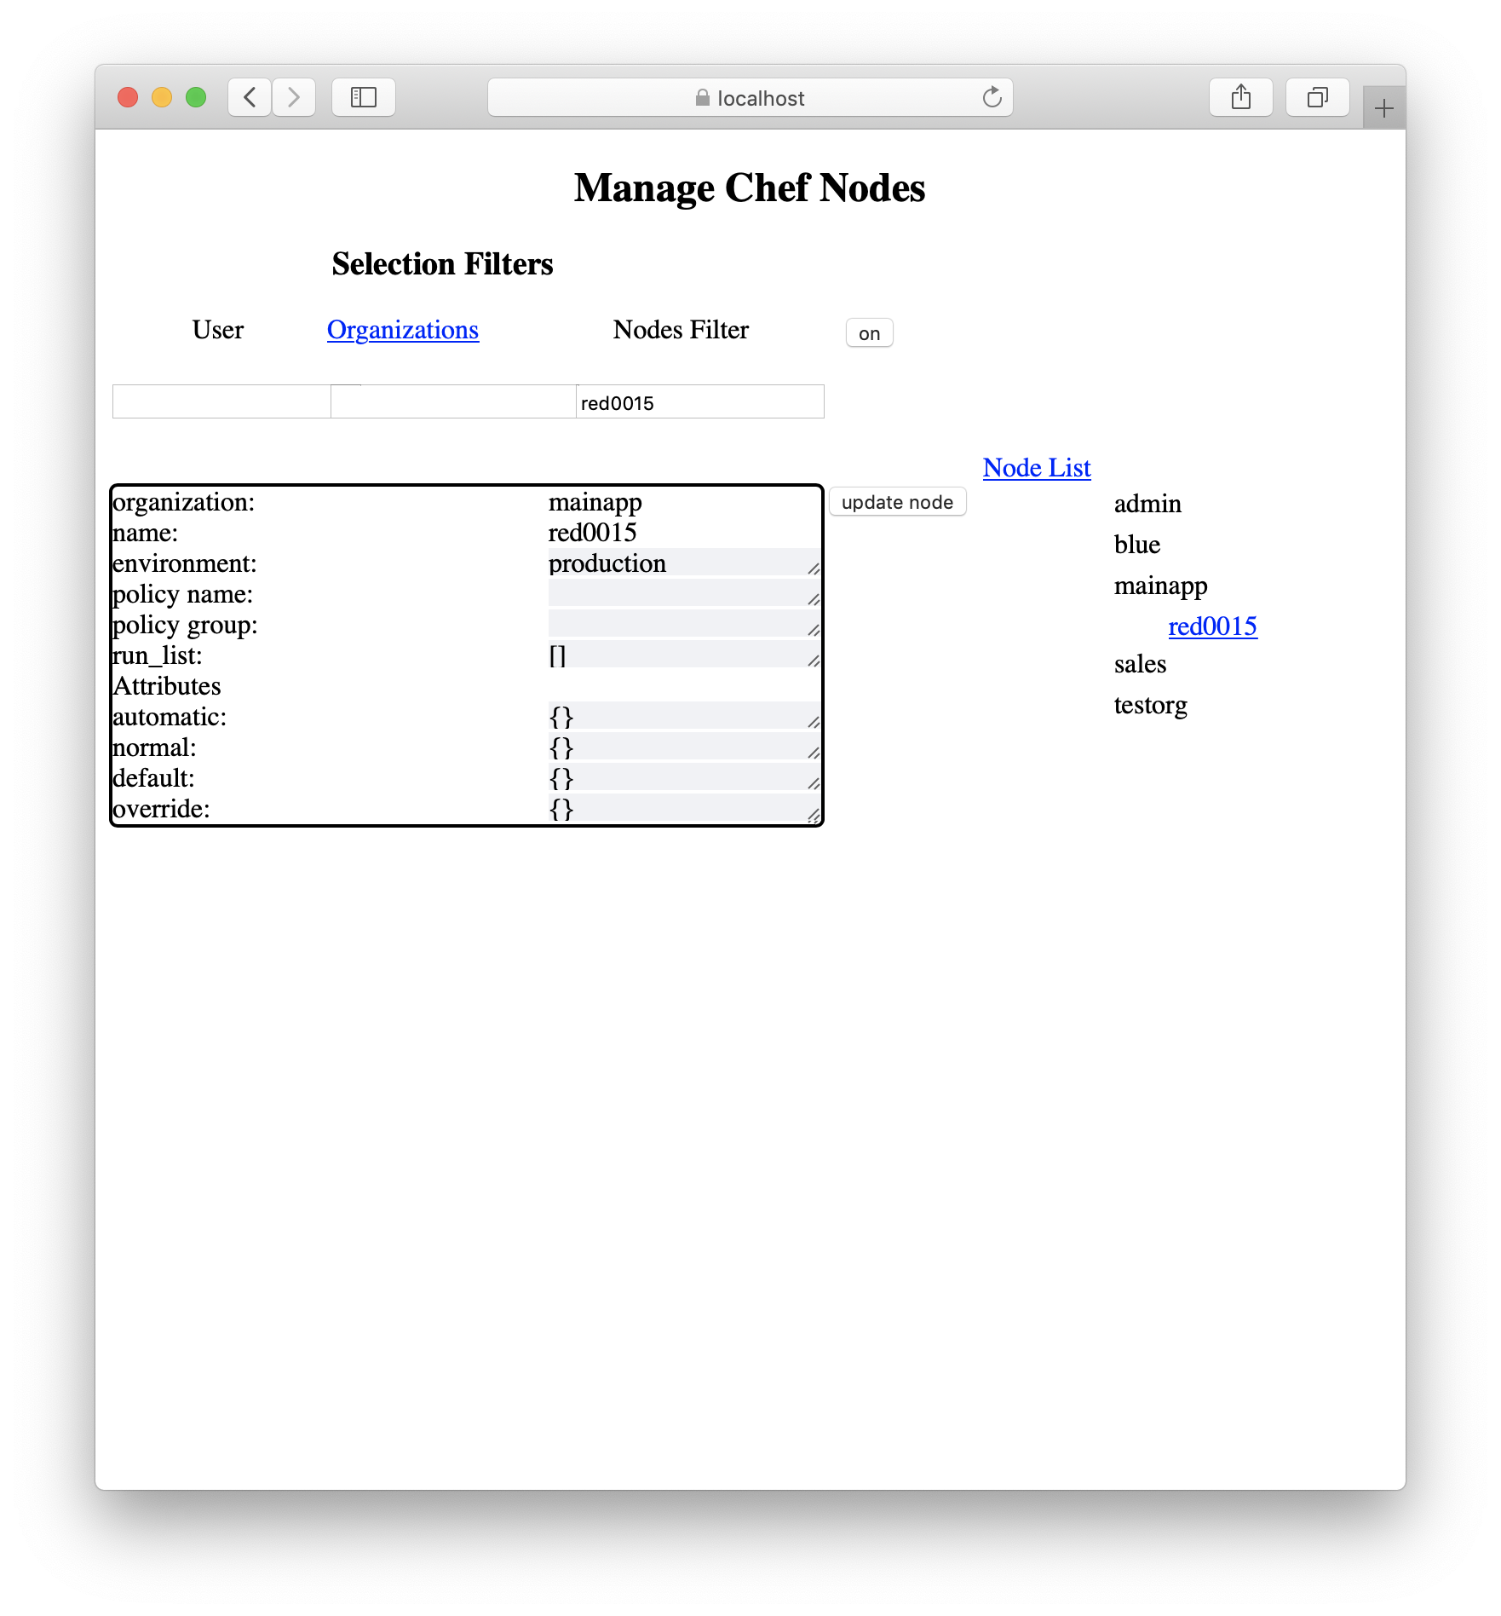
Change the node
Change the node’s environment from _default to production.
Notes:
Clicking on the node brings up an edit screen. Attributes can be changed here.

Slide 21
Environment
Notes:
What environmental constraints lead to creating these applications?

Slide 22
My Background
My Chef History
MarkGibbons
API interest
@gibbonsmj80
GO-CHEF Client
Notes:
MarkGibbons on github and slack.
Chef Infra user for 7 years. I support the Chef environment at Nordstrom.
I’m a Sous-Chef member and I actively support the line, vagrant, fileutils and chefdk-bootstrap public cookbooks.
I’ve written several hundred cookbooks to configure servers and many library cookbooks to provide chef resources.
I ran into Rachel’s problems repeatedly and needed a solution.
None of the existing API clients managed users and organizations.
Go-chef/chef looked like it was maintainable and extendable. Our company standards
preventing writing APIs in ruby. Did some PRs to go-chef/chef and quickly got push permission.
Continuing support by adding missing endpoints and getting some merge requests from Chef and the community.
I’ve been working on go-chef for a year now. PRs about evenly split between go-chef and the Chef Server API documentation.
The Chef Server API documentation was generally 4 to 7 years out of date. As I wrote
tests for go-chef/chef against a real chef server I submitted PRs for the API documentation.
I’ve submitted 30 documentation pull requests at this point.

Slide 23
Company Background
PCI, PII, HIPPA, SOX
High Developer turnover
100+ Organizations
Mixed application Organizations
Single Application Organizations
Notes:
At Nordstrom we have PCI, PII, HIPPA, SOX compliant applications. Access controls and auditing need to be in place. Servers for our applications share Chef Server organizations which requires that the organizations be tightly controlled. We have 1000+ people in Technology and finding the right person can be difficult. With 100+ Chef organizations finding an admin for an organization is a challenge.
Developers and platform folks using chef average about 2 years of experience with the company which is fairly high turnover.
Mixed organizations
Read only organizations are for teams that don’t want or need the full Chef experience. Servers are configured using Chef Infra Client. Applications interact with Chef as much as they want to via application cookbooks. Pipelines manage promoting cookbooks and other Chef objects. We have 10,000 -> 60,000 nodes depending on the month. Very few people are Admins for these organizations. The central Chef team handles most administrative work.
We support 100+ applications each with security and compliance considerations.
Around 250 people use chef.
Access to cookbook management is partitioned by external security. Only the people in the right list can up a particular cookbook. Access is usually based on a cookbook naming standard. PRs are done to get access.
Access to node management is partitioned by external security. We use Service-Now.
Joining a read only organization is open to everyone.
For most people Chef has to be simple to use because they don’t have time to learn it well or use it very much. The process used to create and run cookbooks is:
Write and test the cookbook. Usually using Vagrant and VirtualBox for testing.
Add the cookbook to Chef with a merge to the master branch which launches a pipeline execution and pushes the cookbook to the Chef server.
Add the cookbook to the run_list of the application servers and set the servers’ environments.
Promote the cookbook through environments using a pipeline.
Servers are assigned to organizations and environments. A commonly used model is that each server has two cookbooks unix_base or windows_base and an application cookbook in its run_list.
Single Application Organizations
Self-managed chef organizations. Essentially everyone in the organization is an admin and has full read-write access. Around 10 organizations with under 500 nodes total.
Full features of Chef are available.
Users can move faster here. Some heavy use of compliance, groups that use policyfiles.
Creates clean up issues when all the people in the organization leave.
Admins need to add users to the organization. They should be able to press a button on a request email or slack notification or have a fully automated process. So even these teams may use the demonstration being APIs shown.

Slide 24
Demo API Applications
Notes:
These API applications make sense in the context of the environment at my company. Your company will have their own things that they’ve always wanted to do but couldn’t. Using the Chef Server API may help. These examples show some of the possibilities. The demonstration code is publicly available and can be used for examples of techniques. The user management applications are something I want to help replace Chef Manage which we plan to retire shortly.
The demonstration applications are all golang REST servers using the go-chef/chef api client to talk to a chef server. The login and authorization services are stubs imitating Okta and a REST service that gets authorization information from a Service-Now Configuration management database. Okta and Service-Now are not hooked up to the demonstration code.

Slide 25
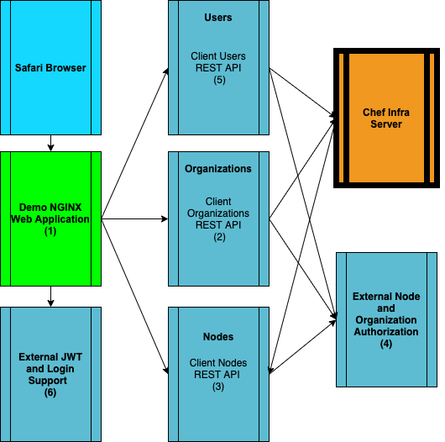
DEMO PROCESSES
Code is at github.com/MarkGibbons
chefapi_nodes_web
chefapi_client_organizations
chefapi_client_nodes
chefapi_node_auth
chefapi_users
chefapi_login
Notes:
Here is the organization of the processes used by the demonstration code.
The web application code uses REST interfaces to access the individual components.
Direct REST calls using curl or custom code could also be made to the demonstration applications.
The Users, Organization and Nodes applications use the go-chef/chef Chef API client to make REST calls to a Chef Server.

Slide 26
Create a User
Uses external authentication
Replaces the Chef Manage function
Customizable. Pick the user name style you want.
Notes:
Adding a user to Chef should not be an administrator function. This demonstration application replaces that function from Chef Manage. Chef manage also has its own rules for creating chef user names. By writing our own code we can use the Chef user naming style we want to use.

Slide 27
Join an Organization
Uses external authorization
Join organization - self service
Find organization names
Find organization admins
Notes:
This demo application simulates using external authentication and authorization.
The first thing to do with a user is to add the person as a Chef User. Without Chef Manage creating a user takes Chef administrator action.
Joining an organization is a self service action. Which makes sense for read-only organizations that use pipelines to change things.
Find organization names. In a large company with many organizations this capability eliminates administrator overhead.
Find organization admins. Needed if you must ask someone to invite you to the organization.
Using the global end points requires a lot of authorization. The demo code uses the pivotal user to get that authorization. An admin user may be set up so that pivotal does not have to be used.

Slide 28
Manage Nodes
Uses external authorization.
Server ownership
Find the organization the node lives in
Common ownership rules
Can manage nodes without being a chef user
Notes:
Chef server doesn’t have the concept of server owner. My company does. We can access the same rules other services use to authorize changing a server by using external authorization.
A person doesn’t need to be a chef user for some basic tasks. That’s true for the other services also. Someone with no Chef knowledge or internal Chef authorization could use one of these applications to manage users and nodes.

Slide 29
Reset Private Key
.
External authorization
Self service private key recovery
Notes:
This is an idea for another service. It’s not part of the demonstration applications.
Without Chef Manage resetting the private key requires a working private key. I don’t want the calls to help people fix broken private keys.
This function could be extended to creating client keys for new nodes. We already do something along those lines to create clients when we build new servers.

Slide 30
Manage Chef Groups
Uses external authentication
Group membership - lookup and changes
Notes:
This application was not part of the demonstration.
Group membership is complicated. Chef uses nested groups which makes looking up membership using knife a nightmare. This application can be very useful and was the first I implemented for real. It’s not included in the demo or as part of the shared code.

Slide 31
How to use the Chef Infra Server API

Slide 32
API Endpoints
Global Endpoints
https://chefserver.co.com/organizations
https://chefserver.co.com/users
Organization Endpoints
https://chefserver.co.com/organizations/ORG/nodes/NODENAME
Notes:
The API is divided into two large sections.
Global end points that apply to Chef as a whole. Endpoints for managing organizations as objects and for managing Users are at this level.
Organization endpoints work within a single organization.
The documentation is organized around the two classes of endpoints be sure you know which type of endpoint you are using. There are User endpoints in both parts of the documentation.

Slide 33
Methods
Delete destroys an object
GET lists objects or show details of specific objects
POST creates a new object
PUT update an object
JSON bodies pass requests and return responses.
Notes:
The obvious methods are used.
GET lists all objects of that type or shows details of specific objects
POST creates a new object
PUT update an object
JSON bodies are sent to pass information for requests and returned as responses.
URL parameters are very rarely used

Slide 34
Example Endpoints
POST /organizations/MYORG/nodes
GET /organizations/MYORG/nodes/N1
Notes:
Post uses a JSON body to specify the node name to be created and the node attributes.
GET, PUT and DELETE take the node name from the URL.
This pattern of specifying the object affected is used for most Chef API objects.
Organization endpoints are documented with an implicit organization/ORGNAME.

Slide 35
API Authentication
Very picky code
Mixlib::Authenticate
Clients do this for you
Notes:
The authorization and request signing code is very picky. Let someone else do this for you. Chef Server API calls require authentication credentials, specific http request headers, signed fields, time stamps, and RSA key processing. The Chef API clients have this code in place already.
The Mixlib::Authenticate class is the authority on how to do API authentication and request signing.

Slide 36
Code Example
go-chef/chef client creating a node
// Create a client for a given organization
client := chefapi_client.OrgClient(“mainapp”)
// set up a node definition node := chef.NewNode(“red0005”) node.RunList = []string{“mybook::default"}
// Add the node newNode, err := client.Nodes.Post(node)
Notes:
This code defines a node called red0005 with a runlist of mybook. The code is a go script run by a chef-client recipe to configure the demonstration Chef Server. All of the objects in the demonstration server are created using the API.
The base URL for the client should be https://chef_server/organizations/mainapp/ to create nodes.
Chefapi_client is code written for this demo. It gathers credentials and URLs and calls chef.Client(). The test_setup repository has examples of adding objects to a Chef Server using the API.

Slide 37
API Client Packages
Notes:
You can read the documentation and try to roll your own API client calls.

Slide 38
Purpose and Function
Chef Server Credentials
Request packaging
Native Language Structures
Application Speed
Notes:
What do you gain by using an API client?
Set up credentials and package the requests to the chef server. The code path for the needed manipulations is just a bit painful.
Translate chef objects to specific language structures. Difficult, time consuming and exacting work.
Generally faster than knife. Chef Inc. is using the go-chef API client in Chef Analyze for instance.
Combined with a caching in a DB the APIs can be really fast and flexible. My real production applications use a mysql or redis database as a cache for speed and to allow me to write my own desired queries and manipulations.

Slide 39
API Clients
Knife and knife exec api.*
go-chef/chef
chef/chef-api
chef/rs-chef-api
coderanger/pychef
Notes:
Knife uses the API it functions as sort of CLI API.
Knife exec api.Get, POST, PUT and DELETE lets you do authenticated api calls.
go-chef/chef is the only API client that addresses the global level endpoints that I know of.
The other clients cover different languages.
chef/chef-api - Ruby
chef/rs-chef-api - Rust
coderanger/pychef - Python

Slide 40
Documentation

Slide 41
Chef Server API Documentation
General observation about documentation
chef server api
Missing pieces
Swagger
Notes:
Documentation is created from notes taken two months before in the lab environment. The lab was updated drastically before the documentation was published. The copy we see now is 4 years old and things have drifted since it was written. This seems to apply universally to all technical documentation.
I use these keywords to find the documentation, the link is also included in the links section.
A few of the endpoints are not documented. Some haven’t been updated in a while. Most are complete and accurate. Lots of work is being done to get them up to date.
The API documentation does not include anything like a swagger definition. Working examples are the easiest way to figure things out. The go-chef/chef client has working examples for most of the endpoints and the go examples should be translatable to ruby and other languages. Many of the endpoints have specific fields that must be specified or that can’t be specified in combination. Examples:
Creating a user requires external_authentication_uid or a password but not both.
Creating a user also requires a unique email address, within the Chef server, and a display name.

Slide 42
Chef Server API Documentation
https://docs.chef.io/api_chef_server/
Global endpoints
Organization endpoints
Notes:
Look at the documentation pages.
For global endpoints use the base server url and the name in the documentation.
For organization endpoints use the base url + organization/ORGNAME + the endpoint name from the documentation.
In knife.rb and client.rb the chef_server_url specification includes organization/Name.
LIVE DEMO!! Browse the documentation
Show the end point naming style, illustrate with /users in both. Do very different things.
Lot’s of 404’s figuring out where things belonged. Classification should be good now.

Slide 43
Summary

Slide 44
Chef Server API
Chef Manage is deprecated
Some solutions for my company
Your problems and solutions
Notes:
Chef Manage is deprecated. It provides some functions that aren’t available any other way. We can use the API to replace the functions we care about.
Each organization will have their own problems. The presented applications using the Chef Server API solve my problems.
Every place is different, you will probably be able to use the API to your advantage.
Nordstrom uses a version of the groups application to display group membership for auditing. Implementing the production versions of the other applications got held up by C19.

Slide 45
Acknowlegments

Slide 46
Thank You
Jesse Nelson @sphereomak
Contributors to go-chef/chef
Chef Inc.
Mark Anderson & Steve Danna
Kimberly Garmoe & Ian Maddus
Mandi Walls & Benny Vasquez
Sous-Chefs Group
Nordstrom Inc. and PCM
Notes:
Author of go-chef/chef
Contributors old and recent
Mark and Steve - Where is stuff
Kimberly and Ian - Documentation!
Mandi and Benny - Great outreach
Sous-Chefs - incredibly supportive OSS team
Nordstrom opportunity to work on Chef and solve real problems
PCM - Virtual toast
People watching and listening

Slide 47
Links

Slide 48
Links
https://docs.chef.io/api_chef_server/
https://github.com/chef/chef-web-docs
https://docs.chef.io/workstation/knife_exec/
https://github.com/go-chef/chef
https://github.com/chef/chef-api
https://github.com/chef/chef-server/tree/master/oc-chef-pedant
https://github.com/chef/chef-server/tree/master/src/oc_erchef/apps/oc_chef_wm/src
Notes:
The links are:
Documentation link for the chef doc website Chef Server API.
The documentation source - please submit corrections and updates.
Knife exec documentation. This one shows many different ways to call the API and the coded needed.
The go-chef/chef source. This API client is what I use.
The Chef ruby api client.
The Chef server api test suite.
One of the Chef Server erlang source api directories. This directory, knife and pedant are the primary sources I use for figuring out the API.

Slide 49
Demo Application Source Code Links
https://github.com/MarkGibbons/chefapi_chefconf2020_slides
https://github.com/MarkGibbons/chefapi_chef_server
https://github.com/MarkGibbons/chefapi_client
https://github.com/MarkGibbons/chefapi_client_nodes
https://github.com/MarkGibbons/chefapi_client_organizations
https://github.com/MarkGibbons/chefapi_client_users
https://github.com/MarkGibbons/chefapi_lib
https://github.com/MarkGibbons/chefapi_login
https://github.com/MarkGibbons/chefapi_node_auth
https://github.com/MarkGibbons/chefapi_test_setup
https://github.com/MarkGibbons/chefapi_web
Notes:
Chefapi_chef_server is a cookbook that spins up a Chef Infra Server and the demo services.
Chefapi_test_setup is used to create the initial set of organizations and objects
The application REST server code is in chefapi_client_nodes, chefapi_clien_organizations and chefapi_client_users
External authentication and authorization fakes are in chefapi_login and chefapi_node_auth. At Nordstrom this is where we would hook in calls to Okta and Service-Now for authentication and authorization.

