Slide 1
Introduction to Programming
01 Oct 2018
Notes:
<number>

Slide 2
Course Format
In-class lectures covering core programming constructs (using Python), processes, tools.
Reference (see course syllabus for links):
Python for Informatics (+ Python for Everybody specialization on coursera)
Think Python
Introduction to Programming in Python
Weekly assignments (starting beginning of week 3)
Notes:
<number>

Slide 3
Logistics
Slides, notebooks, code examples, assignments, solutions etc. will be uploaded in a shared gdrive folder / github
Open office hours (Himanshu: Cube 759 D, Translational Research Bldg; Mark: Science Bldg) or emails
discuss doubts, code, concepts, lightening talk ideas, anything remotely Pythonic
Email before dropping by
Notes:
<number>

Slide 4
Grading Policy (pass / fail)
Course Component | Percentage
Assignments (4) | 4*15 = 60
Lightning talk (1) | 15
Group project | 15
Class participation | 10
Notes:
<number>

Slide 5
Lightning Talks: Become an Explorer
Library / tool / concept of your choice.
Starting week 3 (lookout for signup sheet!)
Format and deliverable:
5-7 mins hands-on demo to class, explaining the idea and its application / utility (preferably using Jupyter notebooks)
If it is a coding concept, show a short snippet of code
Notes:
<number>

Slide 6
Final project
Groups of 2-3 members
Larger programming task
Implement an algorithm
Analyze dataset
Build a small application
Presentations in last lecture

Slide 7
Course Goals
Mental process of solving problems through writing programs; also pseudocoding skills.
Some level of proficiency in using Python
Best-practices
Hands-on with analytics / informatics ecosystem (Matplotlib, Pandas, others as needed)
Basic tools for efficient programming
Anaconda distribution
Development Environments (Atom editor, Jupyter Notebooks)
Debugging skills
Package/library management
Version control
Notes:
<number>

Slide 8
Initial setup
MiniConda: https://docs.conda.io/en/latest/miniconda.html
Python 3.7
Installs Python and several packages
Git version control: https://git-scm.com/downloads
Github account (http://github.com)
Atom text editor: https://atom.io
Notes:
<number>

Slide 9
Let’s roll!
Notes:
<number>

Slide 10
What are Programs?
Notes:
<number>

Slide 11
What are Programs?
Essentially, they solve problems (esp. recurring problems)!!
More specifically:
Sequence of stored instructions for the computer (what next?)
expressing a logical series of steps (algorithm)
to perform a computation or implement a process
on some input to generate some output (value, behavior etc.)
using some language - lexicon, syntax, semantics (communication)
Notes:
Simple or complex algorithm
Python interpreter (sits between your code and the machine)
Using and writing programs require completely different mindsets. As a programmer, you have to anticipate a lot of requirements: a) how your program will be used; b) how it will evolve; c) user interface; d) performance requirements, and much more. A lot of choices to be made that require a more granular thought process.
<number>

Slide 12
Example: Find the largest number in a list
[1, 4, 9, 3, 2, 13, 8, 10, 14, 5, 11]
Think about the mental process!!
Notes:
<number>

Slide 13
Example: Largest number in a list
[1, 4, 9, 3, 2, 13, 8, 10, 14, 5, 11]
[1, 4, 9, 3, 2, 13, 8, 10, 14, 5, 11]
[1, 4, 9, 3, 2, 13, 8, 10, 14, 5, 11]
[1, 4, 9, 3, 2, 13, 8, 10, 14, 5, 11]
[1, 4, 9, 3, 2, 13, 8, 10, 14, 5, 11]
[1, 4, 9, 3, 2, 13, 8, 10, 14, 5, 11]
[1, 4, 9, 3, 2, 13, 8, 10, 14, 5, 11]
.
.
.
[1, 4, 9, 3, 2, 13, 8, 10, 14, 5, 11]
Notes:
<number>

Slide 14
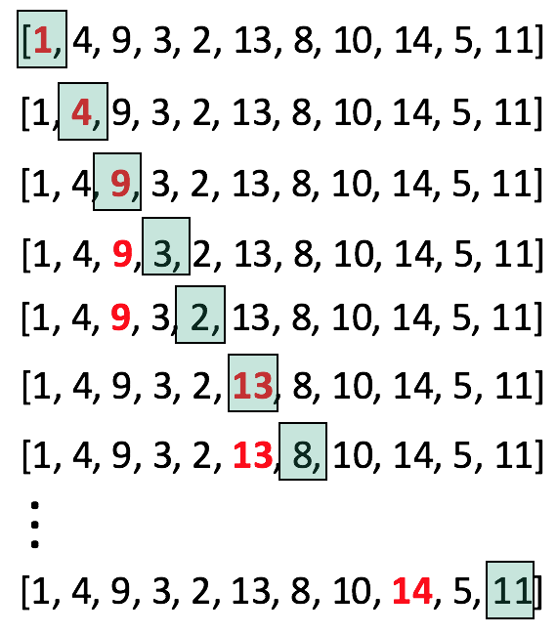
Largest number in a List
Iterate/loop/scan through the list
Keep track of “largest” so far
Initialize
Update (apply) the current “largest” if you find something bigger
Print largest at termination (use)
input → algorithm → output
Notes:
<number>

Slide 15
Largest number in a List
Iterate/loop/scan through the list (for loop)
Keep track of “largest” so far (memory/variables, assignment, re-assignment)
Initialize
Update (apply) the current “largest” if (conditional) you find something bigger
Print largest at termination (use)
numbers = [1,4,9,3,2,13,8,10,14,5,11]
largest = None
for number in numbers:
if largest is None or number > largest:
largest = number
print('Largest: ', largest)
Notes:
<number>

Slide 16
Some Conceptual Patterns
Input (user-supplied, files / databases, other programs, over the network)
Statements representing:
Memory storage or Assignment (variables)
Expressions
Conditional Execution
Repeated Execution
Constructs to organize code
…
Output
Notes:
Low-level conceptual patterns used to build programs…
<number>

Slide 17
Word Counting
Find the most frequent word in a piece of text / file.
Again, think about the mental process!!
https://books.trinket.io/pfe/01-intro.html
Notes:
<number>

Slide 18
Why Python
Generic programming language (Web, Databases, Gaming, Informatics / analytics / big data, AI/ML/Data Science, scientific programming… )
Very easy to learn and use
High-level data types and structures to organize and manipulate data
Batteries included or available
Very expressive; less verbose (although requires practice); higher developer productivity; fast prototyping
Clean syntax; easy to read sourcecode; easy to maintain
Talks to other languages (C/C++, R, Java, …)
Active community of developers
Several others…
Notes:
<number>

Slide 19
Python Program Execution
Python is two things
Language specification (lexicon, syntax, semantics)
Language interpreter – intermediary between your code and the machine
Reads and executes the program statements one after the other, from top to bottom
Two modes of execution:
Interactive (for ex. in plotting and visualization)
Script / batch
Notes:
<number>

Slide 20
Summary
What are programs and the mindset required to write programs (be explicit!!)
Initial setup and tooling (Anaconda, Jupyter notebooks, git / github, Atom)
Notes:
<number>

