Slide 1
Text-Mining Model Comparison: LDA And NMF
Shane Deiley
Mark Heimann
Adrian McLeod

Slide 2

Agenda
Text Mining
LDA
NMF
HDP
does this overfit?
Results

Slide 3
An Introduction to Text Mining

Slide 4
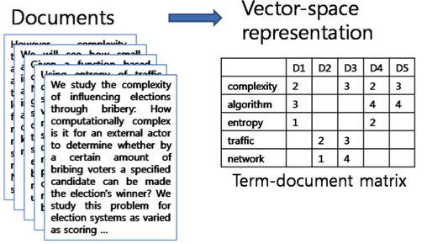
Term-Document Matrix

Slide 5
Motivations for Text Mining
DNA Sequencing (Gene discovery)
Document Classification
Trends across languages
Topic Modeling

Slide 6
Topic Modeling

Slide 7
Latent Dirichlet Allocation
Take pLSA, then put a dirichlict prior on a word given a topic…

Slide 8
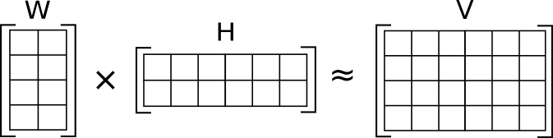

Non-negative Matrix Factorization
Objective Function:

Slide 9
Questions?

