Slide 1
Comparative Topic modeling
Shane Deiley
Mark Heimann
Adrian McLeod

Slide 2
Agenda
Topics
LDA
NMF
HDP
Results

Slide 3
An Introduction to topic modeling

Slide 4
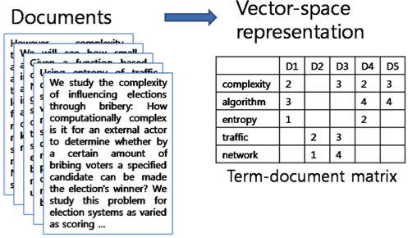
Term-Document Matrix

Slide 5

Motivations for Topic Modeling
Make quick sense of textual data
Useful in humanities and social sciences
Word clouds

Slide 6
Topic Modeling techniques

Slide 7
Latent Dirichlet Allocation (LDA)
Take pLSA, then put a Dirichlet prior on a word given a topic…

Slide 8
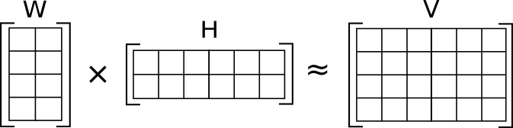

Non-negative Matrix Factorization (NMF)
Objective Function:

Slide 9
Methods for setting number of topics

Slide 10
HDP…

Slide 11
Using LDA Topic-Distributions as Features
How does topic count affect accuracy of classifiers?
How does this relate to other methods of determiniing ideal topic count?

Slide 12
Our progress so far…

Slide 13
Questions?

