Slide 1
A Text Mining Model Comparison: LDA vs NMF
Shane Deiley
Mark Heimann
Adrian McLeod

Slide 2

Agenda
Text Mining ??
NMF
LDA
HDP?
Results

Slide 3
An Introduction to Text Mining

Slide 4
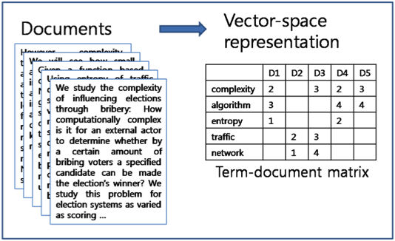
Term-Document Matrix

Slide 5
Topic Modeling

Slide 6
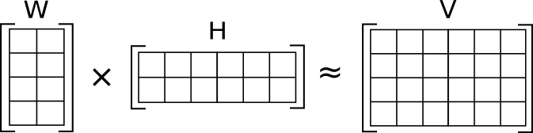

Non-negative Matrix Factorization
Objective Function:

Slide 7
Latent Dirichlet Allocation

