Slide 1
Comparative Topic modeling
Shane Deiley
Mark Heimann
Adrian McLeod

Slide 2
Agenda
Topic Modeling
Comparison of techniques
Determining number of topics

Slide 3
An Introduction to topic modeling

Slide 4

Motivations for Topic Modeling
Make quick sense of textual data
Useful in humanities and social sciences
Word clouds (data visualization)

Slide 5
Representing data
Consider corpus:
“Business is business.”
“None of your business.”
Bag of words
[(“business”, 2), (“is”, 1)]
[(“None”, 1), (“of”, 1), (“your”, 1), (“business”, 1)]
Term-document matrix
 | Business | Is | None | Of | Your
Doc 1 | 2 | 1 | 0 | 0 | 0
Doc 2 | 1 | 0 | 1 | 1 | 1

Slide 6
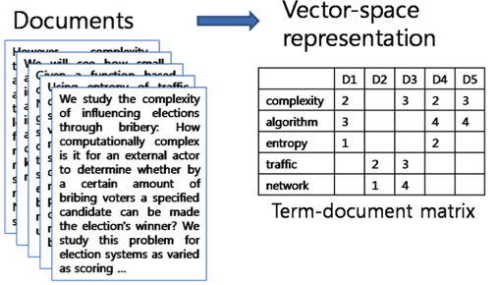
Term-Document Matrix

Slide 7
Topic Modeling techniques

Slide 8
Latent Dirichlet Allocation (LDA)
Assume latent topics in the data
Generative model of document creation

Slide 9
Latent Dirichlet Allocation (LDA)
Modeling documents
Each document d has a distribution θ_{d} of topics
Start out with a prior θ ~ Dirichlet(α)
Update to get posterior distribution, given documents
Given α and β, the distribution of words given topics
Use EM to maximize log likelihood of the distribution

Slide 10
Latent Dirichlet Allocation (LDA)
Generating documents on a per-word basis
Draw a topic from topic distribution θ_{d}
Draw a word from the word distribution of the topic

Slide 11
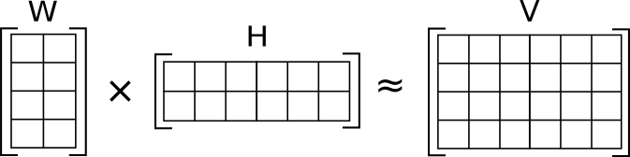

Non-negative Matrix Factorization (NMF)
Objective Function:

Slide 12
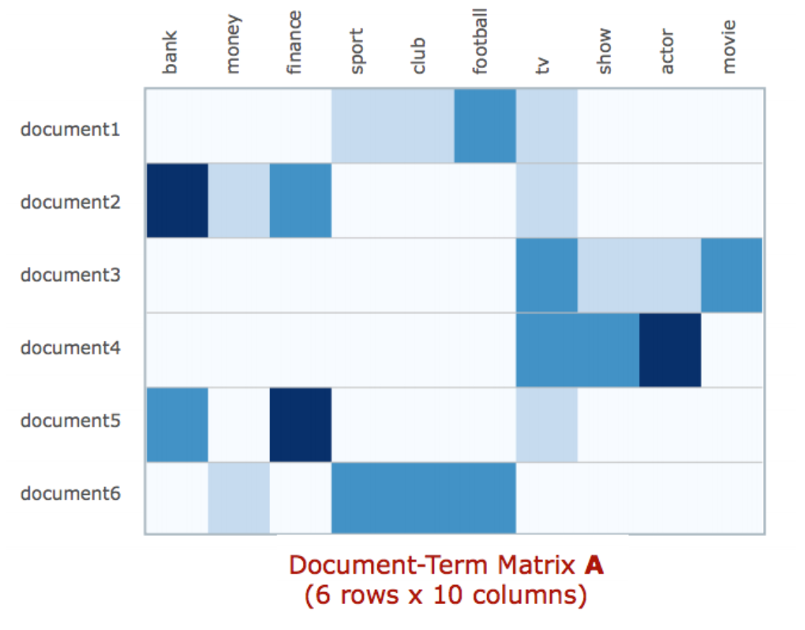
Topic Modeling with NMF
Columns are topic descriptions
Rows are document membership weights
=
x
k rows x 10 columns
6 rows x k columns

Slide 13
LDA vs NMF
Ran experiments on standard 20 newsgroups dataset
NMF is faster of course
NMF seems to produce more coherent topics
particularly with the right representation of corpus—TF-IDF
LDA (depending on representation of corpus) can produce fine or very poor topics
Probably a problem on our end

Slide 14
Methods for setting number of topics

Slide 15
Different possible approaches
Compare different numbers of topics and see what the log likelihood of the distribution is
Hierarchical Dirichlet processes (investigating)

Slide 16
LDA for document classification
Train a machine learning classifier using distributions over topics as features for each document (Blei et al, 2003)
Much lower dimensional
Currently, as mentioned, our topics have quality issues (bug?) so our classifier doesn’t perform well
How does topic count affect accuracy of classifiers?
Too few topics → not enough features
Too many → overfit
How does this relate to other methods of determining ideal topic count?

Slide 17
Questions?

