Slide 1
Creating a HexSticker and other stories
The R Appreciation Society Mark Hanly

Slide 2

A Hex Sticker for our group

Slide 3
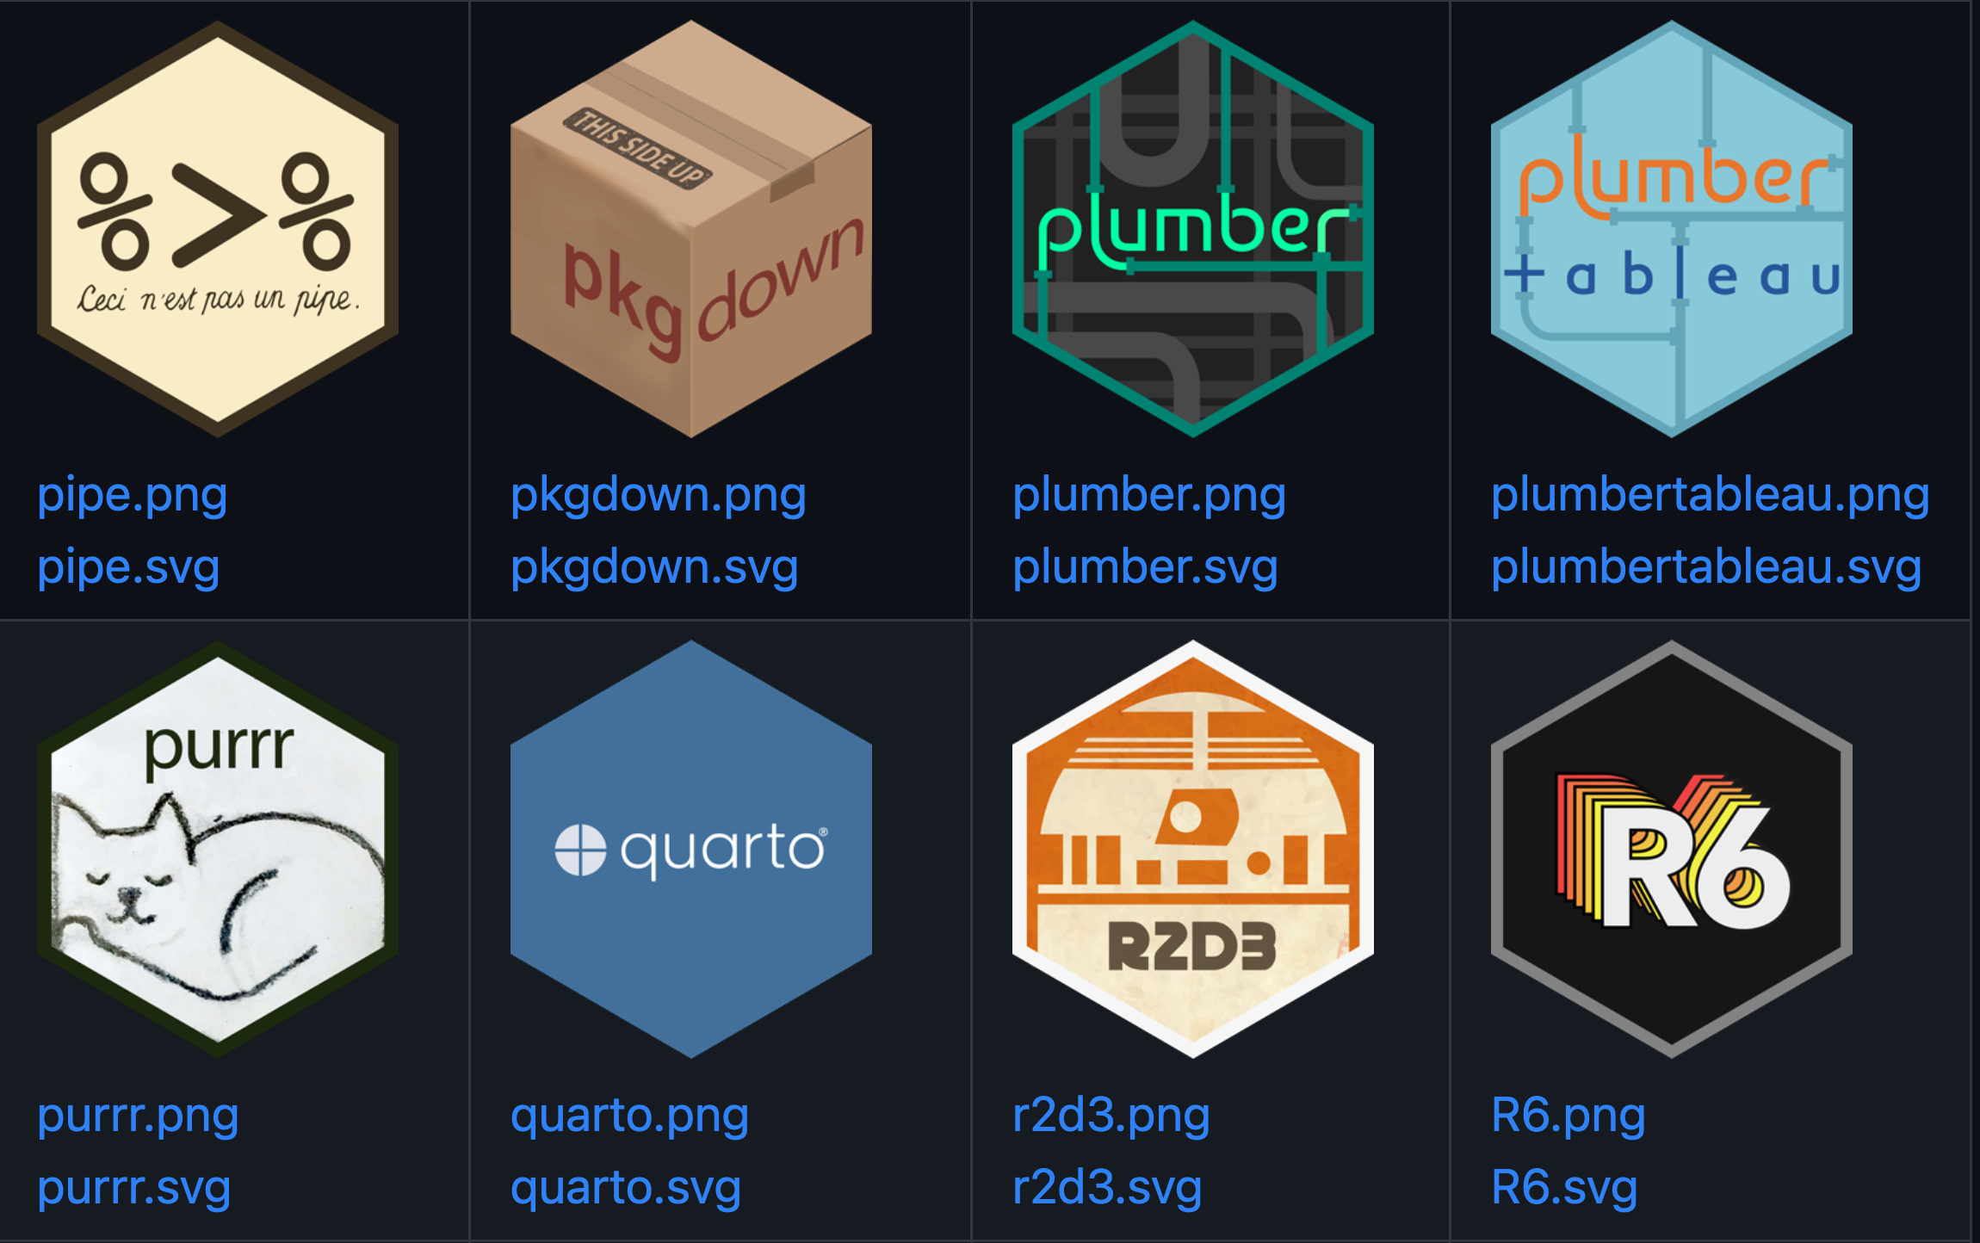
HexStickers in the wild

Slide 4
HexStickers in the wild
Check out…
https://github.com/rstudio/hex-stickers
http://hexb.in/

Slide 5
The main steps
Find a nice image
Use the sticker() function from the hexSticker package
Tweak the colours and fonts

Slide 6

1. Find a nice image
I used the image generator from Canvas but you could use any image or one created in R

Slide 7

2. Use the hexSticker::sticker() function
library(hexSticker) img <- here::here("wine-glass.jpeg") p <- sticker(img, package = "R Appreciation Society") plot(p)

Slide 8

3. Tweak the image position and colour
# Create sticker p <- sticker(img, package="R Appreciation Society", p_color = '#63100a', p_size=10, s_x=1, s_y=.75, h_fill = '#ded3bf', h_color = '#b68e59', filename="rappsoc-logo.png") plot(p)

Slide 9

4. Tweak the font
## Loading Google fonts (http://www.google.com/fonts) sysfonts::font_add_google("Tangerine", regular.wt = 700) ## Automatically use showtext to render text for future devices showtext::showtext_auto() # Create sticker p <- sticker(img, package="R Appreciation Society", p_color = '#63100a', p_family = "Tangerine", p_size=16, s_x=1, s_y=.75, h_fill = '#ded3bf', h_color = '#b68e59', filename="rappsoc-logo.png") plot(p)

Slide 10
Workflow
Code stored on GitHub (https://github.com/MarkHanly/hexSticker-RAppSoc)
Organised as R Project
Literate programming to create this powerpoint

