Slide 1

3. Perception
Organisational Behaviour
Dr. Mary Kinahan
Notes:
https://www.youtube.com/watch?v=VkrrVozZR2c - NB

Slide 2
Some fun exercises
https://www.youtube.com/watch?v=VkrrVozZR2c – Door study!!
- Did you see the difference?
Take a few mins and watch the ending of the SIXTH SENSE
https://www.youtube.com/watch?v=GRu-SVVQzhY

Slide 3
Perception: Learning outcomes
You should be able to:
Identify the main features of the process of perception
Distinguish between the bottom-up processing of sensory information and the top-down interpretation of that information
Explain and discuss the nature and implications of selective attention and perceptual organization
Give examples of how behaviour is influenced by our perceptions
Explain and illustrate the main processes and problems in person perception, including false attribution, halo effects
Notes:
Identify the main features of the process of perception.
People behave according to how they perceive the world, not in response to ‘reality’.
The perceptual process involves the interpretation of sensory input in the light of past
experience, and our store of knowledge, beliefs, expectations and motives.
2. Distinguish between the bottom-up processing of sensory information and the top-down interpretation of that information.
Sensation, or bottom-up processing, determines the data to which we pay attention.
Perception, or top-down processing, determines the way in which we organize and interpret
perceived information in order to make behavioural choices.
3. Understand the nature and implications of selective attention and perceptual organization.
Selective attention is influenced by external factors relating to the stimulus and the context, and by internal factors such as learning, personality and motivation.
The way in which we organize and interpret sensory data in meaningful ways, even when it is incomplete or ambiguous, is known as perceptual organization.
4. Give examples of how behaviour is influenced by our perceptions.
We each have our own perceptual world, an internal mental image of our environment.
Supermarkets exploit an understanding of selective attention when designing store layout,
when positioning goods, and in deciding which odours to use to entice customers.
Different cultures lead to differences in perception and consequently in behaviour.
5. Explain and illustrate the main processes and problems in person perception, including false attributions, halo effects and stereotyping.
An attribution is a belief about cause and effect. When speaking about ourselves, we tend to attribute success to personal factors and failure to external factors. When speaking about others, we tend to attribute success and failure to personality features.
Making an overall favourable judgement of someone on the basis of a single positive characteristic is known as the halo effect, which can be positive or negative.
Assuming that someone possesses a set of personality traits because they belong to a particular social group is known as stereotyping.
Errors in person perception can be overcome by taking more time, collecting more information, avoiding personal prejudices and through increased self-awareness.
100 © Andrzej A. Huczynski and David A. Buchanan 2007
Andrzej A. Huczynski and David A. Buchanan, Organizational Behaviour, sixth edition, Instructor’s Manual 6. Explain some of the less widely appreciated sources of discrimination at work, against men
and women, arising from characteristics of the person perception and attribution processes.
Aspects of behaviour are attributed to appearance, leading to discrimination. You are likely to be paid less at work if you are an overweight or underweight female, a short man, a man with an overweight wife or are perceived to be unattractive.
The fundamental attribution error leads us to emphasize personality and ignore context.

Slide 4
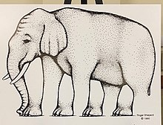
How many legs does the elephant have?

Slide 5

Blivet illusion
Notes:
Figure-ground confusion.

Slide 6
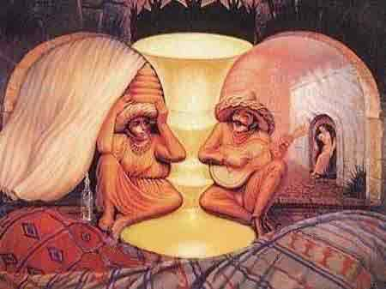
WHAT DO YOU SEE?
WHAT INFLUENCES WHAT YOU SEE FIRST?

Slide 7
WHAT DO YOU SEE?
- Figure-ground perception refers to the tendency of the visual system to simplify a scene into the main object that we are looking at (the figure) and everything else that forms the background (or ground).
- What you perceive depends upon what you identify as background and what as foreground
- This also illustrates another facet of perception – that of culture
- The use of a chalice is only meaningful in those cultural contexts where such drinking vessels are known
Notes:
Figure-ground perception refers to the tendency of the visual system to simplify a scene into the main object that we are looking at (the figure) and everything else that forms the background (or ground).
– do you see chalice or two faces?
WHICH DO YOU SEE?
This perceptual decision can be based on many cues, all of which are of a probabilistic nature.
For instance, size helps us distinguish between the figure and the ground, since smaller regions are often (but not always) figures.
Object shape can help us distinguish figure from ground, because figures tend to be convex.
Movement also helps; the figure may be moving against a static environment.
Color is also a cue, because the background tends to continue as one color behind potentially multiple foreground figures, whose colors may vary.
Edge assignment also helps; if the edge belongs to the figure, it defines the shape while the background exists behind the shape.
But it's at times difficult to distinguish between the two because the edge that would separate figure from ground is really part of neither, it equally defines both the figure and the background.[6]
the best that the brain can do is to take all relevant cues into account in order to generate a probabilistic best-guess.

Slide 8
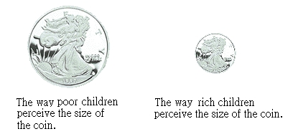
INTRODUCTION
Bruner and Goodman (1947) worked with a group of 10-year-olds and found that the poor children saw the coins as physically larger than did the rich children. Presumably the greater value of the coins to the poor children influenced their perceptual mechanism, and they amplified the sizes

Slide 9
EXPLANATION
We attach meanings, interpretations, values and aims to our actions
What we do (our behaviour) in this world depends
How we understand our place in it
How we perceive ourselves, our physical and social environment
How we perceive our circumstances
We perceive the world around us in different ways
It is our personal perception of that reality which shapes and directs our behaviour
To understand each other’s behaviour, we need to understand why we perceive things differently in the first place

Slide 10
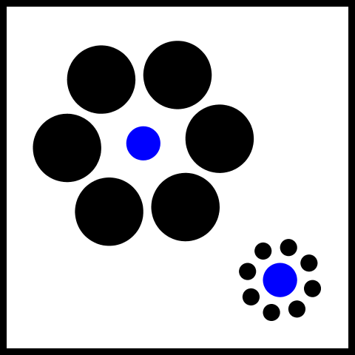
MORE ILLUSIONS

Slide 11
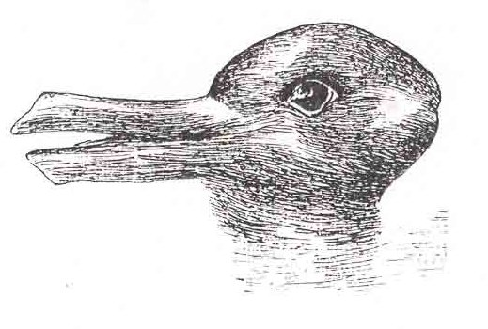
PERCEPTION DEFINED
Perception is the dynamic psychological process responsible for attending to, organizing and interpreting sensory data (page 258, Buchanen)
We behave in, and in response to, the world as we perceive it. We each live in our own perceptual world
Two people can observe the same object but perceive it in different ways

Slide 12
PROCESS OF PERCEPTION
Screens/ filters out
redundant information
so that we can focus
on what is important
“Bottom-up processing”
Sensory input:
incoming raw data
Selective attention:
We cannot pay
Attention to everything
Perceptual
organization
We look for order,
Meaning, patterns
Concerns the mental
processes that allows
us to order, interpret
and make sense of info
“Top-down processing”
Perception is a dynamic
process because it
involves ordering
And attaching meaning
To raw sensory data
Interpretation
Sense-making, seeking
closure
Behavioural response
Notes:
We process and interpret the incoming raw data in the light of our past experiences, in terms of our current needs and interests, and in terms of our knowledge, expectations, beliefs and motives.
From a psychological point of view, the processes of sensation, on the one hand, and perception, on the other hand, work together through what are respectively termed bottom-up and top-down processing. The bottom-up phase concerns the way in which we process the raw data received b our sensory apparatus => need for selectivity „COCKTAIL PARTY SYNDROM“

Slide 13
SUMMARY: PROCESS OF PERCEPTION
People behave according how they perceive the world, not in response to reality
The perceptual process involves the interpretation of sensory input in the light of past experience, our knowledge, beliefs, expectations and motives
Sensation or bottom-up processing, determines the data to which we pay attention
Perception, or top-down processing determines the way in which we organize and interpret information in order to make behavioural choices
https://www.youtube.com/watch?v=gfvMU36fgKw
Notes:
https://www.youtube.com/watch?v=gfvMU36fgKw
Marilon Einstein
https://www.youtube.com/watch?v=VT9i99D_9gI - Flashed Face Distortion Affect (Tangen et al., 2011)

Slide 14
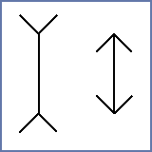
What do you see here?
Notes:
The Müller-Lyer illusion

Slide 15
SELECTIVE ATTENTION
IS THE ABILITY, OFTEN UNCONSCIOUSLY, TO CHOOSE FROM THE STREAM OF SENSORY DATA, TO CONCENTRATE ON CERTAIN ELEMENTS AND TO IGNORE OTHERS
Another DOOR STUDY
https://www.youtube.com/watch?reload=9&v=FWSxSQsspiQ
Internal factors
Learning
Personality
Motivation
etc
External factors
Stimulus factors
And context
factors
Selective
attention
Notes:
Get people‘s attention when they are bored – display of certain products at the cash register
Door study
https://www.youtube.com/watch?v=FWSxSQsspiQ

Slide 16
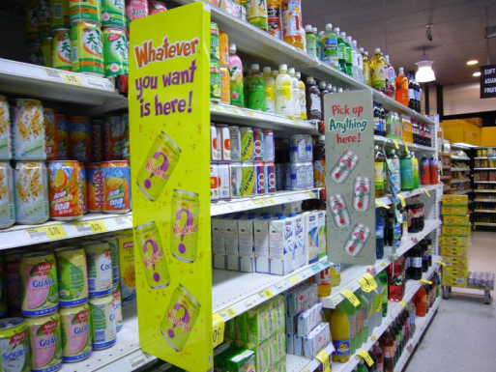
EXTERNAL FACTORS
External factors: Knowledge or expectations about a given situation/ experience will influence our perception
Stimulus factors: Give more attention to stimuli which are:
- large
- moving
- loud
- bright
- stand out from background
Contextual factors: The word “terminal” is likely to be perceived differently in the context of a hospital than in the context of an airport
Notes:
Stimulus factors - our attention is drawn more readily to stimuli that are: Large rather than small/ bright rather than dull etc
E.g. Supermarket – The order in which a shopper looks over the goods is controlled by the order in which they are displayed. Goods at eye level are inspected first, then attention wanders to lower shelves
Context factors: E.g. the word “terminal” is likely to be perceived differently in the context of a hospital, airport or computer firm

Slide 17
INTERNAL FACTORS
Internal factors: Psychological factors will also influence our perception
Personality
Learning
Intelligence
Motivation
Perception
Ability
Past
experience
Training
Goals
Interest
Notes:
Ability: people with impaired senses (e.g., deaf people), people under time pressure
Motivation: jump out of the shower when the cell phone rings if you expect an important call (e.g. from your boyfriend)
Interests: Someone interested in politics will listen to a candidate’s speech differently than someone not interested in politics -

Slide 18
SELECTIVITY IN PERCEPTION
Habituation and Perceptual Filter
FINISHED FILES ARE THE RESULT OF YEARS OF SCIENTIFIC
STUDY COMBINED WITH THE EXPERIENCE OF YEARS
Notes:
Habituation: The decrease in our perceptual response to stimuli once they have become familiar
Perceptual Filter: Individual characteristics, predispositions and preoccupations that interfere with the effective transmission and receipt of messages
Most people who speak English as a second language see all six Fx. Native English speakers ususally pick up only three or four, because they tend to miss the Fs in „of“. Native English speakers have been conditioned – habituated – to skip the „of“ because it does not contribute to the meaning of the sentence.
Adler‘s (2002) explanation is that once we stop seeing the „ofs“ we do not see them again, even as in this example when we are looking for them. Given that we are bombarded with information, we simply screen out that which is apparently of little or no value. Our behavioral choices are determined thus not by realitiy but by what we perceive that reality to be, also called the perceptual filter.

Slide 19
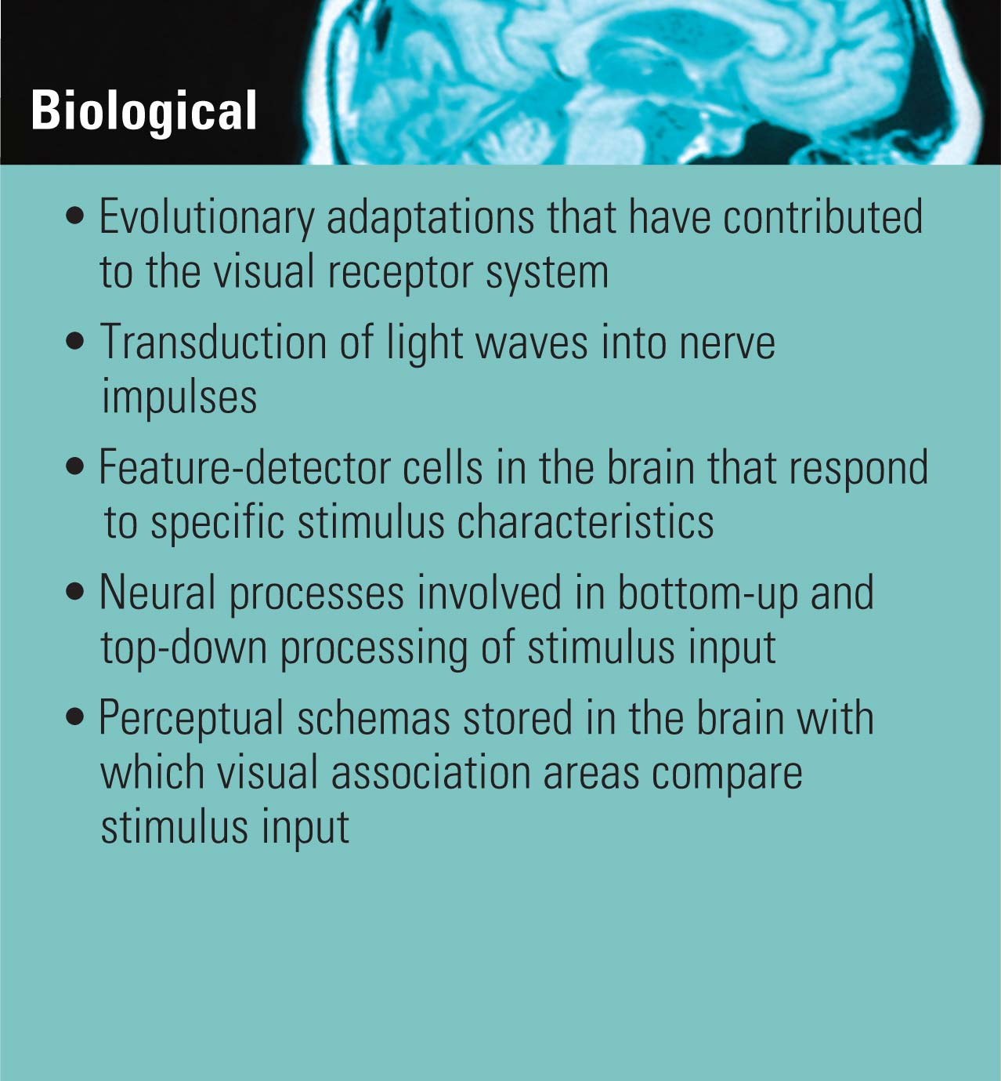
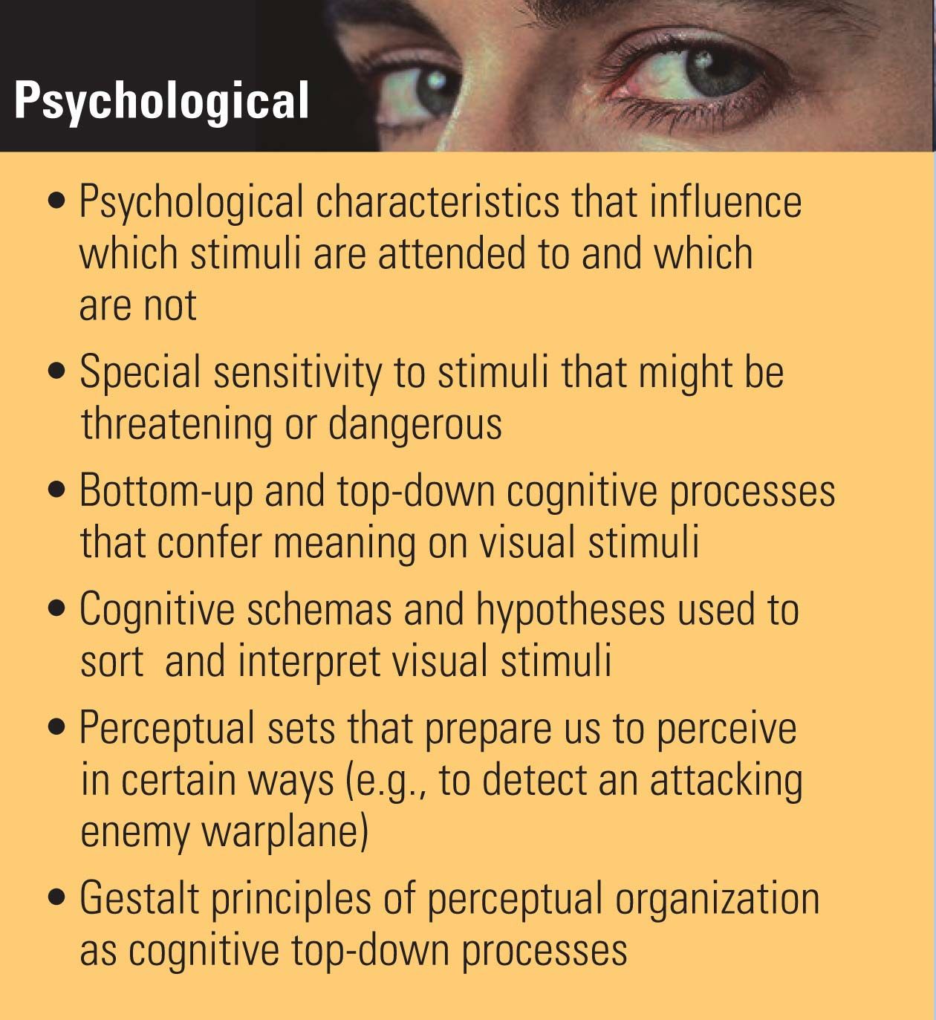
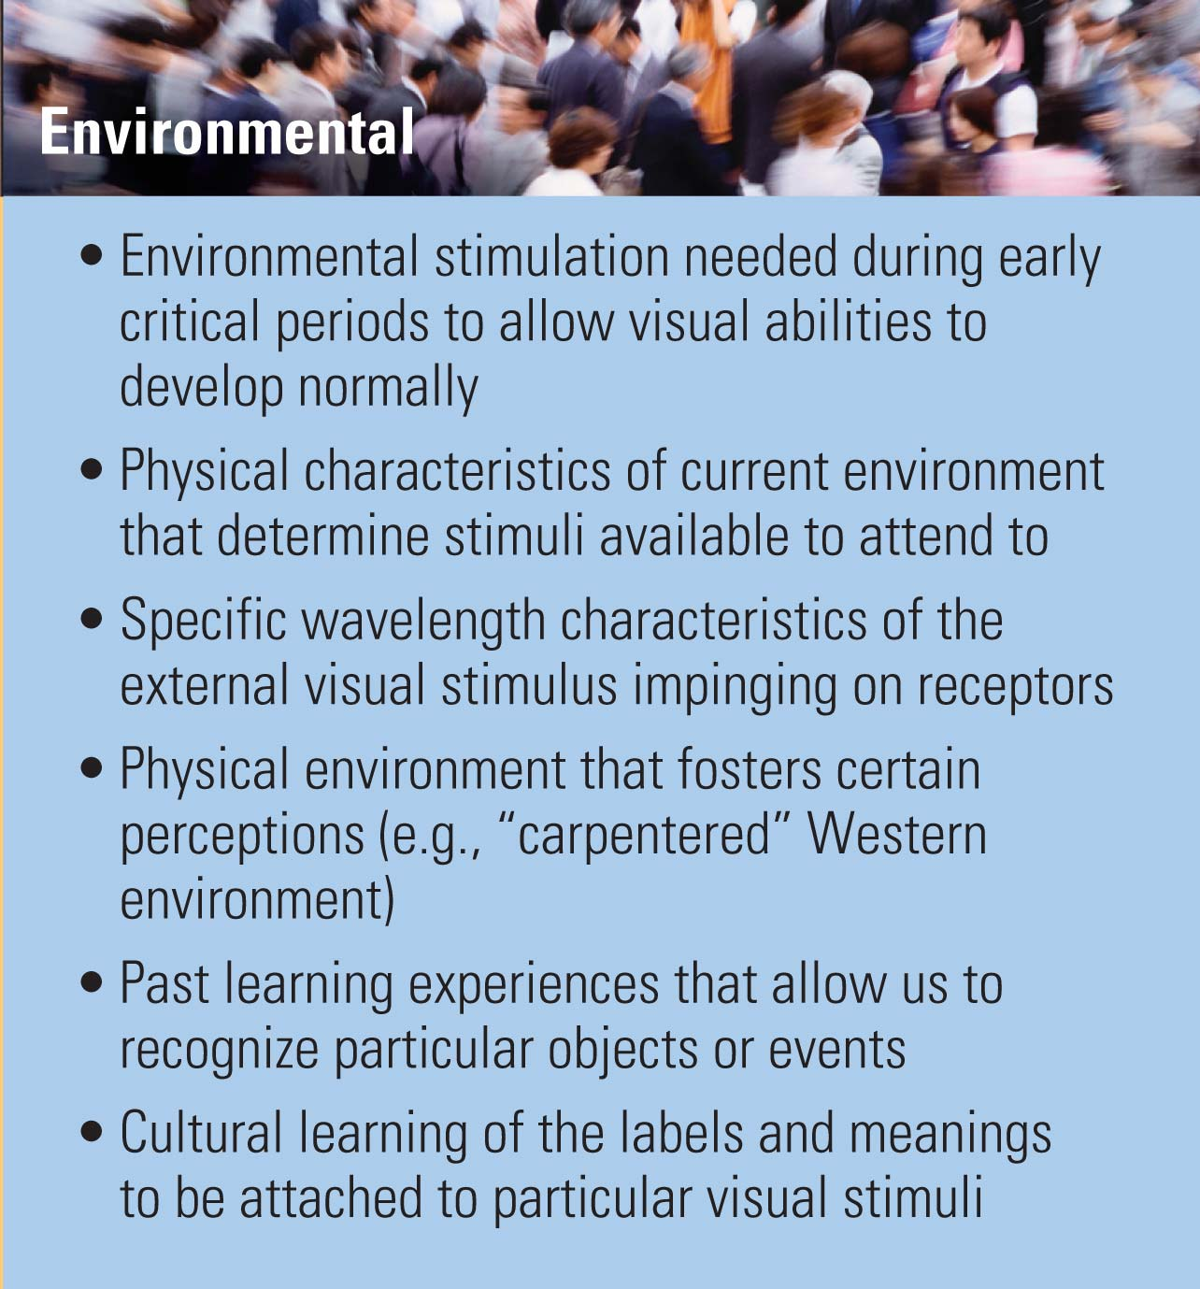
Levels of Analysis The Visual Experience
19
© Mary Ivers, 2009
Notes:
19
If we are aware that our perceptions are dependant on many things and that often they are not accurate then we can be more tolerant of others as we try to understand how they perceive their world.
We can be wrong about people, events, objects, our views of the world are shaped by our experiences.
Why study perception?
To investigate the effects of brain damage with a view towards helping people adapt.
To learn about the development of perception.
For designing equipment with visual appeal and/or safety in mind.
In advertising to understand how we make sense of information that is presented to us.
Summary: The ‘world’ gets into our body in the form of chemical reactions and electrical/nervous impulses. The sensory system selects, transduces, analyses, codes and transmits an unending flow of data to an information hungry and active brain. When the brain organises this into meaningful patterns it is called perception. There are many influences on perception.

Slide 20
PERCEPTUAL ORGANIZATION: THE PROCESS THROUGH WHICH INCOMING STIMULI ARE ORGANIZED IN SYSTEMATIC AND MEANINGFUL WAYS
Proximity principle- we group together similar stimuli that are physically close to each other (people are similar because they live in the same neighborhood)
Similarity principle – classify together stimuli that resemble each other in appearance in some respect (people are similar because they have similar ethnic characteristics)
Principle of closure – “… filling the gaps from our own knowledge or experience
I L VE YO DESP TE YO R
M THER
Notes:
Max Wertheimer
Proximity principle: note how you see three sets of pairs rather than six blobs here
Similarity principle: note that you see four pairs here, not eight objects
I love you despite your mother

Slide 21
PERCEPTUAL SETS AND PERCEPTUAL WORLDS
Observation and experience tell me …… | Therefore my perception is … | Consequently my actions will include …
People who get promoted here are not team players | The organizations rewards individual and not team performance | Avoid team meetings
Performance review rewards individual performance and not team performance |  | Discourage team work
Information – action- perception link
Notes:
Perceptual world – the individuals personal internal image, map or pircture of their social, physical and organisational environment.
Perceptual set – an individual’s predisposition to respond to people and events in a particular manner.

Slide 22
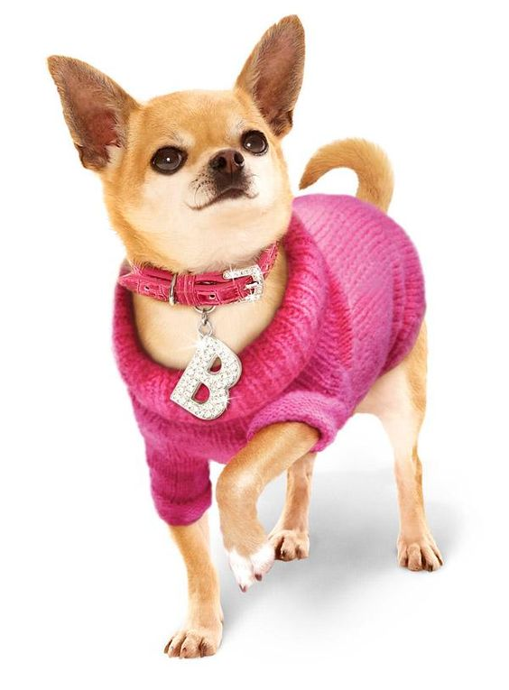
Exercise: Legally Blonde!!
WATCH the clip and OBSERVE the 5 characters CAREFULLY
https://www.youtube.com/watch?v=dDVp-nGo77o (from 1.48 to at 3.15 mins)
1. Decide on an appropriate stereotype label (e.g., absent-minded prof) for each character
2. Explain why you have chosen this label – based on evidence that each character provides (what they say, how they say it, appearance and non verbal)
3. For each character identify 2 adjectives that you think would describe how they would be likely to interact socially with others
4. thinking of each of these 5 characters in an organisational context, assess what you feel would be their strengths and weaknesses.

Slide 23
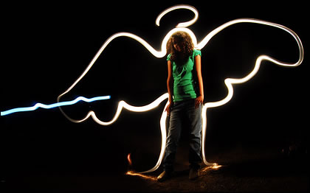
PERCEPTUAL SETS: HALO EFFECT
Perception of a person is formulated on the basis of a favorable (halo) or unfavorable trait (horn).
This effect tends to shut out other relevant characteristics of that person.
A kind of an "angelic halo" surrounds the person, in the eyes of the beholder, and they can do no wrong.
Notes:
Halo effect is the process by which the perception of a person is formulated on the basis of a favorable trait or impression
The halo effect tends to shut out other relevant characteristics of that person
When an individual is found to possess one desirable trait, then that individual is automatically assumed to have many other desirable traits as well. A kind of an "angelic halo" surrounds the person, in the eyes of the beholder, and they can do no wrong. If a person is bestowed with good physical beauty, then this person is also presumed to possess a host of other positive attributes as well, such as social competence, intellectual competence, and personal adjustment
Process can also work in reverse – this is where general judgments about a person are formulated from the perception of a negative characteristic: The candidate is seen as arriving late for an interview
There may be a good reason but on the basis of that one event the person may be perceived as a poor time-keeper on unreliable

Slide 24
Halo effect: Examples
A candidate for employment who arrives punctually, is smart in appearance and friendly may influence the perceptions of the selectors, who then place less emphasis on the candidate’s technical ability or experience
A new member of staff who performs well in a first assignment may be perceived as a likely person for promotion, even though the assignment is not typical of the usual duties the member of staff is expected to take

Slide 25
Problems with the Selection Interview
Confirmatory Bias (Snyder and Swann, 1978) or the first impression error
Horn/Halo Effect
Stereotypes
Contrast Error
Projection Error
Lack of Interview Skills/Training
Notes:
https://www.youtube.com/watch?v=6MlshBuS9C8 – beauty bias \
https://www.youtube.com/watch?v=tZvDaPBqAyg – confirmation bias
A projection error is the unconscious assumption that others think, feel, judge, or perceive more or less what we do. For instance, those who drink (abstain from) alcohol tend to overestimate (underestimate) the drinking habits of others.
In interview or performance appraisal process, error caused by the effect of previously interviewed or appraised applicants on the interviewer. It results in a conscious or subconscious comparison of one applicant with another, and tends to exaggerate the differences between the two.

Slide 26
WHY JOB APPLICANTS ARE NOT HIRED
Poor personal appearance
Over-aggressiveness
Inability to express information clearly
Lack of interest and enthusiasm
Lack of career planning, no purpose and not goals
Nervous, lack of confidence and poise
Overemphasis on money
Unwillingness to start at the bottom
Makes excuses
Lack of tact and courtesy
Etc.
Notes:
A Survey of 153 human resource managers in America identified the 20 most common errors made by applicants attenting job interviews, listed here in order of importance

Slide 27
PERCEPTUAL SETS: STEREOTYPES THE WAY IN WHICH WE GROUP TOGETHER PEOPLE WHO SEEM TO US TO SHARE SIMILAR CHARACTERISTICS
“Pictures in the head” (Lippmann, 1922)
Judgments about a person’s characteristics on the basis of the person’s group membership
Our instant categorization allows us to attribute a range of qualities to them …
Stereotypes are overgeneralizations and not accurate
Have a strong impact on other cognitive functions, e.g. memory
Notes:
When we meet, say an accountant, a nurse, an engineer, a lecturer, we attribute certain personality traits to them because they are accountants, nurses, engineers or lecturers.
Therefore, stereotyping is an error at the perceptual organization stage in the process of perception.
Occupation: lecturers are boring
Age: No old person wants to consider new ideas
Physical: all people with red hair have a fiery temperament
Education: All graduates are intelligent
Social: unemployed people are lazy
Nationality: Australians like cricket

Slide 28
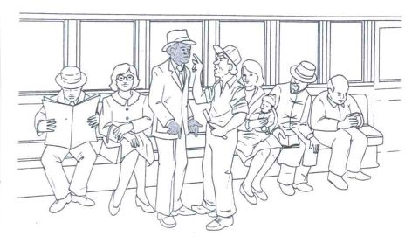
How Stereotypes distort Social Perceptions
Allport & Postman (1947)
Notes:
No only do stereotypes affect how we perceive and interpret other people‘s behaviors, they also often cause us to remember stereotype-consistent information about others better than stereotype inconsistent information. For example, Allport & Postman (1947) showed participants a picture of a subway train filled with passengers. In the picture were a black man dressed in a suit and a white man holding a razor. One participant viewed the scene briefly and then described it to a second participant who had not seen it. The second person communicated the description to a third participant and so on through six rounds of communication.
The result: In more than half the sessions the final participant‘s report indicated that the black man, not the white man, held the razor. Some participants even reported that he had waved it in a threatening manner.
The distortion may occur evenin participants who have no anti-African American bias. It is a very common cultural stereotype that African Americans are hot-tempered and that they are likely to use razors and weapons.

Slide 29
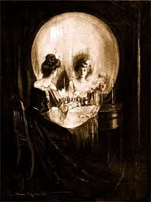
Stereotype – Social Implications
Stereotyping infers that all people within a perceived category are assumed to share the same traits or characteristics (age, race sexual orientation etc)
It can block out accurate perception of the individual or situation
May lead to potential situations of prejudice or discrimination
Consequences of attributing incorrect characteristics are extremely negative
Notes:
29

Slide 30
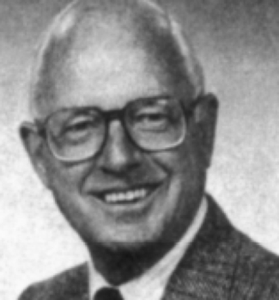
PERCEPTUAL SETS: ATTRIBUTION
Attribution theory
We seek to understand what caused a certain event
We seek to ascribe responsibility what caused a certain event
We seek to evaluate the personal qualities of the people involved
Fundamental Attribution Error
Tendency to explain other people’s behavior based on their personality and to overlook the situation
OUR NEED FOR EXPLAINING AND UNDERSTANDING THE WORLD AROUND US IS REFLECTED IN THE WAY IN WHICH WE SEARCH FOR THE CAUSES OF PEOPLE’S ACTIONS. OUR PERCEPTIONS OF CAUSALITY ARE KNOWN AS ATTRIBUTIONS
Kelley
Notes:
An attribution is a belief about the cause or causes of an event or an action. Why did that person bump into me? Why is my friend so successful? Why did I fail my exam?
If we understand the causes of conflict, success, or failure we may be able to adjust our behavior and other factors accordingly. Attribution is simply the process of attaching causes to the actions and events we see.
This theory was developed in the 1950s and the 1960s by Fritz Heider (1958) and Harold Kelley (1971).
Fundamental attribution error: Assume we are dealing with an unhelpful shop assistant. Our first assumption is that the individual is at fault, rather than aspects of the setting in which they find themselves. Other explanations – individuals factors (assistant does not cope with the demands of the job as not training received), context factors (e.g., shop assistant is bitter about being made redundant due to economic problems), etc.

Slide 31
PERCEPTUAL SETS: ATTRIBUTION
E.g. when viewing others:
We tend to explain (attribute) poor performance to internal deficiencies such as ability or effort, rather than external issues such as bad luck or poor support.
BUT WHEN ASKING THE SAME QUESTIONS OF OURSELVES …
Research:
Sex and appearance influence the way in which we are perceived, paid and promoted (…hourly wage of overweight women was 20% lower on average than that of woman of average weight (Averett & Korenman, 1993)

Slide 32
SOURCES OF PERCEPTUAL ERRORS SUMMARIZED
Not collecting enough information
Using irrelevant information
Seeing only what we expect
Allowing early information to influence perception of later information
Allowing one’s own characteristics influence the way we perceive others
Accepting stereotypes uncritically
Notes:
Not collecting enough information about other people
Basing our judgements on information that is irrelevant or insignificant
Seeing what we expect to see and what we want to see, and not investigating further
Allowing early information about someone to colour our judgement, despite later and contradictory information
Allowing our own characteristics to influence our judgements of others
Accepting stereotypes uncritically
Attempting to decode non-verbal behaviour out with the context in which it appears
Basing attributions on flimsy and potentially irrelevant evidence

Slide 33
HOW TO AVOID PERCEPTUAL ERRORS
Take time: avoid making snap judgments
Consciously collect more information about people
Delay making final decisions about people
Develop personal awareness (awareness of own biases, stereotyped ideas, thoughts and behaviours
Compassion

Slide 34
One final Illusion
http://www.maniacworld.com/Spinning-Silhouette-Optical-Illusion.html
http://www.moillusions.com/wp-content/uploads/i207.photobucket.com/albums/bb234/vurdlak8/2007b.gif
CRASH COURSE:
https://www.youtube.com/watch?v=n46umYA_4dM

Slide 35

Thank you for listening

