Slide 1
Project Proposal House Price Prediction
Team members:
XIA XICHENG, SHEN LI, LI FEIJIAO, WANGYIFAN, JIN WEIGUO

Slide 2

Project Description

Slide 3
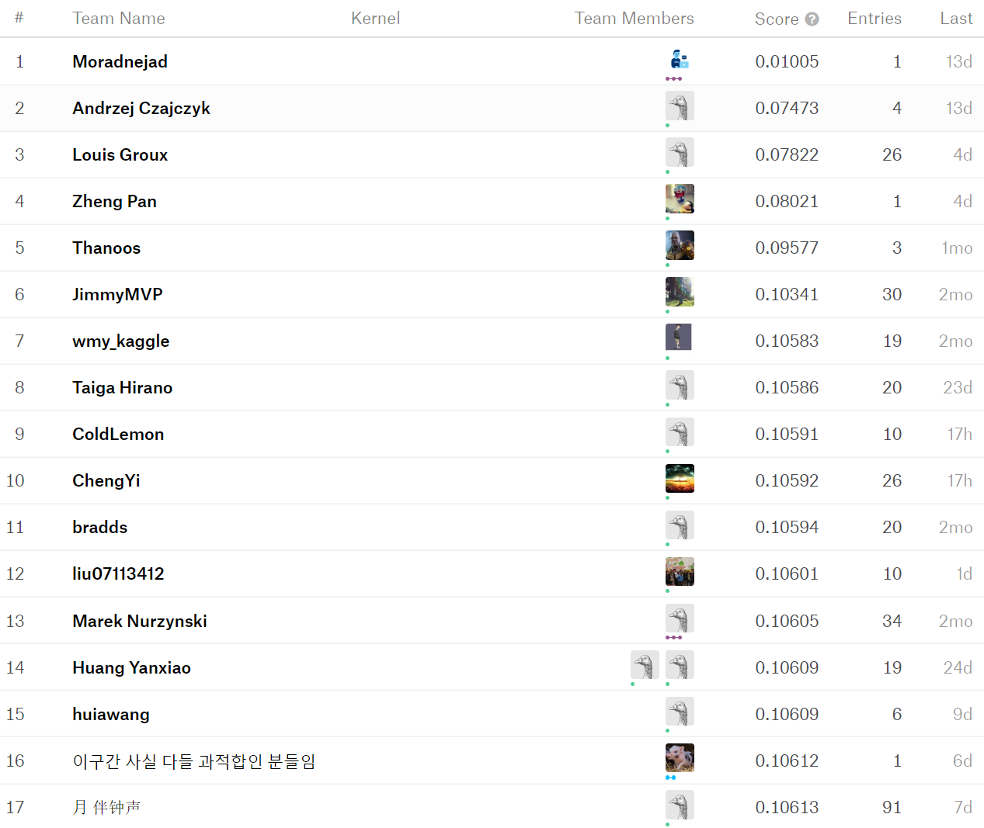

Slide 4
