Slide 1
Project Proposal House Price Prediction
Group 9:
XIA XICHENG, SHEN LI, LI FEIJIAO, WANGYIFAN, JIN WEIGUO

Slide 2

Project Description
Kaggle competition: House Prices: Advanced Regression Techniques
Potential model utilized: Lasso, Ridge

Slide 3
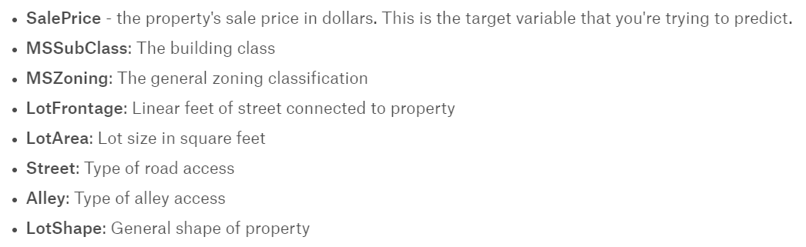
Data Structure
Training dataset: 1459 * 81
Test dataset: 1459 * 80
Sample variables:

Slide 4
Methodology

Slide 5
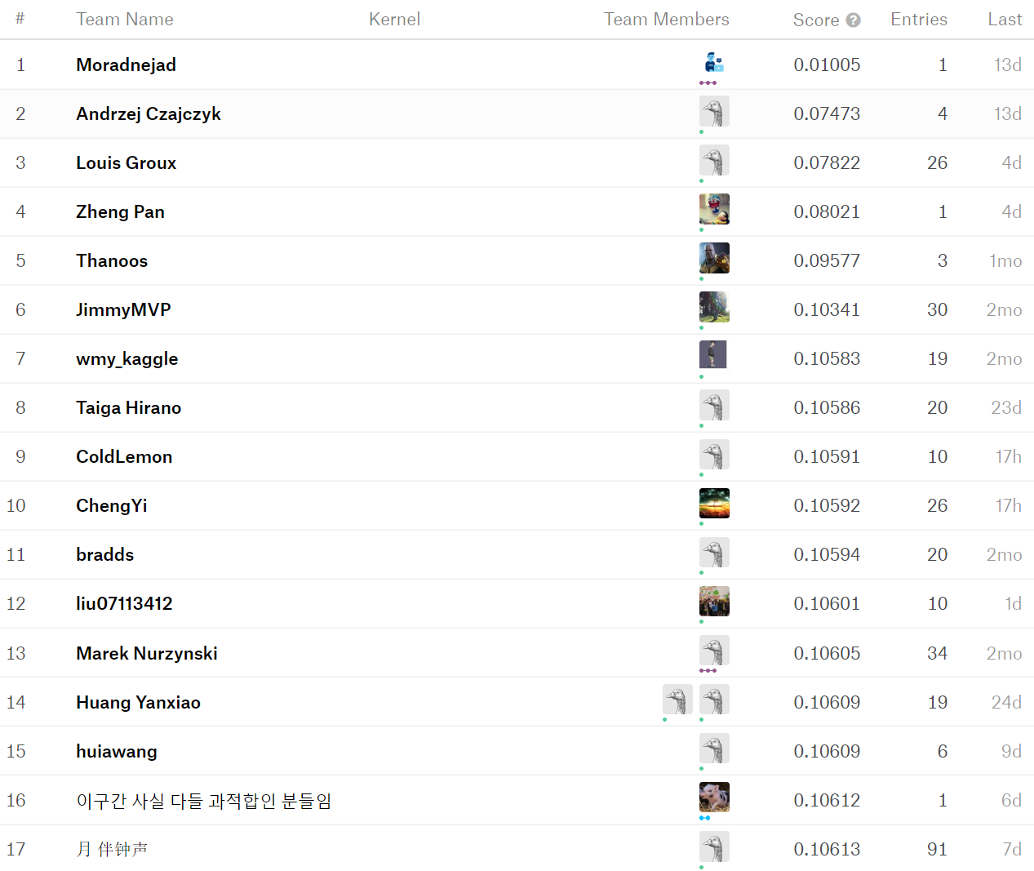
Performance Evaluation Criteria_Root Mean Squared Log Error

Slide 6
Our Target
Conservatively:
Ranking 3000, score of less than 0.15
Hopefully:
Ranking 2000, score of appox. 0.13

Slide 7
Thanks

